Slide 1
Response Patterns by Introductory Physics Students on Mathematics Diagnostic Tests
David E. Meltzer and Dakota H. King
Arizona State University
Supported in part by NSF DUE #1504986 and #1914712

Slide 2
Outline
We have explored the nature and prevalence of physics students’ difficulties with elementary mathematics, using “stripped-down” problems with little or no physics context
In collaboration with Ohio State University, we are developing and testing an online “skill-practice” tool to improve performance

Slide 3
Work to Date
Administer (and analyze) written diagnostic quiz, given to > 5000 students at Tempe and Poly campuses of Arizona State University; calculators are allowed
Carry out individual interviews with 75 students enrolled in those or similar courses during same period
Comparison data: University of Colorado, algebra-based course (N = 384); Ohio State University, calculus- and algebra-based courses (N > 1000).*
*Thanks to Steve Pollock and Colin West (CU-Boulder), and Andrew Heckler and Beatriz Burrola Gabilondo (OSU)

Slide 4
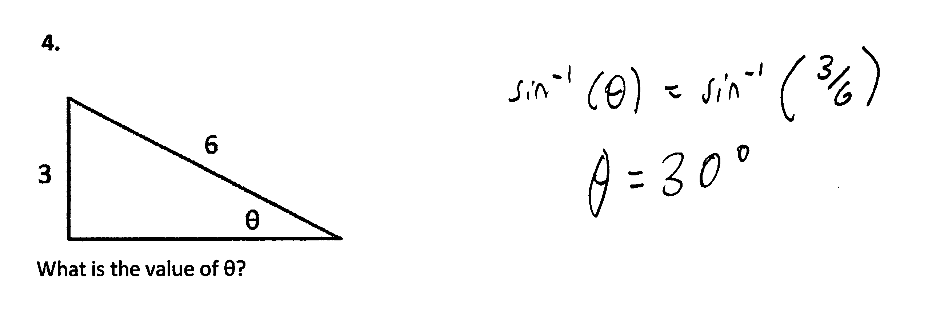
Find Unknown Angle
3.

Slide 5
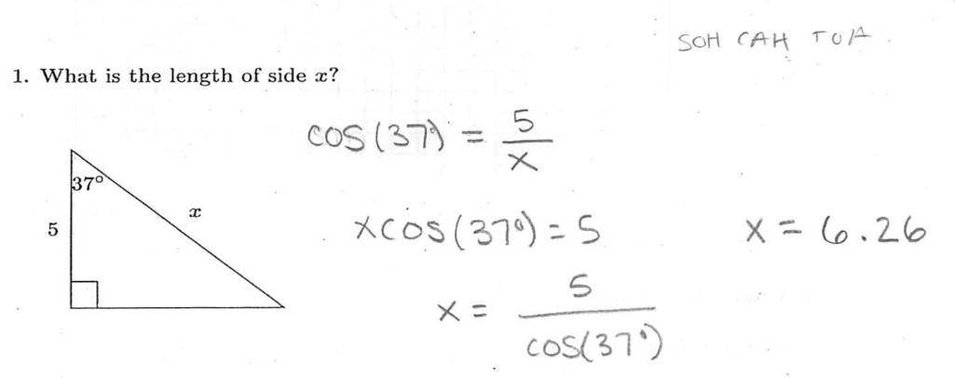
Find Unknown Side

Slide 6
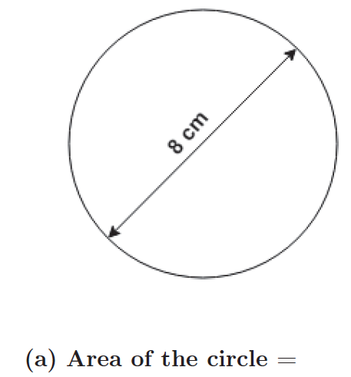
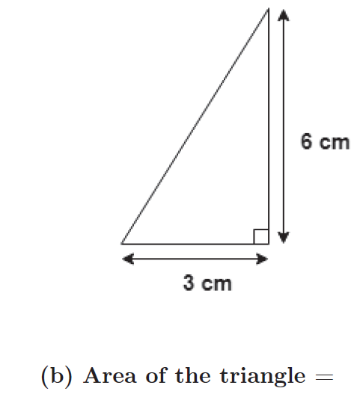
Find Area

Slide 7
Find Slope of Graph

Slide 8
Simultaneous Equations, Numeric Coefficients

Slide 9
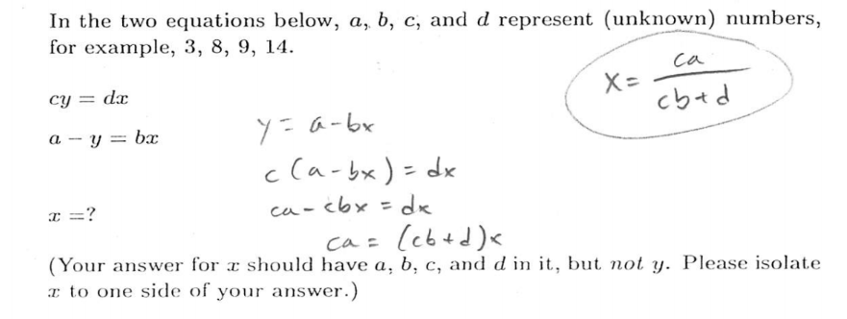
Simultaneous Equations, Symbolic Coefficients

Slide 10
Symbolic Multiple-Choice Problem

Slide 11
(Some) Other Items

Slide 12
Our Primary Sample Populations
PHY 111: Algebra-based; 1st semester
PHY 112: Algebra-based; 2nd semester
PHY 121: Calculus-based; 1st semester
PHY 131: Calculus-based; 2nd semester

Slide 13
Our Primary Sample Populations
PHY 111: Algebra-based; 1st semester
PHY 112: Algebra-based; 2nd semester
PHY 121: Calculus-based; 1st semester
PHY 131: Calculus-based; 2nd semester
Tempe
Poly
Tempe
Poly
Tempe
Poly
Tempe
Poly

Slide 14
Findings
Difficulties with pre-college mathematical operations are widespread among students in both algebra- and calculus-based courses; average error rates range from 20-70%;
Results were highly consistent among four different campuses at three different state universities (ASU Tempe, ASU Poly, CU-Boulder, Ohio State U.)
Performance on algebraic problems using symbols for constant coefficients is significantly worse than on problems using numbers, for all populations;
Despite the great diversity of diagnostic item types, students’ item responses were highly correlated with each other, and with total score on test
→ Class-average score on a single test item can accurately predict class-average total score
Differences between universities were observed (e.g., CU-Boulder scored 20% higher than ASU-Tempe), but individual item scores co-varied consistently and predictably
During problem-solving interviews, students self-correct approximately 50% of errors following minimal prompts, suggesting prevalence of “careless” errors.
The proportion of errors that could be described as “careless” [“non-operational”] was highly correlated with overall correct response rate. [Higher scores → more “careless”]

Slide 15
Findings
Difficulties with pre-college mathematical operations are widespread among students in both algebra- and calculus-based courses; average error rates range from 20-70%;
Results were highly consistent among four different campuses at three different state universities (ASU Tempe, ASU Poly, CU-Boulder, Ohio State U.)
Performance on algebraic problems using symbols for constant coefficients is significantly worse than on problems using numbers, for all populations;
Despite the great diversity of diagnostic item types, students’ item responses were highly correlated with each other, and with total score on test
  Class-average score on a single test item can accurately predict class-average total score
Differences between universities were observed (e.g., CU-Boulder scored 20% higher than ASU-Tempe), but individual item scores co-varied consistently and predictably
During problem-solving interviews, students self-correct approximately 50% of errors following minimal prompts, suggesting prevalence of “careless” errors.
The proportion of errors that could be described as “careless” [“non-operational”] was highly correlated with overall correct response rate. [Higher scores → more “careless”]

Slide 16
“Find Unknown Angle”
3.
Algebra-based course, 2018
ASU-Poly: 35% correct (N = 152)
ASU-Tempe: 52% correct (N = 533)

Slide 17
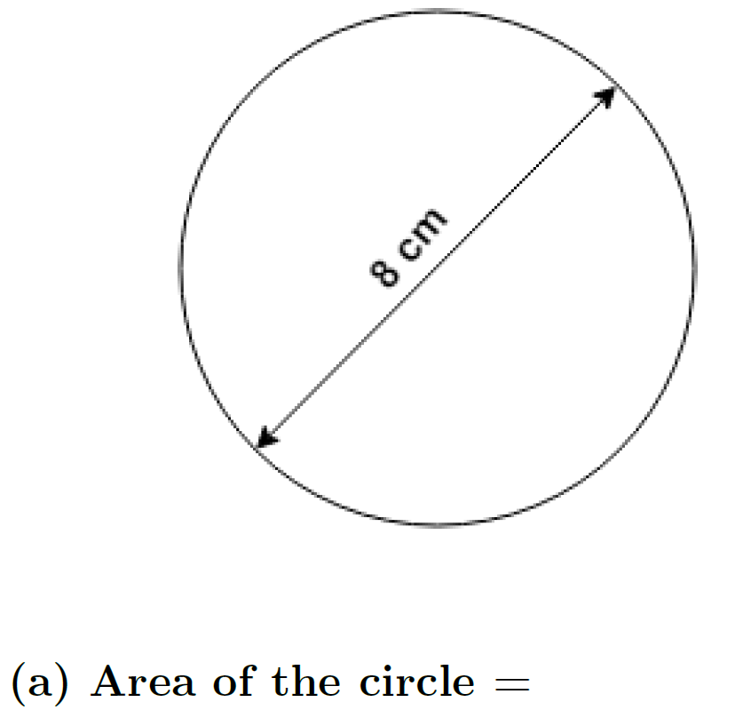
Algebra- and Calculus-based courses combined, 2018
ASU-Poly: 57% correct (N = 250)
ASU-Tempe: 76% correct (N = 1086)
…with correct units: 29% and 45% correct, respectively

Slide 18
All courses: 30-60% correct (N > 2000)

Slide 19
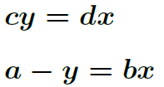

Calculus-based course, 2018
ASU-Tempe: 55% correct (N = 862)

Slide 20
Findings
Difficulties with pre-college mathematical operations are widespread among students in both algebra- and calculus-based courses; average error rates range from 20-70%;
Results were highly consistent among four different campuses at three different state universities (ASU Tempe, ASU Poly, CU-Boulder, Ohio State U.)
Performance on algebraic problems using symbols for constant coefficients is significantly worse than on problems using numbers, for all populations;
Despite the great diversity of diagnostic item types, students’ item responses were highly correlated with each other, and with total score on test
  Class-average score on a single test item can accurately predict class-average total score
Differences between universities were observed (e.g., CU-Boulder scored 20% higher than ASU-Tempe), but individual item scores co-varied consistently and predictably
During problem-solving interviews, students self-correct approximately 50% of errors following minimal prompts, suggesting prevalence of “careless” errors.
The proportion of errors that could be described as “careless” [“non-operational”] was highly correlated with overall correct response rate. [Higher scores → more “careless”]

Slide 21
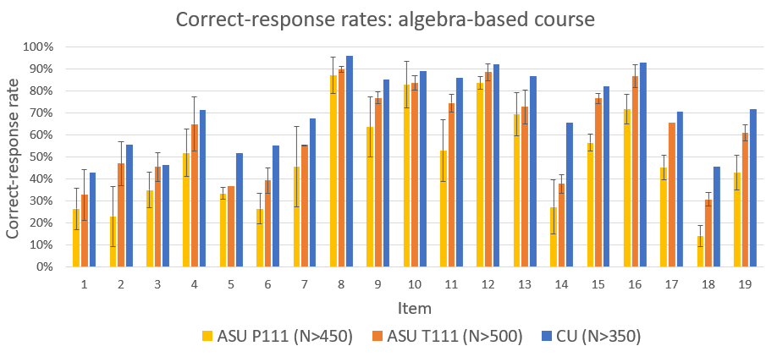

Slide 22
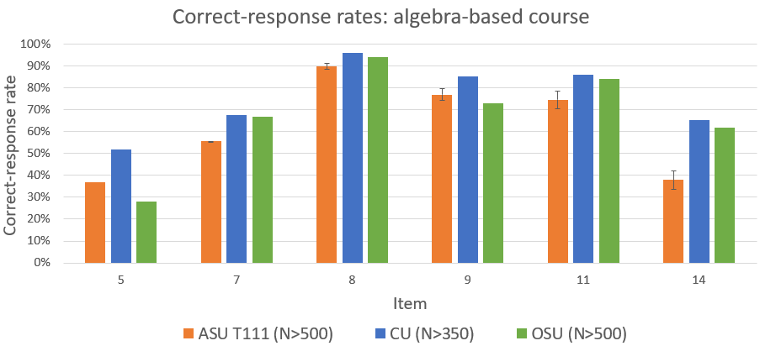

Slide 23
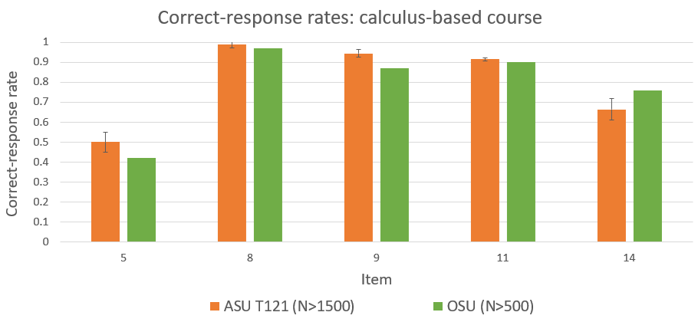

Slide 24
Findings
Difficulties with pre-college mathematical operations are widespread among students in both algebra- and calculus-based courses; average error rates range from 20-70%;
Results were highly consistent among four different campuses at three different state universities (ASU Tempe, ASU Poly, CU-Boulder, Ohio State U.)
Performance on algebraic problems using symbols for constant coefficients is significantly worse than on problems using numbers, for all populations;
Despite the great diversity of diagnostic item types, students’ item responses were highly correlated with each other, and with total score on test
  Class-average score on a single test item can accurately predict class-average total score
Differences between universities were observed (e.g., CU-Boulder scored 20% higher than ASU-Tempe), but individual item scores co-varied consistently and predictably
During problem-solving interviews, students self-correct approximately 50% of errors following minimal prompts, suggesting prevalence of “careless” errors.
The proportion of errors that could be described as “careless” [“non-operational”] was highly correlated with overall correct response rate. [Higher scores → more “careless”]

Slide 25
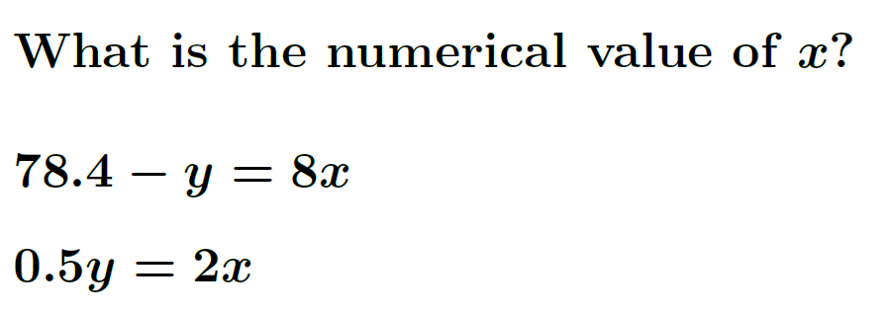
Algebra: Symbolic vs. Numeric Coefficients
Calculus-based course, 1st semester (% correct; ASU-Tempe, 2018 fall + spring)
  79% correct (N = 1043)
  55% correct (N = 862)
Numeric version
Symbolic version

Slide 26
Findings
Difficulties with pre-college mathematical operations are widespread among students in both algebra- and calculus-based courses; average error rates range from 20-70%;
Results were highly consistent among four different campuses at three different state universities (ASU Tempe, ASU Poly, CU-Boulder, Ohio State U.)
Performance on algebraic problems using symbols for constant coefficients is significantly worse than on problems using numbers, for all populations;
Despite the great diversity of diagnostic item types, students’ item responses were highly correlated with each other, and with total score on test
  Class-average score on a single test item can accurately predict class-average total score
Differences between universities were observed (e.g., CU-Boulder scored 20% higher than ASU-Tempe), but individual item scores co-varied consistently and predictably
During problem-solving interviews, students self-correct approximately 50% of errors following minimal prompts, suggesting prevalence of “careless” errors.
The proportion of errors that could be described as “careless” [“non-operational”] was highly correlated with overall correct response rate. [Higher scores → more “careless”]

Slide 27
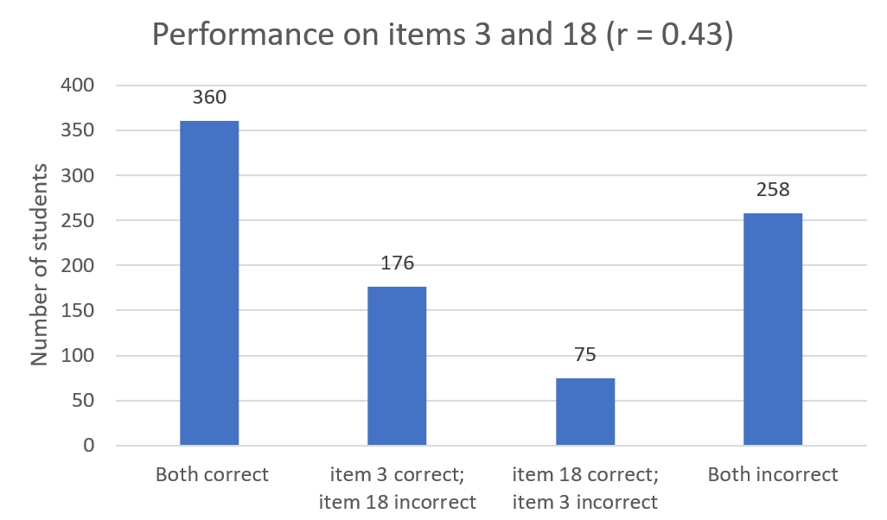

Slide 28
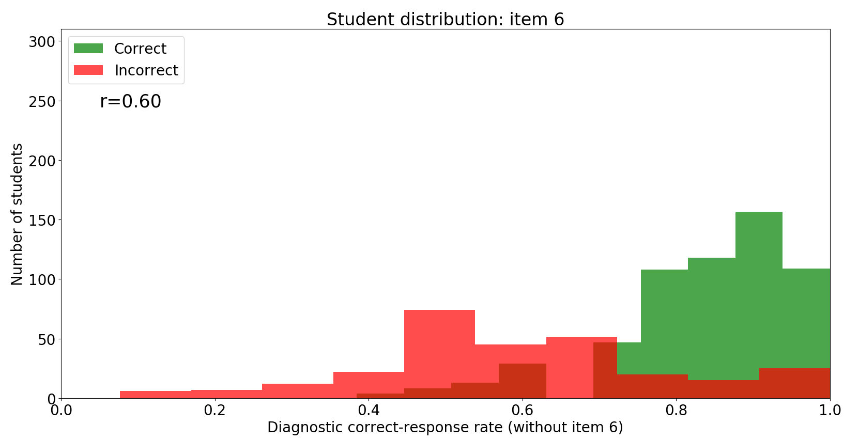
Students’ individual item responses are highly correlated with their total score

Slide 29
Findings
Difficulties with pre-college mathematical operations are widespread among students in both algebra- and calculus-based courses; average error rates range from 20-70%;
Results were highly consistent among four different campuses at three different state universities (ASU Tempe, ASU Poly, CU-Boulder, Ohio State U.)
Performance on algebraic problems using symbols for constant coefficients is significantly worse than on problems using numbers, for all populations;
Despite the great diversity of diagnostic item types, students’ item responses were highly correlated with each other, and with total score on test
  Class-average score on a single test item can accurately predict class-average total score
Differences between universities were observed (e.g., CU-Boulder scored 20% higher than ASU-Tempe), but individual item scores co-varied consistently and predictably
During problem-solving interviews, students self-correct approximately 50% of errors following minimal prompts, suggesting prevalence of “careless” errors.
The proportion of errors that could be described as “careless” [“non-operational”] was highly correlated with overall correct response rate. [Higher scores → more “careless”]

Slide 30
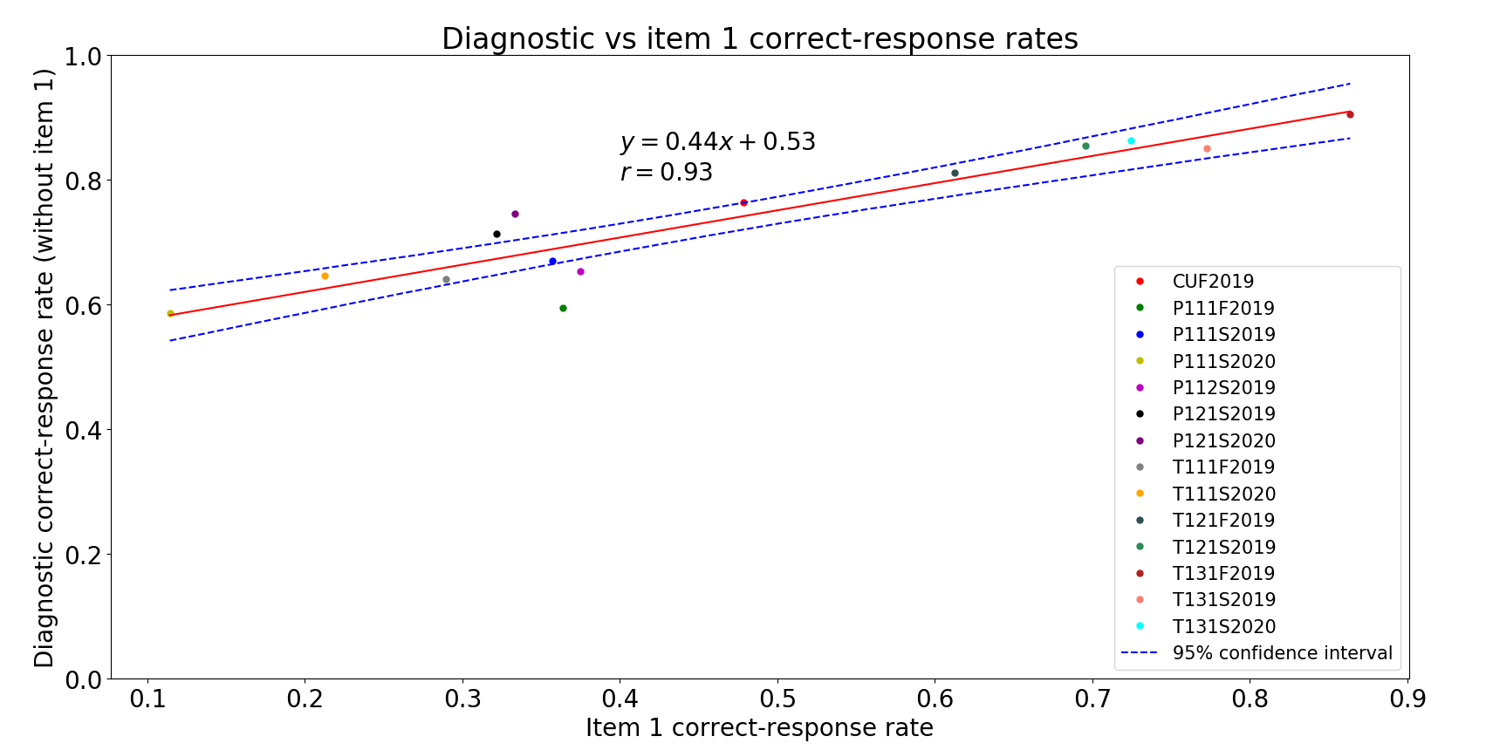
Class-average responses on individual test items are highly predictive of class-average total score

Slide 31
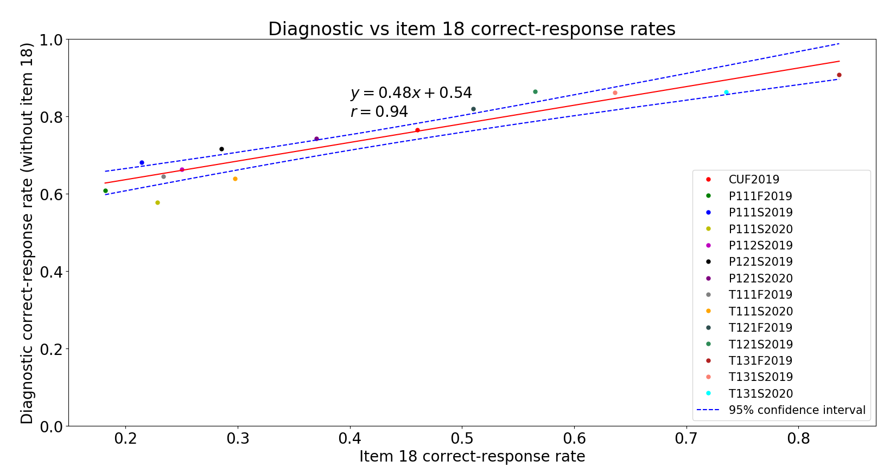
Class-average responses on individual test items are highly predictive of class-average total score

Slide 32
Findings
Difficulties with pre-college mathematical operations are widespread among students in both algebra- and calculus-based courses; average error rates range from 20-70%;
Results were highly consistent among four different campuses at three different state universities (ASU Tempe, ASU Poly, CU-Boulder, Ohio State U.)
Performance on algebraic problems using symbols for constant coefficients is significantly worse than on problems using numbers, for all populations;
Despite the great diversity of diagnostic item types, students’ item responses were highly correlated with each other, and with total score on test
  Class-average score on a single test item can accurately predict class-average total score
Differences between universities were observed (e.g., CU-Boulder scored 20% higher than ASU-Tempe), but individual item scores co-varied consistently and predictably
During problem-solving interviews, students self-correct approximately 50% of errors following minimal prompts, suggesting prevalence of “careless” errors.
The proportion of errors that could be described as “careless” [“non-operational”] was highly correlated with overall correct response rate. [Higher scores → more “careless”]

Slide 33
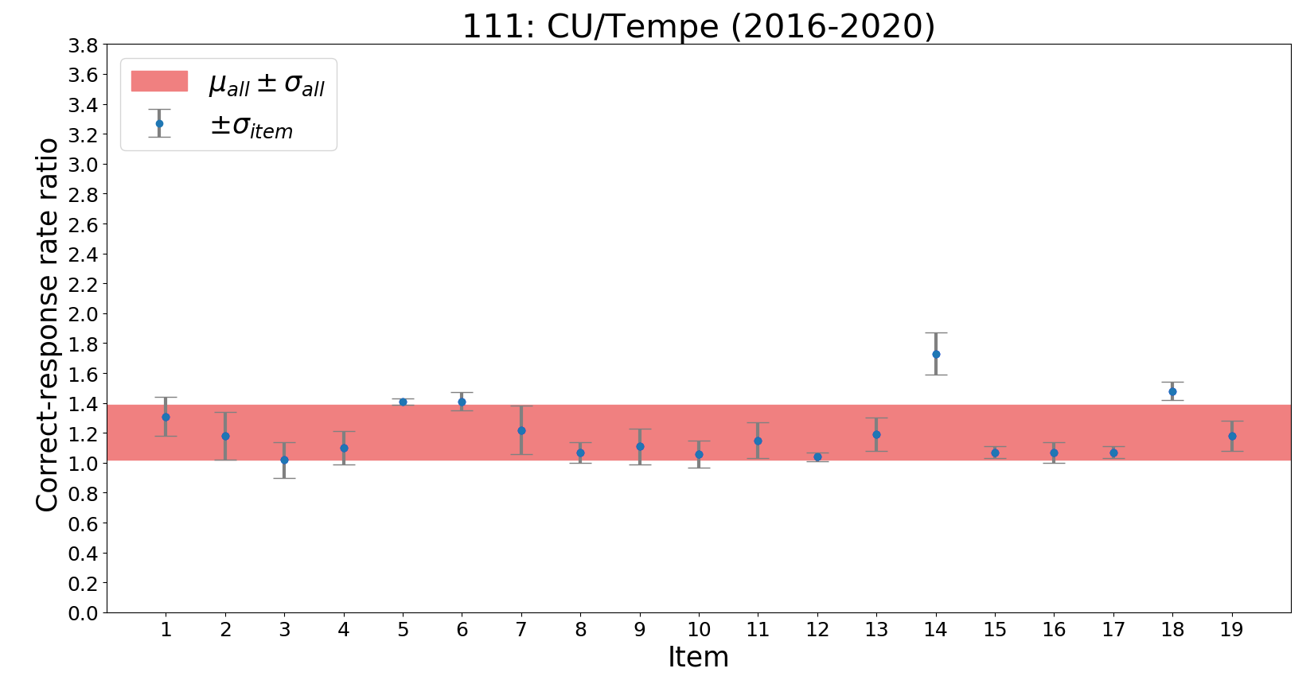
Algebra-based Course:
CU-Boulder students consistently averaged 20% higher scores than ASU-Tempe students

Slide 34
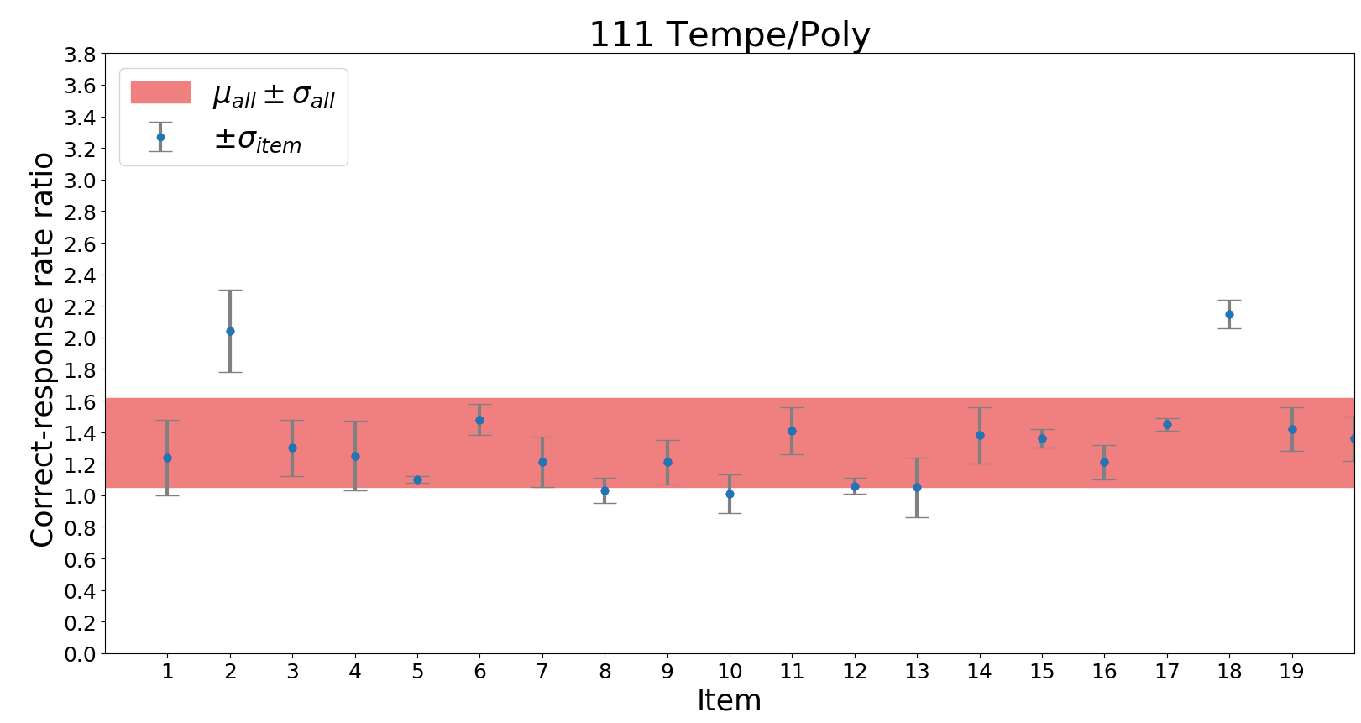
Algebra-based Course:
ASU-Tempe students consistently averaged 33% higher scores than ASU-Poly students

Slide 35
Findings
Difficulties with pre-college mathematical operations are widespread among students in both algebra- and calculus-based courses; average error rates range from 20-70%;
Results were highly consistent among four different campuses at three different state universities (ASU Tempe, ASU Poly, CU-Boulder, Ohio State U.)
Performance on algebraic problems using symbols for constant coefficients is significantly worse than on problems using numbers, for all populations;
Despite the great diversity of diagnostic item types, students’ item responses were highly correlated with each other, and with total score on test
  Class-average score on a single test item can accurately predict class-average total score
Differences between universities were observed (e.g., CU-Boulder scored 20% higher than ASU-Tempe), but individual item scores co-varied consistently and predictably
During problem-solving interviews, students self-correct approximately 50% of errors following minimal prompts, suggesting prevalence of “careless” errors.
The proportion of errors that could be described as “careless” [“non-operational”] was highly correlated with overall correct response rate. [Higher scores → more “careless”]

Slide 36
Findings
Difficulties with pre-college mathematical operations are widespread among students in both algebra- and calculus-based courses; average error rates range from 20-70%;
Results were highly consistent among four different campuses at three different state universities (ASU Tempe, ASU Poly, CU-Boulder, Ohio State U.)
Performance on algebraic problems using symbols for constant coefficients is significantly worse than on problems using numbers, for all populations;
Despite the great diversity of diagnostic item types, students’ item responses were highly correlated with each other, and with total score on test
  Class-average score on a single test item can accurately predict class-average total score
Differences between universities were observed (e.g., CU-Boulder scored 20% higher than ASU-Tempe), but individual item scores co-varied consistently and predictably
During problem-solving interviews, students self-correct approximately 50% of errors following minimal prompts, suggesting prevalence of “careless” errors.
The proportion of errors that could be described as “careless” [“non-operational”] was highly correlated with overall correct response rate. [Higher scores → more “careless”]

Slide 37
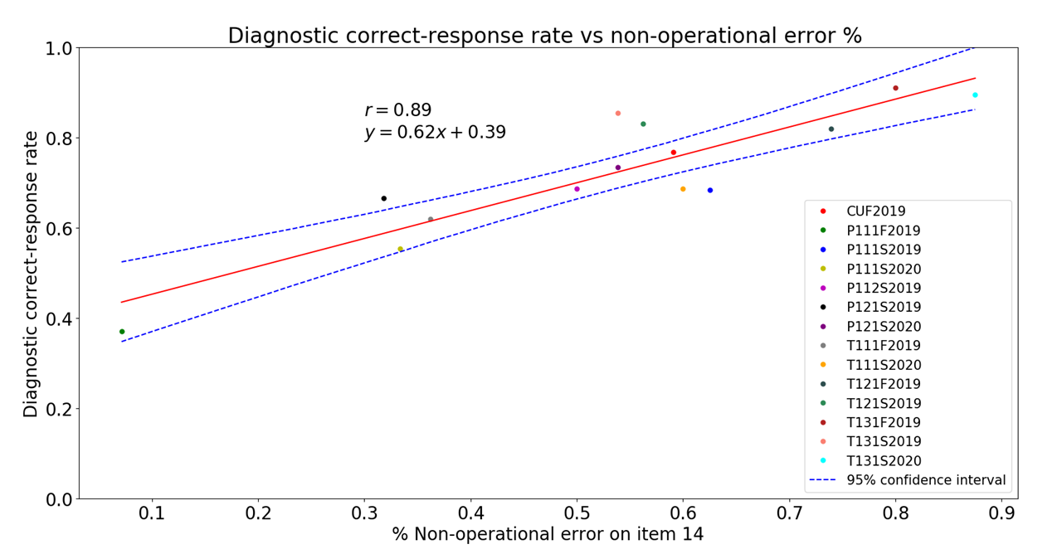

Slide 38
Possible Instructional Strategies
Difficulties due to skill-practice deficits might be addressed by short-term, in- and out-of-class tutorials and assignments, designed to refresh students’ previously learned knowledge and skills (e.g., Mikula and Heckler, 2017)
  Current project, OSU + ASU, NSF DUE #1914709/1914712
  Regular low-stakes on-line homework assignments requiring multiple consecutive correct answers
Inclusion of multi-step contexts in these assignments may reduce the prevalence of non-operational errors as well.

Slide 39
Pretest (February 13)

Slide 40
Pretest (February 13)

Slide 41
Instructional Intervention
Initial instruction and group practice in class before pretest was administered
Virtually no in-class review after pretest
Three rounds (one every two weeks) of online “Essential Skills” [from Ohio State University] practice assignments (homework points awarded for completion of four correct items in a row) before post-test

Slide 42
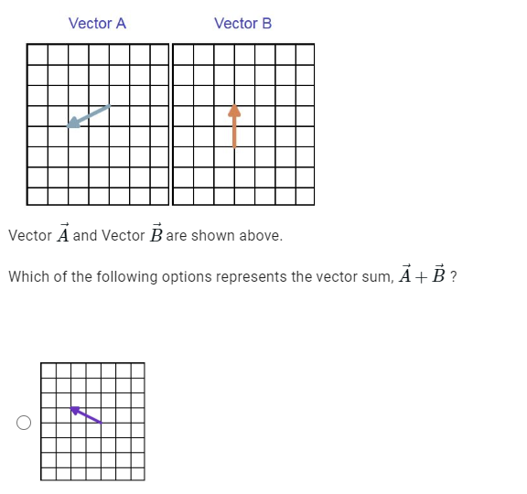
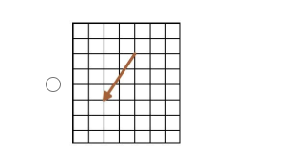
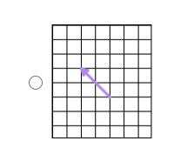
“Essential Skills” practice, example #1

Slide 43
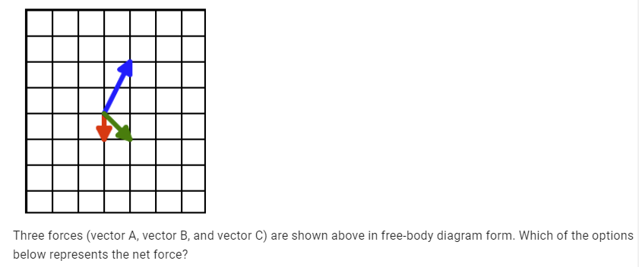
“Essential Skills” practice, example #2

Slide 44
Posttest (April 2)

Slide 45
Results on Vector-Diagram Problem
N = 39 (Matched, pre- and post)
Class Average Pretest Score: 44%
Class Average Posttest Score: 79%
(Difference in means significant, p < 0.001)

Slide 46
Summary
Physics students’ mathematical errors have a variety of causes
Errors due to skill-practice deficits with “unfamiliar” operations (such as vectors) may be addressable through regular, brief online assignments
Errors due to deeply-ingrained difficulties carried over from K-12 instruction may be harder to address

Slide 47
Possible Instructional Strategies
Difficulties due to “carelessness” might be addressed by guiding students to (1) carefully check and re-check key steps in their calculation; (2) slow down, review problem statements, and re-solve when possible
Other studies (e.g., G. White) have shown that much practice and repetition is needed to induce students to adopt consistent error-checking habits

Slide 48
Our 8 Sample Populations
PHY 111: Algebra-based; 1st semester
PHY 112: Algebra-based; 2nd semester
PHY 121: Calculus-based; 1st semester
PHY 131: Calculus-based; 2nd semester
Tempe
Poly
Tempe
Poly
Tempe
Poly
Tempe
Poly

Slide 49
Arizona State University: Algebra-based; 1st semester
Tempe
Poly

Slide 50
Our 3 Sample Populations
Arizona State University: Algebra-based; 1st semester
University of Colorado: Algebra-based, 1st semester
Tempe
Poly

Slide 52
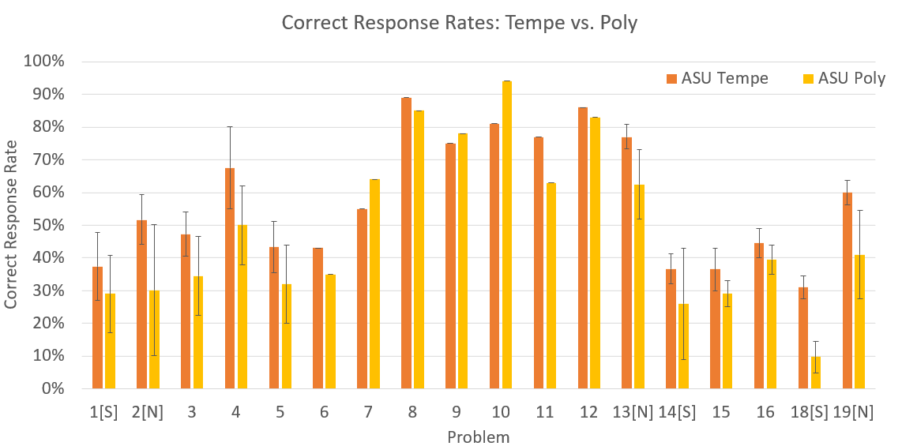

Slide 53
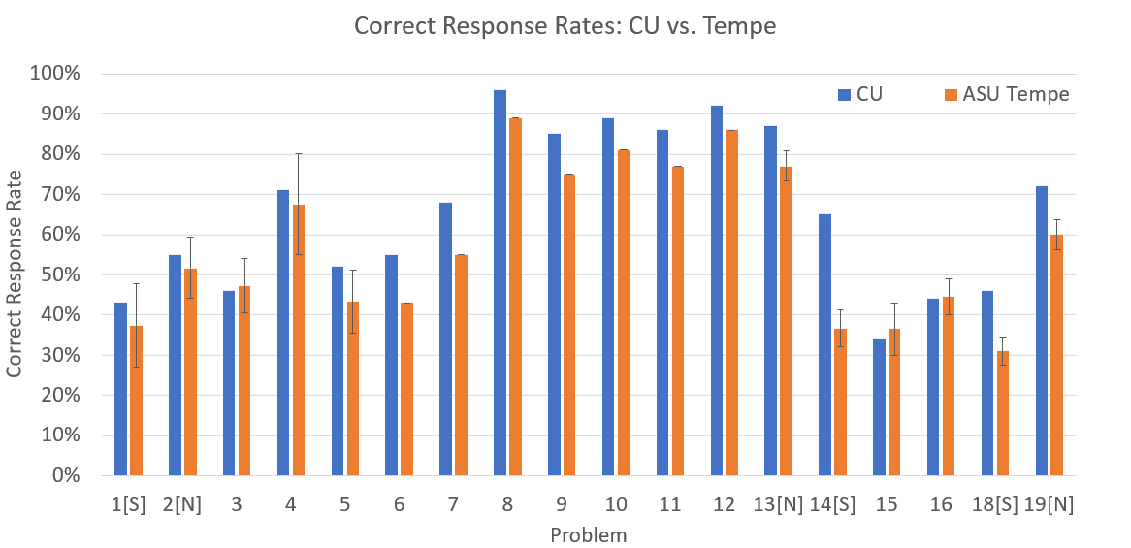

Slide 54
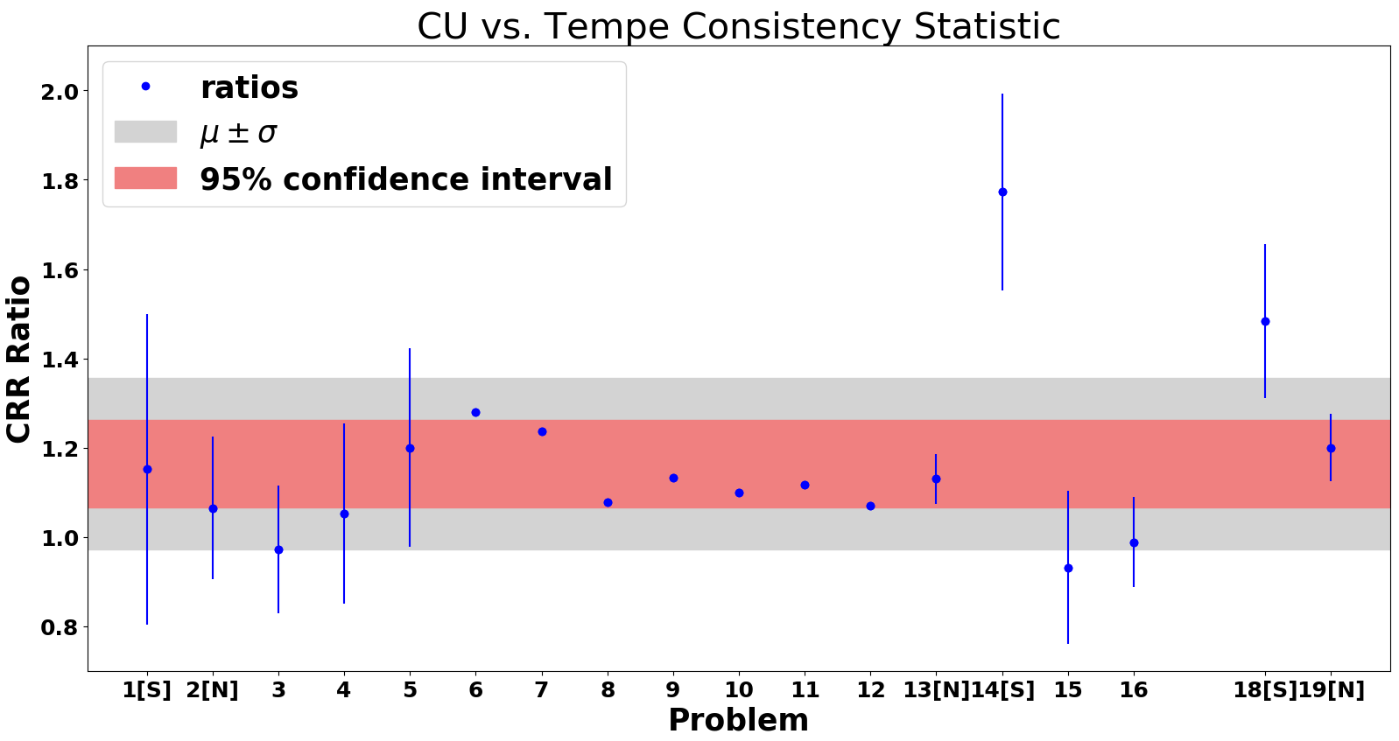

Slide 56
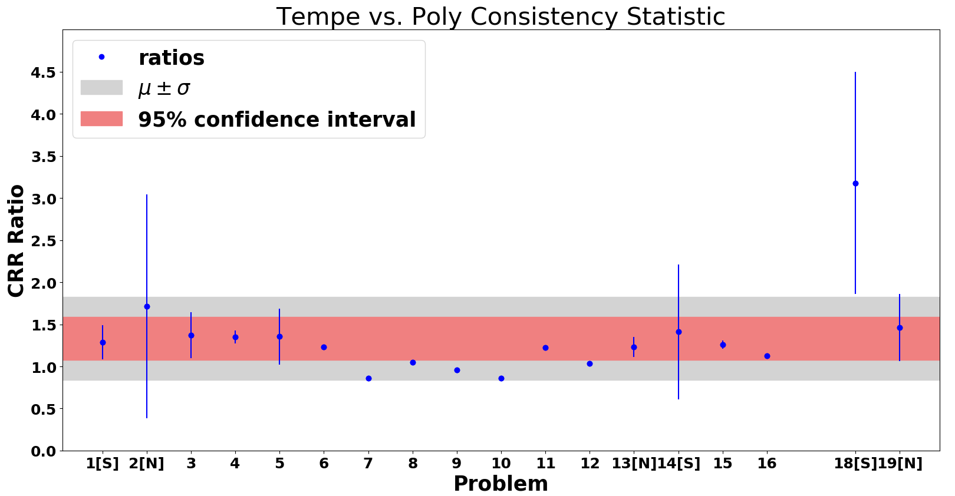

Slide 58
Item Responses Reflect Institutional Differences
The correct-response rate (CRR) for CU on the 19 test items averages 16% higher than those at ASU-Tempe, while Tempe averages 33% higher than Poly, with ratios of all but two test items falling within fairly narrow bands (mean +/− 1 sd).
Conjecture #1: The differences in mean CRRs reflect differences among the institutions’ student populations
Conjecture #2: Most of the (otherwise diverse) test items probe operational ability to similar “degrees”
Conjecture #3: Another “level” of operational-ability difference is probed by the multi-step symbolic test items

Slide 59
Why the Difficulties with Symbols?
Some Suggestions Arising from the Interviews
In elementary math courses, “simplified forms” of equations are emphasized (i.e., few messy symbols and functions).
Many students get “overloaded” by seeing all the variables, and are unable to carry out procedures that they do successfully with numbers.
Many students have had insufficient practice with algebraic operations to avoid being overwhelmed by standard algebraic manipulations.
  Students tend to become careless

Slide 60
Error Types
“Operational” Errors: Inadequate learning or expertise with fundamental operations
  Conceptual confusion, e.g., What is an inverse sine? What is slope?
  Weak skills with numerical and/or algebraic operations (e.g., factoring)
  Inadequate practice with symbolic operations (e.g., dividing fractions)
“Non-operational” Errors: Difficulties connecting context of problem to context in which operations were learned
  Physics context, e.g., position-time graph with appropriate units
  Problems involving multiple linked steps, each involving basic operations

Slide 61
Weak Operational Skills, or Carelessness?
We define “non-operational errors” as errors that occur when the student apparently demonstrates knowledge of the mathematical operations needed to solve individual steps of a multi-step problem, yet fails to solve the problem correctly
  causes for error might include not accessing previously learned skills, or not exercising sufficient care.
With certain assumptions, we can estimate the percentage of students that solved certain problems incorrectly because of “non-operational errors”

Slide 62
Possible Origins of Errors
We assume several different possible sources for students’ errors:
  Difficulty with operations: Inadequate learning or expertise with fundamental operations, including symbolic operations
  Difficulty accessing knowledge: Students don’t connect context of problem to context in which operations were learned, e.g., “multi-step” context
  “Careless” errors, due to simple inattention, lack of checking, etc.; can be corrected (in principle) by greater attentiveness.
    (Note: ≈50% of errors were “self-corrected” during interviews)

