Slide 1
Exploring the Origins of Physics Student Misconceptions in Mathematics
John D. Byrd^{1,2} johnbyrd@msu.edu
David E. Meltzer,¹ and Dakota H. King^{1,3}
¹ Arizona State University
² Michigan State University (present address)
³ National Heart, Lung, and Blood Institute, National Institutes of Health
Supported in part by NSF DUE #1504986 and #1914712
These Slides

Slide 2
Exploring the Origins of Physics Student Misconceptions in Mathematics
John D. Byrd^{1,2} johnbyrd@msu.edu
David E. Meltzer,¹ and Dakota H. King^{1,3}
¹ Arizona State University
² Michigan State University (present address)
³ National Heart, Lung, and Blood Institute, National Institutes of Health
Supported in part by NSF DUE #1504986 and #1914712
These Slides

Slide 3
Exploring Areas of Introductory Physics Student Difficulties in Mathematics
John D. Byrd^{1,2} johnbyrd@msu.edu
David E. Meltzer,¹ and Dakota H. King^{1,3}
¹ Arizona State University
² Michigan State University (present address)
³ National Heart, Lung, and Blood Institute, National Institutes of Health
Supported in part by NSF DUE #1504986 and #1914712
These Slides

Slide 4
Motivation
Math skills are correlated with student success in physics
By better understanding areas of student difficulties, we can work to address them
Why are certain mathematical operations so difficult for students?
Are there patterns of common difficulties between students?
Difficult to determine student mindset from written work alone

Slide 5
The Project and Findings
7 student interviews with students in algebra-based physics immediately after they take the 15-question diagnostic
90% average score, much higher than average across all students in similar courses
Errors were representative of those commonly seen in the larger student population
Interesting findings will be presented, along with statistics for similar classes

Slide 6
Questions with Interesting Results

Slide 7
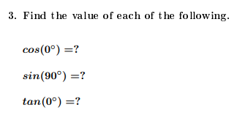
Question 3 - Trigonometry
86% (6/7) got all values correct
Similar courses: 65% correct (N = 660)
71% (5/7) students did not remember values without a calculator
We should not assume students in intro courses remember cos (0°) = 1 and sin (90°) = 1.

Slide 8
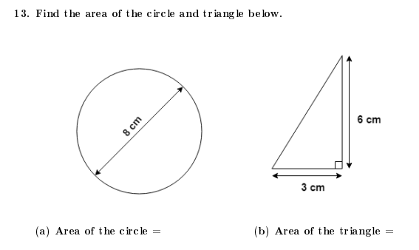
Question 13 - Area
71% provided correct numerical answer
Similar courses: 77% correct (N = 596)
Only 29% provided any units, even with prompting
Similar courses: < 50% correct units
“I don’t include units until the end, it gets me too confused.” - Student 1
We should not assume that students know how to find the area of a circle, or the correct units.

Slide 9
Question 13 - Area
100% provided correct numerical answer for triangle
Similar courses: 87% correct (N = 588)
Only 29% provided correct units, even with prompting
Two students provided no units for the circle, and incorrect units for the triangle (cm)
We should not assume that students can provide correct units for area.

Slide 10
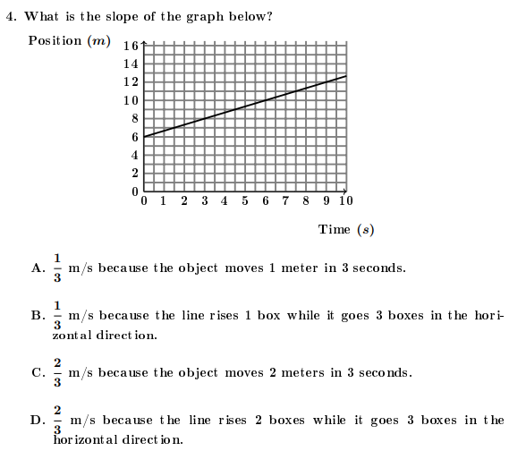
Question 4 - Graphing
71% provided correct answer (C)
Similar courses: 37% correct (N = 133)
Common error: ignore axis labels
We should not assume that students read and utilize the axis labels on graphs.

Slide 11
Question 15 - Algebra
57% initially provided correct answer
Similar courses: 31% correct (N = 372)
Most students corrected their errors during interviews with no prompting
Similar to findings in larger interview samples
Multiple students had issues with isolating x from fractions
Students frequently make algebra errors, many of which might be correctable with prompting

Slide 12
Future Work
Reassess interview recruitment strategies. (Larger interview sample sizes are needed for any definitive conclusions.)
Focus on how to help students automatically self-correct their errors.
New questions should be designed to specifically examine student difficulties with units.

Slide 13
References
Jones, M. (2016). The Mathematical Successes and Failures of Students in an Introductory Physics Course. Honors Thesis. (unpublished).
Meltzer, D. (2002). The relationship between mathematics preparation and conceptual learning gains in physics: A possible “hidden variable” in diagnostic pretest scores.
Am. J. Phys. 70 (12), 1259-1268.

Slide 14
This work is supported in part by NSF DUE #1504986 and #1914712
Any opinions, findings, and conclusions, or recommendations expressed in this material are those of the author(s) and do not necessarily reflect the views of the National Science Foundation.

