Slide 1
Symbolic manipulation fluency predicts introductory physics students’ mathematical preparedness
Dakota H. King and David E. Meltzer
Arizona State University
Supported in part by NSF DUE #1504986 and #1914712

Slide 2
Our mathematics diagnostic
Administered to 7,264 students over the past 5 years
Includes students enrolled in algebra- and calculus-based introductory physics courses at four large state universities
Tests knowledge on basic trigonometry, geometry, graphing, and algebra
Our latest version:
A multiple-choice online assessment
In addition to math, it includes physics items testing conceptual understanding of Newton’s second and third laws

Slide 3
Our mathematics diagnostic
Link to our diagnostic:
https://testmoz.com/q/ExampleDiagnostic
Previous hand-written versions (in total):
6061 students
38 classes
10-15 mathematics items
Free-response and multiple-choice items
Latest online version:
1203 students
11 classes
14 mathematics items
4 physics items
Only multiple-choice items

Slide 4
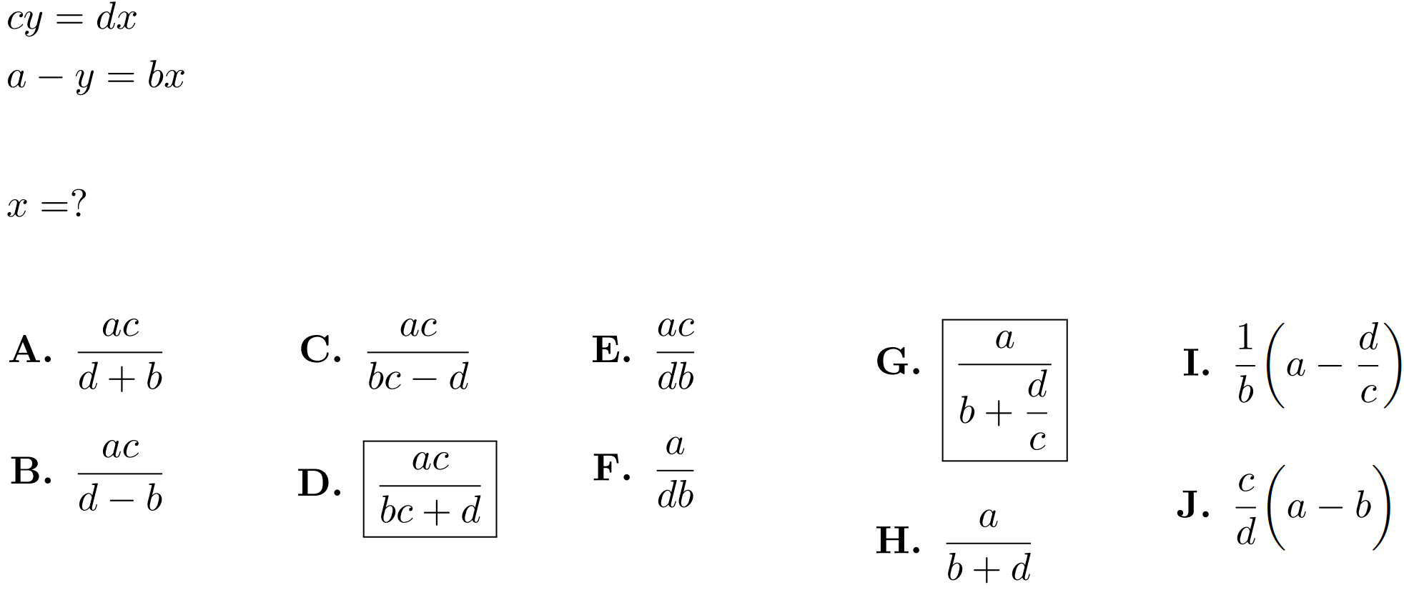
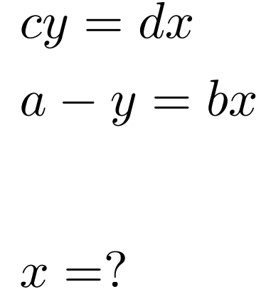
Designing the online diagnostic
Free-response items were reformatted to multiple-choice by analyzing student responses from four years of data
Online version
Hand-written version

Slide 5
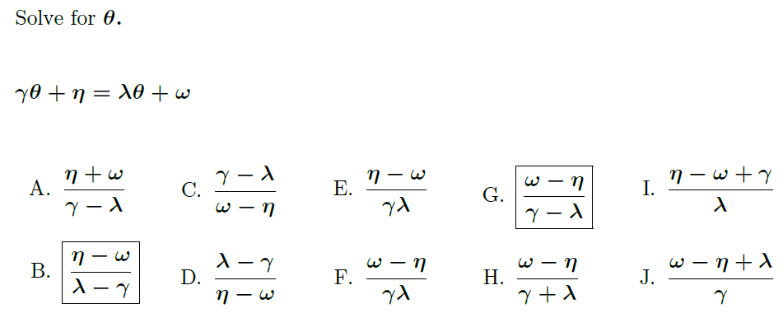
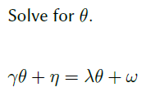
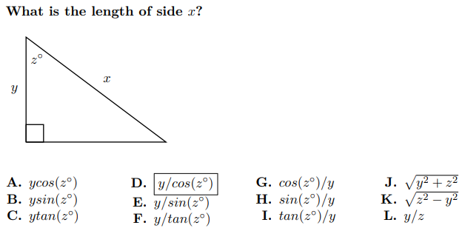
Designing the online diagnostic
Hand-written version
Online version

Slide 6
Results: online vs hand-written diagnostic (math items only)

Slide 7
Online vs hand-written: correct-response rates
Data before applying a time cutoff
0 min < t

Slide 8
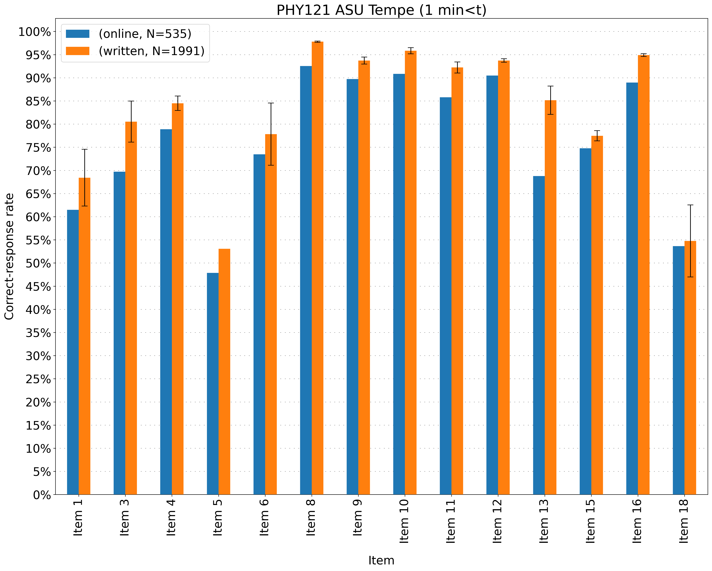
Online vs hand-written: correct-response rates
1 min < t

Slide 9
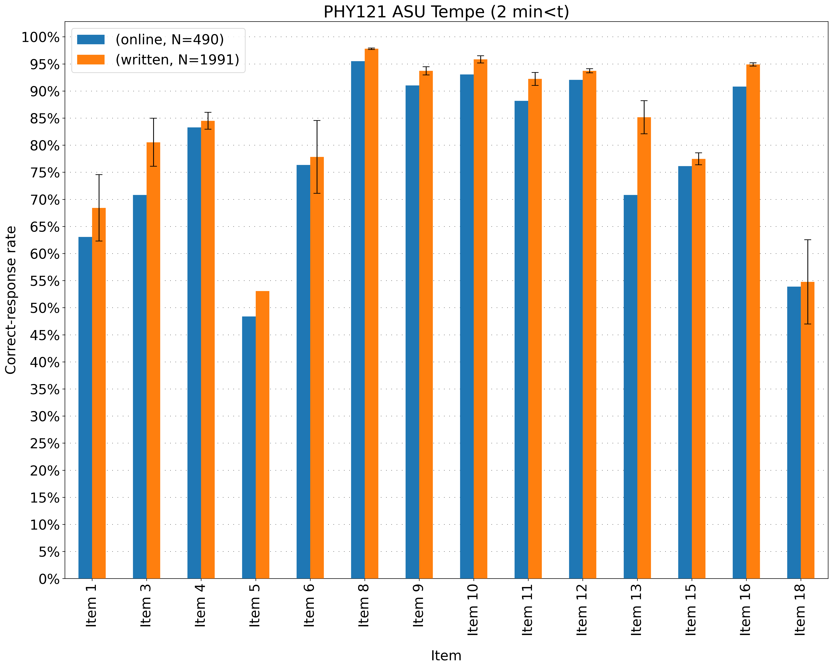
Online vs hand-written: correct-response rates
2 min < t

Slide 10
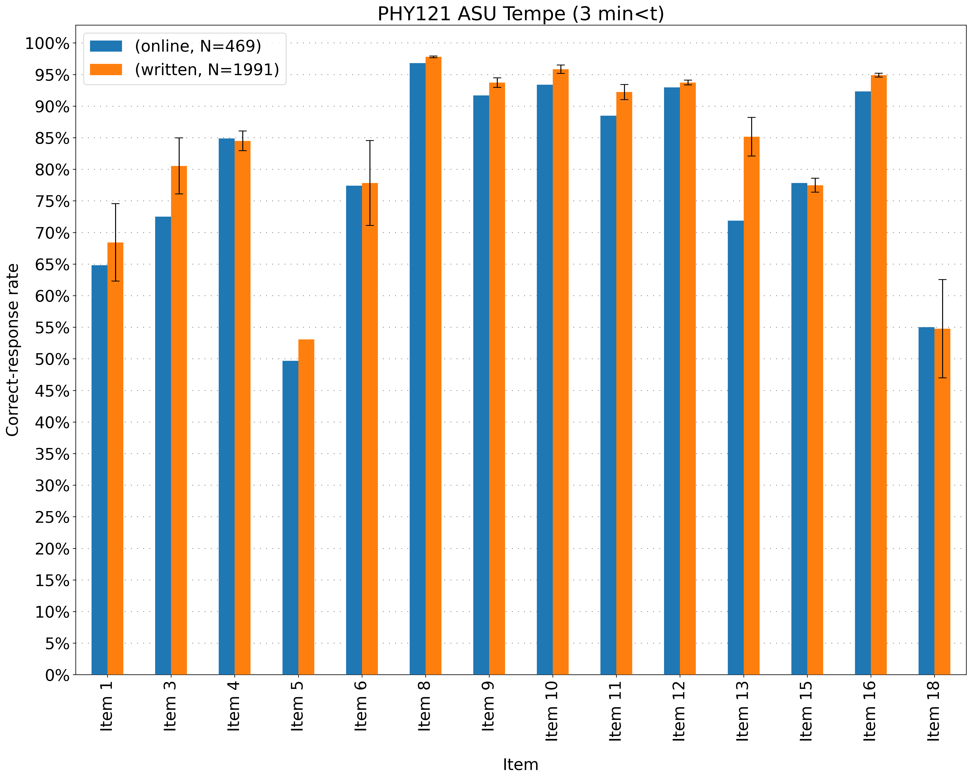
Online vs hand-written: correct-response rates
3 min < t

Slide 11
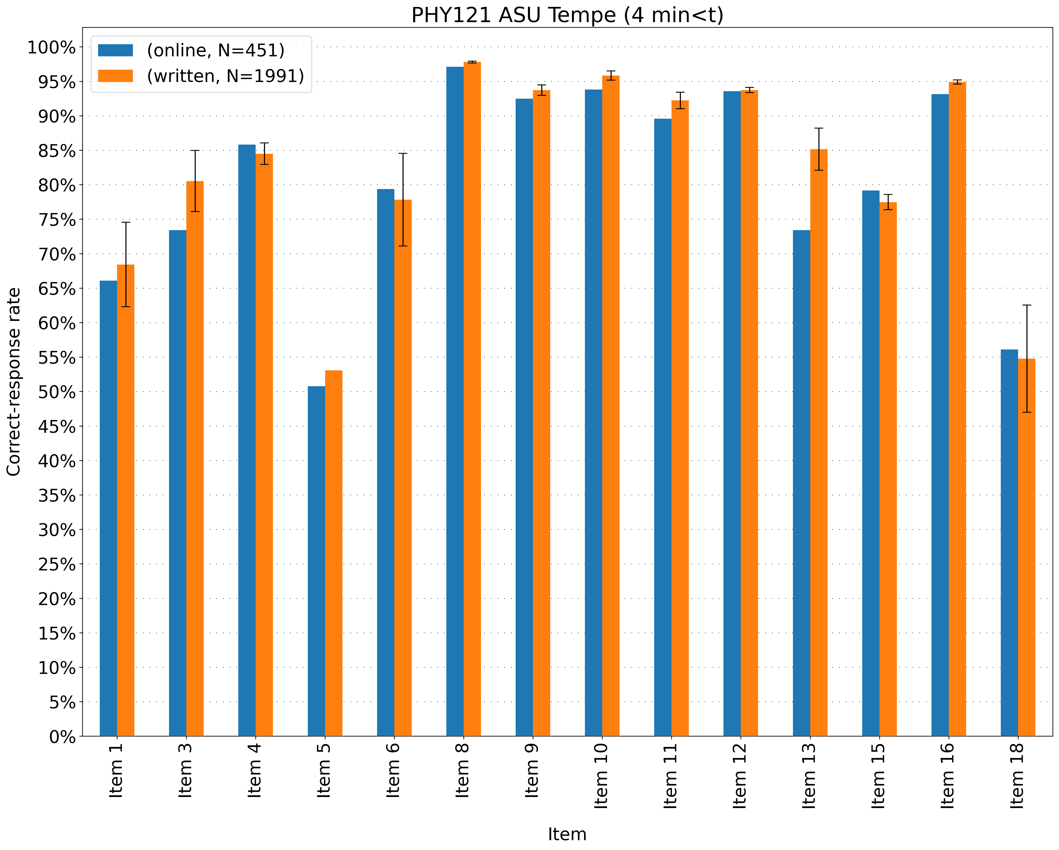
Online vs hand-written: correct-response rates
4 min < t

Slide 12
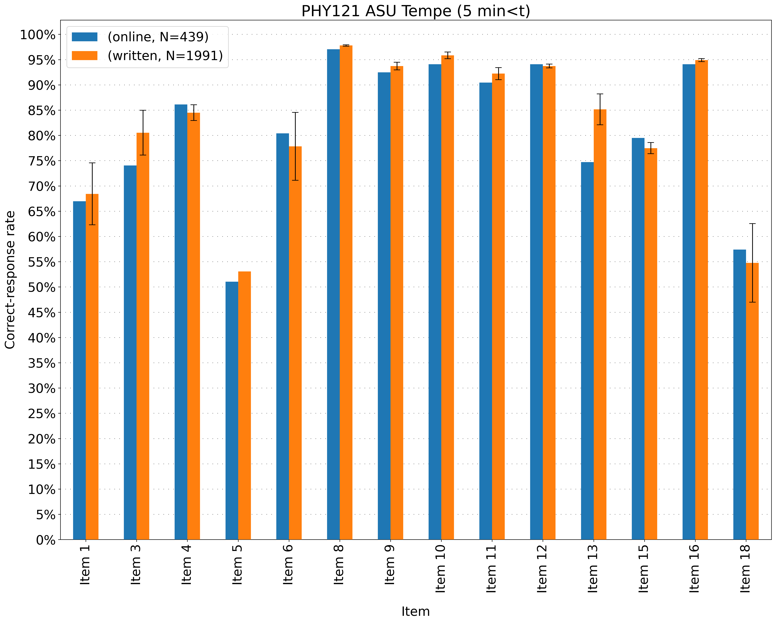
Online vs hand-written correct-response rates
5 min < t

Slide 13
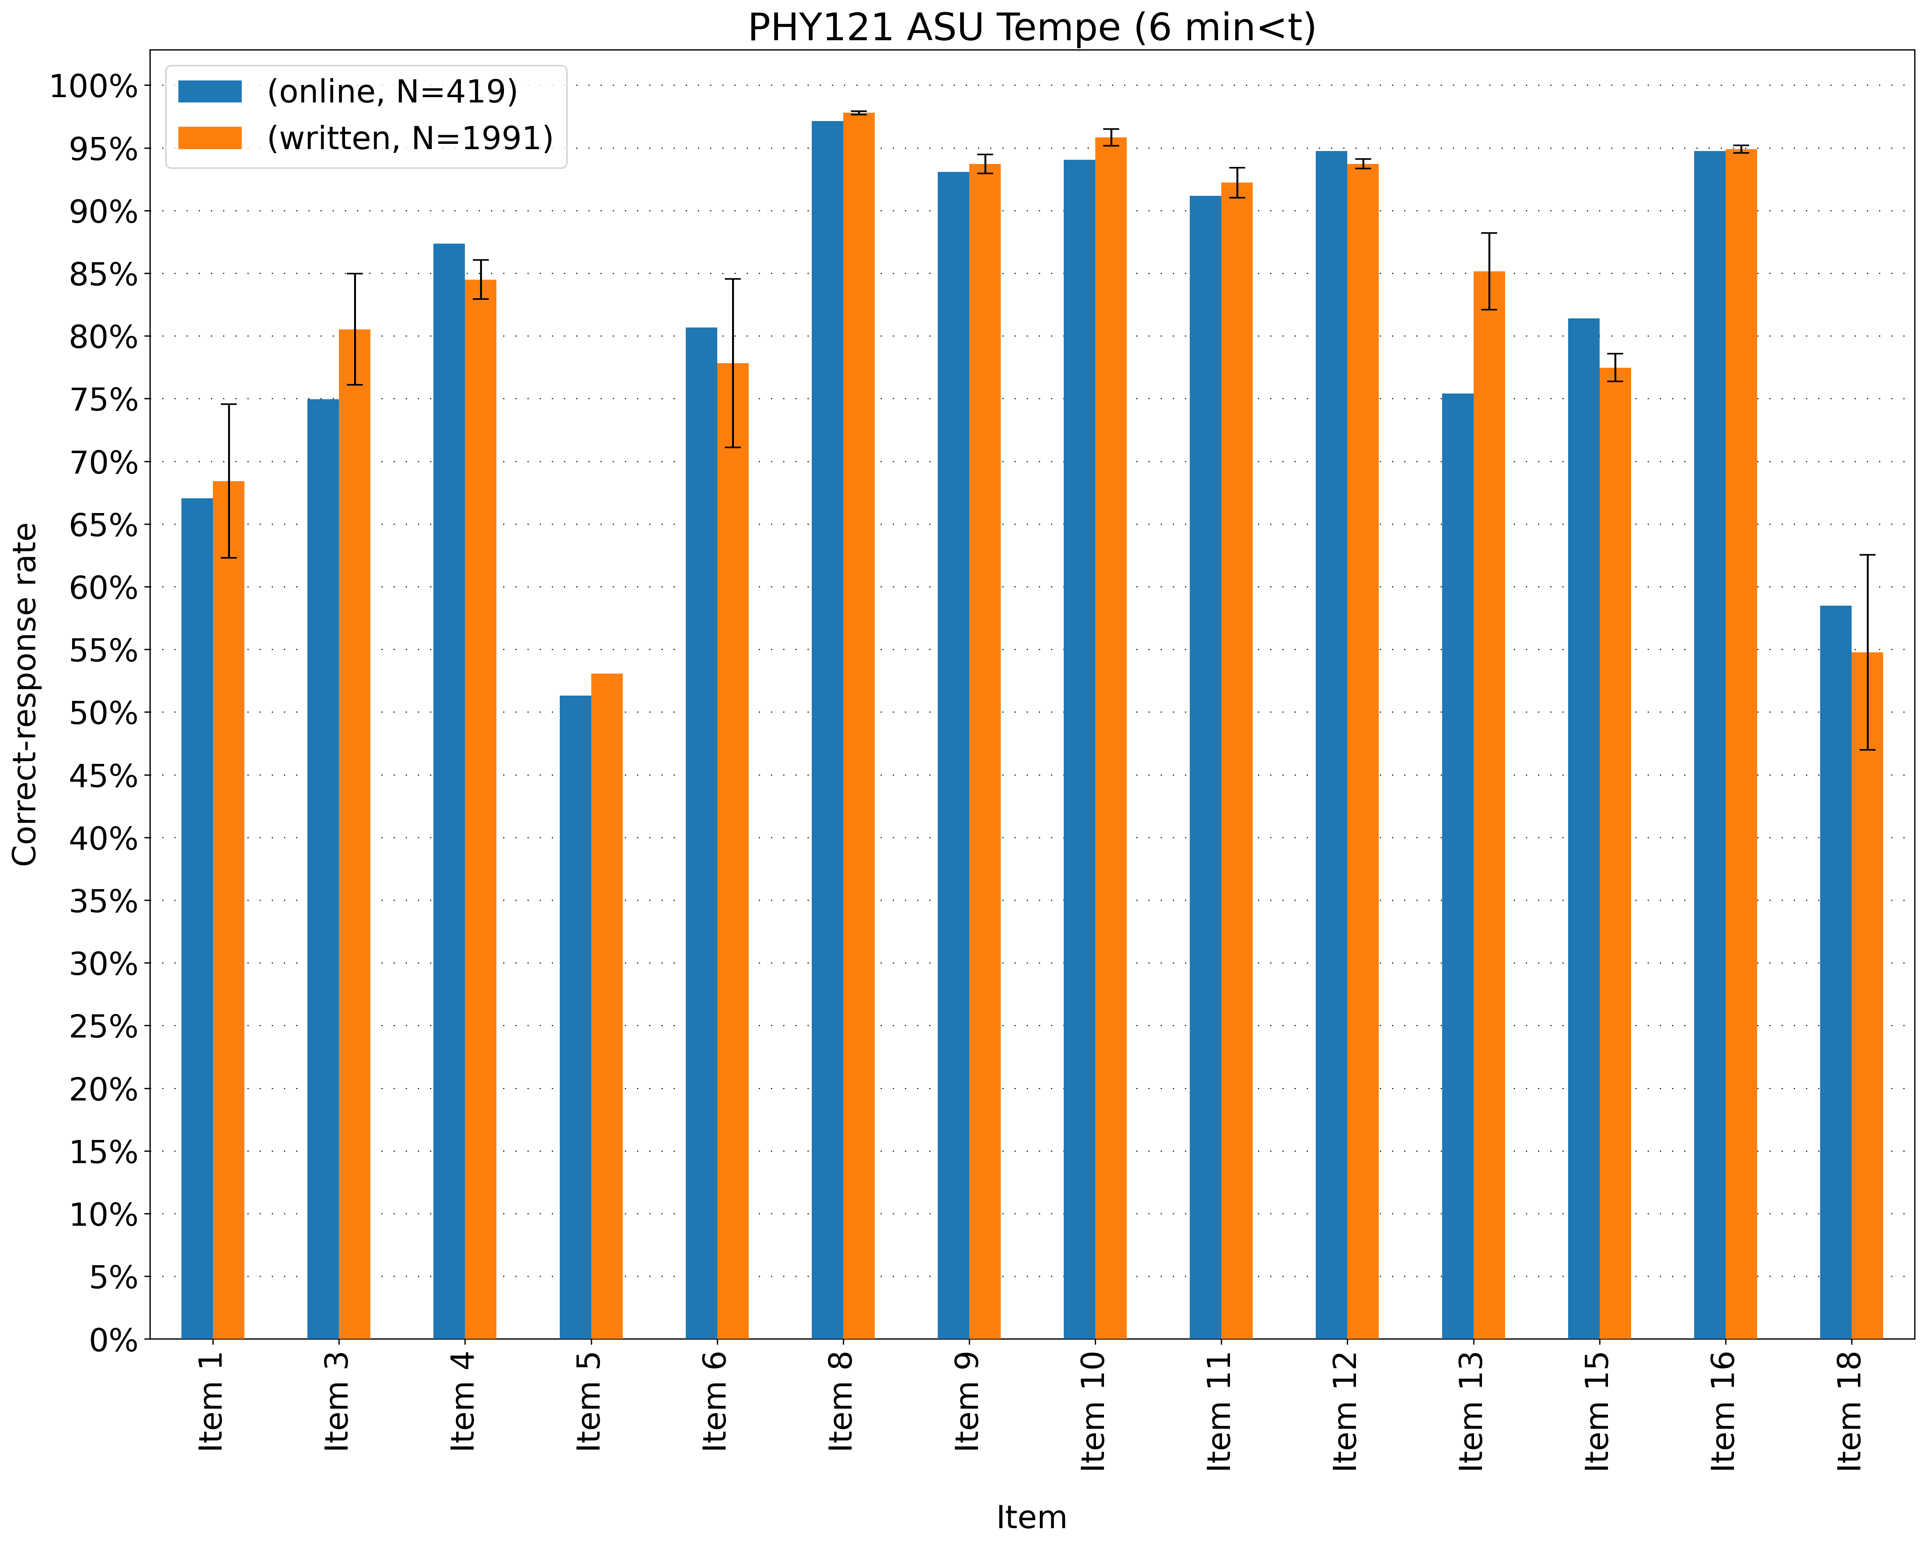
Online vs hand-written correct-response rates
6 min < t

Slide 14
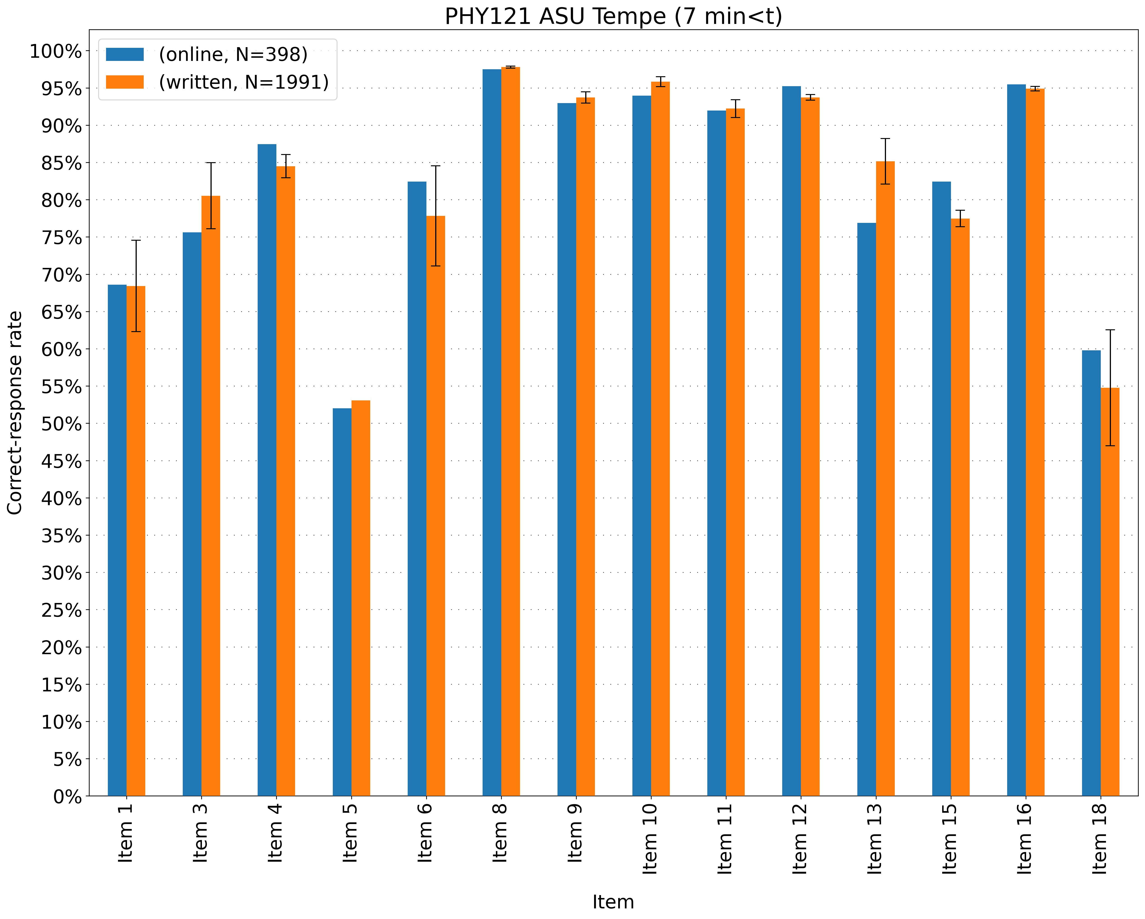
Online vs hand-written correct-response rates
7 min < t

Slide 15
Online vs hand-written correct-response rates
8 min < t

Slide 16
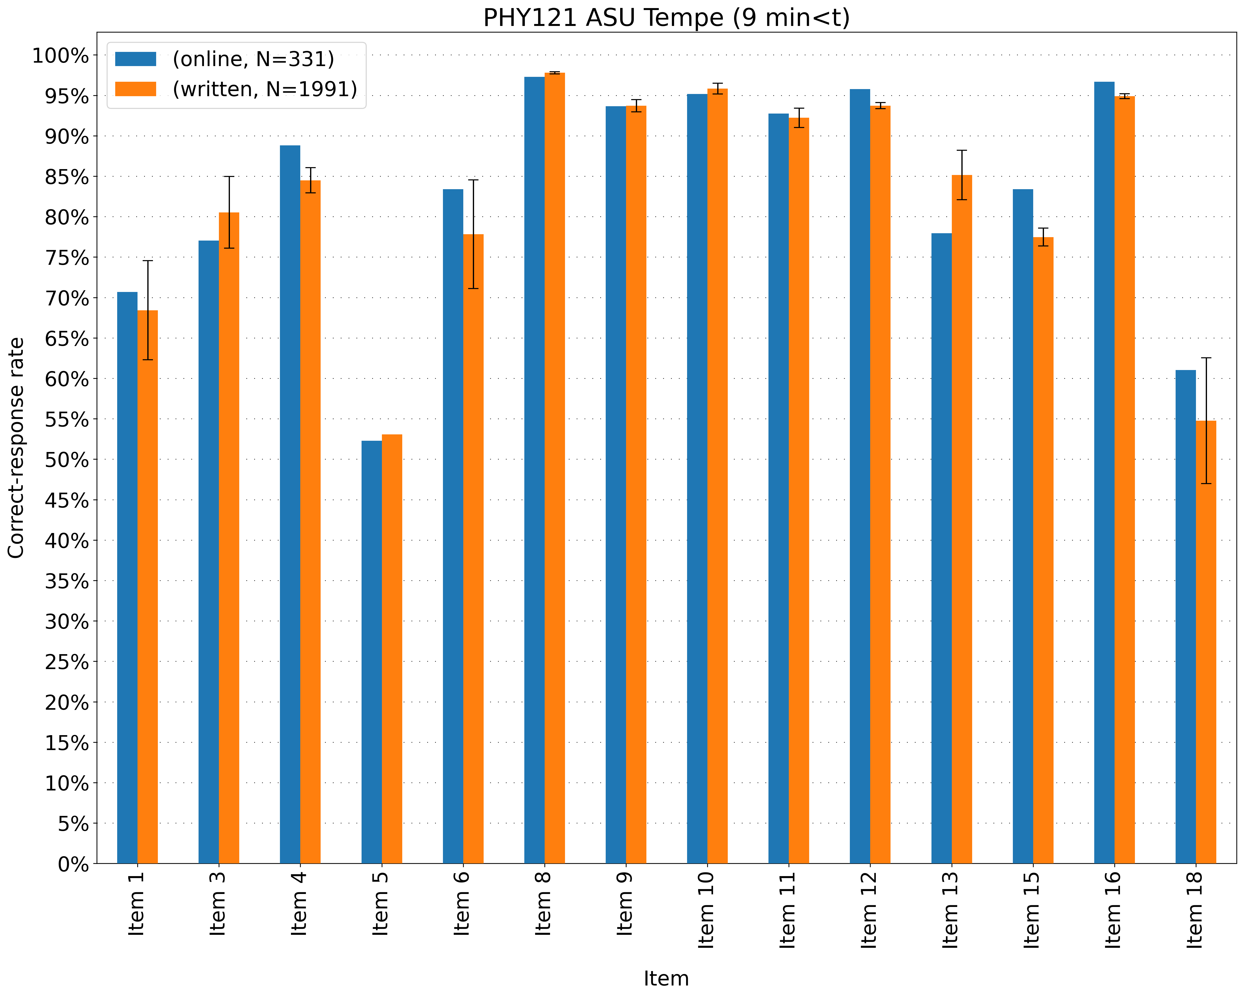
Online vs hand-written correct-response rates
9 min < t

Slide 17
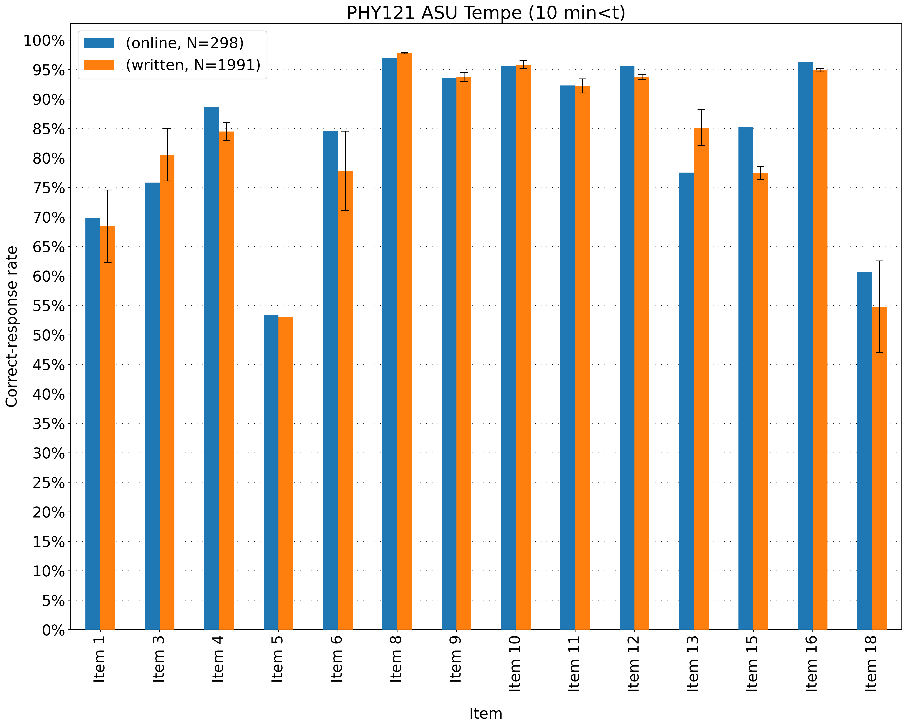
Online vs hand-written correct-response rates
10 min < t

Slide 18
Online vs hand-written: correct-response rates
5 min < t < 60 min

Slide 19
Online vs hand-written: correct-response rates
Applying a time cutoff helped reduce guessing rates
Correct-response rates are within 6% for all items except item 13

Slide 20
Online vs hand-written: course-level predictive power
With a class’s score on a single item, can we predict the class’s mean performance on the remaining 13 math items?
Item 18

Slide 21
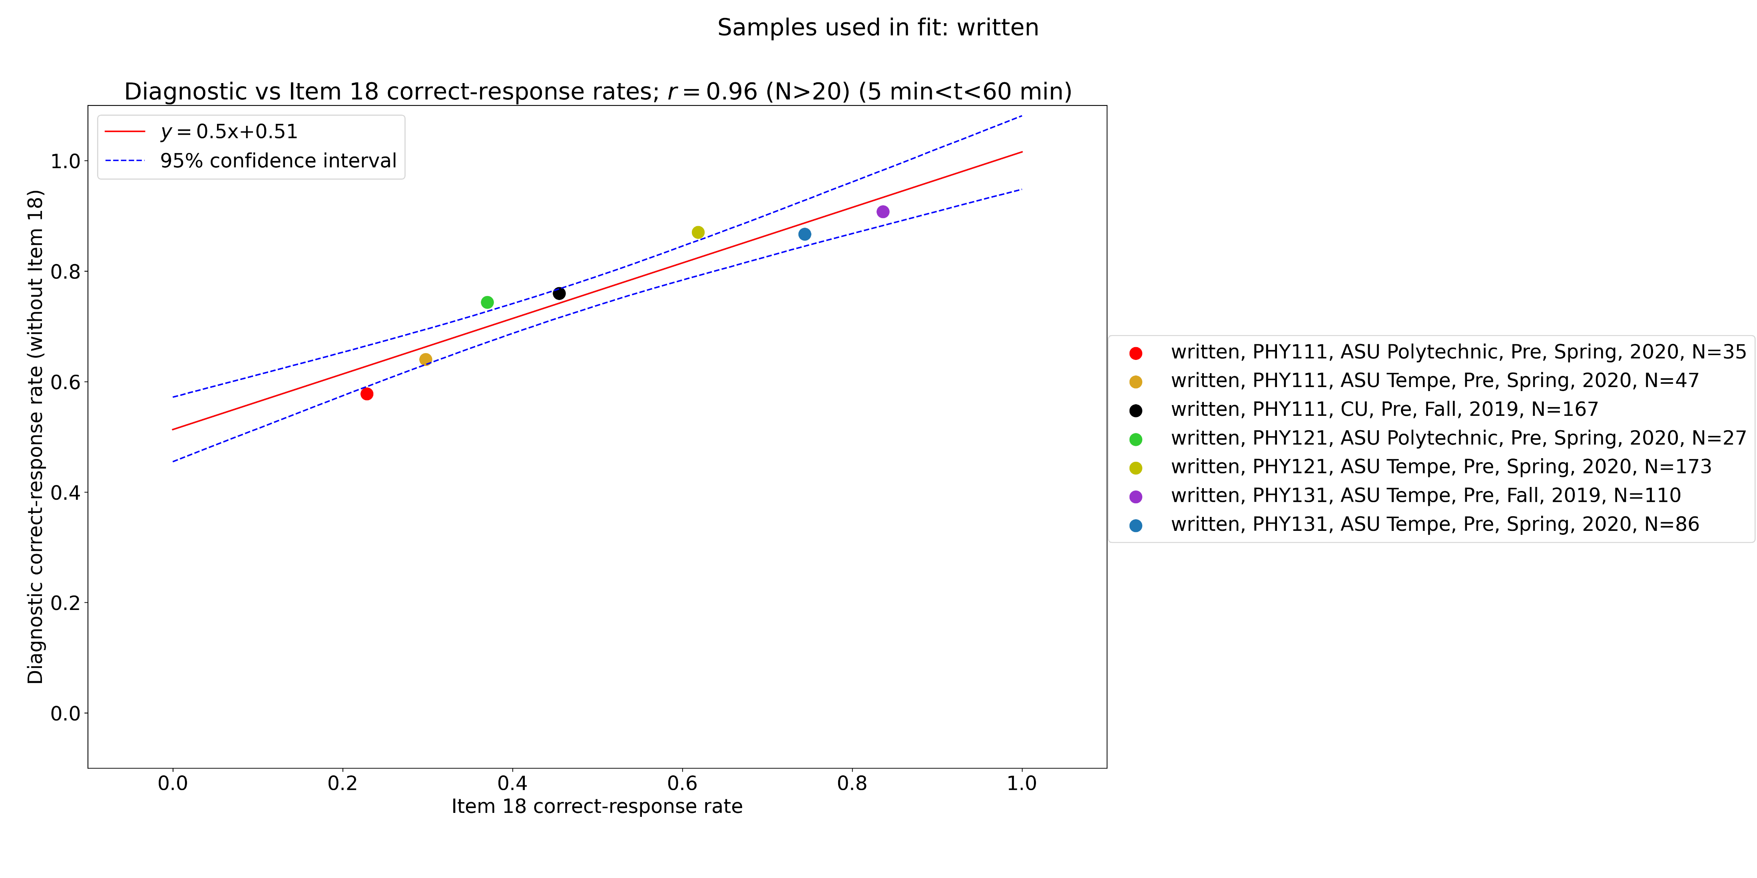
Online vs hand-written: course-level predictive power
Samples used in fit: written
Written only

Slide 22
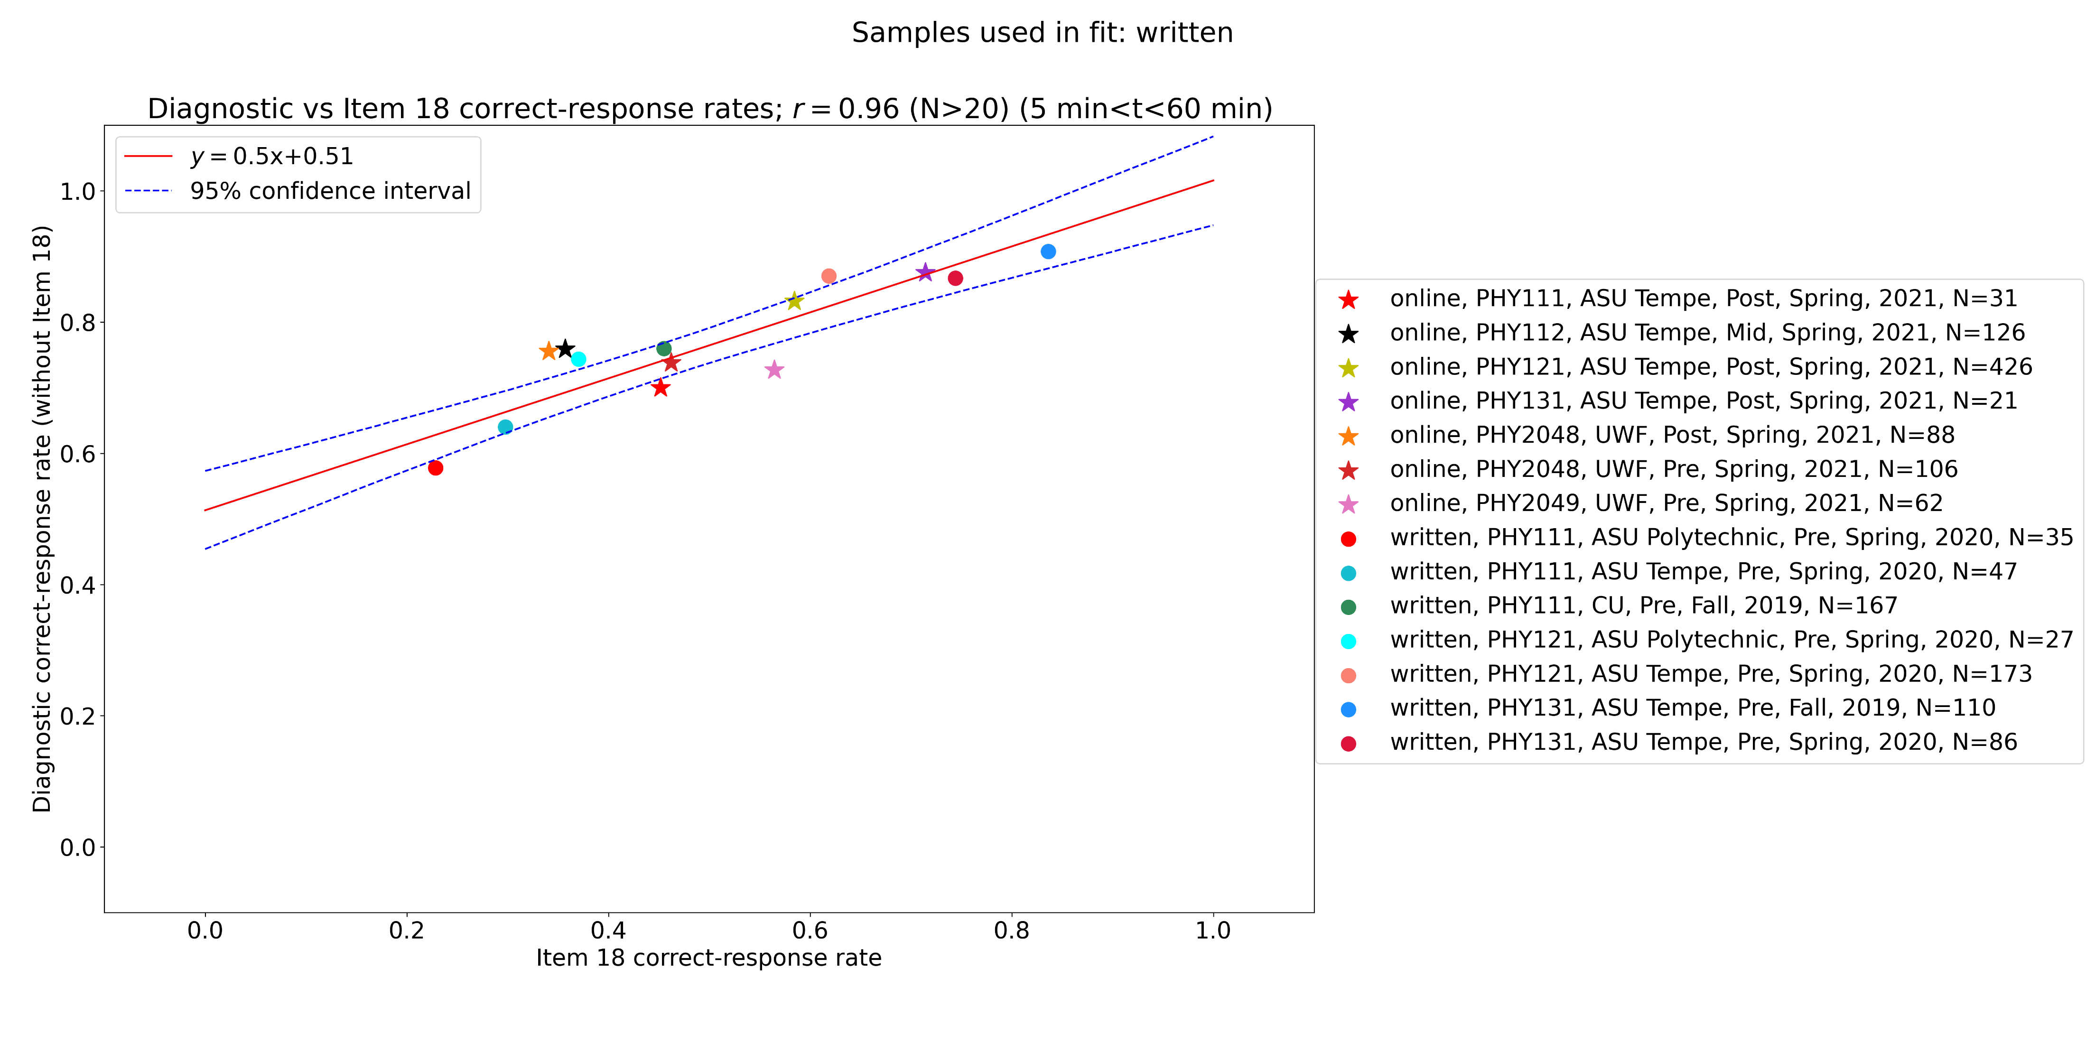
Online vs hand-written: course-level predictive power
Samples used in fit: written
Written and online

Slide 23
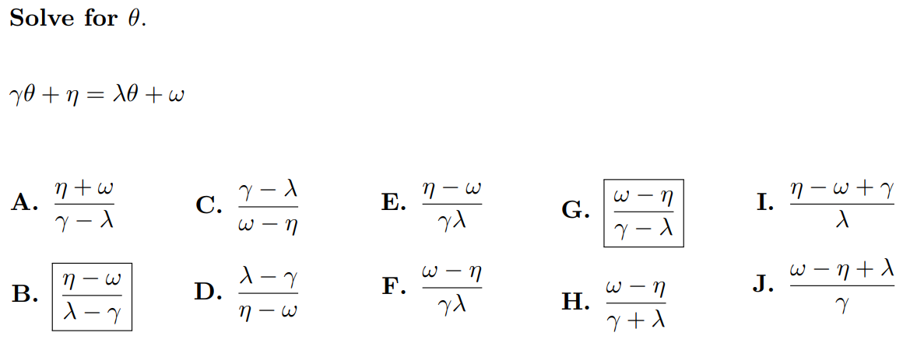
Online vs hand-written: course-level predictive power
Item 6

Slide 24
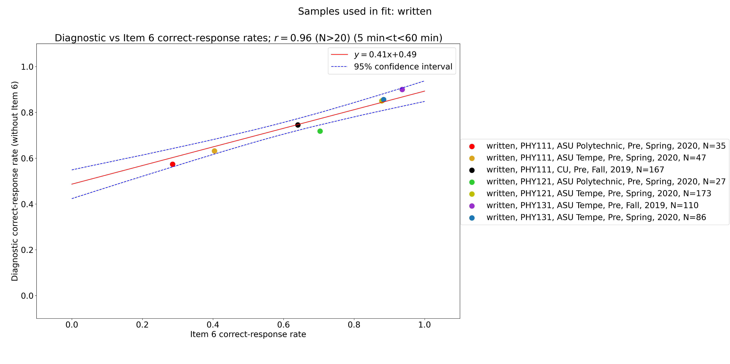
Online vs hand-written: course-level predictive power
Samples used in fit: written
Written only

Slide 25
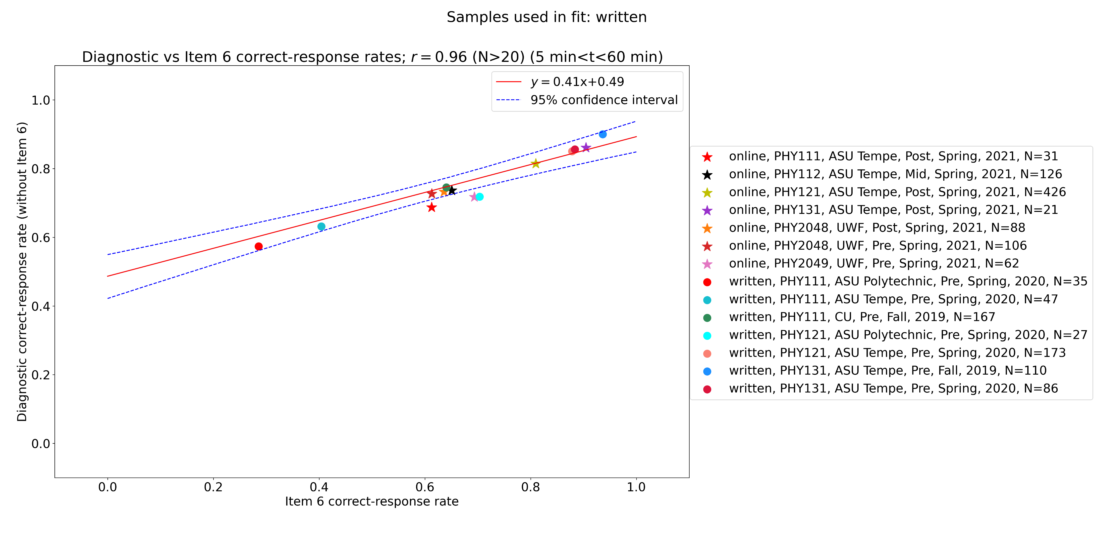
Online vs hand-written: course-level predictive power
Samples used in fit: written
Written and online

Slide 26
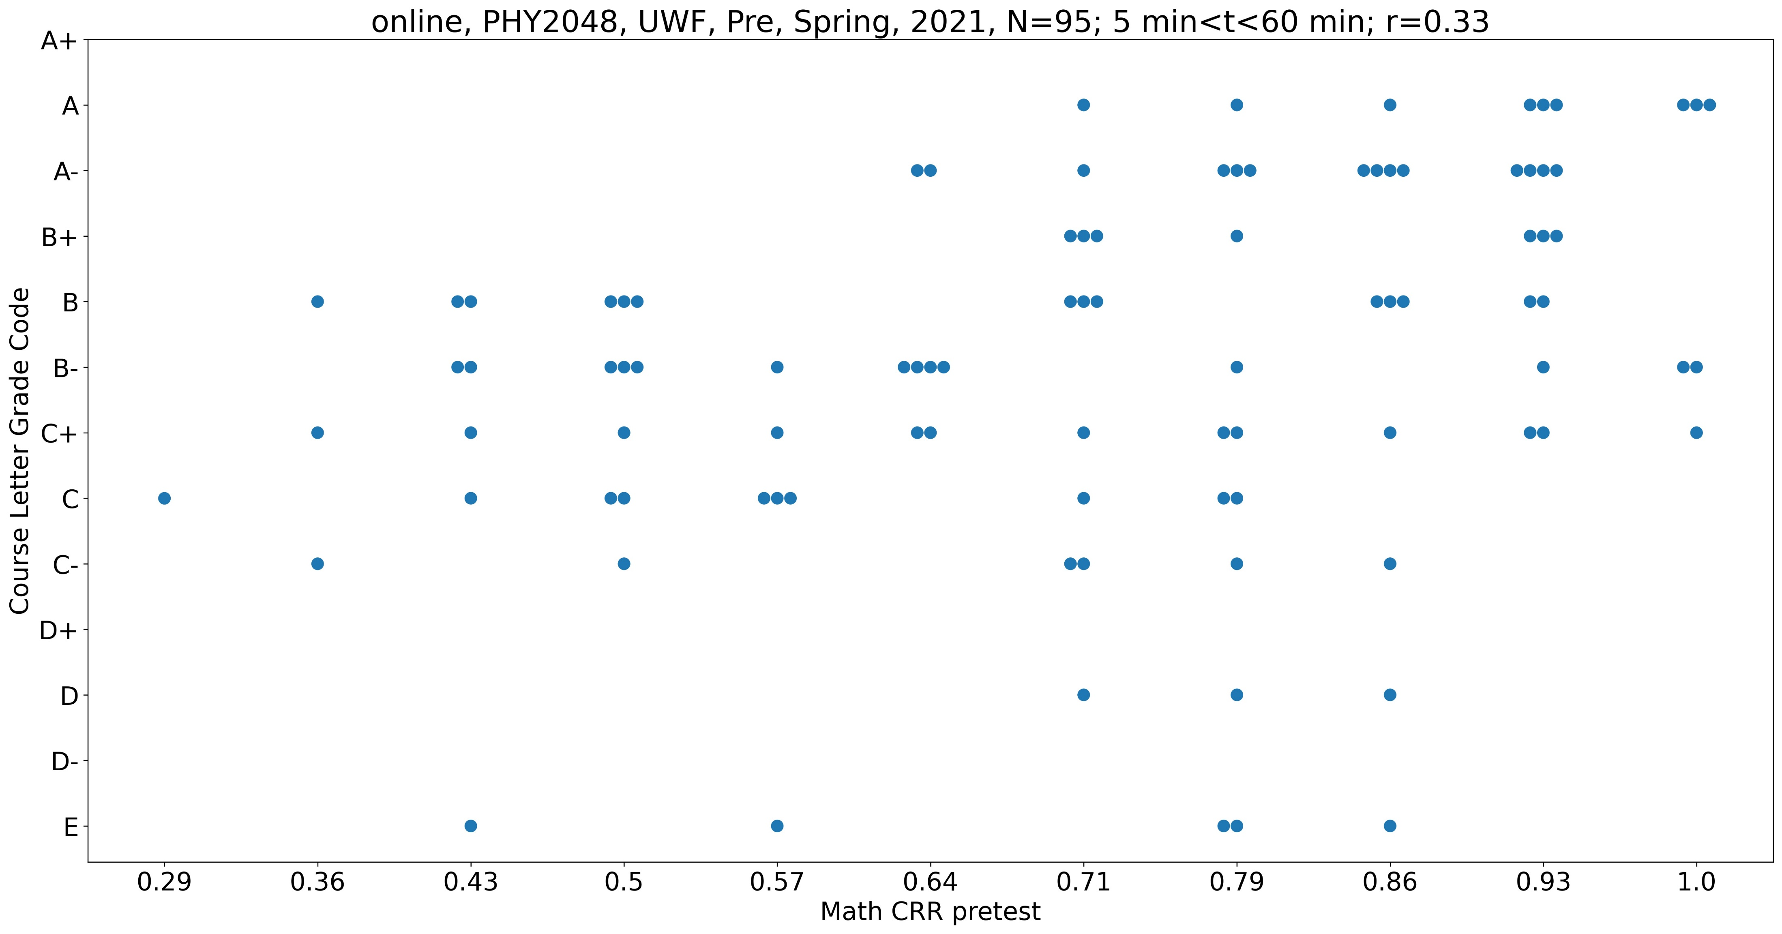
Course performance vs diagnostic math performance
100% of students who earned a B+ or higher scored at least 64% correct
Almost half of students with lower grades scored less than 64% correct

Slide 27
Summary
The online diagnostic appears to be consistent with our hand-written diagnostic in measuring students’ mathematical difficulties
Course-level performance on the math portion of the diagnostic can be accurately predicted using a single math item
Performance on the math portion of the diagnostic is related to students’ final course grade

