Slide 1
Investigating and Addressing Physics Students’ Mathematical Difficulties
David E. Meltzer
Arizona State University
http://www.physicseducation.net/
Supported in part by NSF DUE #1504986 and #1914712

Slide 2
Undergraduate Student Research Assistants
Dakota King (undergraduate and recent graduate)
Matt Jones (now at Dartmouth U.)
John Byrd (now at Michigan State U.)

Slide 3
Acknowledgments
Student data and very useful discussions have been provided by (among others):
Darya Dolenko (Arizona State University)
Andrew Heckler (Ohio State University)
Beatriz Burrola Gabilondo (Ohio State University)
Steven Pollock (University of Colorado, Boulder)
Colin West (University of Colorado, Boulder)
Christopher Varney (University of West Florida)

Slide 4
The Pedagogical Challenge
Difficulties with basic math skills impact performance of introductory physics students
The difficulties are often not resolved by students’ previous mathematical training
Students can’t effectively grapple with physics ideas when they feel overburdened in dealing with calculational issues

Slide 5
Development of Students’ Mathematical Thinking
Most college physics students receive their initial mathematical preparation in middle school and high school, therefore…
…the “mathematical landscape” of physics students’ thinking must be traced back to these formative years…

Slide 6
Studies of Physics Students’ Math Skills
Beginning in 1918 and continuing today, investigators have probed physics students’ mathematics preparation and asked whether it’s adequate for college physics.
Many mathematics diagnostic tests have been administered to high school and college physics students.

Slide 7
Representative Results from Diagnostic Tests
Hughes (1924) argued that poor math performance by university students showed that it was not possible to “mathematize” high school physics to any great extent and still get satisfactory achievement.
Lohr (1925) concluded that it was necessary for university physics teachers to “re-teach until [they are] sure of assimilation of the mathematics involved before attempting to give the physics using these principles.”
Kilzer (1929) concluded that there was a need for “maintenance drills” covering the math needed in high school physics courses.
Breitenberger (1992) found that new physics graduate students were deficient in math skills and mathematical thinking!

Slide 8
Probes of Math’s Impact on Physics Performance…
Bless (1932) found a very high correlation between university students’ physics grades and their scores on an arithmetic/algebra diagnostic test.
Carter (1932) found a similarly high correlation among high school students.
  However, he noted that the correlation was sharply reduced when student’s “intelligence” (determined by an IQ test) was held constant
Kruglak and Keller (1950) found a high correlation between math course grades and physics course grades of university students.
Halloun and Hestenes (1985) found a high correlation (+0.51) between math pretest scores and physics grades, and that math scores were a factor independent of physics pretest scores
Meltzer (2002) found that algebra pretest scores were roughly predictive of performance improvements on a non-quantitative physics concept test

Slide 9
But the Problem is More Complicated…
Weak calculational skills are only part of the problem.
Many early studies were flawed by conflating difficulties with physics concepts together with weak mathematical skills, and presuming the combination was “problems with math.”
Up until the 1970s, there was virtually no research on which to base efforts to improve the situation.

Slide 10
Lillian McDermott and the Physics Education Group at the University of Washington
Lillian McDermott and the University of Washington Physics Education Group (PEG) demonstrated that physics students’ mathematical skills, physics ideas, and reasoning abilities are not easily disentangled, and must often be studied together, in the context of authentic physical systems.
The PEG investigated students’ abilities to work with multiple representations of physics ideas, including graphs and diagrams.

Slide 11
Some Examples of the PEG’s Work
Trowbridge and McDermott (1981): Probed students’ thinking regarding ratios of differences, e.g. Δv/Δt
  Distinguishing between a quantity (v), change in that quantity (Δv), and ratios of changes (Δv/Δt) is always challenging, but confusion about the distinction between velocity and acceleration introduced additional obstacles
McDermott, Rosenquist, and Van Zee (1987): Investigated students’ ideas about graphical representations of motion (position-, velocity-, and acceleration-time graphs)
  Students’ difficulties in graphical interpretation were exacerbated by misleading intuitions drawn from objects’ physical trajectories.

Slide 12
Overview: Requirements for Successful Application of Math to Physics
Understanding of mathematical concepts
Technical skill with mathematical procedures
Ability to apply in physical context
Ability to apply in problem-solving context

Slide 13
Our Approach
Assess nature and scope of difficulties using written and on-line diagnostic instruments, as well as one-on-one oral interviews.
Address students’ mathematical difficulties within the context of physics classes themselves, using in-class and out-of-class instructional materials.
  In collaboration with Andrew Heckler’s group at Ohio State University, using the “Stemfluency” online practice tool.

Slide 14
Data Sources
We have given diagnostic pretests covering pre-college mathematics to over 7000 introductory physics students (non-credit; calculators allowed):
Results from five campuses at four different state universities were consistent with each other
Results on an online version are consistent with those on the written version
High and low scores on the diagnostic are somewhat predictive of course grades
In addition, we have carried out more than 70 one-on-one problem-solving interviews with physics students to further explore the nature of students’ thinking.

Slide 15
Examples of Test Items

Slide 16
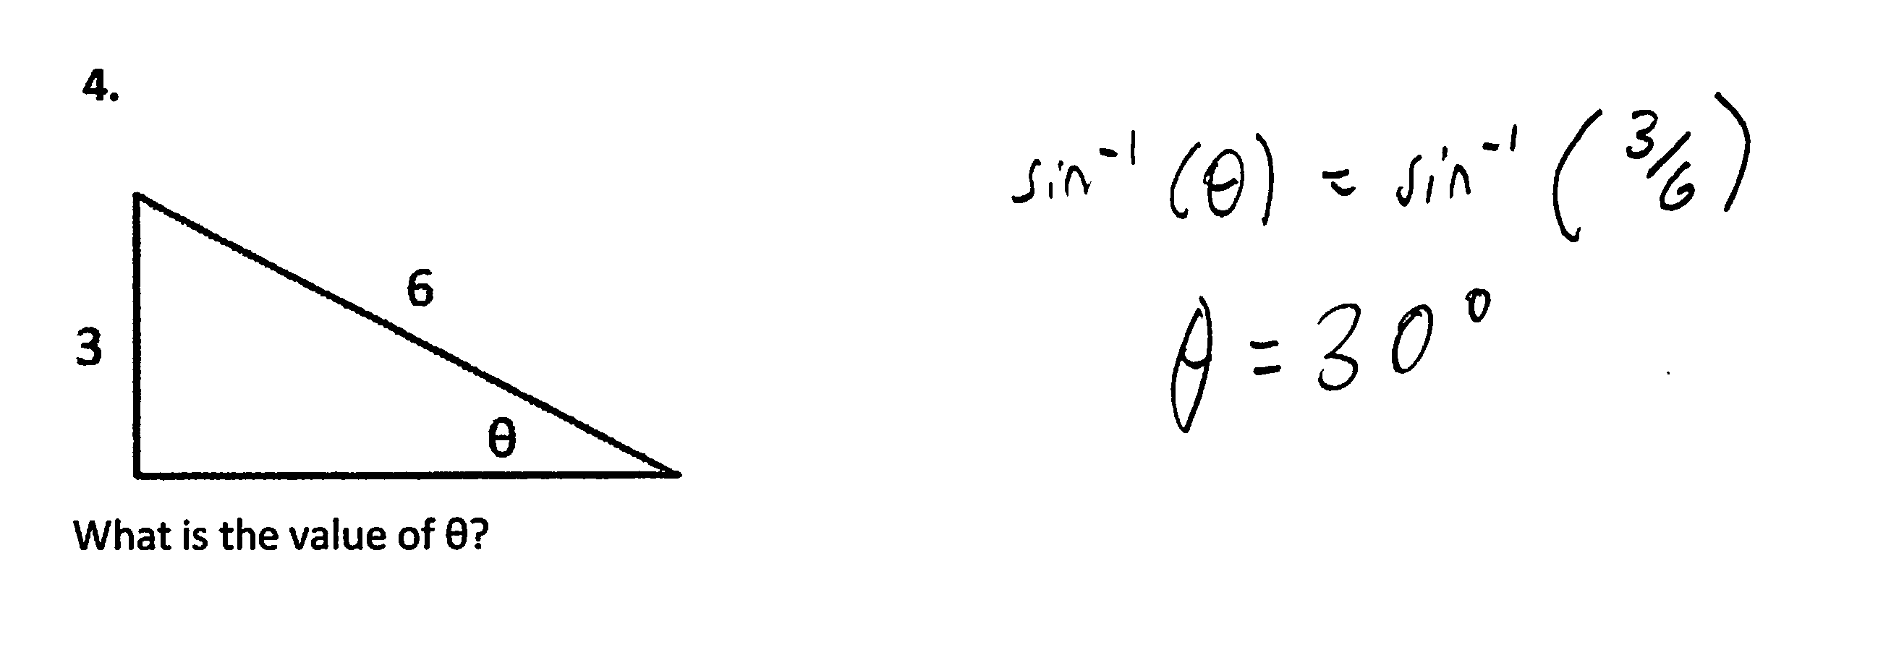
Find Unknown Angle
3.

Slide 17
Find Slope of Graph

Slide 18
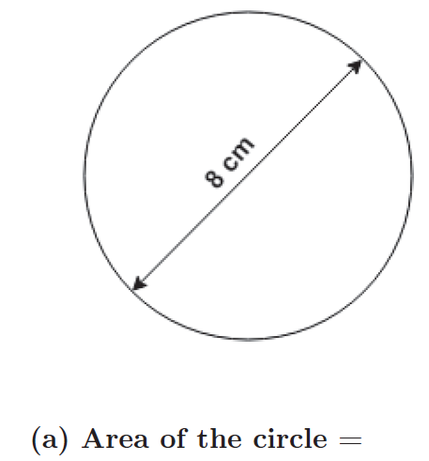
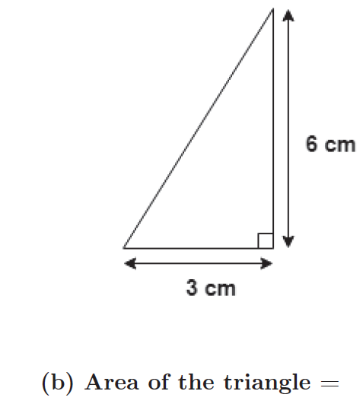
Find Area

Slide 19
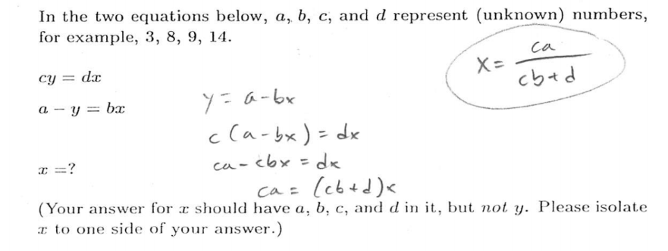
Simultaneous Equations, Symbolic Coefficients

Slide 20
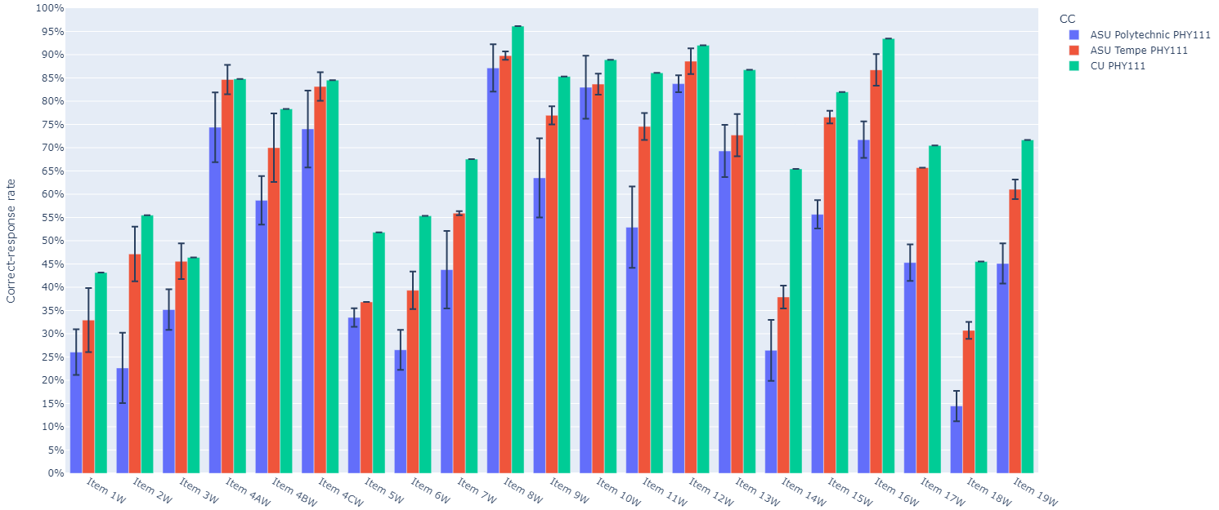
High consistency of results among five campuses at four different universities (three campuses shown below) suggests findings are generalizable
Correct-response rates: algebra-based course
ASU Poly (N>450)
ASU Tempe (N>500)
CU (N>350)

Slide 21
High consistency of results among five campuses at four different universities (three campuses shown below) suggests findings are generalizable
Correct-response rates: algebra-based course
ASU Poly (N>450)
ASU Tempe (N>500)
CU (N>350)

Slide 22
High consistency of results among five campuses at four different universities (three campuses shown below) suggests findings are generalizable
Correct-response rates: algebra-based course
ASU Poly (N>450)
ASU Tempe (N>500)
CU (N>350)

Slide 23
High consistency of results among five campuses at four different universities (three campuses shown below) suggests findings are generalizable
Correct-response rates: algebra-based course
ASU Poly (N>450)
ASU Tempe (N>500)
CU (N>350)

Slide 24
High consistency of results among five campuses at four different universities (three campuses shown below) suggests findings are generalizable
Correct-response rates: algebra-based course
ASU Poly (N>450)
ASU Tempe (N>500)
CU (N>350)

Slide 25
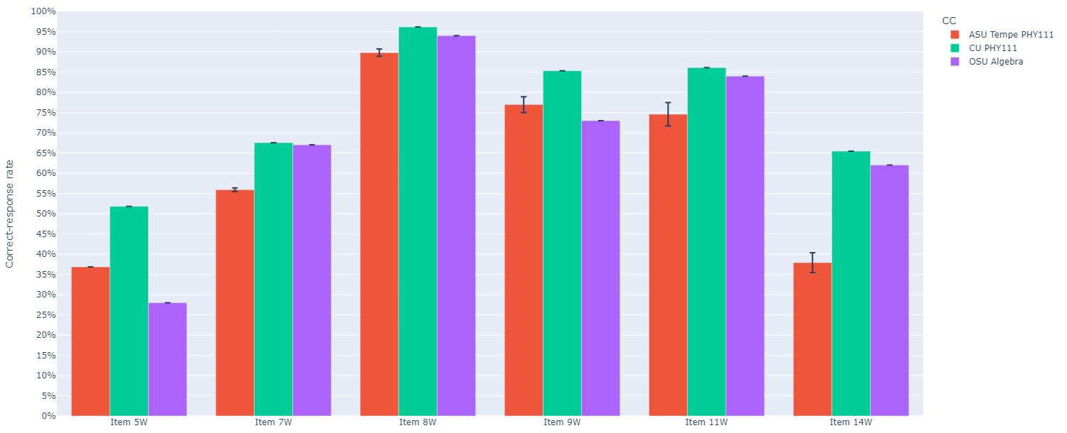
Correct-response rates: algebra-based course
ASU Tempe (N>500)
CU (N>350)
OSU (N>500)

Slide 26
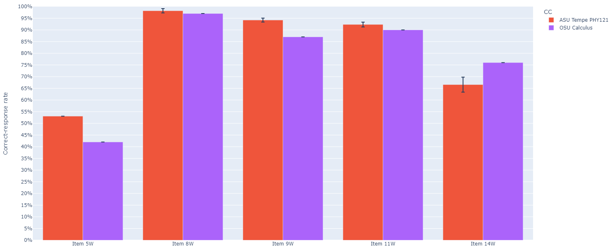
Correct-response rates: calculus-based course
ASU Tempe (N>500)
OSU (N>500)

Slide 27
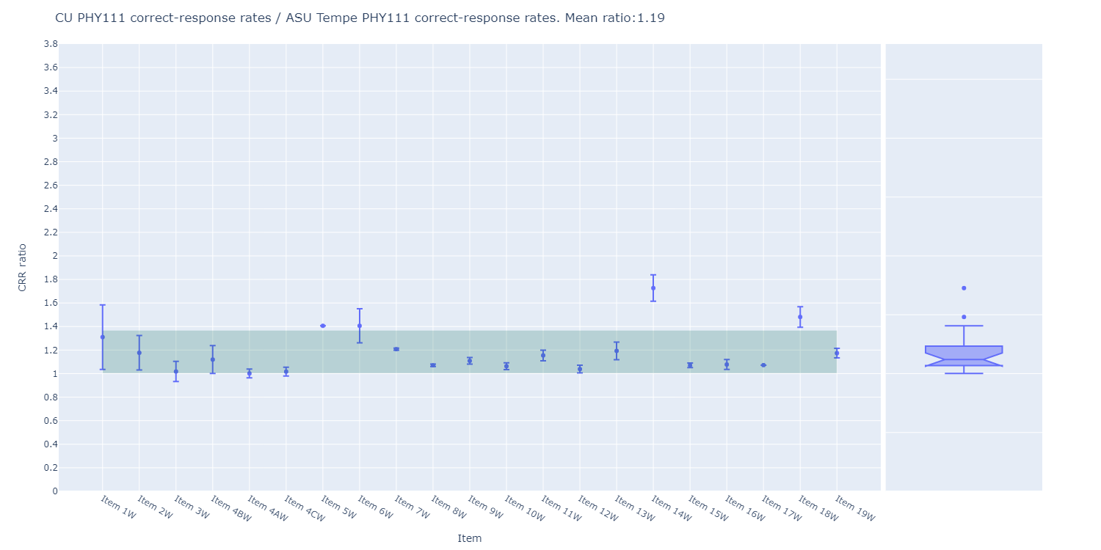
Algebra-based Course:
CU-Boulder students consistently averaged 19% higher scores than ASU-Tempe students

Slide 28
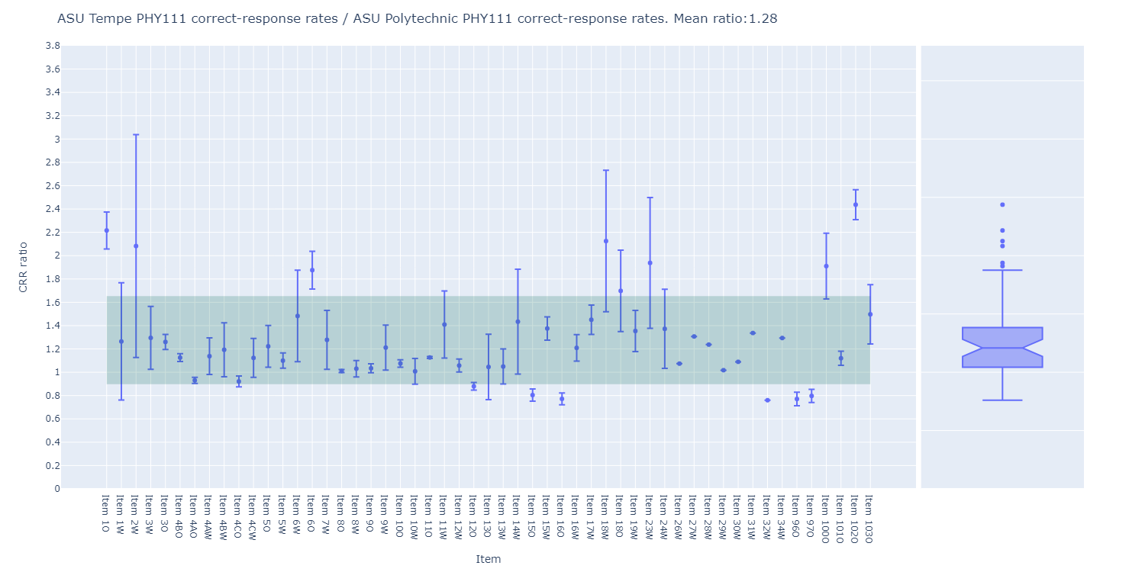
Algebra-based Course:
ASU-Tempe students consistently averaged 28% higher scores than ASU-Poly students

Slide 29
Some Sample Results

Slide 30
Students show weakness with units and graphing
Many students ignored graph-axis labels, and provided no or incorrect units for area and velocity.

Slide 31
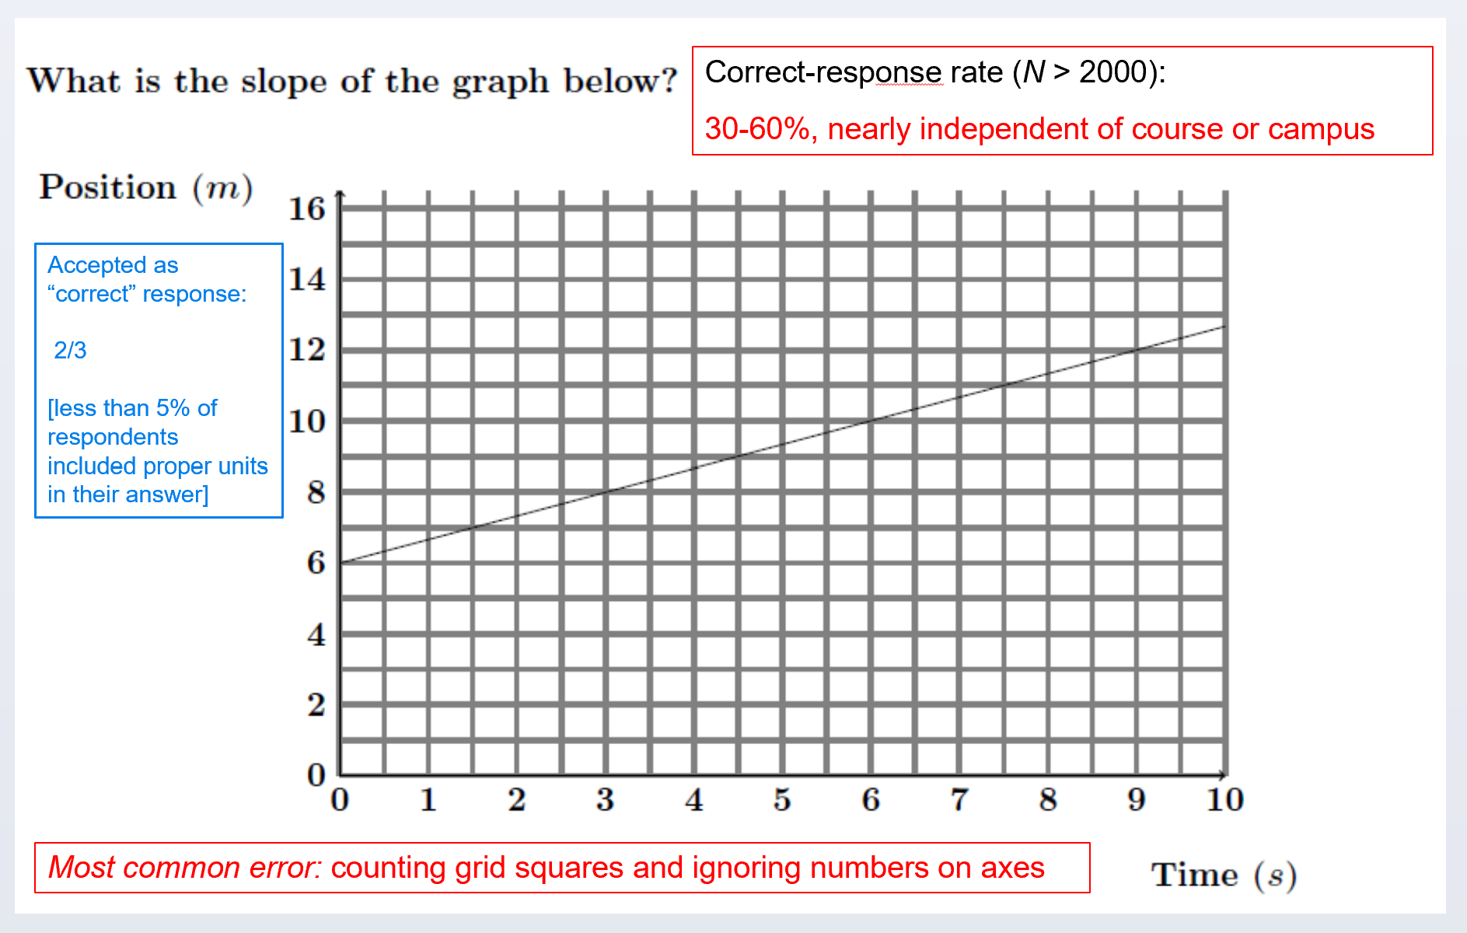

Slide 33
Most common error: Counting grid squares and ignoring numbers on axes

Slide 34
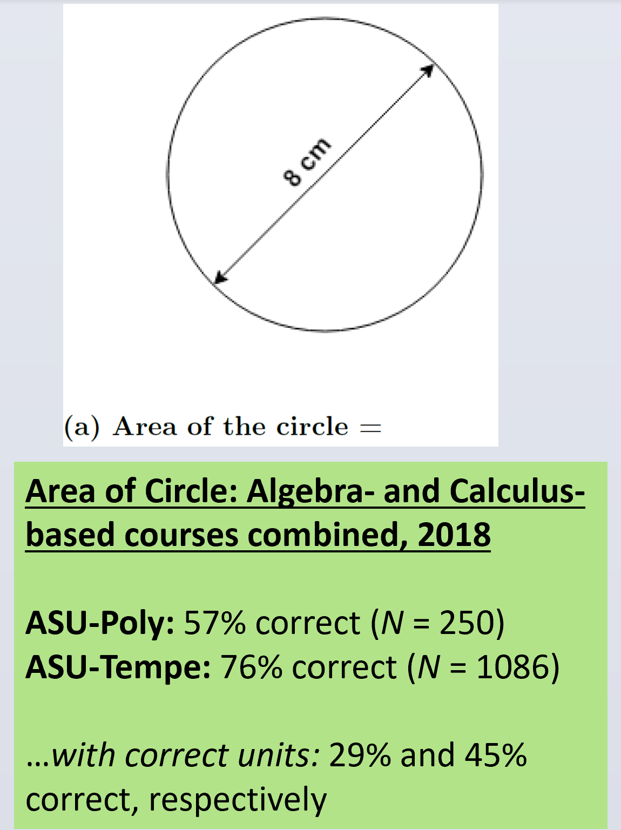

Slide 36
 | N | Numerically correct | Correct with correct units
ASU-Polytechnic | 250 | 57% | 29%
ASU-Tempe | 1086 | 76% | 45%

Slide 37
 | N | Numerically correct | Correct with correct units
ASU-Polytechnic | 250 | 57% | 29%
ASU-Tempe | 1086 | 76% | 45%

Slide 38
 | N | Numerically correct | Correct with correct units
ASU-Polytechnic | 250 | 57% | 29%
ASU-Tempe | 1086 | 76% | 45%

Slide 39
On-line Version

Slide 40
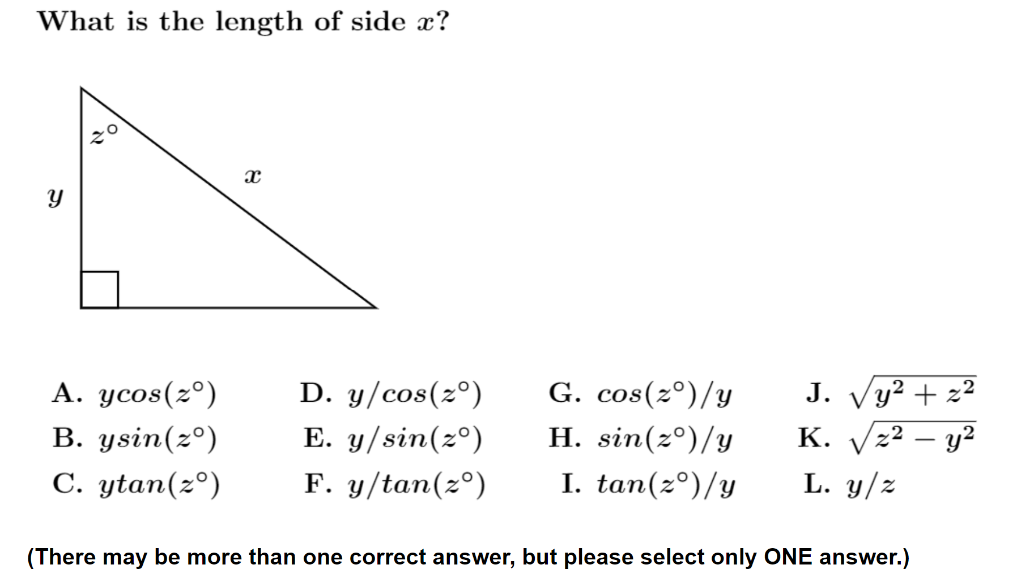
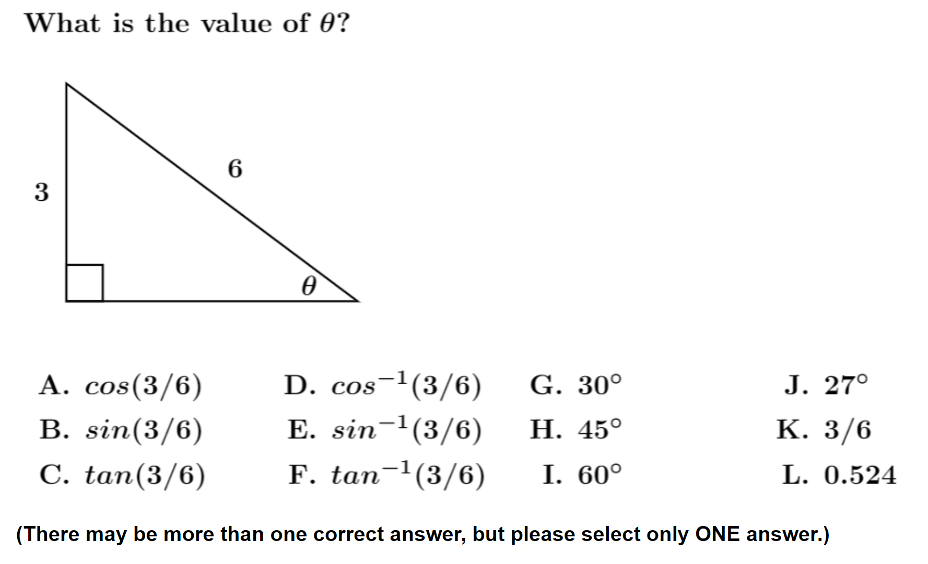
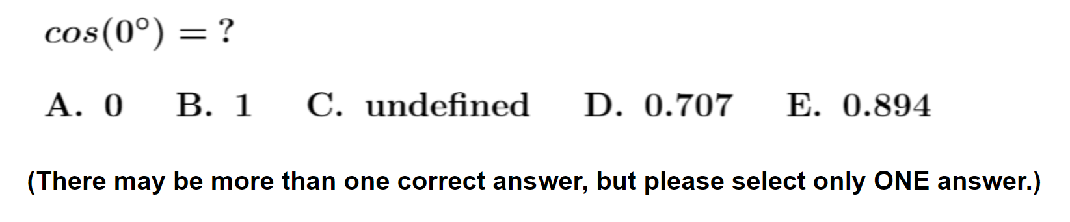
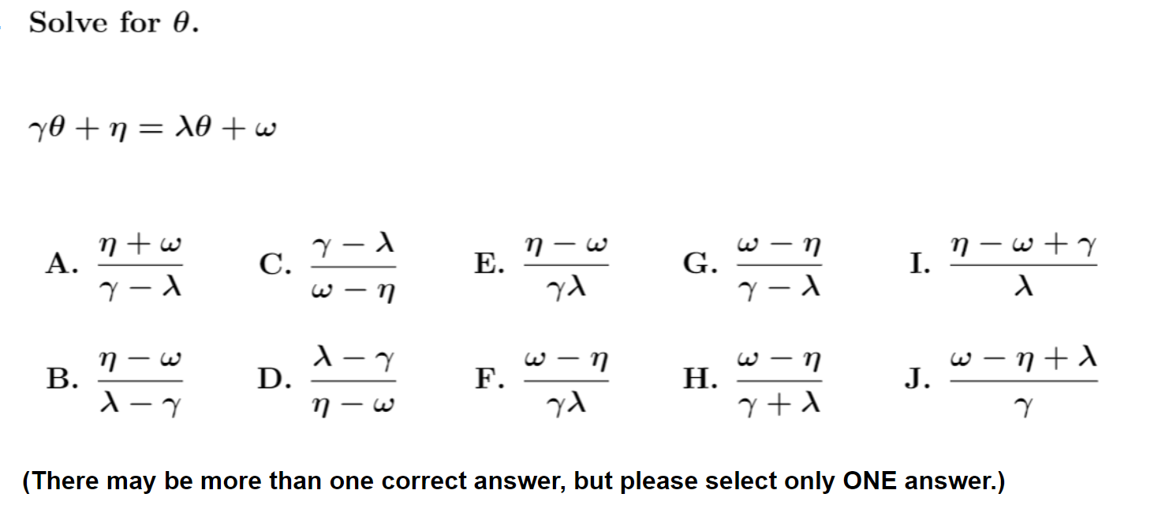
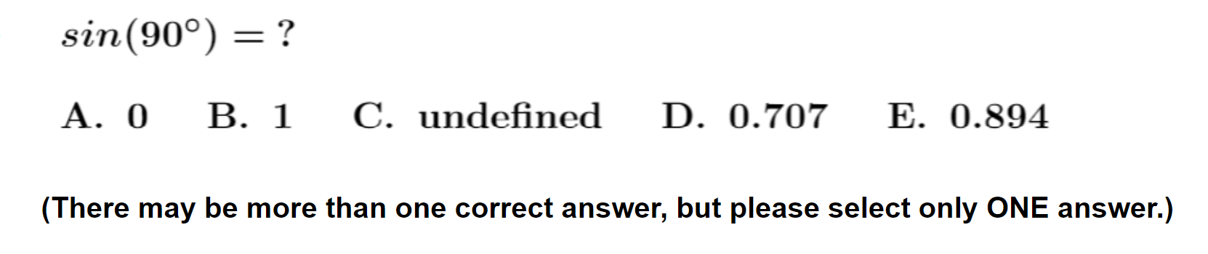
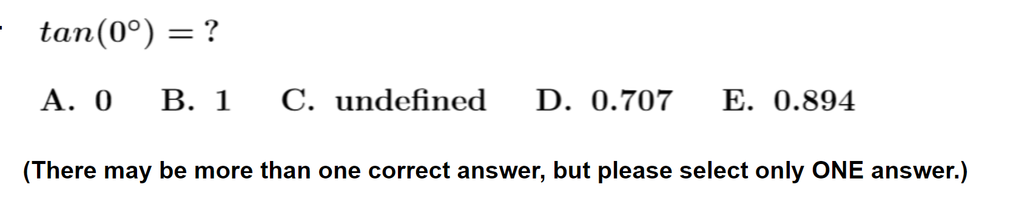

Slide 41
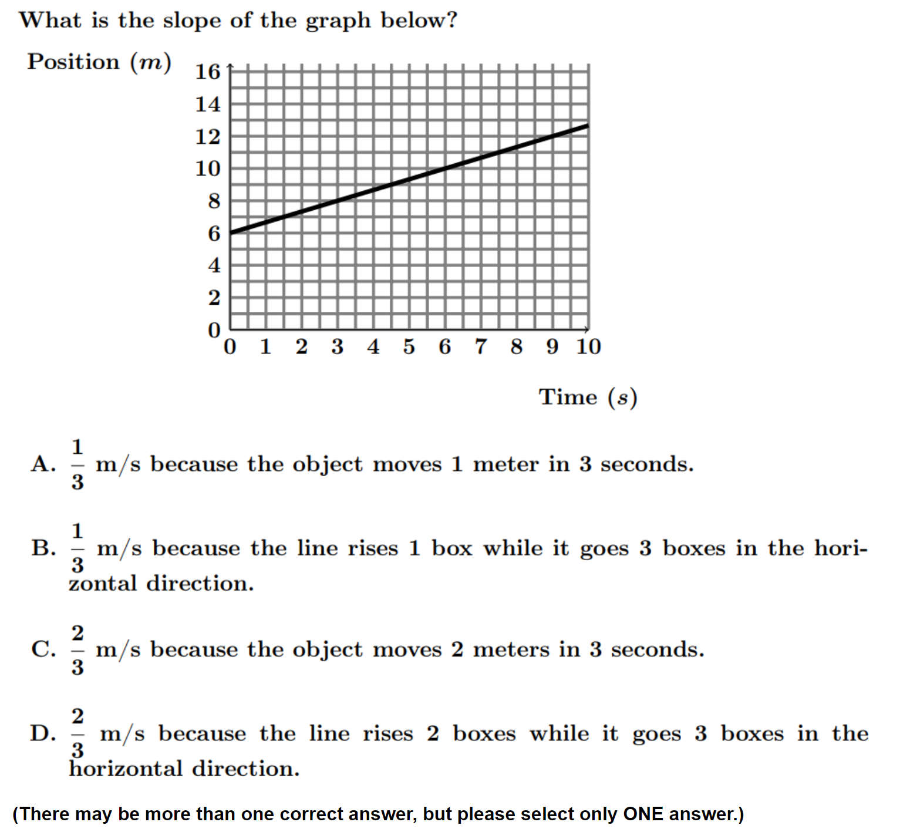
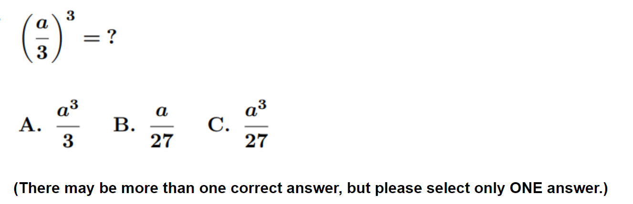
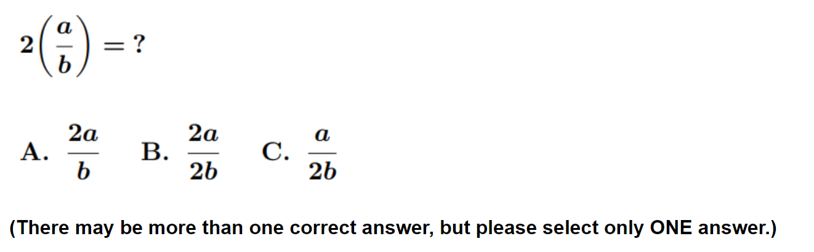
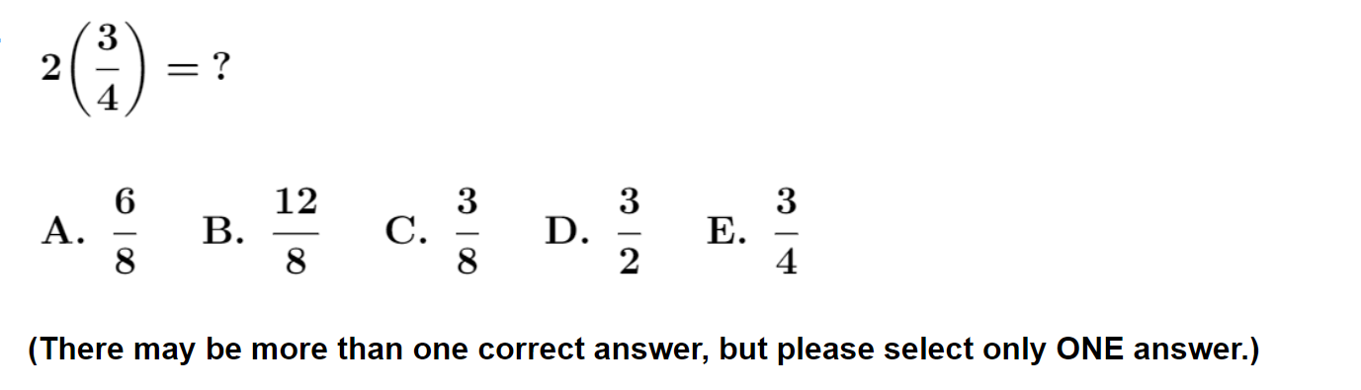
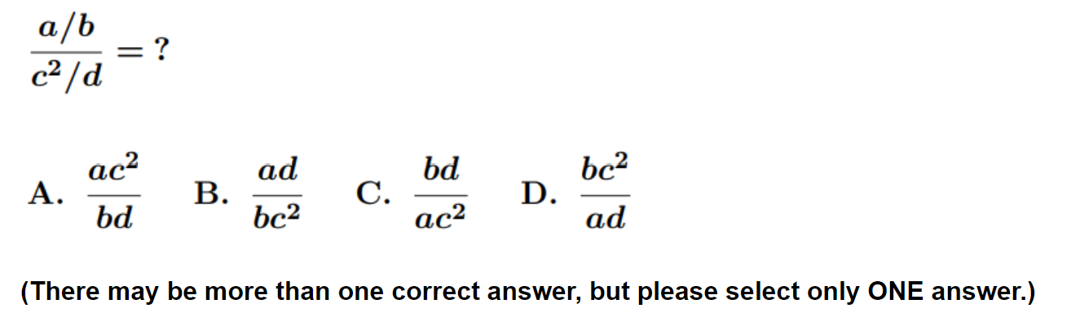

Slide 42
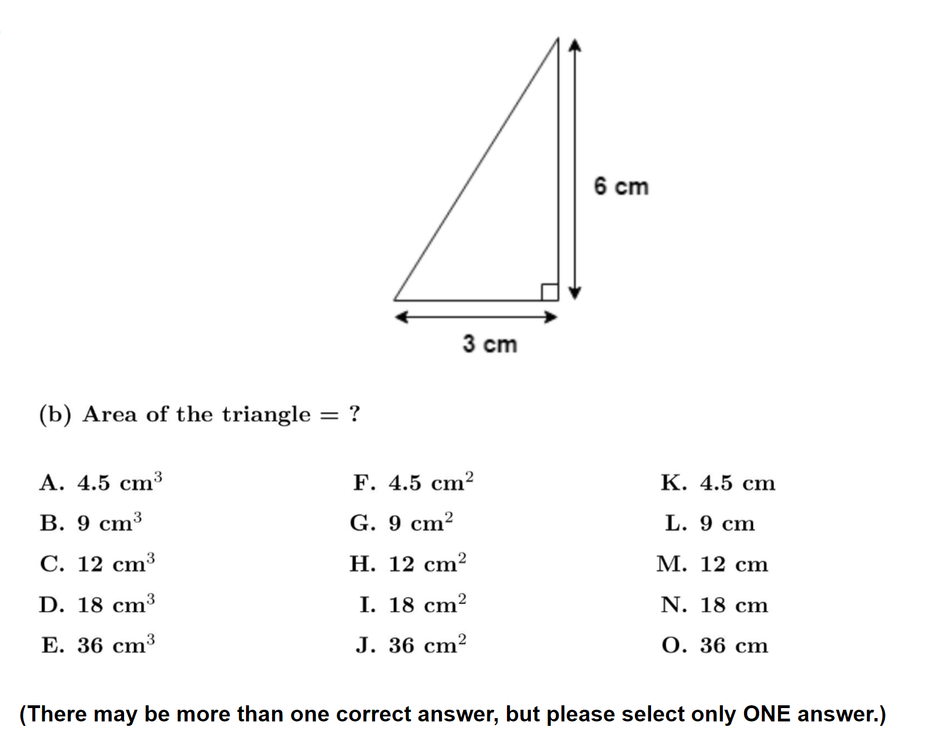
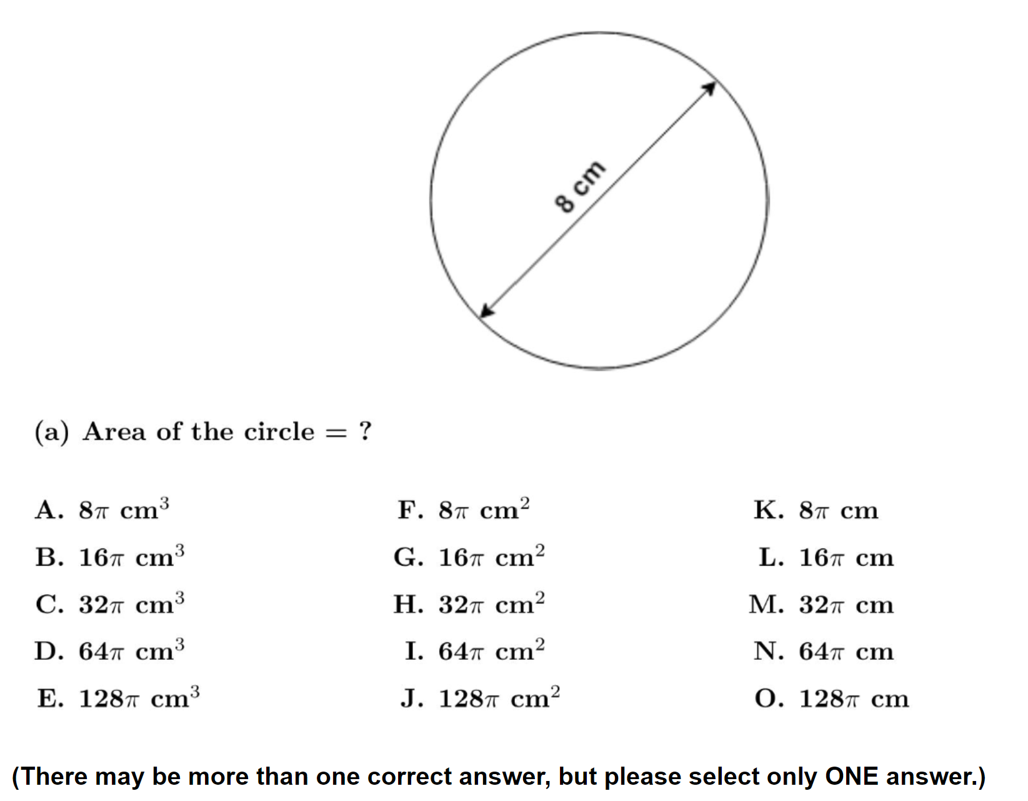
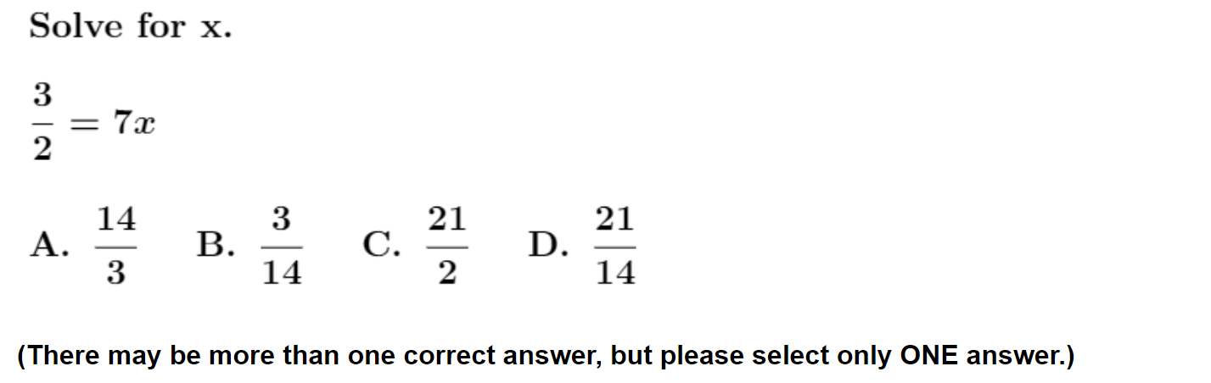
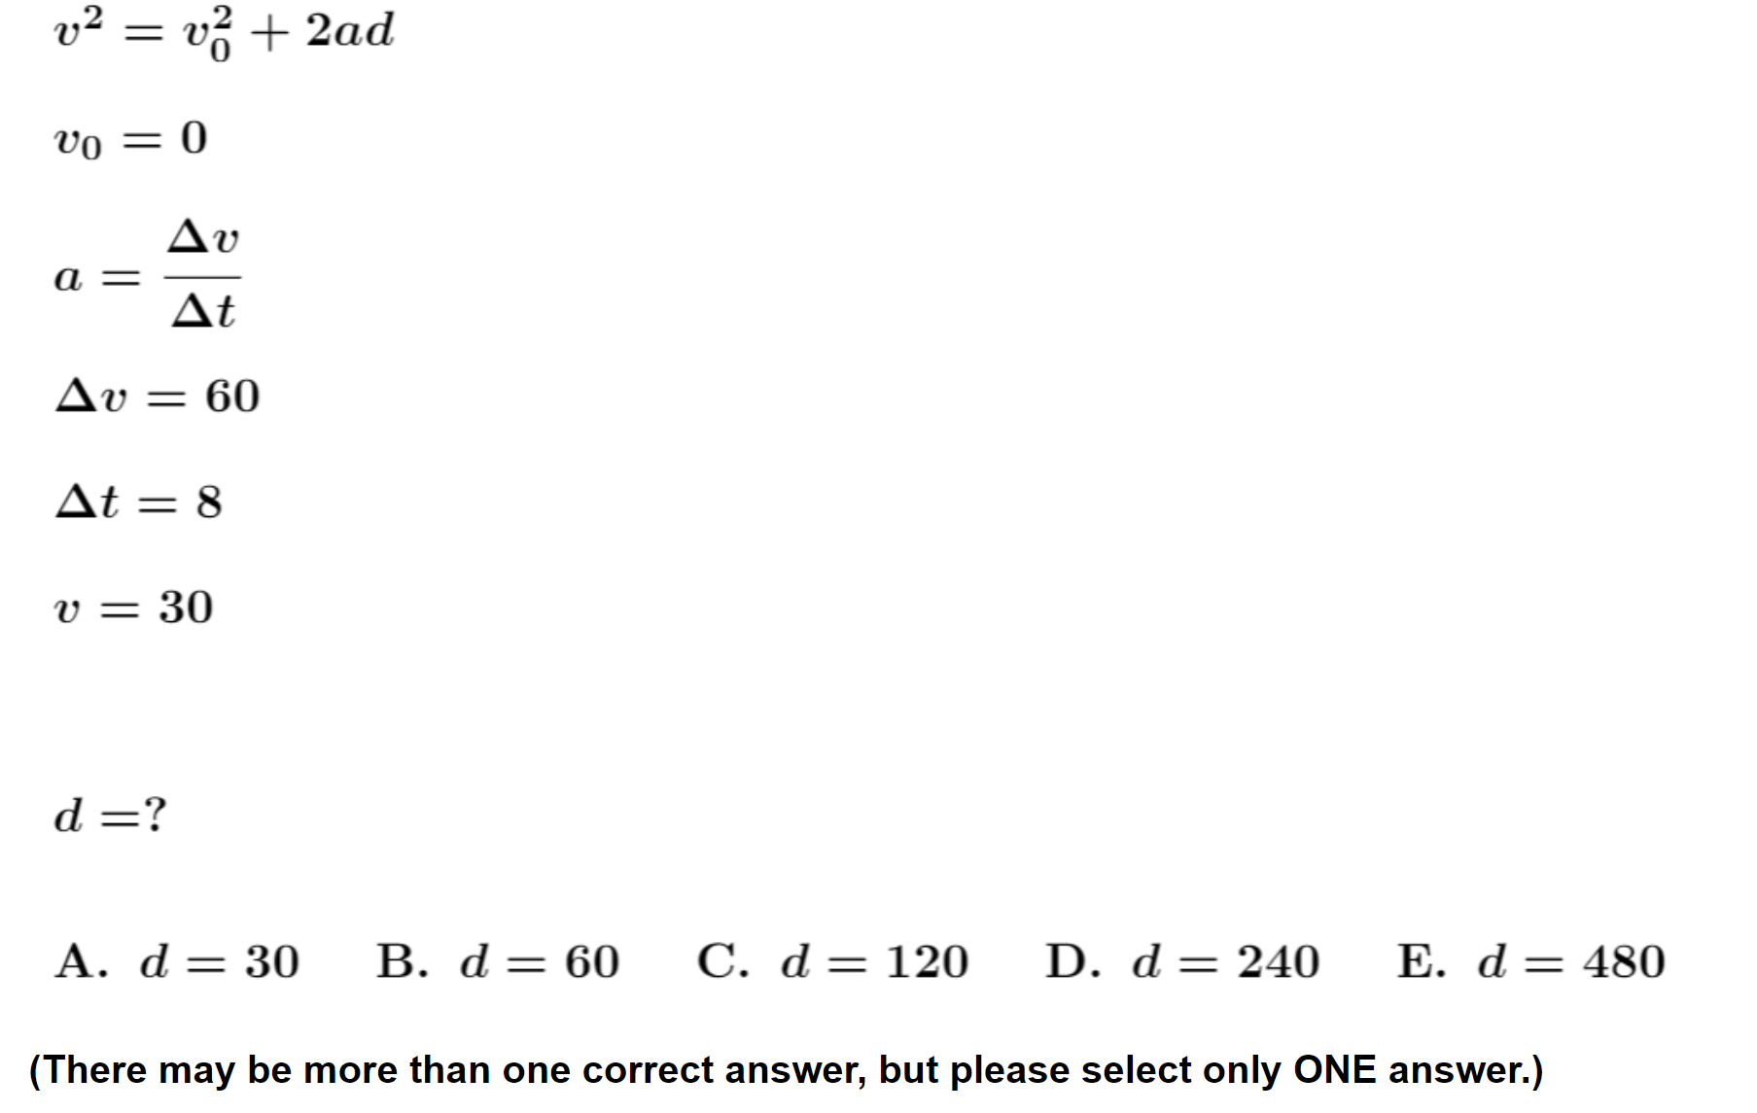
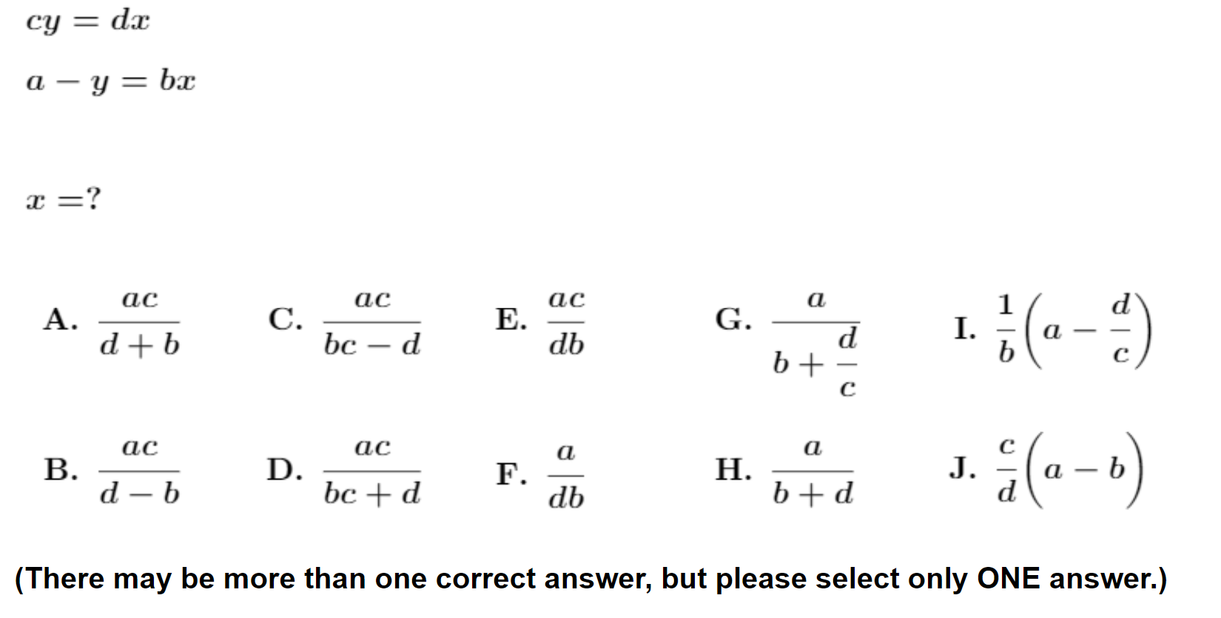

Slide 43

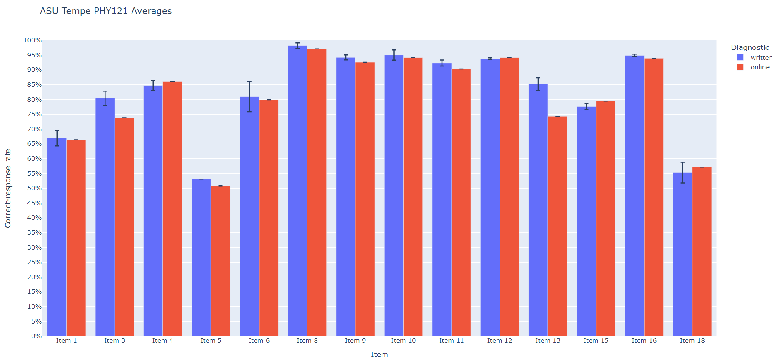
On-line and written versions yield consistent results
written online

Slide 44
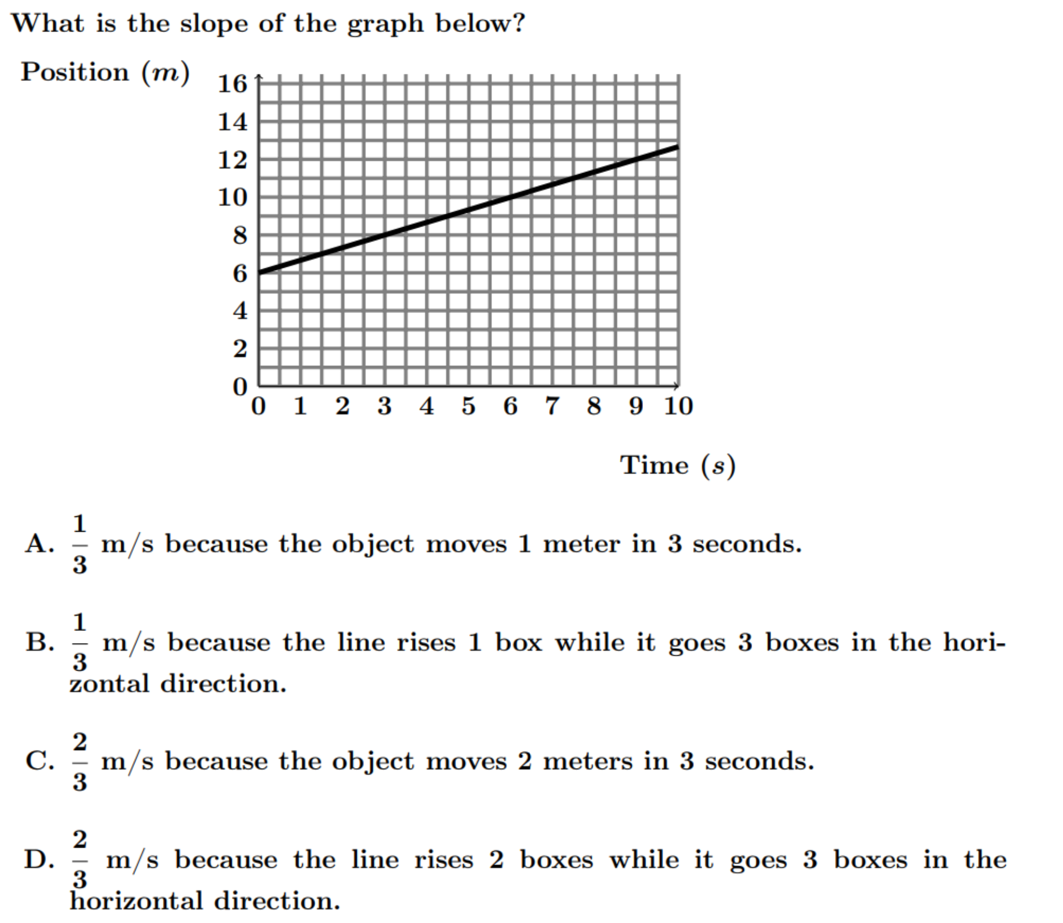
N = 2556
Numerically correct (C or D): 59%
Actually correct (C): 48%
Consistent with results on written version
Most common error: Counting grid squares and ignoring numbers on axes

Slide 45
Findings from >70 Interviews:
Students make many “careless” errors
During interviews, students tended to self-correct approximately 60% of their initial errors with little or no prompting, suggesting that many errors are “careless.”
These findings suggest that increased focus on improving students’ self-checking behavior might provide significant performance dividends.
  However, studies have shown that making these improvements is quite challenging

Slide 46
1. Understanding of Mathematical Concepts
Recognition of meaning and significance of mathematical operations
Example [trigonometry]: Unknown sides and angles of a right triangle may be found by applying sine, cosine, and tangent functions to known sides and angles
Example [vectors]: Direction of a vector may be defined as the angle with respect to an axis in some fixed coordinate system

Slide 47
1. Understanding of Mathematical Concepts
  Sherin (2001): Students’ understanding of the concepts underlying mathematical problem solving are central to success in physics
    Example [wave phenomena]: Steinberg, Wittmann, and Redish (1997) probed students’ understanding of mathematical concepts related to wave propagation, and developed curricular materials to address the difficulties they observed
    Example [harmonic motion]: Galle and Meredith (2014) developed tutorial worksheets to address students’ confusion with meaning of, for example, x(t ) =15 cm cos (2π f t )
  How to address these problems: Have students practice explaining the meaning of the mathematical expressions (Galle and Meredith, 2014)

Slide 48
1. Understanding of Mathematical Concepts
  Trigonometry: Many students are confused or unaware (or have forgotten) about the relationships between sides and angles in a right triangle.
  Examples: Questions from a diagnostic math test administered to over 7000 students, 2016-2022 (Administered as no-credit quiz during first week labs and/or recitation sections; calculators allowed)

Slide 49
Trigonometry Questions with samples of correct student responses

Slide 50
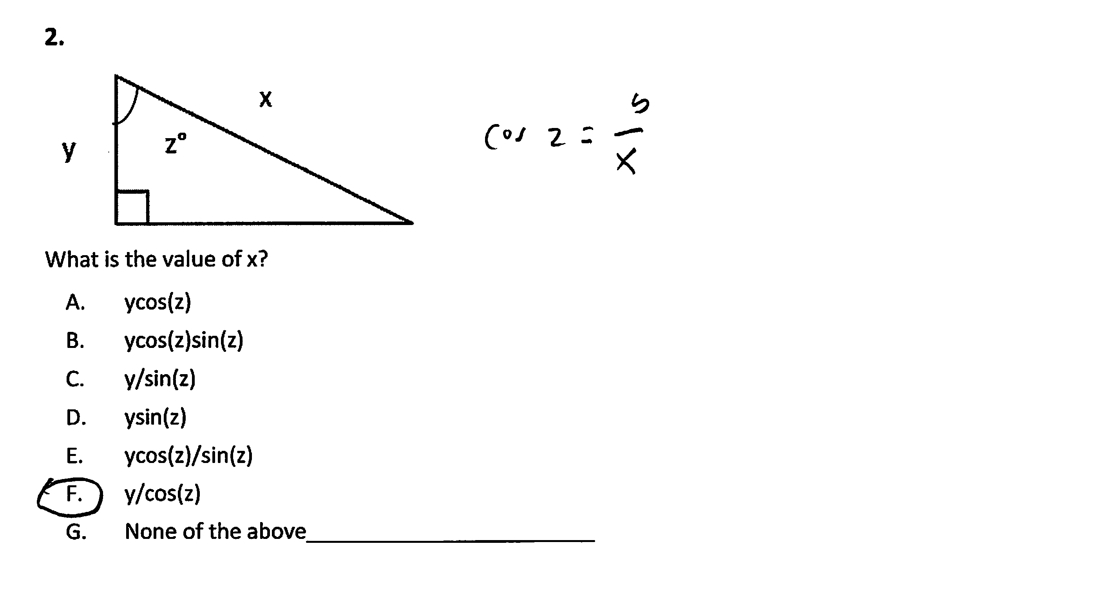

Slide 51
3.

Slide 52
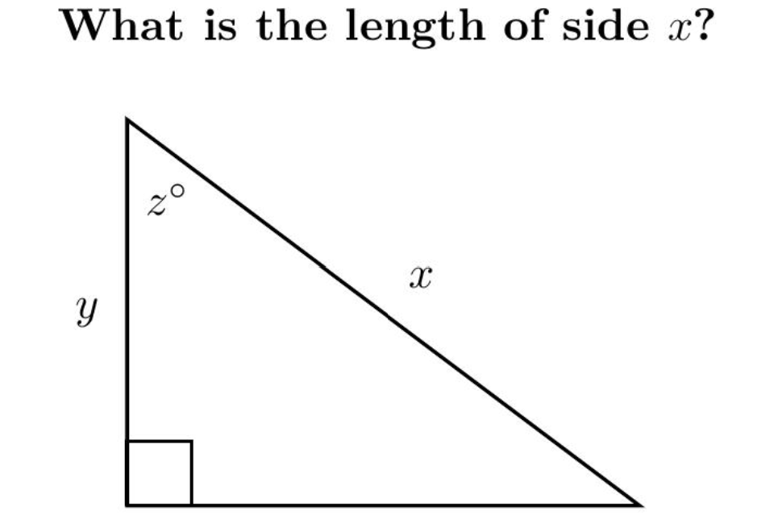

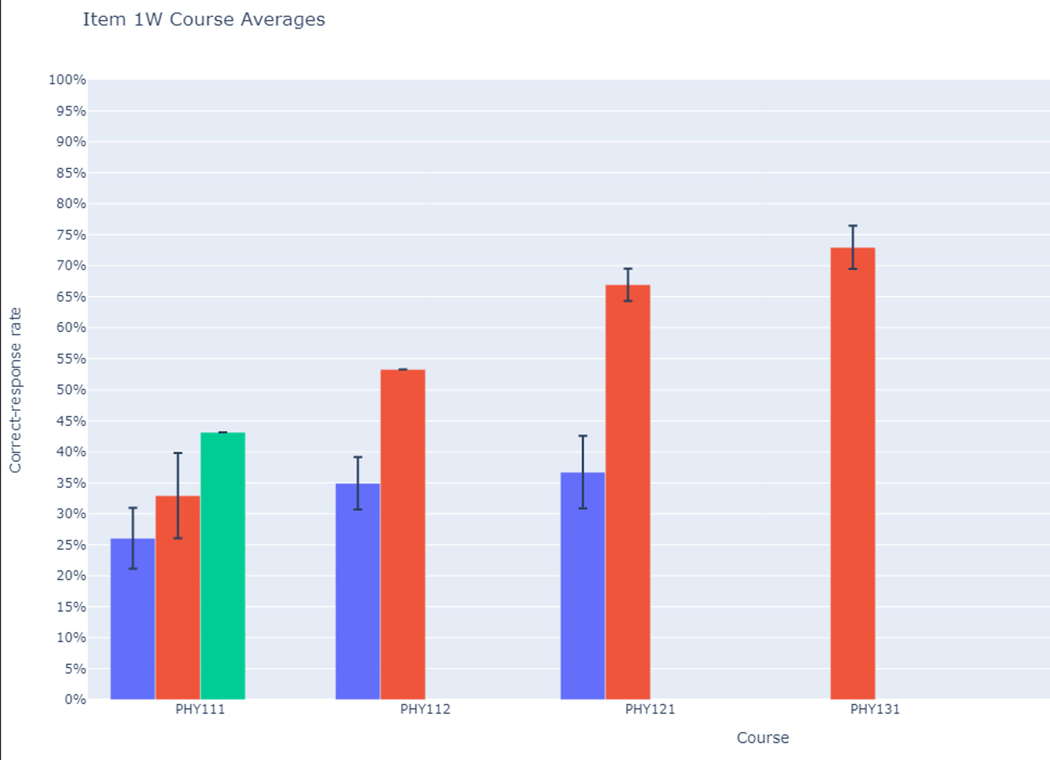
Correct-response rates
(36 classes; N > 3000)
Many results in the 30-60% range
Alg-1
Alg-2
Calc-1
Calc-2

Slide 53
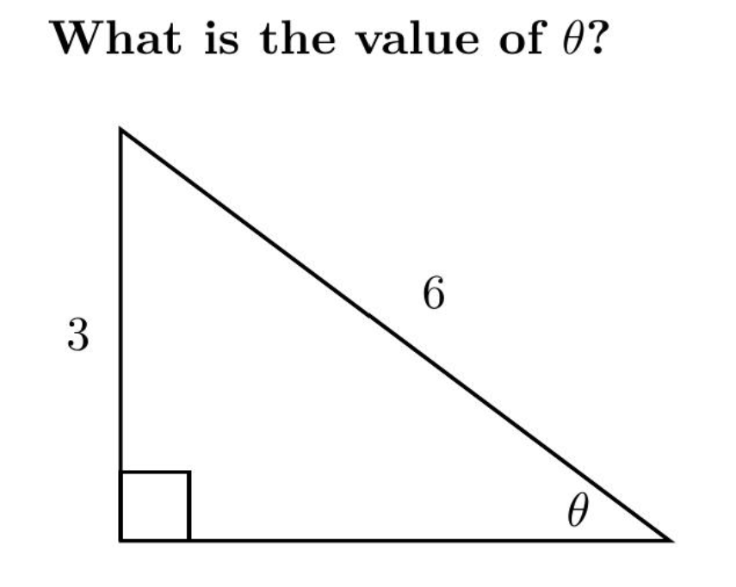
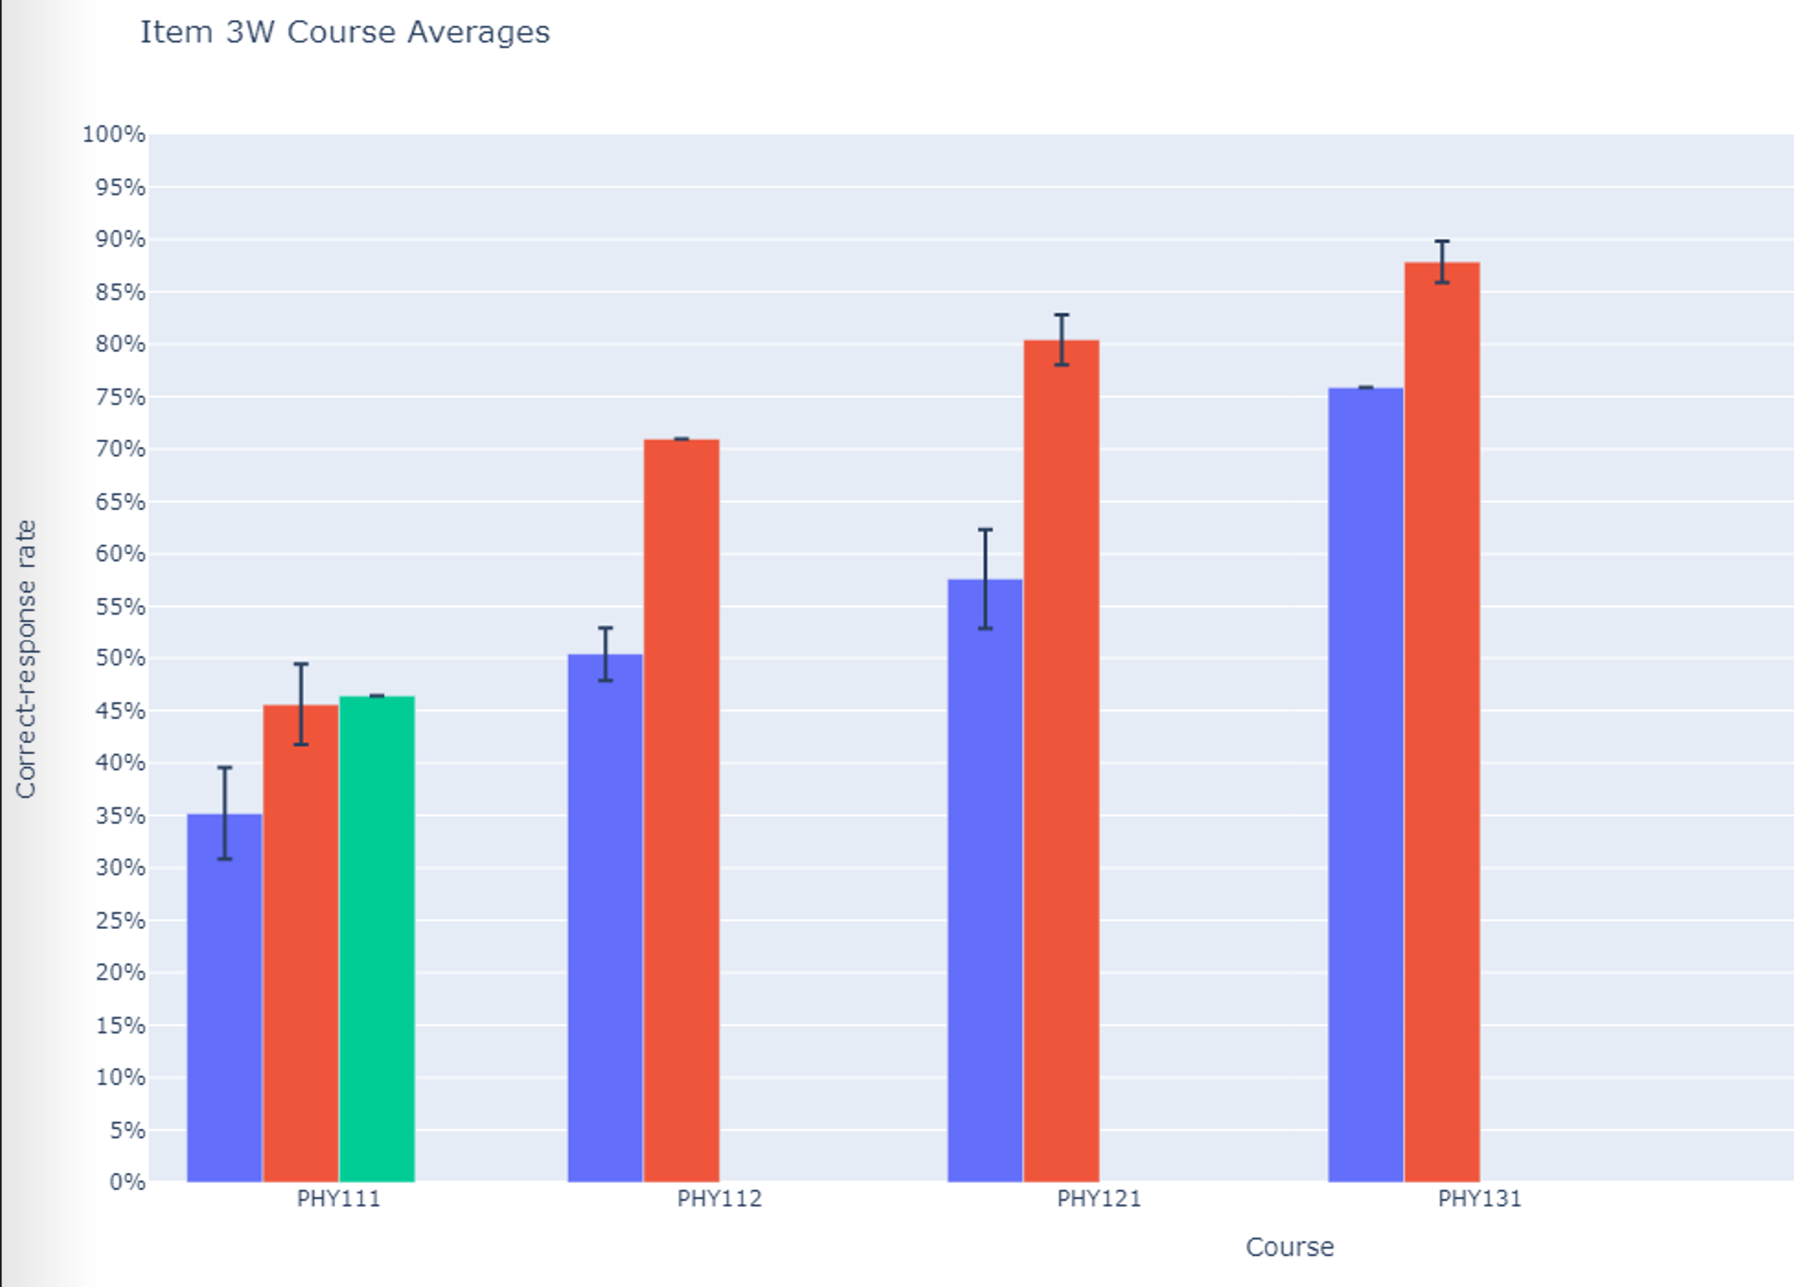
Correct-response rates
(36 classes; N > 3000)
Many results in the 30-60% range
Alg-1
Alg-2
Calc-1
Calc-2
Alg-1
Alg-2
Calc-1
Calc-2

Slide 54
Results on Trigonometry Questions
Errors oberved: use of incorrect trigonometric function (e.g., cosine instead of sine), calculator set on radians instead of degrees, algebra errors; unaware (or forgot) about inverse trigonometric functions, e.g., arctan, arcsin, arccos [tan⁻¹, sin⁻¹, cos⁻¹]
  How to address these problems: It seems that students require substantial additional practice and repetition with basic trigonometric procedures

Slide 55
2. Technical Skill: Vectors
    Vectors: Students have difficulty interpreting and manipulating vector quantities represented as arrows [Nguyen and Meltzer, 2003; Barniol and Zavala, 2014)
      Example: Add (or subtract) vectors A and B to find the resultant
A
B

Slide 56
2. Technical Skill: Vectors
    Vectors: Students have difficulty interpreting and manipulating vector quantities represented as arrows [Nguyen and Meltzer, 2003; Barniol and Zavala, 2014)
      Example: Add (or subtract) vectors A and B to find the resultant
A
B

Slide 57
2. Technical Skill: Vectors
    Vectors: Students have difficulty interpreting and manipulating vector quantities represented as arrows [Nguyen and Meltzer, 2003; Barniol and Zavala, 2014)
      Example: Add (or subtract) vectors A and B to find the resultant
A
B
A + B

Slide 58
Addition of Vectors
(Free Response)

Slide 59
Addition of Vectors
(Free Response)

Slide 60
Addition of Vectors
Percent Correct Responses (Free Response)
Algebra-based Course, 2nd semester (ASU-Tempe): 36% (N = 61)
Algebra-based Course, 2nd semester (Iowa State): 44% (N = 201)

Slide 61
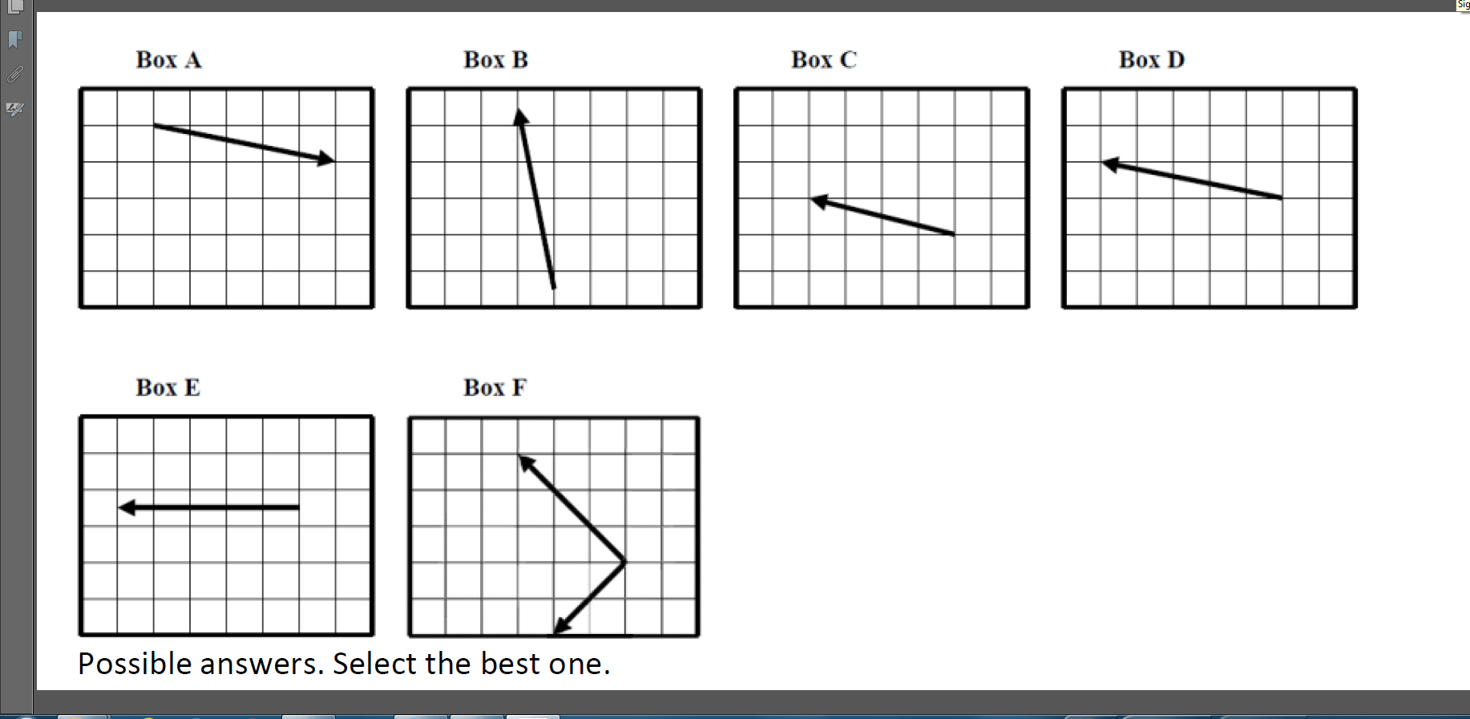
Addition of Vectors
Multiple Choice
X
✓

Slide 62
Addition of Vectors
Percent Correct Responses (Multiple Choice)
Algebra-based Course, 2nd semester (ASU-Tempe): 27% (N = 62)
X
✓

Slide 63
Addition of Vectors
Percent Correct Responses (Multiple Choice)
Algebra-based Course, 2nd semester (ASU-Tempe): 27% (N = 62)
Calculus-based Course, 1st semester (ASU-Tempe): 70% (N = 98)
X
✓

Slide 64
Common Student Errors With Vector Addition
“Split the Difference” or “Bisector Vector”:
“Tip-to-Tip”:
+
=
=
+

Slide 65
2. Technical Skill: Vectors
    Vectors: Students have difficulty interpreting and manipulating vector quantities represented as arrows [Nguyen and Meltzer, 2003; Barniol and Zavala, 2014)
    How to address this problem:
      Practice with a variety of vector orientations; introduce and use the “ijk” coordinate representation for vectors (Heckler and Scaife, 2015)
      Provide extensive on-line practice and homework assignments related to frequently used vector procedures (Mikula and Heckler, 2017)
      Design tutorial worksheet to aid students’ understanding (Barniol and Zavala, 2016)

Slide 66
2. Technical Skill: Symbols
    “Language mismatches”: Students are confused by the very different symbols and techniques used in physics classes, for identical operations first seen in mathematics classes (Dray and Manogue, 1999-2004)
    Unfamiliar symbols: Students are often confused by new symbols or representations used in physics that are not used in mathematics classes, e.g., “arrow” representation of electric fields and gravitational forces; motion graphs (velocity-time, acceleration-time); “flux” [Φ] of electric field through a surface [Meltzer, 2005; Gire and Price, 2013]

Slide 67
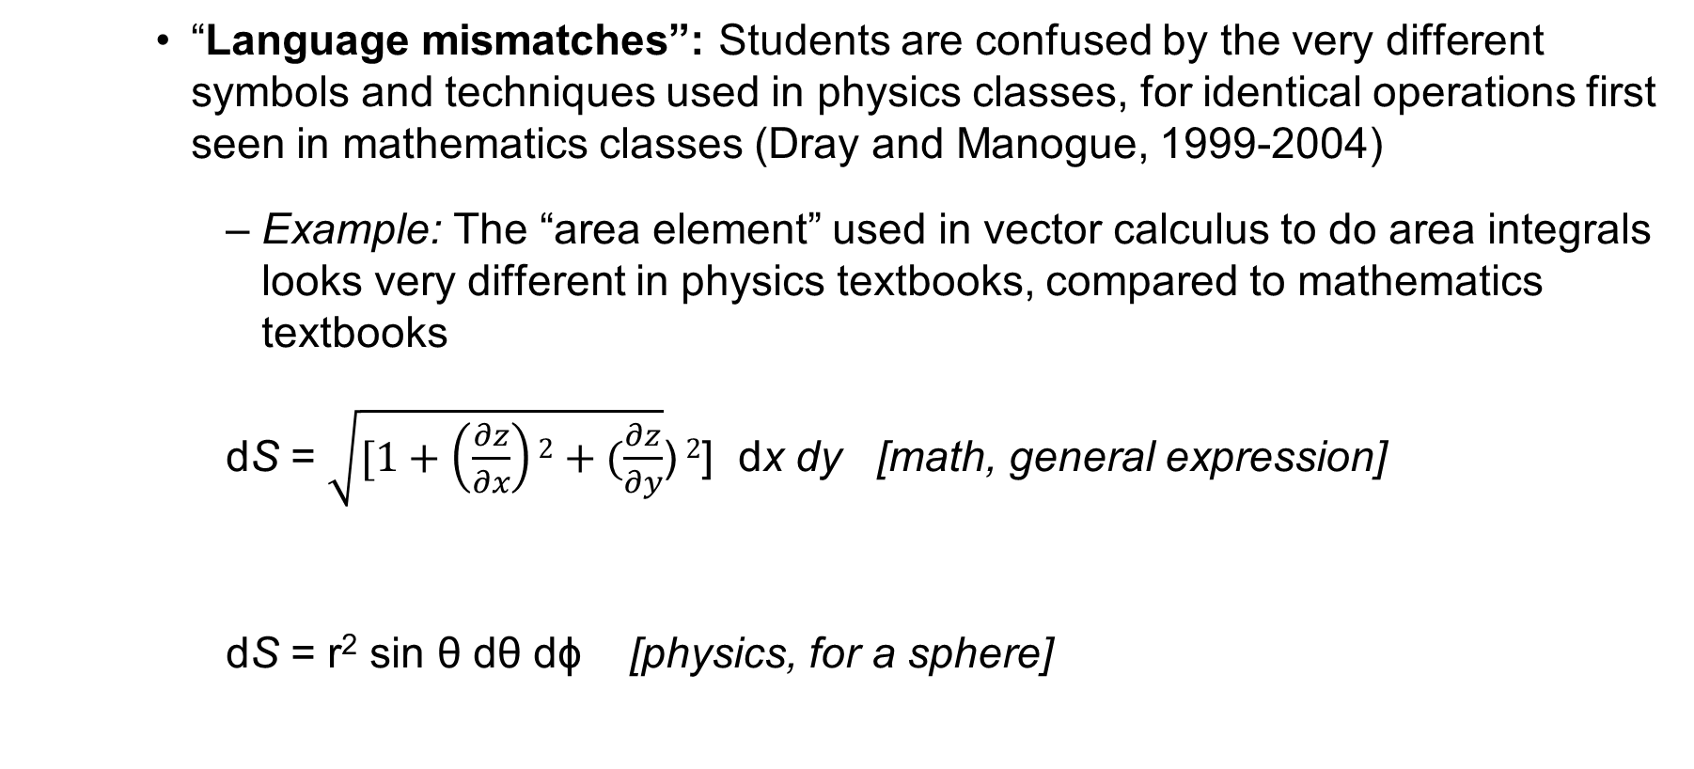
2. Technical Skill: Symbols
    “Language mismatches”: Students are confused by the very different symbols and techniques used in physics classes, for identical operations first seen in mathematics classes (Dray and Manogue, 1999-2004)
      Example: The “area element” used in vector calculus to do area integrals looks very different in physics textbooks, compared to mathematics textbooks
      dS = $\sqrt{[1+\left(\frac{∂z}{∂x}\right)2+(\frac{∂z}{∂y}}$) $2$] dx dy [math, general expression]
      dS = r² sin θ dθ dϕ [physics, for a sphere]

Slide 68
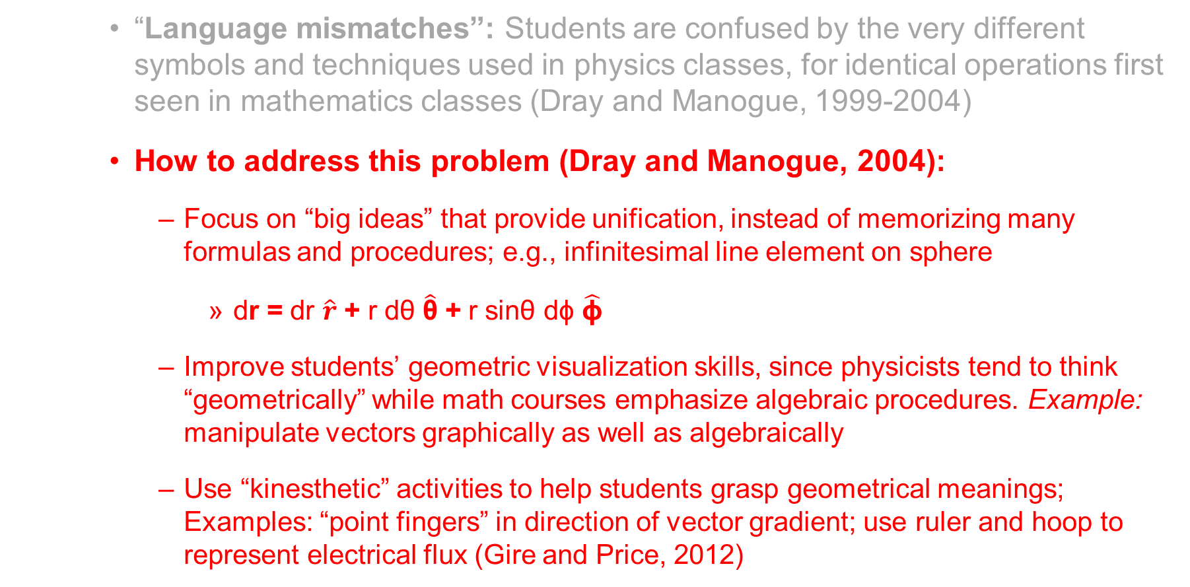
2. Technical Skill: Symbols
    “Language mismatches”: Students are confused by the very different symbols and techniques used in physics classes, for identical operations first seen in mathematics classes (Dray and Manogue, 1999-2004)
    How to address this problem (Dray and Manogue, 2004):
      Focus on “big ideas” that provide unification, instead of memorizing many formulas and procedures; e.g., infinitesimal line element on sphere
        dr = dr $\hat{r}$ + r dθ $\hat{\text{θ}}$ + r sinθ dϕ $\hat{\text{ϕ}}$
      Improve students’ geometric visualization skills, since physicists tend to think “geometrically” while math courses emphasize algebraic procedures. Example: manipulate vectors graphically as well as algebraically
      Use “kinesthetic” activities to help students grasp geometrical meanings; Examples: “point fingers” in direction of vector gradient; use ruler and hoop to represent electrical flux (Gire and Price, 2012)

Slide 69
2. Technical Skill: Symbols
    Unfamiliar symbols: Students are often confused by new symbols used in physics that are not used in mathematics classes, e.g., “arrow” representation of electric fields and gravitational forces [Meltzer, 2005); Gire and Price, 2013]
    How to address this problem:
      Ensure that students have ample practice with representations used specifically in physics (e.g., diagrams, graphs, charts);
      Include practice in “translating” between different representations (e.g., from “math” to “words” to “graphs”)
      Use “kinesthetic” activities to help students grasp geometrical meanings; Examples: “point fingers” in direction of vector gradient; use ruler and hoop to represent electrical flux

Slide 70
2. Technical Skill: Symbolic Procedures
    Confusion of symbolic meaning: Students perform worse on solving problems when symbols are used to represent common physical quantities in equations [Torigoe and Gladding, 2007; 2011)
    Example [Multiple-choice questions; University of Illinois]:
Version #1: A car can go from 0 to 60 m/s in 8 s. At what distance d from the start at rest is the car traveling 30 m/s?
Version #2: A car can go from 0 to v₁ in t₁ seconds. At what distance d from the start at rest is the car traveling (v₁/2)?
Our results on “stripped-down” versions are analogous, although differences are smaller
[93% correct]
[57% correct]
Much worse!

Slide 71
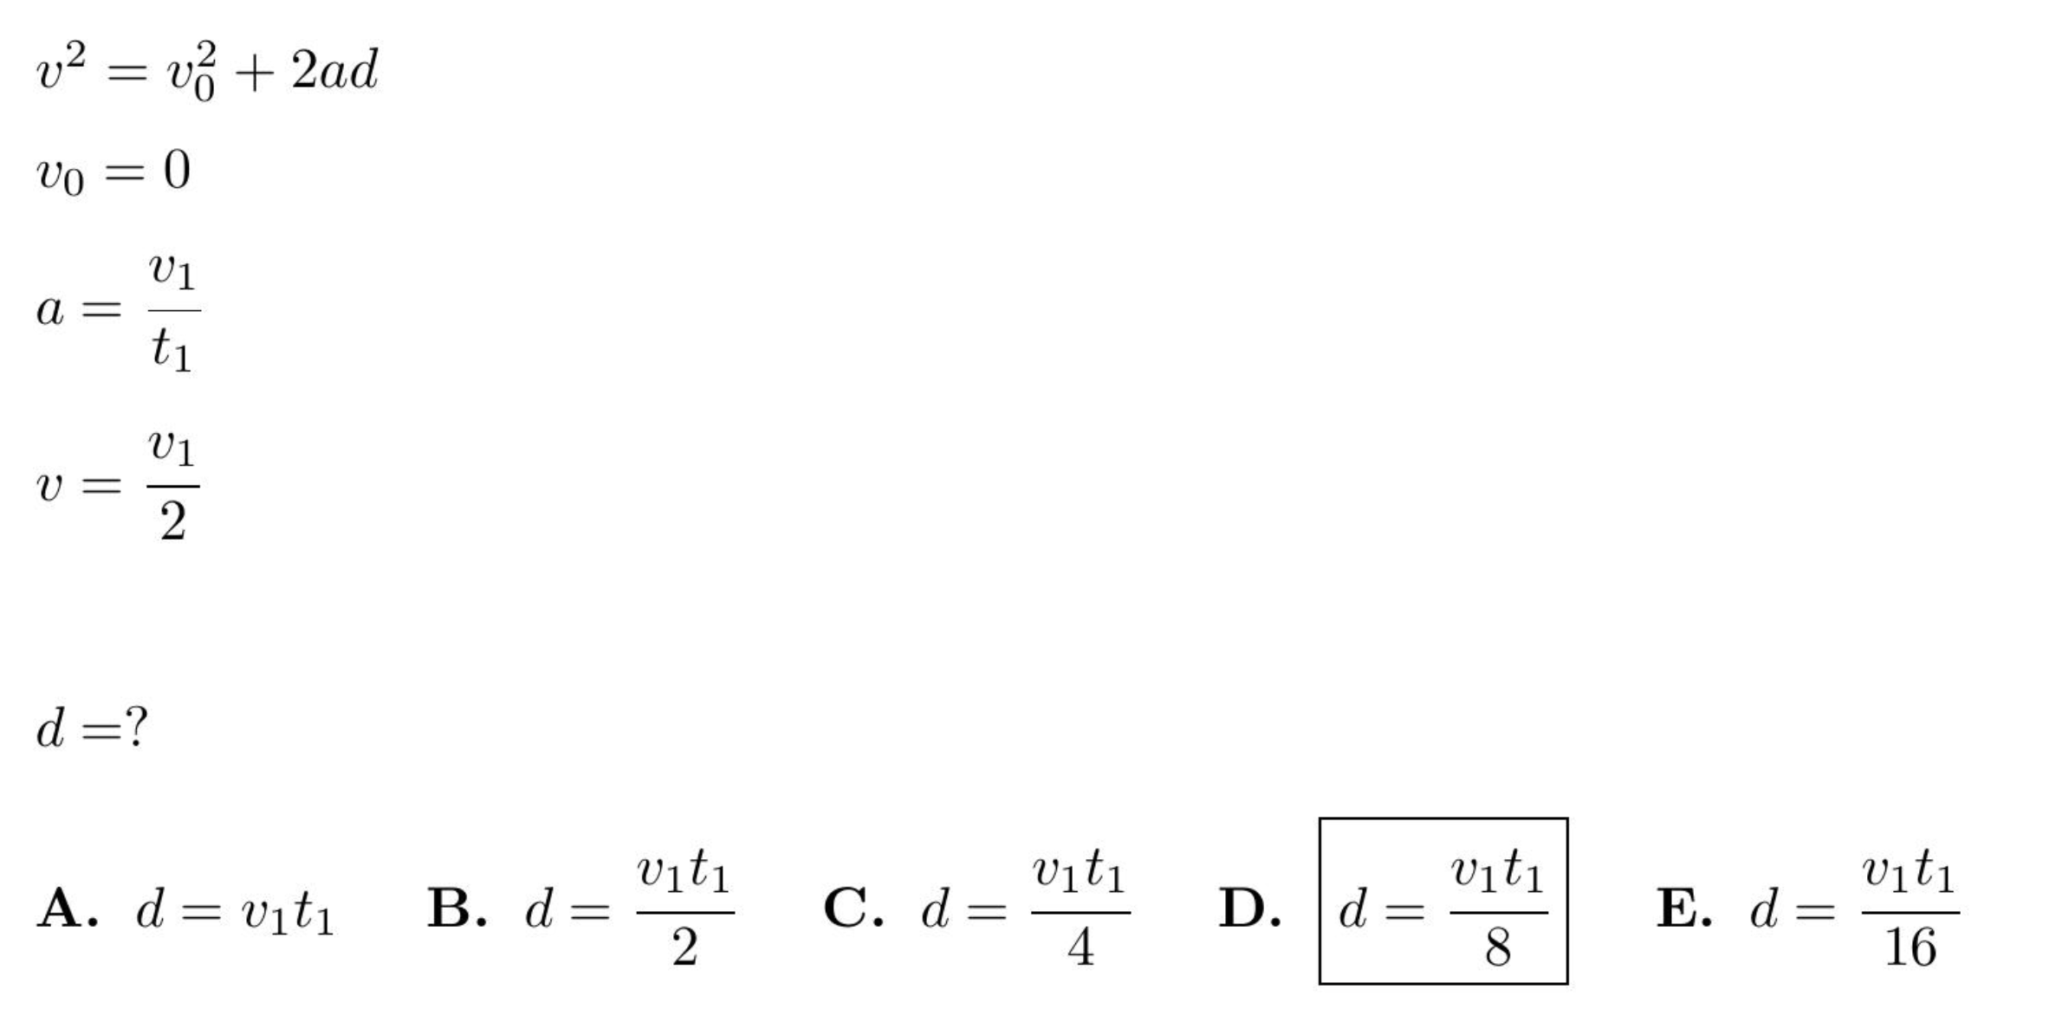
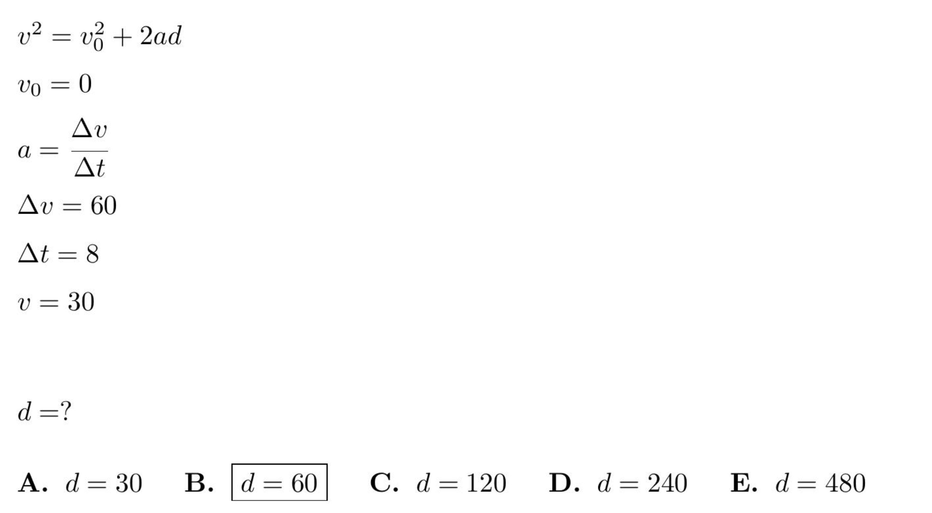
Symbolic version
Numeric version

Slide 72
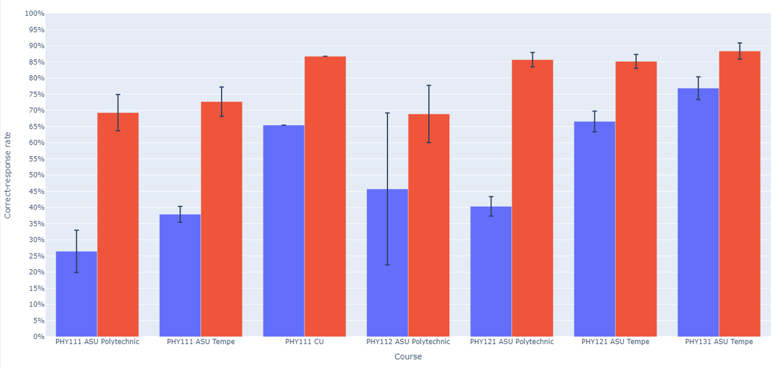
Symbolic version: Numeric version:

Slide 73
Students favor non-standard solution methods
Introductory physics students favor semi-arithmetic methods for solving solve algebraic equations; they do not “isolate the unknown variable.”
  Implication: Physics instructors’ habitual approach to algebraic manipulation may be confusing to their introductory students.

Slide 74
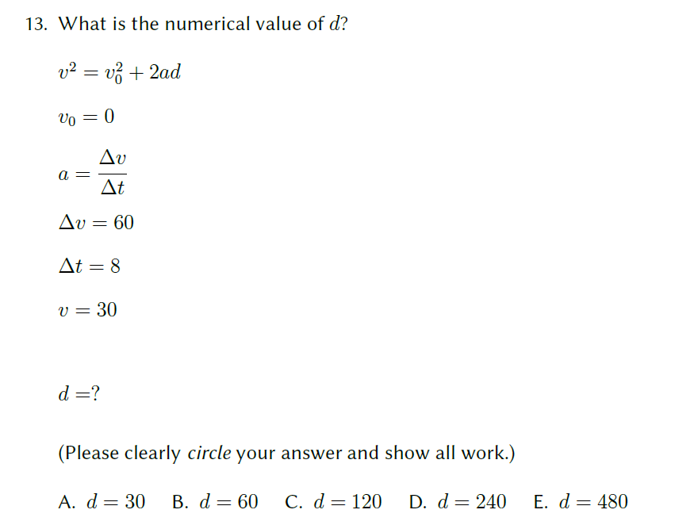
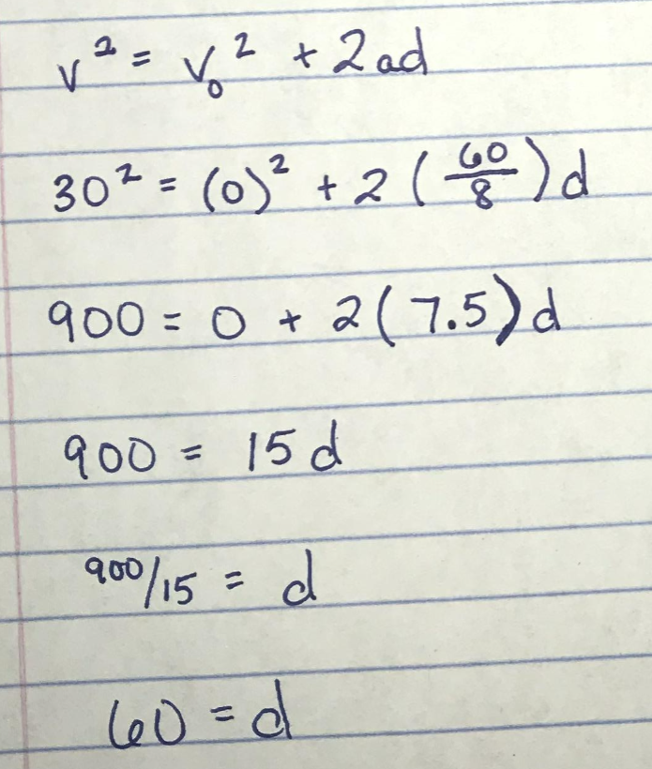
53/53 students solved it this way:
How would you solve this?
We observed these methods used on thousands of students’ submissions

Slide 75
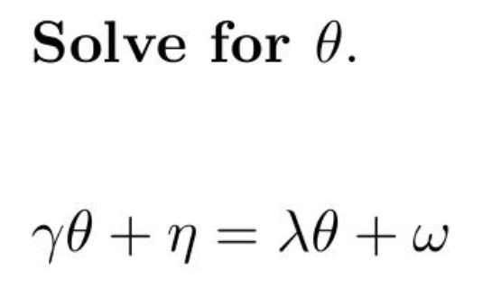
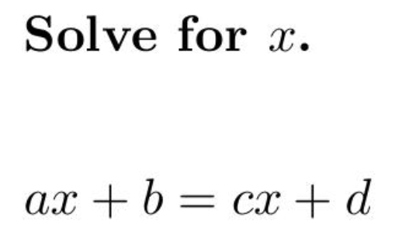
Confusion can result from the nature of the symbols themselves

Slide 76
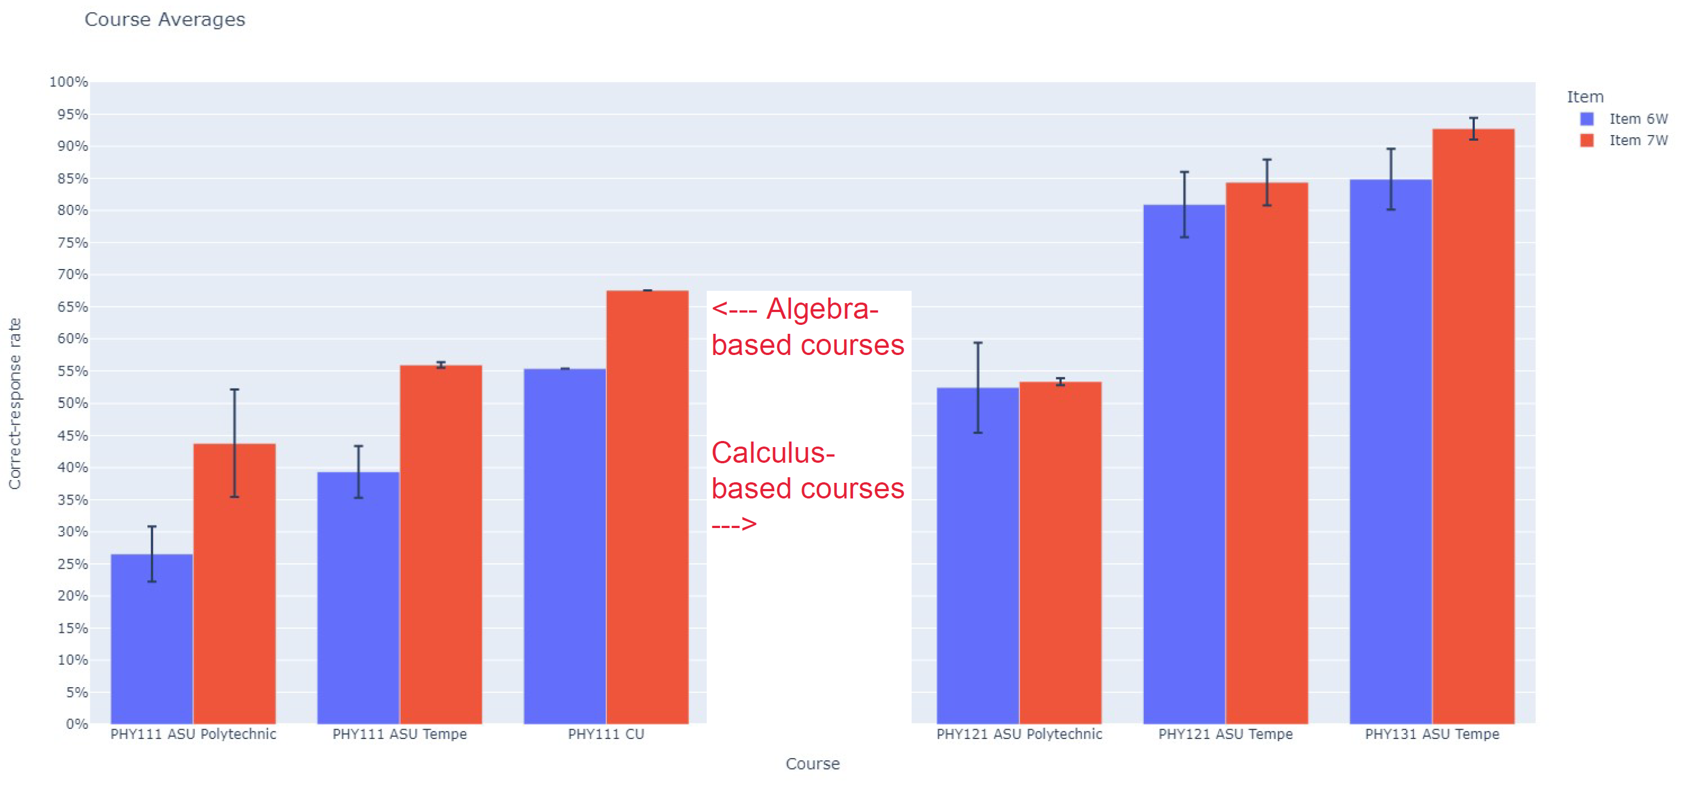
Significantly lower correct-response rates on Greek-letter version in algebra-based courses
(Total N > 1000)

Slide 77
Significantly lower correct-response rates on Greek-letter version in algebra-based courses
(Total N > 1000)

Slide 78
2. Technical Skill: Symbolic Procedures
Algebra (simultaneous equations): Do differences in students’ success rate between numerical and symbolic versions of same problem persist when simultaneous equations are involved? (E.g., two equations, two unknowns)

Slide 79
From Torigoe and Gladding (2011):
Mg − T = Ma
TR = Iα
[I = ½ MR²; α = a/R]
…→
Mg − T = Ma
TR = [½ MR²][a/R]
F_{net} = ma
τ_{net} = I α
g = 9.8 m/s²
a = 6.54 m/s

Slide 80
From Torigoe and Gladding (2011):
Mg − T = Ma
TR = Iα
[I = ½ MR²; α = a/R]
…→
Mg − T = Ma
TR = [½ MR²][a/R]

Slide 81
From Torigoe and Gladding (2011):
Mg − T = Ma
TR = Iα
[I = ½ MR²; α = a/R]
…→
Mg − T = Ma
TR = [½ MR²][a/R]
Symbolic version

Slide 82
From Torigoe and Gladding (2011):
Mg − T = Ma
TR = Iα
[I = ½ MR²; α = a/R]
…→
Mg − T = Ma
TR = [½ MR²][a/R]
a = 2/3 g
Symbolic version

Slide 83
Results on #10
[Torigoe and Gladding, 2011]
Numeric version: 49% correct (N ≈ 380)
Symbolic version: 53% correct (N ≈ 380)
  No significant difference

Slide 84
From Torigoe and Gladding (2011):
Mg − T = Ma
TR = Iα
[I = ½ MR²; α = a/R]
…→
Mg − T = Ma
TR = [½ MR²][a/R]
a = ?
Symbolic version

Slide 85
From Torigoe and Gladding (2011):
Mg − T = Ma
TR = Iα
[I = ½ MR²; α = a/R]
…→
Mg − T = Ma
TR = [½ MR²][a/R]
a = ?
a – y = bx
cy = dx
x =?
Rename to simplify:
“Mg” → “a”
“M” → “b”
“R” → “c”
“½MR” → “d”
“T” → “y”
“a” → “x”
Our Symbolic version

Slide 86
From Torigoe and Gladding (2011):
Mg − T = Ma
TR = Iα
[I = ½ MR²; α = a/R]
…→
Mg − T = Ma
TR = [½ MR²][a/R]
a = ?
78.4 – y = 8x
0.5y = 2x
x =?
Our Numeric version

Slide 87
Results on Our Versions
  Consistent, large, and highly significant difference

Slide 88
Symbolic notation degrades student performance
Use of symbols to replace numbers in otherwise identical algebraic equations lowered correct-response rates by ≈25%.

Slide 89
Algebra: Simultaneous Equations (algebra-based course, ASU-T)
0.5y = 2x
78.4 − y = 8x
[Solve for x]
  Numeric Version 61% correct (N = 470)
cy = dx
a − y = bx
[Solve for x]
  Symbolic Version 55% correct (N = 862)

Slide 90
Algebra: Simultaneous Equations (algebra-based course, ASU-T)
0.5y = 2x
78.4 − y = 8x
[Solve for x]
  Numeric Version 61% correct (N = 470)
cy = dx
a − y = bx
[Solve for x]
  Symbolic Version 31% correct (N = 372)

Slide 91
Algebra: Simultaneous Equations (calculus-based course, ASU-T)
0.5y = 2x
78.4 − y = 8x
[Solve for x]
  Numeric Version 79% correct (N = 1205)
cy = dx
a − y = bx
[Solve for x]
  Symbolic Version 55% correct (N = 862)

Slide 92
Algebra: Simultaneous Equations (calculus-based course, ASU-T)
0.5y = 2x
78.4 − y = 8x
[Solve for x]
  Numeric Version 79% correct (N = 1205)
cy = dx
a − y = bx
[Solve for x]
  Symbolic Version 55% correct (N = 1202)

Slide 93
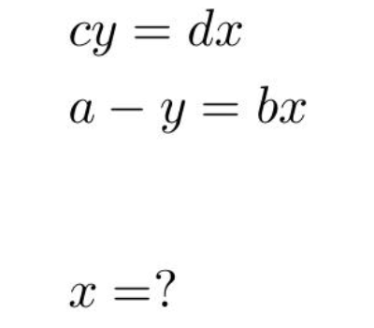
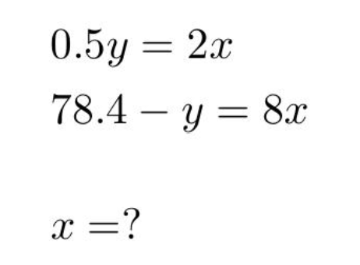
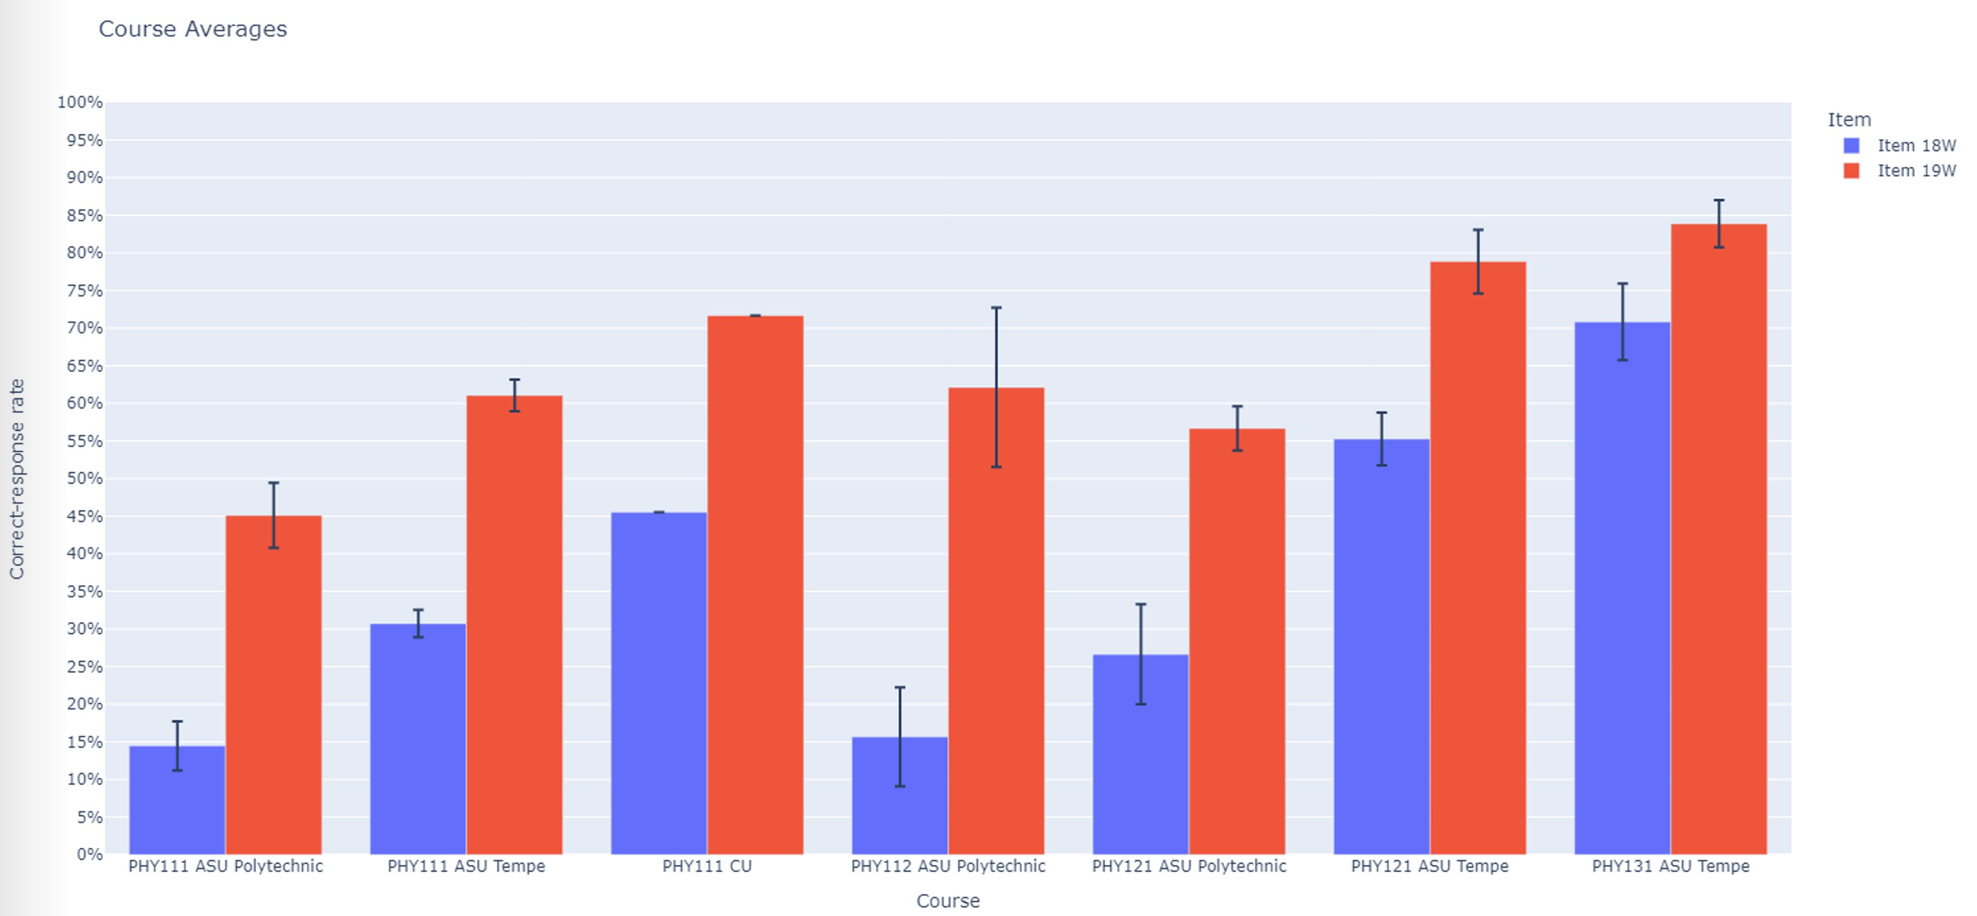

Slide 94
Sources of Difficulties
“Carelessness”
  Students very frequently self-correct errors during interviews
Skill practice deficit: Insufficient repetitive practice with learned skills
  e.g., dividing symbolic fractions
Conceptual confusion
  e.g., not realizing that both sides of an equation must be multiplied or divided by the same symbol

Slide 95
How to Address Difficulties?
Carelessness:
  (1) review and check steps
  (2) find alternative solutions
  (3) habitual use of estimation
  (4) apply dimensional analysis (for physical problems)
Skill deficit: Practice and repetition
Conceptual confusion: Review and study of basic ideas

Slide 96
3. Ability to Apply Mathematics in a Physical Context
Student difficulties that appear to be mathematical in origin may actually be due in part to application in a physical context [Thompson, Manogue, Roundy, and Mountcastle, 2012; Zavala and Barniol, 2013]
Example [calculus]: Finding and comparing the “area under the curve” by applying the definite integral may be more challenging in a thermodynamics context (thermodynamic process represented on a Pressure-Volume diagram) [Christensen and Thompson, 2010-2012]
Example [vectors]: The method used and the errors made by students when adding or subtracting vectors depend strongly on the specific physical context, and on whether there is a physical context [Shaffer and McDermott, 2005; Van Deventer and Wittmann, 2005; Barniol and Zavala, 2010]

Slide 97
3. Ability to Apply Mathematics in a Physical Context
Student difficulties that appear to be mathematical in origin may actually be due in part to application in a physical context
    How to address this problem:
      Mathematics procedures must be practiced in a variety of physical contexts, and students must be made aware of possible confusion introduced by the context

Slide 98
4. Ability to Apply Mathematics in a Problem-Solving Context
Students often fail to make use of specific mathematical tools that they do know how to use, because they don’t recognize their applicability to a physics problem [Bing and Redish, 2009; Gupta and Elby, 2011]
    How to address this problem:
      Vary the physical context, to provide a wide range of possible approaches
      Become aware of how students interpret problems; “exaggerate” cues regarding appropriate solution pathways (Bing and Redish, 2009)

Slide 99
Interim Summary:
What Options do Physics Instructors Have for Dealing with Students’ Mathematics Difficulties?
Test to assess scope of problem
Take time to review basic math
Assign or suggest out-of-class math review practice
  e.g., OSU “Stemfluency” on-line practice tool
Reduce mathematical burden of syllabus
  more qualitative problems, fewer problems requiring algebraic manipulation
Nothing: Leave it up to the students (??)

Slide 100
Caution: Difficulties with one topic implies difficulties with others as well
Students’ scores on different problem types tend to track each other closely: relatively low scores on one type imply relatively low scores on the others
Since scores on different items are correlated with each other, scores on even a single test item can be predictive of overall score, particularly when class-average scores are considered.

Slide 101
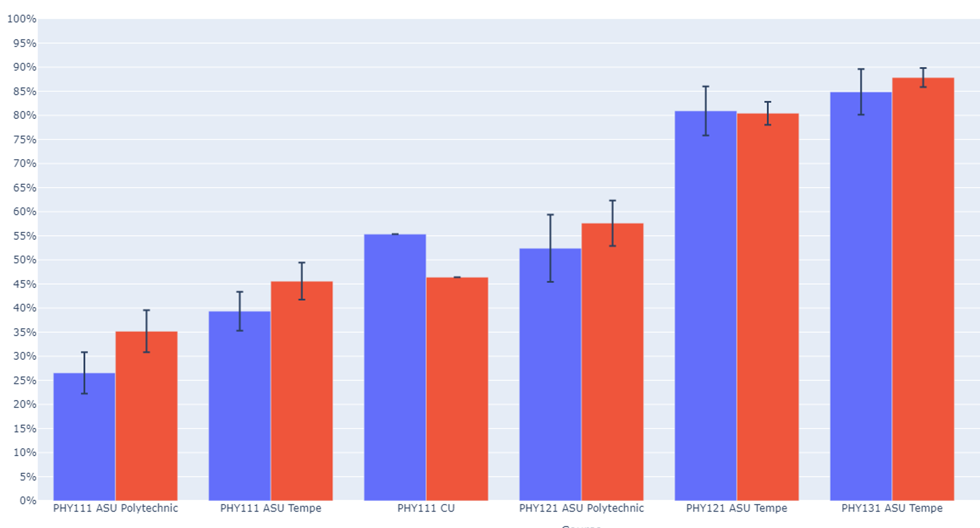
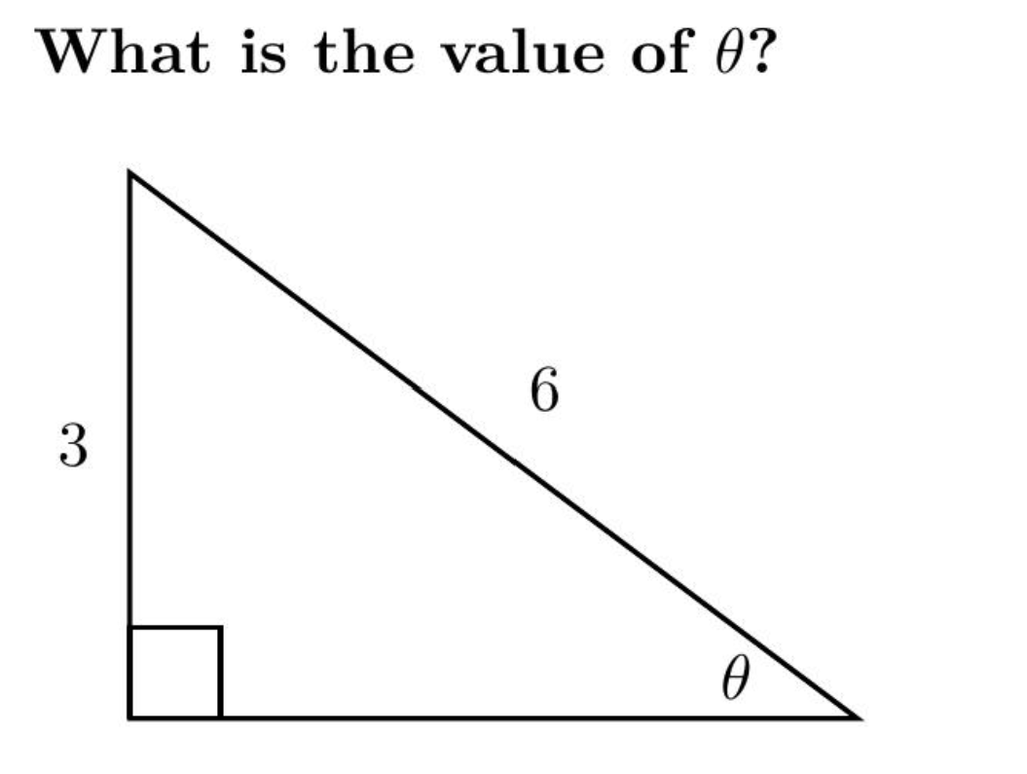

Similar scores on two very different problems
(N > 5000)

Slide 102

Even single test items are highly predictive
Performance on one single diagnostic item can accurately predict class-average score on the full 16-item diagnostic with that item removed
Example: “Simultaneous Equations”

Slide 103



Item “Simultaneous Equations” vs. Full-Diagnostic Correct-Response Rates Written Only (r = 0.96)
Full Diagnostic Correct-Response Rate
(without this problem)
Correct-Response Rate on this Problem

Slide 104
Item “Simultaneous Equations” vs. Full-Diagnostic Correct-Response Rates Written + Online (r = 0.86)
Full Diagnostic Correct-Response Rate
(without this problem)
Correct-Response Rate on this Problem

Slide 105

Example: “Greek Letters”

Slide 106

Item “Greek Letters” vs. Full-Diagnostic Correct-Response Rates Written + Online (r = 0.93)
Full Diagnostic Correct-Response Rate
(without this problem)
Correct-Response Rate on this Problem

Slide 107
If single items can predict total scores, what can total scores predict?
  Implication: It may be possible to diagnose the level of students’ difficulties with only one or very few mathematics pretest items.
  Test: 3-item subset of diagnostic items is somewhat predictive of students’ final grades
  → Full diagnostic offers greater predictive power

Slide 108
Relation Between Scores and Grades
Performance on full online diagnostic can approximately predict final course grade

Slide 109
Low Course Grade vs. Full Diagnostic Score
Course | Campus | N | Overall % grade ≤ C+ | Score ≥ 81% % grade ≤ C+ | Score ≤ 57% % grade ≤ C+ | Low-grade Ratio score ≤ 57% vs. score ≥ 81%
Alg-1 | ASU-P | 82 | 25% | 19% | 38% | 2.1
Alg-2 | ASU-P | 72 | 33% | 14% | 32% | 2.3
Alg-1: Algebra-based course, first semester
Alg-2: Algebra-based course, second semester
Calc-1: Calculus-based course, first semester
Calc-2: Calculus-based course, second semester
ASU-P: Arizona State University, Polytechnic campus
ASU-T: Arizona State University, Tempe campus
UWF: University of West Florida
Students who scored low on math diagnostic pretest had more “C” course grades than those who scored high

Slide 110
Low Course Grade vs. Full Diagnostic Score
Course | Campus | N | Overall % grade ≤ C+ | % grade ≤ B- score ≥ 81% | % grade ≤ B- score ≤ 57% | Low-grade Ratio score ≤ 57% vs. score ≥ 81%
Alg-1 | ASU-P | 78 | 26% | 19% | 38% | 2.1
Alg-2 | ASU-P | 72 | 29% | 14% | 32% | 2.3
Calc-1 | UWF | 103 | 39%
Alg-1: Algebra-based course, first semester
Alg-2: Algebra-based course, second semester
Calc-1: Calculus-based course, first semester
Calc-2: Calculus-based course, second semester
ASU-P: Arizona State University, Polytechnic campus
ASU-T: Arizona State University, Tempe campus
UWF: University of West Florida
Students who scored low on math diagnostic pretest had more “C” course grades than those who scored high

Slide 111
Low Course Grade vs. Full Diagnostic Score
Course | Campus | N | Overall % grade ≤ C+ | Score ≥ 81% % grade ≤ C+ | Score ≤ 57% % grade ≤ C+ | Low-grade Ratio score ≤ 57% vs. score ≥ 81%
Alg-1 | ASU-P | 78 | 26% | 19% | 38% | 2.1
Alg-2 | ASU-P | 72 | 29% | 14% | 32% | 2.3
Calc-1 | UWF | 103 | 39%
Alg-1: Algebra-based course, first semester
Alg-2: Algebra-based course, second semester
Calc-1: Calculus-based course, first semester
Calc-2: Calculus-based course, second semester
ASU-P: Arizona State University, Polytechnic campus
ASU-T: Arizona State University, Tempe campus
UWF: University of West Florida
Students who scored low on math diagnostic pretest had more “C” course grades than those who scored high

Slide 112
Low Course Grade vs. Full Diagnostic Score
Course | Campus | N | Overall % grade ≤ C+ | Score ≥ 81% % grade ≤ C+ | Score ≤ 57% % grade ≤ C+ | Low-grade Ratio score ≤ 57% vs. score ≥ 81%
Alg-1 | ASU-P | 78 | 26% | 19% | 38% | 2.1
Alg-2 | ASU-P | 72 | 29% | 14% | 35% | 2.6
Calc-1 | UWF | 103 | 39% | 26% | 54% | 2.1
Alg-1: Algebra-based course, first semester
Alg-2: Algebra-based course, second semester
Calc-1: Calculus-based course, first semester
Calc-2: Calculus-based course, second semester
ASU-P: Arizona State University, Polytechnic campus
ASU-T: Arizona State University, Tempe campus
UWF: University of West Florida
Students who scored low on math diagnostic pretest had more “C” course grades than those who scored high

Slide 113
High Course Grade vs. Full Diagnostic Score
Course | Campus | N | Overall % grade ≥ A- | Score ≥ 81% % grade ≥ A- | Score ≤ 57% % grade ≥ A- | High-grade Ratio score ≥ 81% vs. score ≤ 57%
Alg-1 | ASU-P | 78 | 35% | 63% | 15% | 4.2
Alg-2 | ASU-P | 72 | 39% | 64% | 25% | 2.6
Alg-2 | ASU-T | 129 | 60% | 65% | 53% | 1.2
Calc-1 | UWF | 103 | 22% | 39% | 0% | ∞
Calc-2 | UWF | 59 | 49% | 60% | 25% | 2.4
Alg-1: Algebra-based course, first semester
Alg-2: Algebra-based course, second semester
Calc-1: Calculus-based course, first semester
Calc-2: Calculus-based course, second semester
ASU-P: Arizona State University, Polytechnic campus
ASU-T: Arizona State University, Tempe campus
UWF: University of West Florida

Slide 114
High Course Grade vs. Full Diagnostic Score
Course | Campus | N | Overall % grade ≥ A- | Score ≥ 81% % grade ≥ A- | Score ≤ 57% % grade ≥ A- | High-grade Ratio score ≥ 81% vs. score ≤ 57%
Alg-1 | ASU-P | 78 | 35% | 63% | 15% | 4.2
Alg-2 | ASU-P | 72 | 39% | 64% | 25% | 2.6
Alg-2 | ASU-T | 129 | 60% | 65% | 53% | 1.2
Calc-1 | UWF | 103 | 22% | 39% | 0% | ∞
Calc-2 | UWF | 59 | 49% | 60% | 25% | 2.4
Alg-1: Algebra-based course, first semester
Alg-2: Algebra-based course, second semester
Calc-1: Calculus-based course, first semester
Calc-2: Calculus-based course, second semester
ASU-P: Arizona State University, Polytechnic campus
ASU-T: Arizona State University, Tempe campus
UWF: University of West Florida

Slide 115
High Course Grade vs. Full Diagnostic Score
Course | Campus | N | Overall % grade ≥ A- | Score ≥ 81% % grade ≥ A- | Score ≤ 57% % grade ≥ A- | High-grade Ratio score ≥ 81% vs. score ≤ 57%
Alg-1 | ASU-P | 78 | 35% | 63% | 15% | 4.2
Alg-2 | ASU-P | 72 | 39% | 64% | 25% | 2.6
Alg-2 | ASU-T | 129 | 60% | 67% | 55% | 1.2
Calc-1 | UWF | 103 | 22% | 40% | 0% | “∞”
Calc-2 | UWF | 59 | 49% | 61% | 38% | 1.6
Alg-1: Algebra-based course, first semester
Alg-2: Algebra-based course, second semester
Calc-1: Calculus-based course, first semester
Calc-2: Calculus-based course, second semester
ASU-P: Arizona State University, Polytechnic campus
ASU-T: Arizona State University, Tempe campus
UWF: University of West Florida
Students who scored high on math diagnostic pretest had more “A” course grades than those who scored low

Slide 116
High Course Grade vs. Full Diagnostic Score
Course | Campus | N | Overall % grade ≥ A- | Score ≥ 81% % grade ≥ A- | Score ≤ 57% % grade ≥ A- | High-grade Ratio score ≥ 81% vs. score ≤ 57%
Alg-1 | ASU-P | 78 | 35% | 63% | 15% | 4.2
Alg-2 | ASU-P | 72 | 39% | 64% | 25% | 2.6
Alg-2 | ASU-T | 129 | 60% | 65% | 53% | 1.2
Calc-1 | UWF | 103 | 22% | 39% | 0% | ∞
Calc-2 | UWF | 59 | 49% | 60% | 25% | 2.4
Alg-1: Algebra-based course, first semester
Alg-2: Algebra-based course, second semester
Calc-1: Calculus-based course, first semester
Calc-2: Calculus-based course, second semester
ASU-P: Arizona State University, Polytechnic campus
ASU-T: Arizona State University, Tempe campus
UWF: University of West Florida
But here, we can examine individual data points [students] in more detail…

Slide 117


Slide 118
9/16 or worse on math pre-test
13/16 or better on math pre-test

Slide 119


Slide 120
Frequently e-mailed instructor to get suggestions for quiz-study topics

Slide 121
always came to class
sat near front
actively participated in all class activities

Slide 122
always came to class
sat near front
actively participated in all class activities
stopped coming to class
stopped taking quizzes

Slide 123
always came to class
sat near front
actively participated in all class activities
didn’t hand in any homework assignments
stopped coming to class
stopped taking quizzes

Slide 124
always came to class
sat near front
actively participated in all class activities
missed many classes
didn’t hand in any homework assignments
stopped coming to class
stopped taking quizzes

Slide 125
always came to class
sat near front
actively participated in all class activities
missed many classes
missed many classes
didn’t hand in any homework assignments
stopped coming to class
stopped taking quizzes

Slide 126
always came to class
sat near front
actively participated in all class activities
missed many classes
missed many classes
didn’t hand in any homework assignments
stopped coming to class
stopped taking quizzes
Scored 17th percentile on Lawson test of scientific reasoning

Slide 127
always came to class
sat near front
actively participated in all class activities
missed many classes
Scored 17th percentile on Lawson test of scientific reasoning
didn’t hand in any homework assignments
stopped coming to class
stopped taking quizzes
Scored 17th percentile on Lawson test of scientific reasoning

Slide 128
always came to class
sat near front
actively participated in all class activities
missed many classes
missed many classes
didn’t hand in any homework assignments
stopped coming to class
stopped taking quizzes
Scored 80th percentile on Lawson test of scientific reasoning

Slide 129
always came to class
sat near front
actively participated in all class activities
missed many classes
missed many classes
didn’t hand in any homework assignments
Scored 10th percentile on FCI Pre-test
Scored 80th percentile on Lawson test of scientific reasoning

Slide 130
always came to class
sat near front
actively participated in all class activities
Scored 81th percentile on FCI Pre-test
missed many classes
missed many classes
didn’t hand in any homework assignments
Scored 10th percentile on FCI Pre-test
Scored 80th percentile on Lawson test of scientific reasoning

Slide 131
Scored 77th percentile on FCI Pre-test
Scored 81th percentile on FCI Pre-test
missed many classes
missed many classes
didn’t hand in any homework assignments
Scored 10th percentile on FCI Pre-test
Scored 80th percentile on Lawson test of scientific reasoning

Slide 132
Recommendations Summary
Instructors should be wary of assumptions about students’ mathematics preparation before making assessments
  Pre-instruction performance on a brief mathematics diagnostic may provide indications of students’ difficulties and of students at risk
Instructors may wish to modify their instructional practices to take account of students’ mathematical difficulties and behaviors
  e.g., constrained use of symbolic manipulations, addition of math practice
Recognize that deep-lying difficulties may be hard to address, but motivational factors can provide some compensation

