Slide 1
Predictors of performance in introductory physics courses
David E. Meltzer and Dakota H. King
Arizona State University
Supported in part by NSF DUE #1504986 and #1914712

Slide 2
Data Sources
Diagnostic pretest covering pre-college mathematics
calculators allowed
Pre-instruction tests of scientific reasoning skill and physics concept knowledge:
Lawson Test of Scientific Reasoning
Force Concept Inventory

Slide 3
Acknowledgments
Diagnostic data have been provided by (among others):
Vince Coletta (Loyola Marymount University)
Steven Pollock (University of Colorado, Boulder)
Christopher Varney (University of West Florida)

Slide 4
Mathematics Diagnostic Pretest

Slide 5
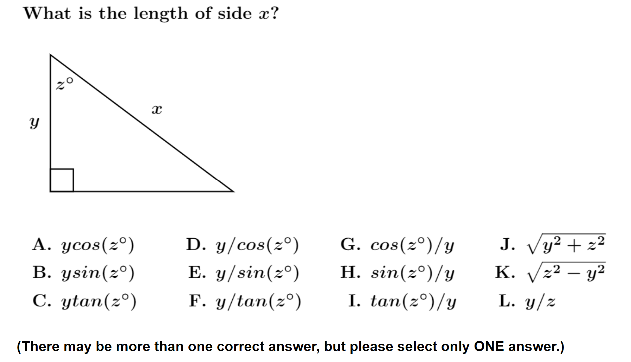
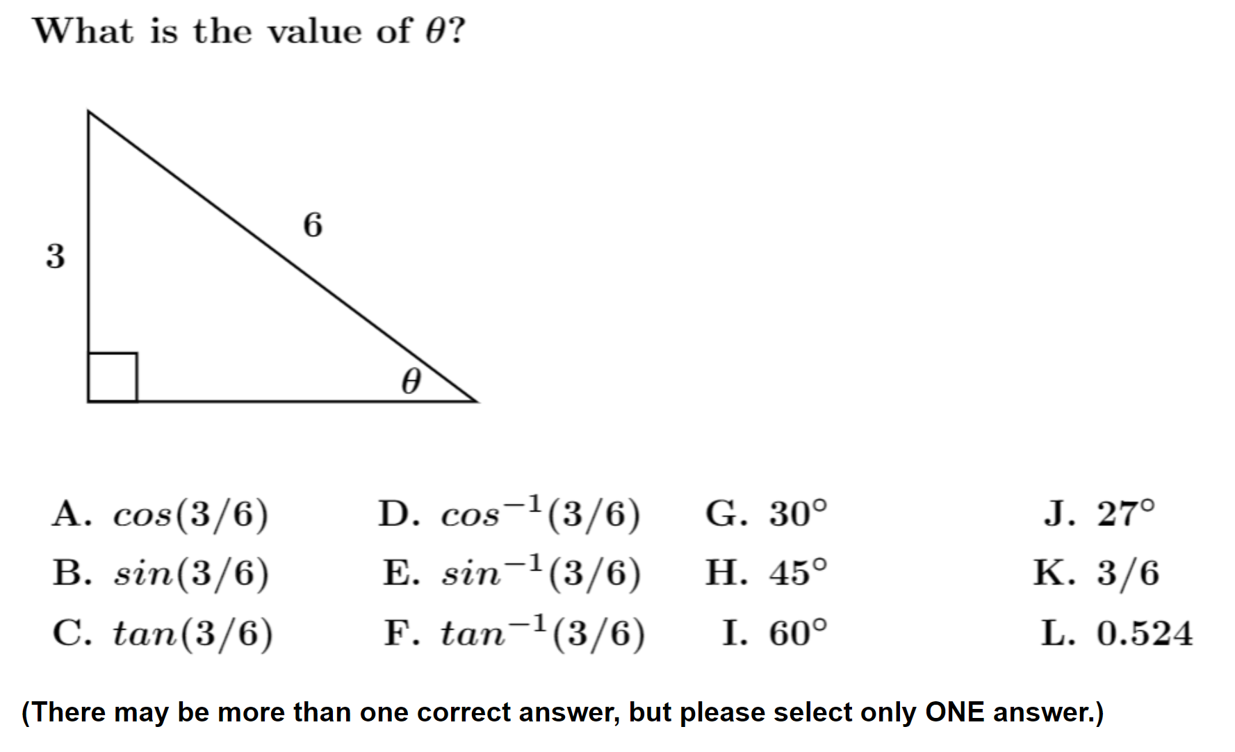

Slide 6
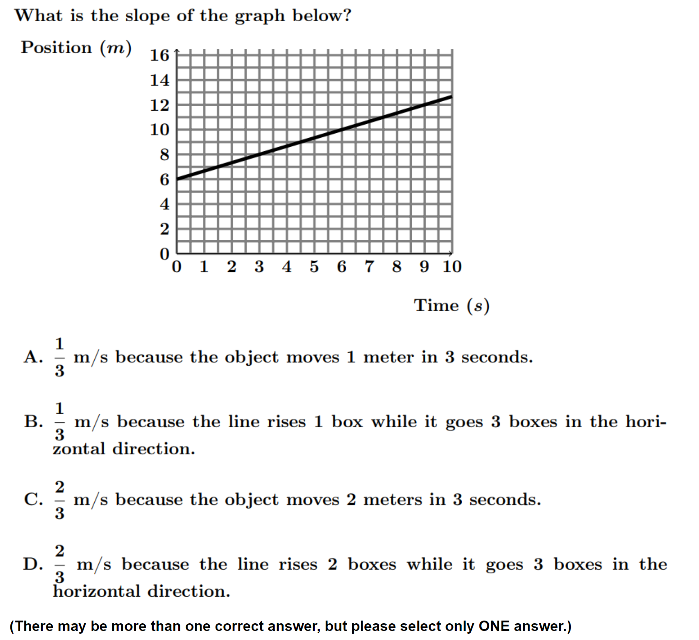

Slide 7
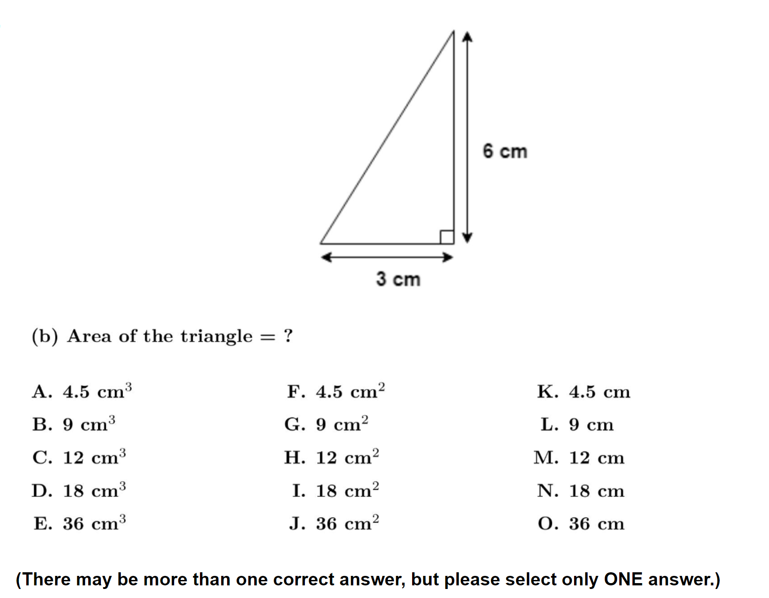
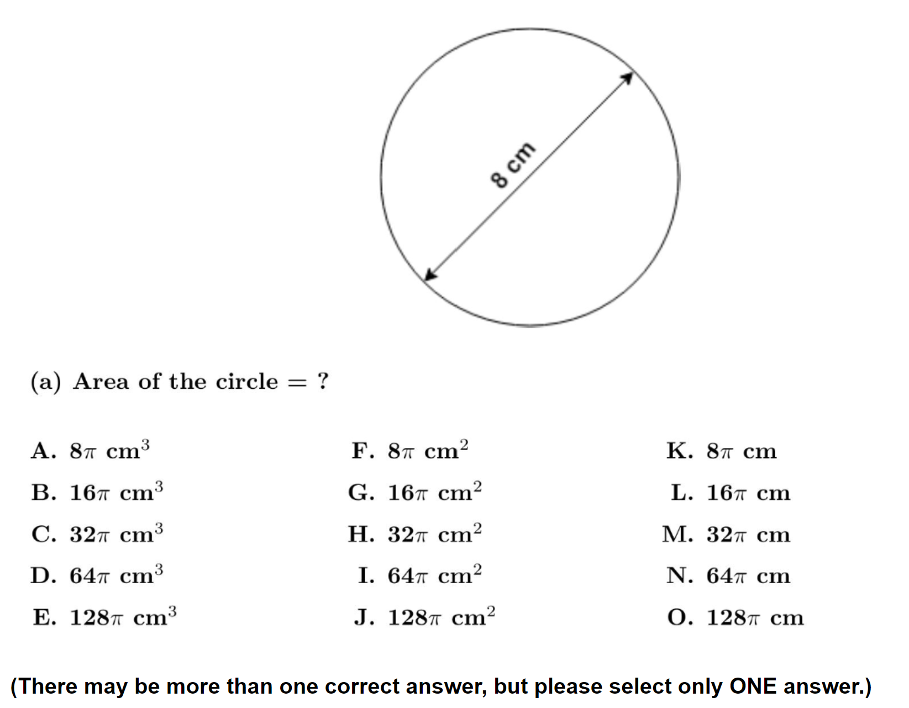
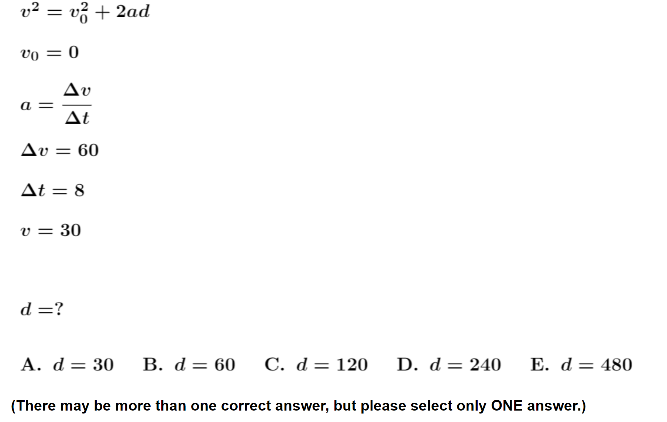
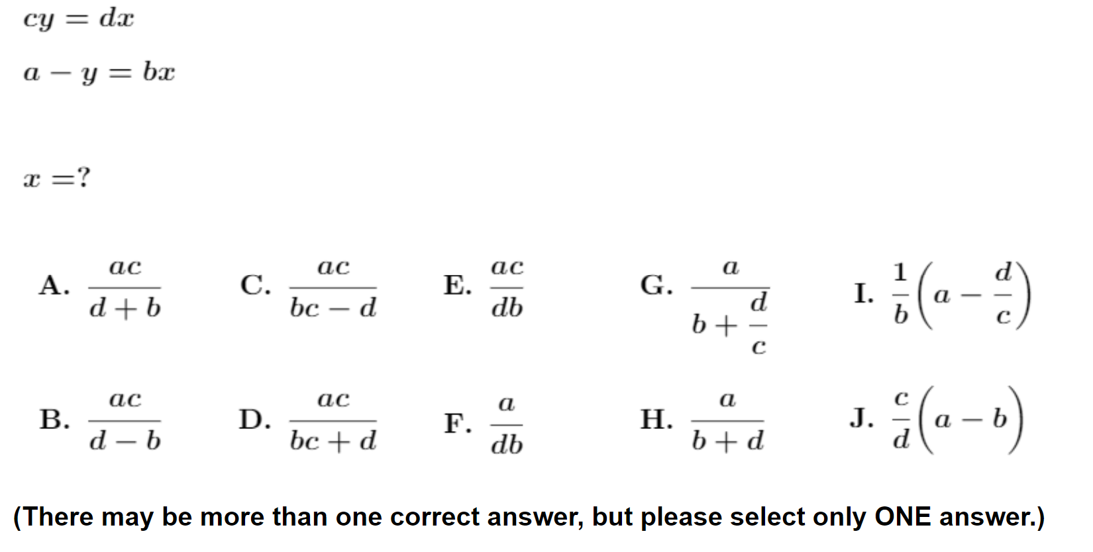

Slide 8
Relation Between Scores and Grades
Correlation coefficient between mathematics pretest score and final course grades varies greatly from course to course:
r ≈ +0.10 - +0.50.
However, slope of fit line for grades vs. math score is relatively high, therefore…
…pretest score on mathematics diagnostic can approximately predict final course grade

Slide 9
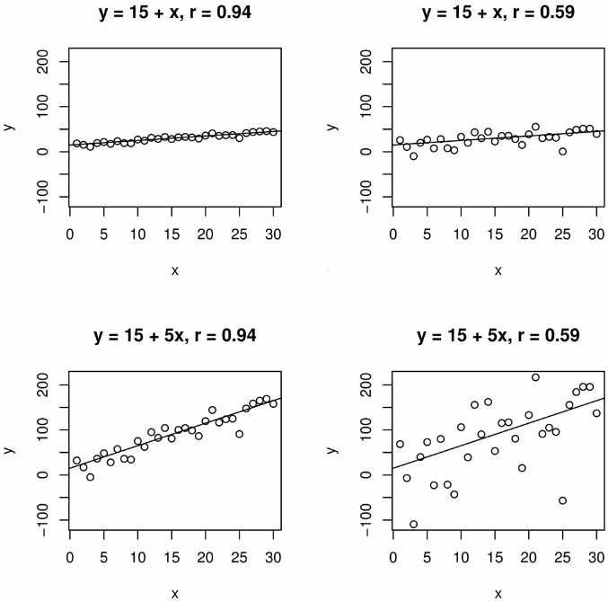
High correlation, small slope:
Changes in predictor variable have little effect (though highly predictable)

Slide 10
High correlation, small slope:
Changes in predictor variable have little effect (though highly predictable)
Low correlation, large slope:
Changes in predictor variable have large effect (despite large scatter)

Slide 11
High correlation, small slope:
Changes in predictor variable have little effect (though highly predictable)
Low correlation, large slope:
Changes in predictor variable have large effect (despite large scatter)

Slide 12
Low Course Grade vs. Mathematics Diagnostic Pretest Score
Course | Campus | N | Top-quartile Math: % with bottom-quartile grades | Bottom-quartile Math: % with bottom-quartile grades | Low-grade odds ratio

Slide 13
Low Course Grade vs. Mathematics Diagnostic Pretest Score
Course | Campus | N | Top-quartile Math: % with bottom-quartile grades | Bottom-quartile Math: % with bottom-quartile grades | Low-grade odds ratio
Students whose mathematics pretest scores placed them among the top quarter of the class (75th percentile and higher): what percentage of them received low (bottom-quartile, C+ or lower) course grades?

Slide 14
Low Course Grade vs. Mathematics Diagnostic Pretest Score
Course | Campus | N | Top-quartile Math: % with bottom-quartile grades | Bottom-quartile Math: % with bottom-quartile grades | Low-grade odds ratio
Students whose mathematics pretest scores placed them among the top quarter of the class (75th percentile and higher): what percentage of them received low (bottom-quartile, C+ or lower) course grades?
Students whose mathematics pretest scores placed them among the bottom quarter of the class (25th percentile or lower): what percentage of them received low (bottom-quartile, C+ or lower) course grades?

Slide 15
Low Course Grade vs. Mathematics Diagnostic Pretest Score
Course | Campus | N | Top-quartile Math: % with bottom-quartile grades | Bottom-quartile Math: % with bottom-quartile grades | Low-grade odds ratio
Alg-1 2021 | ASU-P | 81
Alg-1: Algebra-based course, first semester
ASU-P: Arizona State University, Polytechnic campus

Slide 16
Low Course Grade vs. Mathematics Diagnostic Pretest Score
Course | Campus | N | Top-quartile Math: % with bottom-quartile grades | Bottom-quartile Math: % with bottom-quartile grades | Low-grade odds ratio
Alg-1 2021 | ASU-P | 81 | 15%
Alg-1: Algebra-based course, first semester
ASU-P: Arizona State University, Polytechnic campus

Slide 17
Low Course Grade vs. Mathematics Diagnostic Pretest Score
Course | Campus | N | Top-quartile Math: % with bottom-quartile grades | Bottom-quartile Math: % with bottom-quartile grades | Low-grade odds ratio
Alg-1 2021 | ASU-P | 81 | 15% | 46%
Alg-1: Algebra-based course, first semester
ASU-P: Arizona State University, Polytechnic campus

Slide 18
Low Course Grade vs. Mathematics Diagnostic Pretest Score
Course | Campus | N | Top-quartile Math: % with bottom-quartile grades | Bottom-quartile Math: % with bottom-quartile grades | Low-grade odds ratio
Alg-1 2021 | ASU-P | 81 | 15% | 46% | 3.2
Low-scorers on the math diagnostic pretest were 3.2 times more likely to get a low grade than high scorers
Alg-1: Algebra-based course, first semester
ASU-P: Arizona State University, Polytechnic campus

Slide 19
Low Course Grade vs. Mathematics Diagnostic Pretest Score
Course | Campus | N | Top-quartile Math: % with bottom-quartile grades | Bottom-quartile Math: % with bottom-quartile grades | Low-grade odds ratio
Alg-1 2021 | ASU-P | 81 | 15% | 46% | 3.2
Question: How consistent was this result?
Alg-1: Algebra-based course, first semester
ASU-P: Arizona State University, Polytechnic campus

Slide 20
Low Course Grade vs. Mathematics Diagnostic Pretest Score
Course | Campus | N | Top-quartile Math: % with bottom-quartile grades | Bottom-quartile Math: % with bottom-quartile grades | Low-grade odds ratio
Alg-1 2021 | ASU-P | 81 | 15% | 46% | 3.2
Answer: Very consistent.
Alg-1: Algebra-based course, first semester
ASU-P: Arizona State University, Polytechnic campus

Slide 21
Low Course Grade vs. Mathematics Diagnostic Pretest Score
Course | Campus | N | Top-quartile Math: % with bottom-quartile grades | Bottom-quartile Math: % with bottom-quartile grades | Low-grade odds ratio
Alg-1 2021 | ASU-P | 81 | 15% | 46% | 3.2
Alg-1 2022 | ASU-P | 92
Alg-1: Algebra-based course, first semester
ASU-P: Arizona State University, Polytechnic campus

Slide 22
Low Course Grade vs. Mathematics Diagnostic Pretest Score
Course | Campus | N | Top-quartile Math: % with bottom-quartile grades | Bottom-quartile Math: % with bottom-quartile grades | Low-grade odds ratio
Alg-1 2021 | ASU-P | 81 | 15% | 46% | 3.2
Alg-1 2022 | ASU-P | 92 | 11% | 44% | 4.0
Alg-1: Algebra-based course, first semester
ASU-P: Arizona State University, Polytechnic campus

Slide 23
Low Course Grade vs. Mathematics Diagnostic Pretest Score
Course | Campus | N | Top-quartile Math: % with bottom-quartile grades | Bottom-quartile Math: % with bottom-quartile grades | Low-grade odds ratio
Alg-1 2021 | ASU-P | 81 | 15% | 46% | 3.2
Alg-1 2022 | ASU-P | 92 | 11% | 44% | 4.0
Alg-2 2022 | ASU-P | 75
Alg-2 2023 | ASU-P | 92
Alg-1: Algebra-based course, first semester
Alg-2: Algebra-based course, second semester
ASU-P: Arizona State University, Polytechnic campus

Slide 24
Low Course Grade vs. Mathematics Diagnostic Pretest Score
Course | Campus | N | Top-quartile Math: % with bottom-quartile grades | Bottom-quartile Math: % with bottom-quartile grades | Low-grade odds ratio
Alg-1 2021 | ASU-P | 81 | 15% | 46% | 3.2
Alg-1 2022 | ASU-P | 92 | 11% | 44% | 4.0
Alg-2 2022 | ASU-P | 75 | 11% | 26% | 2.4
Alg-2 2023 | ASU-P | 92 | 11% | 30% | 2.8
Alg-1: Algebra-based course, first semester
Alg-2: Algebra-based course, second semester
ASU-P: Arizona State University, Polytechnic campus

Slide 25
Low Course Grade vs. Mathematics Diagnostic Pretest Score
Course | Campus | N | Top-quartile Math: % with bottom-quartile grades | Bottom-quartile Math: % with bottom-quartile grades | Low-grade odds ratio
Alg-1 2021 | ASU-P | 81 | 15% | 46% | 3.2
Alg-1 2022 | ASU-P | 92 | 11% | 44% | 4.0
Alg-2 2022 | ASU-P | 75 | 11% | 26% | 2.4
Alg-2 2023 | ASU-P | 92 | 11% | 30% | 2.8
Alg-2 2021 | ASU-T | 129
Alg-1: Algebra-based course, first semester
Alg-2: Algebra-based course, second semester
ASU-P: Arizona State University, Polytechnic campus
ASU-T: Arizona State University, Tempe campus

Slide 26
Low Course Grade vs. Mathematics Diagnostic Pretest Score
Course | Campus | N | Top-quartile Math: % with bottom-quartile grades | Bottom-quartile Math: % with bottom-quartile grades | Low-grade odds ratio
Alg-1 2021 | ASU-P | 81 | 15% | 46% | 3.2
Alg-1 2022 | ASU-P | 92 | 11% | 44% | 4.0
Alg-2 2022 | ASU-P | 75 | 11% | 26% | 2.4
Alg-2 2023 | ASU-P | 92 | 11% | 30% | 2.8
Alg-2 2021 | ASU-T | 129 | 11% | 30% | 2.8
Alg-1: Algebra-based course, first semester
Alg-2: Algebra-based course, second semester
ASU-P: Arizona State University, Polytechnic campus
ASU-T: Arizona State University, Tempe campus

Slide 27
Low Course Grade vs. Mathematics Diagnostic Pretest Score
Course | Campus | N | Top-quartile Math: % with bottom-quartile grades | Bottom-quartile Math: % with bottom-quartile grades | Low-grade odds ratio
Alg-1 2021 | ASU-P | 81 | 15% | 46% | 3.2
Alg-1 2022 | ASU-P | 92 | 11% | 44% | 4.0
Alg-2 2022 | ASU-P | 75 | 11% | 26% | 2.4
Alg-2 2023 | ASU-P | 92 | 11% | 30% | 2.8
Alg-2 2021 | ASU-T | 129 | 11% | 30% | 2.8
Calc-1 2021 | UWF | 103
Calc-2 2021 | UWF | 59
Alg-1: Algebra-based course, first semester
Alg-2: Algebra-based course, second semester
Calc-1: Calculus-based course, first semester
Calc-2: Calculus-based course, second semester
ASU-P: Arizona State University, Polytechnic campus
ASU-T: Arizona State University, Tempe campus
UWF: University of West Florida

Slide 28
Low Course Grade vs. Mathematics Diagnostic Pretest Score
Course | Campus | N | Top-quartile Math: % with bottom-quartile grades | Bottom-quartile Math: % with bottom-quartile grades | Low-grade odds ratio
Alg-1 2021 | ASU-P | 81 | 15% | 46% | 3.2
Alg-1 2022 | ASU-P | 92 | 11% | 44% | 4.0
Alg-2 2022 | ASU-P | 75 | 11% | 26% | 2.4
Alg-2 2023 | ASU-P | 92 | 11% | 30% | 2.8
Alg-2 2021 | ASU-T | 129 | 11% | 30% | 2.8
Calc-1 2021 | UWF | 103 | 4% | 37% | 8.9
Calc-2 2021 | UWF | 59 | 24% | 44% | 1.8
Alg-1: Algebra-based course, first semester
Alg-2: Algebra-based course, second semester
Calc-1: Calculus-based course, first semester
Calc-2: Calculus-based course, second semester
ASU-P: Arizona State University, Polytechnic campus
ASU-T: Arizona State University, Tempe campus
UWF: University of West Florida

Slide 29
Low Course Grade vs. Mathematics Diagnostic Pretest Score
Course | Campus | N | Top-quartile Math: % with bottom-quartile grades | Bottom-quartile Math: % with bottom-quartile grades | Low-grade odds ratio
Alg-1 2021 | ASU-P | 81 | 15% | 46% | 3.2
Alg-1 2022 | ASU-P | 92 | 11% | 44% | 4.0
Alg-2 2022 | ASU-P | 75 | 11% | 26% | 2.4
Alg-2 2023 | ASU-P | 92 | 11% | 30% | 2.8
Alg-2 2021 | ASU-T | 129 | 11% | 30% | 2.8
Calc-1 2021 | UWF | 103 | 4% | 37% | 8.9
Calc-2 2021 | UWF | 59 | 24% | 44% | 1.8
Alg-1: Algebra-based course, first semester
Alg-2: Algebra-based course, second semester
Calc-1: Calculus-based course, first semester
Calc-2: Calculus-based course, second semester
ASU-P: Arizona State University, Polytechnic campus
ASU-T: Arizona State University, Tempe campus
UWF: University of West Florida
Students who scored low on math diagnostic pretest had consistently more low grades than those who scored high

Slide 30
High Course Grade vs. Mathematics Diagnostic Pretest Score
Course | Campus | N | Top-quartile Math: % with top-quartile grades | Bottom-quartile Math: % with top-quartile grades | High-grade odds ratio
Alg-1 2021 | ASU-P | 81

Slide 31
High Course Grade vs. Mathematics Diagnostic Pretest Score
Course | Campus | N | Top-quartile Math: % with top-quartile grades | Bottom-quartile Math: % with top-quartile grades | High-grade odds ratio
Alg-1 2021 | ASU-P | 81
Students whose mathematics pretest scores placed them among the top quarter of the class (75th percentile and higher): what percentage of them received high (top-quartile, A − or higher) course grades?
Students whose mathematics pretest scores placed them among the bottom quarter of the class (25th percentile or lower): what percentage of them received high (top-quartile, A− or higher) course grades?

Slide 32
High Course Grade vs. Mathematics Diagnostic Pretest Score
Course | Campus | N | Top-quartile Math: % with top-quartile grades | Bottom-quartile Math: % with top-quartile grades | High-grade odds ratio
Alg-1 2021 | ASU-P | 81 | 47% | 11% | 4.5
Alg-1: Algebra-based course, first semester
ASU-P: Arizona State University, Polytechnic campus

Slide 33
High Course Grade vs. Mathematics Diagnostic Pretest Score
Course | Campus | N | Top-quartile Math: % with top-quartile grades | Bottom-quartile Math: % with top-quartile grades | High-grade odds ratio
Alg-1 2021 | ASU-P | 81 | 47% | 11% | 4.5
Alg-1 2022 | ASU-P | 92 | 38% | 9% | 4.4
Alg-2 2022 | ASU-P | 75 | 46% | 21% | 2.2
Alg-2 2023 | ASU-P | 92 | 41% | 13% | 3.2
Alg-2 2021 | ASU-T | 129 | 30% | 39% | 0.8
Calc-1 2021 | UWF | 103 | 41% | 1% | 58.5
Calc-2 | UWF | 59 | 65% | 37% | 1.8
Alg-1: Algebra-based course, first semester
Alg-2: Algebra-based course, second semester
Calc-1: Calculus-based course, first semester
Calc-2: Calculus-based course, second semester
ASU-P: Arizona State University, Polytechnic campus
ASU-T: Arizona State University, Tempe campus
UWF: University of West Florida
Students who scored high on math diagnostic pretest had consistently more high grades than those who scored high

Slide 34
Factors other than math preparation may influence course performance
For example:
Scientific reasoning skills, as measured by the Lawson Test of Scientific Reasoning
Physics concept knowledge, as measured by the Force Concept Inventory

Slide 35
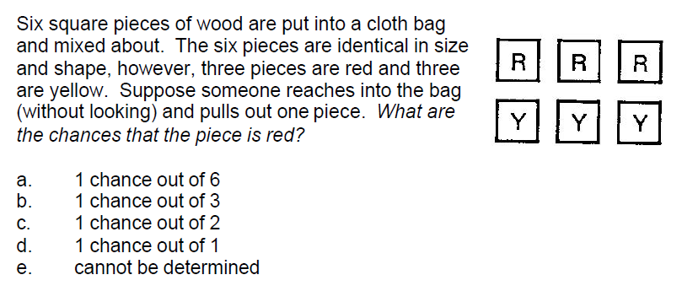
Scientific reasoning skills: The 24-item Lawson test
Understanding shape-independence of mass
Probabilistic reasoning

Slide 36
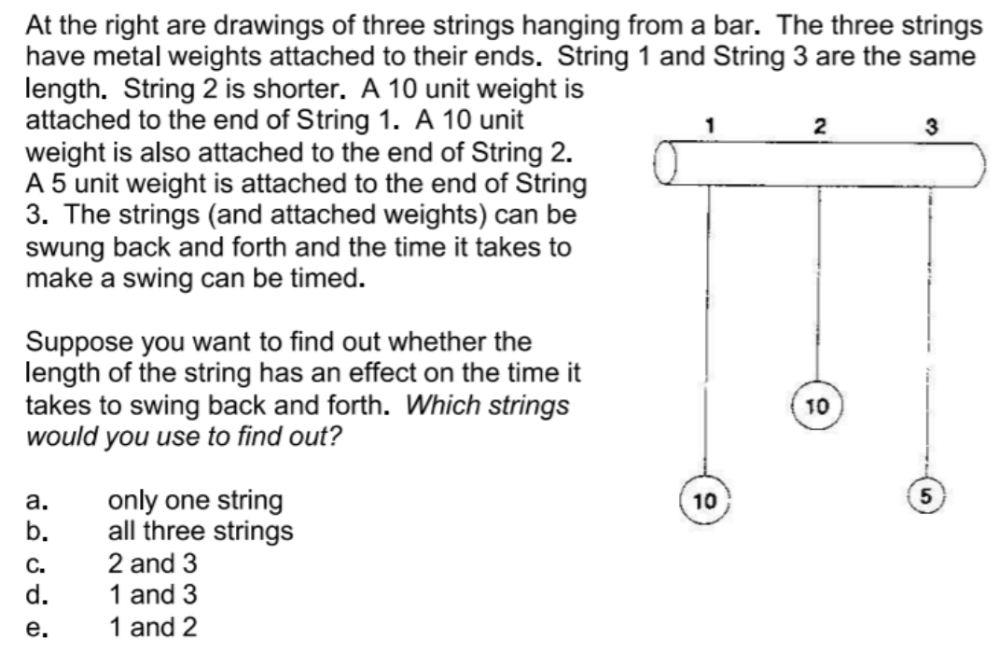
Proportional reasoning
Control of variables

Slide 37
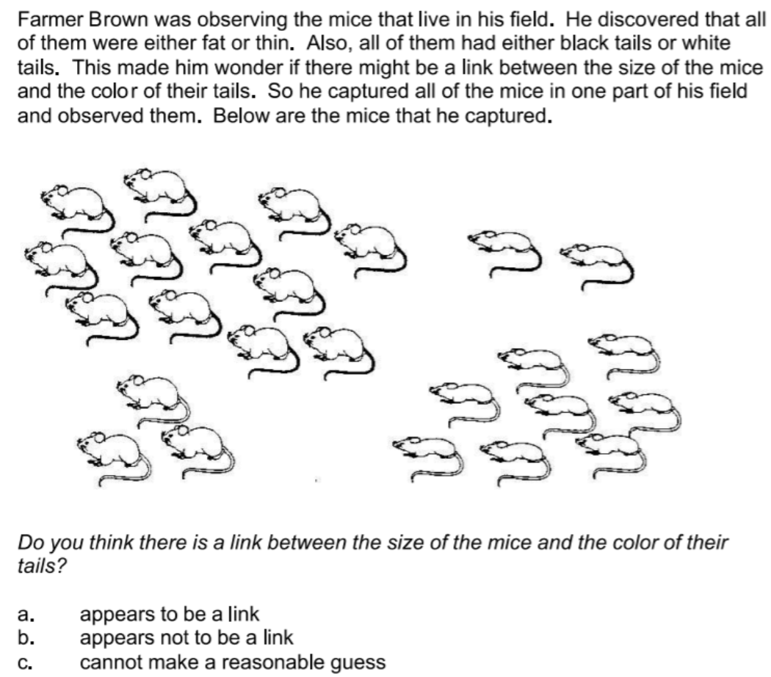
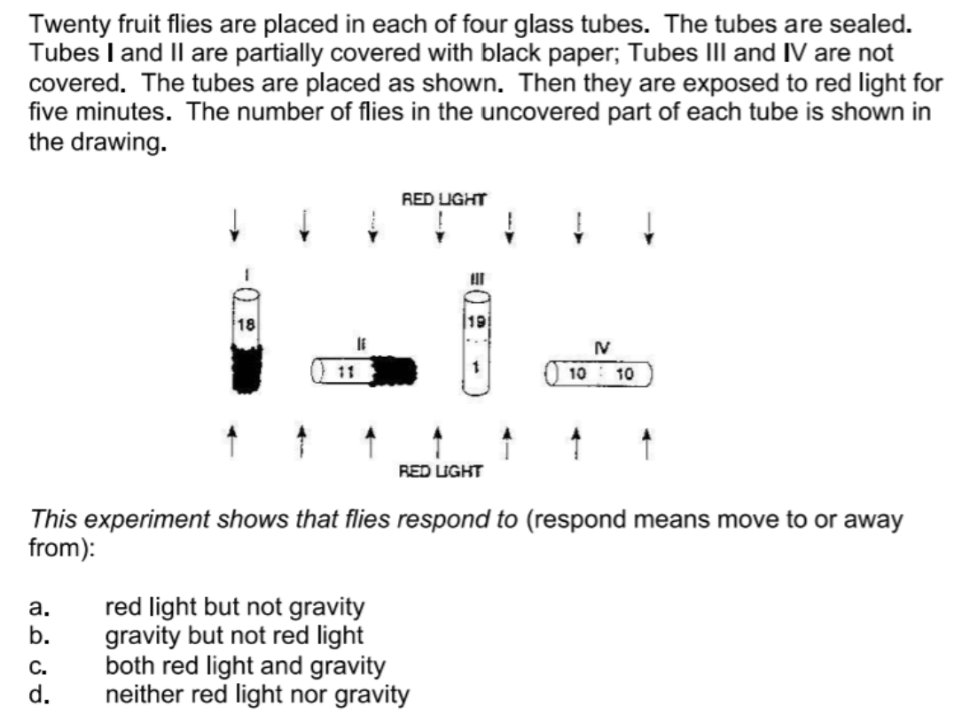
Correlational reasoning

Slide 38
Objections to Lawson Test
Wordy, potentially confusing text: becomes a test of reading comprehension
Ambiguous wording and/or answers, dependent on some outside knowledge or assumptions
Mediocre graphics

Slide 39
High Course Grade vs. Lawson Test of Scientific Reasoning Pretest Score
Course | Campus | N | Top-quartile Lawson: % with top-quartile grades | Bottom-quartile Lawson: % with top-quartile grades | High-grade odds ratio

Slide 40
High Course Grade vs. Lawson Test of Scientific Reasoning Pretest Score
Course | Campus | N | Top-quartile Lawson: % with top-quartile grades | Bottom-quartile Lawson: % with top-quartile grades | High-grade odds ratio
High-scorers on Lawson pretest

Slide 41
High Course Grade vs. Lawson Test of Scientific Reasoning Pretest Score
Course | Campus | N | Top-quartile Lawson: % with top-quartile grades | Bottom-quartile Lawson: % with top-quartile grades | High-grade odds ratio
High-scorers on Lawson pretest
Low-scorers on Lawson pretest

Slide 42
High Course Grade vs. Lawson Test of Scientific Reasoning Pretest Score
Course | Campus | N | Top-quartile Lawson: % with top-quartile grades | Bottom-quartile Lawson: % with top-quartile grades | High-grade odds ratio
Alg-1 2021 | ASU-P | 73 | 46% | 16% | 2.8

Slide 43
High Course Grade vs. Lawson Test of Scientific Reasoning Pretest Score
Course | Campus | N | Top-quartile Lawson: % with top-quartile grades | Bottom-quartile Lawson: % with top-quartile grades | High-grade odds ratio
Alg-1 2021 | ASU-P | 73 | 46% | 16% | 2.8
Alg-1 2022 | ASU-P | 95 | 52% | 8% | 6.2
Alg-2 2022 | ASU-P | 73 | 41% | 6% | 7.6
Alg-2 2023 | ASU-P | 92 | 52% | 10% | 5.0
Alg-1 | CU | 469 | 45% | 8% | 5.5
Calc-2 | CU | 276 | 57% | 8% | 6.9
Alg-1 2007 | LMU | 24 | 50% | 0% | “∞”
Alg-1 2009 | LMU | 51 | 34% | 11% | 3.2
Alg-1 2011 | LMU | 57 | 53% | 18% | 2.9
Alg-1 2012 | LMU | 44 | 64% | 6% | 10.5
Alg-1 2013 | LMU | 30 | 53% | 12% | 4.6
Alg-1 2014 | LMU | 33 | 61% | 0% | “∞”
Alg-1 2015 | LMU | 24 | 63% | 0% | “∞”
Alg-1 2016 | LMU | 35 | 41% | 0% | “∞”
Alg-1 2018 | LMU | 47 | 54% | 9% | 6.3
Alg-1 2021 | LMU | 27 | 44% | 0% | “∞”

Slide 44
High Course Grade vs. Lawson Test of Scientific Reasoning Pretest Score
Course | Campus | N | Top-quartile Lawson: % with top-quartile grades | Bottom-quartile Lawson: % with top-quartile grades | High-grade odds ratio
Alg-1 2021 | ASU-P | 73 | 46% | 16% | 2.8
Alg-1 2022 | ASU-P | 95 | 52% | 8% | 6.2
Alg-2 2022 | ASU-P | 73 | 41% | 6% | 7.6
Alg-2 2023 | ASU-P | 92 | 52% | 10% | 5.0
Alg-1 | CU | 469 | 45% | 8% | 5.5
Calc-2 | CU | 276 | 57% | 8% | 6.9
Alg-1 2007 | LMU | 24 | 50% | 0% | “∞”
Alg-1 2009 | LMU | 51 | 34% | 11% | 3.2
Alg-1 2011 | LMU | 57 | 53% | 18% | 2.9
Alg-1 2012 | LMU | 44 | 64% | 6% | 10.5
Alg-1 2013 | LMU | 30 | 53% | 12% | 4.6
Alg-1 2014 | LMU | 33 | 61% | 0% | “∞”
Alg-1 2015 | LMU | 24 | 63% | 0% | “∞”
Alg-1 2016 | LMU | 35 | 41% | 0% | “∞”
Alg-1 2018 | LMU | 47 | 54% | 9% | 6.3
Alg-1 2021 | LMU | 27 | 44% | 0% | “∞”

Slide 45
Low Course Grade vs. Lawson Test of Scientific Reasoning Pretest Score
Course | Campus | N | Top-quartile Lawson: % with bottom-quartile grades | Bottom-quartile Lawson: % with bottom-quartile grades | Low-grade odds ratio
Alg-1 2021 | ASU-P | 73 | 6% | 49% | 9.0

Slide 46
Low Course Grade vs. Lawson Test of Scientific Reasoning Pretest Score
Course | Campus | N | Top-quartile Lawson: % with bottom-quartile grades | Bottom-quartile Lawson: % with bottom-quartile grades | Low-grade odds ratio
Alg-1 2021 | ASU-P | 73 | 6% | 49% | 9.0
Alg-1 2022 | ASU-P | 95 | 13% | 42% | 3.3
Alg-2 2022 | ASU-P | 73 | 16% | 27% | 1.7
Alg-2 2023 | ASU-P | 92 | 13% | 37% | 2.8
Alg-1 | CU | 469 | 10% | 42% | 4.4
Calc-2 | CU | 276 | 12% | 44% | 3.8
Alg-1 2007 | LMU | 24 | 0% | 58% | “∞”
Alg-1 2009 | LMU | 51 | 5% | 48% | 10.4
Alg-1 2011 | LMU | 57 | 15% | 46% | 3.0
Alg-1 2012 | LMU | 44 | 9% | 27% | 3.0
Alg-1 2013 | LMU | 30 | 27% | 12% | 0.4
Alg-1 2014 | LMU | 33 | 0% | 68% | “∞”
Alg-1 2015 | LMU | 24 | 0% | 75% | “∞”
Alg-1 2016 | LMU | 35 | 11% | 46% | 4.0
Alg-1 2018 | LMU | 47 | 16% | 42% | 2.7
Alg-1 2021 | LMU | 27 | 0% | 89% | “∞”

Slide 47
Low Course Grade vs. Lawson Test of Scientific Reasoning Pretest Score
Course | Campus | N | Top-quartile Lawson: % with bottom-quartile grades | Bottom-quartile Lawson: % with bottom-quartile grades | Low-grade odds ratio
Alg-1 2021 | ASU-P | 73 | 6% | 49% | 9.0
Alg-1 2022 | ASU-P | 95 | 13% | 42% | 3.3
Alg-2 2022 | ASU-P | 73 | 16% | 27% | 1.7
Alg-2 2023 | ASU-P | 92 | 13% | 37% | 2.8
Alg-1 | CU | 469 | 10% | 42% | 4.4
Calc-2 | CU | 276 | 12% | 44% | 3.8
Alg-1 2007 | LMU | 24 | 0% | 58% | “∞”
Alg-1 2009 | LMU | 51 | 5% | 48% | 10.4
Alg-1 2011 | LMU | 57 | 15% | 46% | 3.0
Alg-1 2012 | LMU | 44 | 9% | 27% | 3.0
Alg-1 2013 | LMU | 30 | 27% | 12% | 0.4
Alg-1 2014 | LMU | 33 | 0% | 68% | “∞”
Alg-1 2015 | LMU | 24 | 0% | 75% | “∞”
Alg-1 2016 | LMU | 35 | 11% | 46% | 4.0
Alg-1 2018 | LMU | 47 | 16% | 42% | 2.7
Alg-1 2021 | LMU | 27 | 0% | 89% | “∞”

Slide 48
Is physics concept pretest score a predictor of grades?
We use the Force Concept Inventory

Slide 49
High Course Grade vs. FCI
Course | Campus | N | Top-quartile FCI: % with top-quartile grades | Bottom-quartile FCI: % with top-quartile grades | High-grade odds ratio
Alg-1 2021 | ASU-P | 72 | 51% | 6% | 9.2

Slide 50
High Course Grade vs. FCI
Course | Campus | N | Top-quartile FCI: % with top-quartile grades | Bottom-quartile FCI: % with top-quartile grades | High-grade odds ratio
Alg-1 2021 | ASU-P | 72 | 51% | 6% | 9.2
Alg-1 2022 | ASU-P | 93 | 24% | 12% | 2.0
Alg-1 | CU | 470 | 41% | 12% | 3.5
Alg-1 2007 | LMU | 23 | 87% | 0% | “∞”
Alg-1 2009 | LMU | 51 | 63% | 0% | “∞”
Alg-1 2012 | LMU | 44 | 50% | 0% | “∞”
Alg-1 2013 | LMU | 30 | 51% | 0% | “∞”
Alg-1 2014 | LMU | 33 | 43% | 12% | 3.6
Alg-1 2015 | LMU | 24 | 67% | 0% | “∞”
Alg-1 2016 | LMU | 34 | 71% | 0% | “∞”
Alg-1 2018 | LMU | 47 | 34% | 14% | 2.4
Alg-1 2021 | LMU | 27 | 44% | 0% | “∞”

Slide 51
High Course Grade vs. FCI
Course | Campus | N | Top-quartile FCI: % with top-quartile grades | Bottom-quartile FCI: % with top-quartile grades | High-grade odds ratio
Alg-1 2021 | ASU-P | 72 | 51% | 6% | 9.2
Alg-1 2022 | ASU-P | 93 | 24% | 12% | 2.0
Alg-1 | CU | 470 | 41% | 12% | 3.5
Alg-1 2007 | LMU | 23 | 87% | 0% | “∞”
Alg-1 2009 | LMU | 51 | 63% | 0% | “∞”
Alg-1 2012 | LMU | 44 | 50% | 0% | “∞”
Alg-1 2013 | LMU | 30 | 51% | 0% | “∞”
Alg-1 2014 | LMU | 33 | 43% | 12% | 3.6
Alg-1 2015 | LMU | 24 | 67% | 0% | “∞”
Alg-1 2016 | LMU | 34 | 71% | 0% | “∞”
Alg-1 2018 | LMU | 47 | 34% | 14% | 2.4
Alg-1 2021 | LMU | 27 | 44% | 0% | “∞”

Slide 52
Low Course Grade vs. FCI
Course | Campus | N | Top-quartile FCI: % with bottom-quartile grades | Bottom-quartile FCI: % with bottom-quartile grades | Low-grade odds ratio
Alg-1 2021 | ASU-P | 72 | 7% | 50% | 7.5
Alg-1 2022 | ASU-P | 93 | 17% | 30% | 1.7
Alg-1 | CU | 470 | 19% | 22% | 1.1
Alg-1 2007 | LMU | 23 | 0% | 52% | “∞”
Alg-1 2009 | LMU | 51 | 8% | 47% | 6.0
Alg-1 2012 | LMU | 44 | 9% | 50% | 5.4
Alg-1 2013 | LMU | 30 | 24% | 37% | 1.5
Alg-1 2014 | LMU | 33 | 7% | 32% | 4.7
Alg-1 2015 | LMU | 24 | 0% | 67% | “∞”
Alg-1 2016 | LMU | 34 | 12% | 47% | 4.0
Alg-1 2018 | LMU | 47 | 15% | 31% | 2.2
Alg-1 2021 | LMU | 27 | 0% | 44% | “∞”

Slide 53
Low Course Grade vs. FCI
Course | Campus | N | Top-quartile FCI: % with bottom-quartile grades | Bottom-quartile FCI: % with bottom-quartile grades | Low-grade odds ratio
Alg-1 2021 | ASU-P | 72 | 7% | 50% | 7.5
Alg-1 2022 | ASU-P | 93 | 17% | 30% | 1.7
Alg-1 | CU | 470 | 19% | 22% | 1.1
Alg-1 2007 | LMU | 23 | 0% | 52% | “∞”
Alg-1 2009 | LMU | 51 | 8% | 47% | 6.0
Alg-1 2012 | LMU | 44 | 9% | 50% | 5.4
Alg-1 2013 | LMU | 30 | 24% | 37% | 1.5
Alg-1 2014 | LMU | 33 | 7% | 32% | 4.7
Alg-1 2015 | LMU | 24 | 0% | 67% | “∞”
Alg-1 2016 | LMU | 34 | 12% | 47% | 4.0
Alg-1 2018 | LMU | 47 | 15% | 31% | 2.2
Alg-1 2021 | LMU | 27 | 0% | 44% | “∞”

Slide 54
Factors are correlated, but not 100%
Correlation coefficients between predictors are ≈ +0.30-+0.40
Outliers using one prediction method can often be explained by high pretest scores on another predictor

Slide 55
Math and Lawson pretests are (semi-)independent predictors

Slide 56
Math and Lawson pretests are (semi-)independent predictors
Example: Algebra-based physics, first semester, ASU-P 2022

Slide 57
Math and Lawson pretests are (semi-)independent predictors
Each colored band represents a student in the class, ranked top to bottom in order of course grade points
Example: Algebra-based physics, first semester, ASU-P 2022

Slide 58
Math and Lawson pretests are (semi-)independent predictors
Top-quartile grades
Example: Algebra-based physics, first semester, ASU-P 2022
Bottom-quartile grades

Slide 59
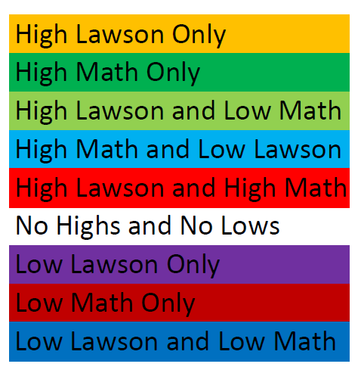
Math and Lawson pretests are (semi-)independent predictors
Top-quartile grades
Bottom-quartile grades

Slide 60
Math and Lawson pretests are (semi-)independent predictors
Top-quartile grades
78% are top-quartile in Math, Lawson, or both
Bottom-quartile grades

Slide 61
Math and Lawson pretests are (semi-)independent predictors
Top-quartile grades
Bottom-quartile grades
52% are bottom quartile in Math, Lawson, or both without compensating high score

Slide 62
Math and Lawson pretests are (semi-)independent predictors
0% low Math or Lawson without compensating high score
Top-quartile grades
Bottom-quartile grades

Slide 63
Math and Lawson pretests are (semi-)independent predictors
Top-quartile grades
Bottom-quartile grades
Only 22% with Lawson and/or Math high (regardless of compensation)

Slide 64
Grades vs. Predictors: An example

Slide 65
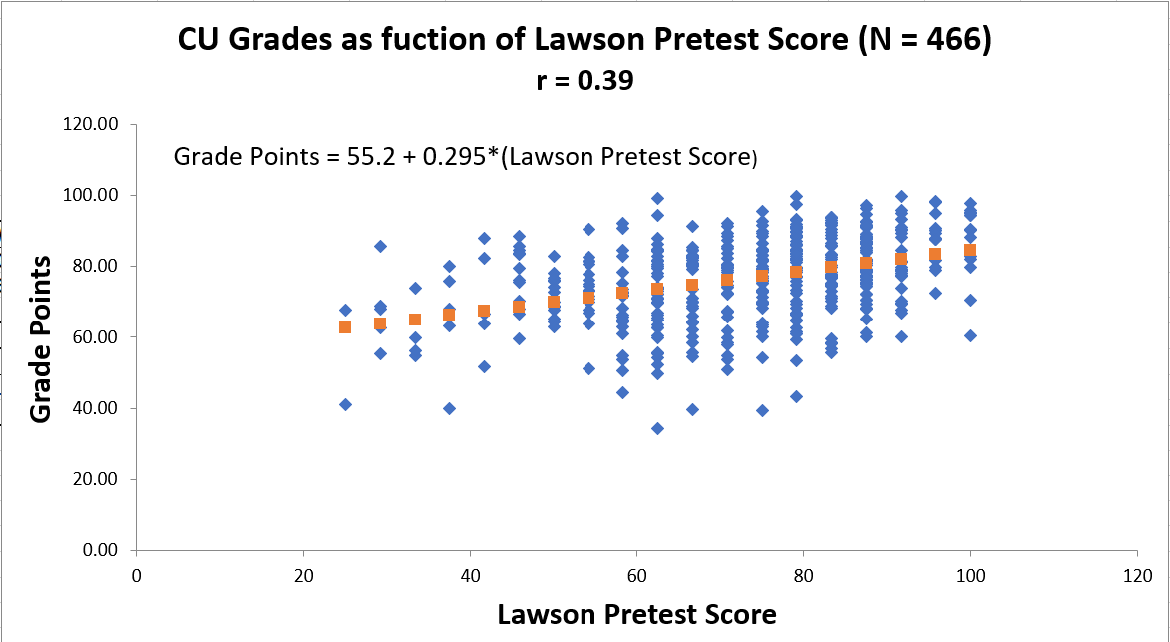
CU Grades = 0.2945*Lawson Pre
CU Grades as a function of Lawson Pretest Score (N=466)
r = 0.39

Slide 66
CU Grades = 0.2945*Lawson Pre
CU Grades as a function of Lawson Pretest Score (N=466)
r = 0.39
Lawson pretest score can have large effect on grades

Slide 67
CU Grades = 0.2945*Lawson Pre
CU Grades as a function of Lawson Pretest Score (N=466)
r = 0.39
15/24 correct = C grade

Slide 68
CU Grades = 0.2945*Lawson Pre
CU Grades as a function of Lawson Pretest Score (N=466)
r = 0.39
21/24 correct = B grade
15/24 correct = C grade

Slide 69
CU Grades = 0.2945*Lawson Pre

Slide 70
CU Grades = 0.2945*Lawson Pre = 0.08 FCI Pretest + 0.2642 Lawson Pretest

Slide 71
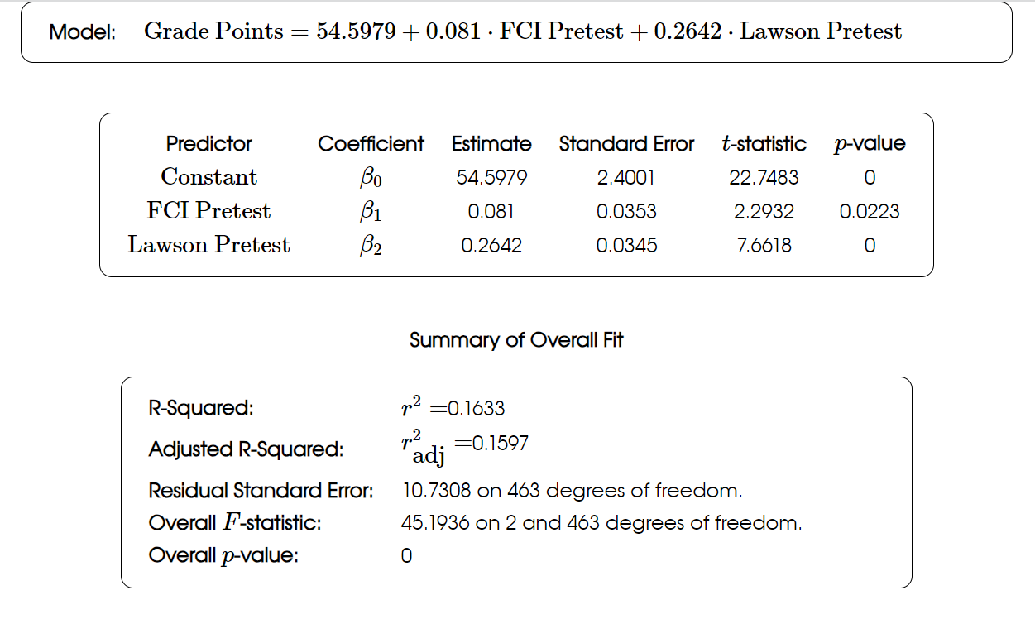
CU Grades = 0.2945*Lawson Pre = 0.08 FCI Pretest + 0.2642 Lawson Pretest

Slide 72
CU Grades = 0.2945*Lawson Pre = 0.08 FCI Pretest + 0.2642 Lawson Pretest
In this class, the Lawson score had the larger influence on grades

Slide 73
Summary
Numerous factors influence students’ physics course performance
Previous preparation in calculational skill, reasoning, and physics concept knowledge is important (as well as effort)
Our results are consistent with findings reported by:
L. Ding, PRPER 10, 023101 (2014)]
Salehi et al., PRPER 15, 020114 (2019)
Stewart et al., PRPER 17, 010107 (2021)

