Slide 1
Relationship between course grades in introductory physics and pre-instruction assessment scores
David E. Meltzer¹ and Dakota H. King²
¹Arizona State University
²University of Arizona College of Veterinary Medicine
Supported in part by NSF DUE #1504986 and #1914712

Slide 2
Acknowledgments
Diagnostic data have been provided by (among others):
Vince Coletta (Loyola Marymount University)
Steven Pollock (University of Colorado, Boulder)
Christopher Varney (University of West Florida)

Slide 3
Assessment Pretests
Diagnostic pretest covering pre-college mathematics (“Math”)
calculators allowed
Pre-instruction tests of scientific reasoning skill and physics concept knowledge:
Lawson Test of Scientific Reasoning (“Lawson”)
Force Concept Inventory (FCI)
Why do this? Perhaps ultimately we can offer special assistance to those students who need it most.

Slide 4
Sample Description
30 introductory physics classes from 4 universities, over 2000 total students
Instruction in most classes was “non-traditional,” generally highly interactive using research-based instructional materials and methods

Slide 5
Course and Institution Code
Alg-1: Algebra-based course, first semester
Alg-2: Algebra-based course, second semester
Calc-1: Calculus-based course, first semester
Calc-2: Calculus-based course, second semester
ASU-P: Arizona State University, Polytechnic campus
ASU-T: Arizona State University, Tempe campus
LMU: Loyola Marymount University
UWF: University of West Florida
CU: University of Colorado, Boulder

Slide 6
Comparing probabilities of high* and low* grades
What is the probability of a student with a high score on a pre-instruction assessment getting a high grade in the class?
How does that compare to a low-scoring student’s probability of getting a high grade?
(and, same questions for probabilities of getting a low grade)
*In this context, “high” and “low” mean “top quartile” and “bottom quartile”

Slide 7
Consistent result:
High scorers on the diagnostic pretests were much more likely to get high grades than were low scorers

Slide 8
High Course Grade vs. Mathematics Diagnostic Pretest Score
Course | Campus | N | Top-quartile Math: % with top-quartile grades | Bottom-quartile Math: % with top-quartile grades | High-grade odds ratio
Alg-1 2021a | ASU-P | 39 | 51% | 10% | 5.0
Alg-1 2021b | ASU-P | 42 | 44% | 10% | 4.6
Alg-1 2022a | ASU-P | 40 | 27% | 6% | 4.4
Alg-1 2022b | ASU-P | 52 | 49% | 10% | 5.1
Alg-1 2023a | ASU-P | 42 | 39% | 10% | 4.1
Alg-1 2023b | ASU-P | 46 | 64% | 9% | 7.3
Alg-2 2022 | ASU-P | 75 | 46% | 21% | 2.2
Alg-2 2023 | ASU-P | 92 | 41% | 13% | 3.2
Alg-2 2024 | ASU-P | 99 | 51% | 8% | 6.1
Alg-2 2021 | ASU-T | 129 | 30% | 39% | 0.8
Calc-1 2021a | UWF | 53 | 43% | 0% | “∞”
Calc-1 2021b | UWF | 42 | 43% | 0% | “∞”
Calc-2 2021 | UWF | 58 | 43% | 14% | 3.1
AVERAGE | (unweighted) | (809) | 44% | 12% | 3.8

Slide 9
High Course Grade vs. Mathematics Diagnostic Pretest Score
Course | Campus | N | Top-quartile Math: % with top-quartile grades | Bottom-quartile Math: % with top-quartile grades | High-grade odds ratio
Alg-1 2021a | ASU-P | 39 | 51% | 10% | 5.0
Alg-1 2021b | ASU-P | 42 | 44% | 10% | 4.6
Alg-1 2022a | ASU-P | 40 | 27% | 6% | 4.4
Alg-1 2022b | ASU-P | 52 | 49% | 10% | 5.1
Alg-1 2023a | ASU-P | 42 | 39% | 10% | 4.1
Alg-1 2023b | ASU-P | 46 | 64% | 9% | 7.3
Alg-2 2022 | ASU-P | 75 | 46% | 21% | 2.2
Alg-2 2023 | ASU-P | 92 | 41% | 13% | 3.2
Alg-2 2024 | ASU-P | 99 | 51% | 8% | 6.1
Alg-2 2021 | ASU-T | 129 | 30% | 39% | 0.8
Calc-1 2021a | UWF | 53 | 43% | 0% | “∞”
Calc-1 2021b | UWF | 42 | 43% | 0% | “∞”
Calc-2 2021 | UWF | 58 | 43% | 14% | 3.1
AVERAGE | (unweighted) | (809) | 44% | 12% | 3.8

Slide 10
High Course Grade vs. Mathematics Diagnostic Pretest Score
Course | Campus | N | Top-quartile Math: % with top-quartile grades | Bottom-quartile Math: % with top-quartile grades | High-grade odds ratio
Alg-1 2021a | ASU-P | 39 | 51% | 10% | 5.0
Alg-1 2021b | ASU-P | 42 | 44% | 10% | 4.6
Alg-1 2022a | ASU-P | 40 | 27% | 6% | 4.4
Alg-1 2022b | ASU-P | 52 | 49% | 10% | 5.1
Alg-1 2023a | ASU-P | 42 | 39% | 10% | 4.1
Alg-1 2023b | ASU-P | 46 | 64% | 9% | 7.3
Alg-2 2022 | ASU-P | 75 | 46% | 21% | 2.2
Alg-2 2023 | ASU-P | 92 | 41% | 13% | 3.2
Alg-2 2024 | ASU-P | 99 | 51% | 8% | 6.1
Alg-2 2021 | ASU-T | 129 | 30% | 39% | 0.8
Calc-1 2021a | UWF | 53 | 43% | 0% | “∞”
Calc-1 2021b | UWF | 42 | 43% | 0% | “∞”
Calc-2 2021 | UWF | 58 | 43% | 14% | 3.1
AVERAGE | (unweighted) | (809) | 44% | 12% | 3.8

Slide 11
High Course Grade vs. Mathematics Diagnostic Pretest Score
Course | Campus | N | Top-quartile Math: % with top-quartile grades | Bottom-quartile Math: % with top-quartile grades | High-grade odds ratio
Alg-1 2021a | ASU-P | 39 | 51% | 10% | 5.0
Alg-1 2021b | ASU-P | 42 | 44% | 10% | 4.6
Alg-1 2022a | ASU-P | 40 | 27% | 6% | 4.4
Alg-1 2022b | ASU-P | 52 | 49% | 10% | 5.1
Alg-1 2023a | ASU-P | 42 | 39% | 10% | 4.1
Alg-1 2023b | ASU-P | 46 | 64% | 9% | 7.3
Alg-2 2022 | ASU-P | 75 | 46% | 21% | 2.2
Alg-2 2023 | ASU-P | 92 | 41% | 13% | 3.2
Alg-2 2024 | ASU-P | 99 | 51% | 8% | 6.1
Alg-2 2021 | ASU-T | 129 | 30% | 39% | 0.8
Calc-1 2021a | UWF | 53 | 43% | 0% | “∞”
Calc-1 2021b | UWF | 42 | 43% | 0% | “∞”
Calc-2 2021 | UWF | 58 | 43% | 14% | 3.1
AVERAGE | (unweighted) | (809) | 44% | 12% | 3.8

Slide 12
High Course Grade vs. Mathematics Diagnostic Pretest Score
Course | Campus | N | Top-quartile Math: % with top-quartile grades | Bottom-quartile Math: % with top-quartile grades | High-grade odds ratio
Alg-1 2021a | ASU-P | 39 | 51% | 10% | 5.0
Alg-1 2021b | ASU-P | 42 | 44% | 10% | 4.6
Alg-1 2022a | ASU-P | 40 | 27% | 6% | 4.4
Alg-1 2022b | ASU-P | 52 | 49% | 10% | 5.1
Alg-1 2023a | ASU-P | 42 | 39% | 10% | 4.1
Alg-1 2023b | ASU-P | 46 | 64% | 9% | 7.3
Alg-2 2022 | ASU-P | 75 | 46% | 21% | 2.2
Alg-2 2023 | ASU-P | 92 | 41% | 13% | 3.2
Alg-2 2024 | ASU-P | 99 | 51% | 8% | 6.1
Alg-2 2021 | ASU-T | 129 | 30% | 39% | 0.8
Calc-1 2021a | UWF | 53 | 43% | 0% | “∞”
Calc-1 2021b | UWF | 42 | 43% | 0% | “∞”
Calc-2 2021 | UWF | 58 | 43% | 14% | 3.1
AVERAGE | (unweighted) | (809) | 44% | 12% | 3.8

Slide 13
High scorers on math pretest were 3.8 times more likely to get a high grade than were low scorers

Slide 14
High Course Grade vs. Lawson Test of Scientific Reasoning Pretest Score
Course | Campus | N | Top-quartile Lawson: % with top-quartile grades | Bottom-quartile Lawson: % with top-quartile grades | High-grade odds ratio
Alg-1 2021a | ASU-P | 35 | 46% | 23% | 2.0
Alg-1 2021b | ASU-P | 38 | 32% | 8% | 4.0
Alg-1 2022a | ASU-P | 41 | 49% | 10% | 5.0
Alg-1 2022b | ASU-P | 54 | 57% | 10% | 5.6
Alg-1 2023a | ASU-P | 36 | 39% | 33% | 1.2
Alg-1 2023b | ASU-P | 44 | 55% | 9% | 6.0
Alg-2 2022 | ASU-P | 73 | 41% | 6% | 7.6
Alg-2 2023 | ASU-P | 92 | 52% | 10% | 5.0
Alg-2 2024 | ASU-P | 90 | 42% | 5% | 9.2
Alg-1 | CU | 469 | 45% | 8% | 5.5
Calc-2 | CU | 276 | 57% | 8% | 6.9
Alg-1 2007 | LMU | 24 | 50% | 0% | “∞”
Alg-1 2009 | LMU | 51 | 34% | 11% | 3.2
Alg-1 2011 | LMU | 57 | 53% | 18% | 2.9
Alg-1 2012 | LMU | 44 | 64% | 6% | 10.5
Alg-1 2013 | LMU | 30 | 53% | 12% | 4.6
Alg-1 2014 | LMU | 33 | 61% | 0% | “∞”
Alg-1 2015 | LMU | 24 | 63% | 0% | “∞”
Alg-1 2016 | LMU | 35 | 41% | 0% | “∞”
Alg-1 2018 | LMU | 47 | 54% | 9% | 6.3
Alg-1 2021 | LMU | 27 | 44% | 0% | “∞”
AVERAGE | (unweighted) | (1620) | 49% | 9% | 5.5

Slide 15
High Course Grade vs. FCI
Course | Campus | N | Top-quartile FCI: % with top-quartile grades | Bottom-quartile FCI: % with top-quartile grades | High-grade odds ratio
Alg-1 2018 | ASU-P | 48 | 40% | 8% | 4.8
Alg-1 2019 | ASU-P | 63 | 38% | 13% | 3.0
Alg-1 2021a | ASU-P | 35 | 57% | 0% | “∞”
Alg-1 2021b | ASU-P | 37 | 32% | 17% | 1.9
Alg-1 2022a | ASU-P | 41 | 21% | 15% | 1.4
Alg-1 2022b | ASU-P | 52 | 26% | 7% | 3.9
Alg-1 2023a | ASU-P | 40 | 30% | 20% | 1.3
Alg-1 2023b | ASU-P | 47 | 55% | 18% | 3.1
Alg-1 | CU | 470 | 41% | 12% | 3.5
Alg-1 2007 | LMU | 23 | 87% | 0% | “∞”
Alg-1 2009 | LMU | 51 | 63% | 0% | “∞”
Alg-1 2012 | LMU | 44 | 50% | 0% | “∞”
Alg-1 2013 | LMU | 30 | 51% | 0% | “∞”
Alg-1 2014 | LMU | 33 | 43% | 12% | 3.6
Alg-1 2015 | LMU | 24 | 67% | 0% | “∞”
Alg-1 2016 | LMU | 34 | 71% | 0% | “∞”
Alg-1 2018 | LMU | 47 | 34% | 14% | 2.4
Alg-1 2021 | LMU | 27 | 44% | 0% | “∞”
Calc-1 2012 | ASU-P | 40 | 43% | 0% | “∞”
Calc-1 2013a | ASU-P | 18 | 44% | 0% | “∞”
Calc-1 2013b | ASU-P | 48 | 54% | 17% | 3.3
Calc-1 2021a | UWF | 62 | 29% | 26% | 1.1
Calc-1 2021b | UWF | 53 | 40% | 15% | 2.6
AVERAGE | (unweighted) | (1367) | 46% | 8% | 5.4

Slide 16
High scorers on the pretests were about 5 times more likely to get a high grade than low scorers.
Low scorers on the pretests were about 4 times more likely to get a low grade than high scorers.
High and low grades for high and low scorers were compared for more than 2000 students in 30 distinct classes at 4 universities, yielding a total of 114 high/low comparisons.
The quartile ratios were greater than 1.0 in 111 of the 114 cases (97%).

Slide 17
Relevant Questions
Which, if any, of the diagnostic pretests is most predictive of students’ performance?
Does using multiple predictor variables offer greater predictive power than using just one of them?
Can an “accurate” predictive model be created that incorporares multiple predictor variables?
Does better performance on one pretest indicate that another pretest is more (or less) predictive? (This would be an “interaction” effect.)

Slide 18
Relevant Questions
Which, if any, of the diagnostic pretests is most predictive of students’ performance?
Courses and instructors differ on the relative emphasis placed on conceptual problems, mathematical problem solving, and problems requiring significant reading and reasoning skills.
There are also many possible ways to compare relative “predictability”
…for example, compare high/low grade ratios for different pretests
Varies with the course

Slide 19
High Grade Odds Ratios
Course | Campus | N (# classes) | High-grade odds ratio, Math (average) | High-grade odds ratio, Lawson (average) | High-grade odds ratio, FCI (average)
Alg-1 | ASU-P | 6 | 5.0 | 3.0 | 3.6
Alg-1 | CU | 1 | -- | 5.5 | 3.5
Alg-1 | LMU | 9 | -- | 12.2 | 19.6
Alg-2 | ASU-P | 3 | 3.3 | 6.4 | --
Calc-1 | UWF | 2 | “∞” | -- | 1.7

Slide 20
High Grade Odds Ratios
Course | Campus | N (# classes) | High-grade odds ratio, Math (average) | High-grade odds ratio, Lawson (average) | High-grade odds ratio, FCI (average)
Alg-1 | ASU-P | 6 | 5.0 | 3.0 | 3.6
Alg-1 | CU | 1 | -- | 5.5 | 3.5
Alg-1 | LMU | 9 | -- | 12.2 | 19.6
Alg-2 | ASU-P | 3 | 3.3 | 6.4 | --
Calc-1 | UWF | 2 | “∞” | -- | 1.7
Low Grade Odds Ratios
Course | Campus | N (# classes) | Low-grade odds ratio, Math (average) | Low-grade odds ratio, Lawson (average) | Low-grade odds ratio, FCI (average)
Alg-1 | ASU-P | 6 | 2.8 | 3.9 | 3.2
Alg-1 | CU | 1 | -- | 4.4 | 1.1
Alg-1 | LMU | 9 | -- | 6.8 | 5.4
Alg-2 | ASU-P | 3 | 3.7 | 2.6 | --
Calc-1 | UWF | 2 | 4.2 | -- | 3.1

Slide 21
Another Approach: Multiple Regression
Fit an equation including all predictor variables to the data using ordinary least squares, e.g.:
Grades = β₀ + β₁ * Lawson Pretest + β₂ * Math Pretest + β₃ * FCI Pretest
Problem: most sample sizes too small to yield significant results, and too much between-class variation to combine samples
Partial solution:
choose one very large sample (Alg-1 CU; N = 466) to compare Lawson and FCI
combine three very similar classes taught by same instructor (Alg-2 ASU-P, 2022-23-24; N = 216) to compare Lawson and Math

Slide 22
Reminder: Results for High Grade Odds Ratios for CU sample
Course | Campus | N | High-grade odds ratio, Math | High-grade odds ratio, Lawson | High-grade odds ratio, FCI
Alg-1 | CU | 466 | -- | 5.5 | 3.5
Low Grade Odds Ratios
Course | Campus | N | Low-grade odds ratio, Math | Low-grade odds ratio, Lawson | Low-grade odds ratio, FCI
Alg-1 | CU | 466 | -- | 4.4 | 1.1
Lawson pretest score seems to be more predictive than FCI pretest score

Slide 23
Alg-1 CU, N = 466
Results of Multiple Regression

Slide 24
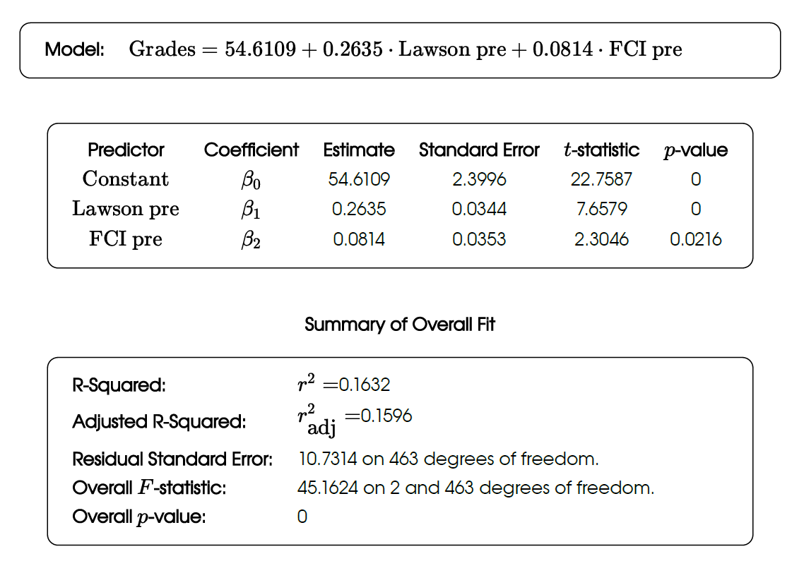
Alg-1 CU, N = 466

Slide 25
Alg-1 CU, N = 466
Lawson more “influential”* than FCI
Both variables statistically significant
But correlation is quite low
*weighted more heavily when predicting grades
(Interaction effect not significant)

Slide 26
High Grade Odds Ratios for Alg-2 ASU-P
Course | Campus | N | High-grade odds ratio, Math | High-grade odds ratio, Lawson | High-grade odds ratio, FCI
Alg-2 | ASU-P, 2022-23-24 | 216 | 2.8 | 4.1 | --

Slide 27
High Grade Odds Ratios for Alg-2 ASU-P
Course | Campus | N | High-grade odds ratio, Math | High-grade odds ratio, Lawson | High-grade odds ratio, FCI
Alg-2 | ASU-P, 2022-23-24 | 216 | 2.8 | 4.1 | --

Slide 28
High Grade Odds Ratios for Alg-2 ASU-P
Course | Campus | N | High-grade odds ratio, Math | High-grade odds ratio, Lawson | High-grade odds ratio, FCI
Alg-2 | ASU-P, 2022-23-24 | 216 | 2.8 | 4.1 | --
Low Grade Odds Ratios for Alg-2 ASU-P
Course | Campus | N | Low-grade odds ratio, Math | Low-grade odds ratio, Lawson | Low-grade odds ratio, FCI
Alg-2 | ASU-P, 2022-23-24 | 216 | 4.8 | 2.4 | --
No consistent “best” predictor

Slide 29
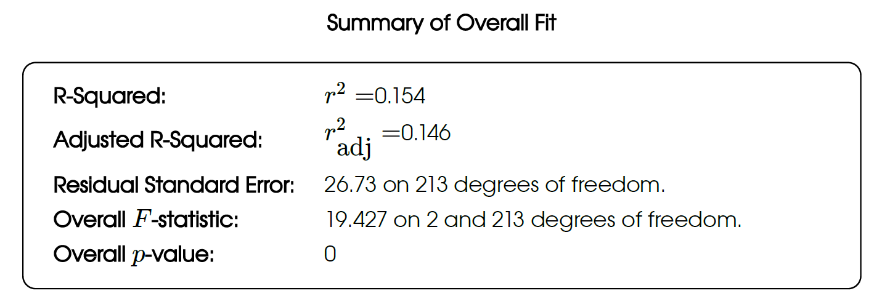
Alg-2 ASU-P, 2022-23-24, N = 216
Math more “influential” than Lawson?
Both variables statistically significant
But correlation is still quite low
(Interaction effect not significant)

Slide 30
Regression analysis can be misleading
High scatter in the data leads to relatively low correlation
However, quartile comparison can reveal highly significant differences between low and high scorers

Slide 31
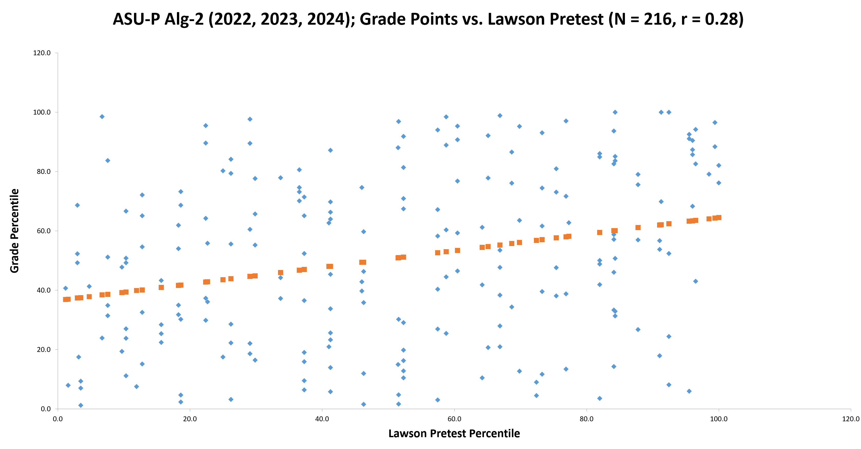

Slide 32
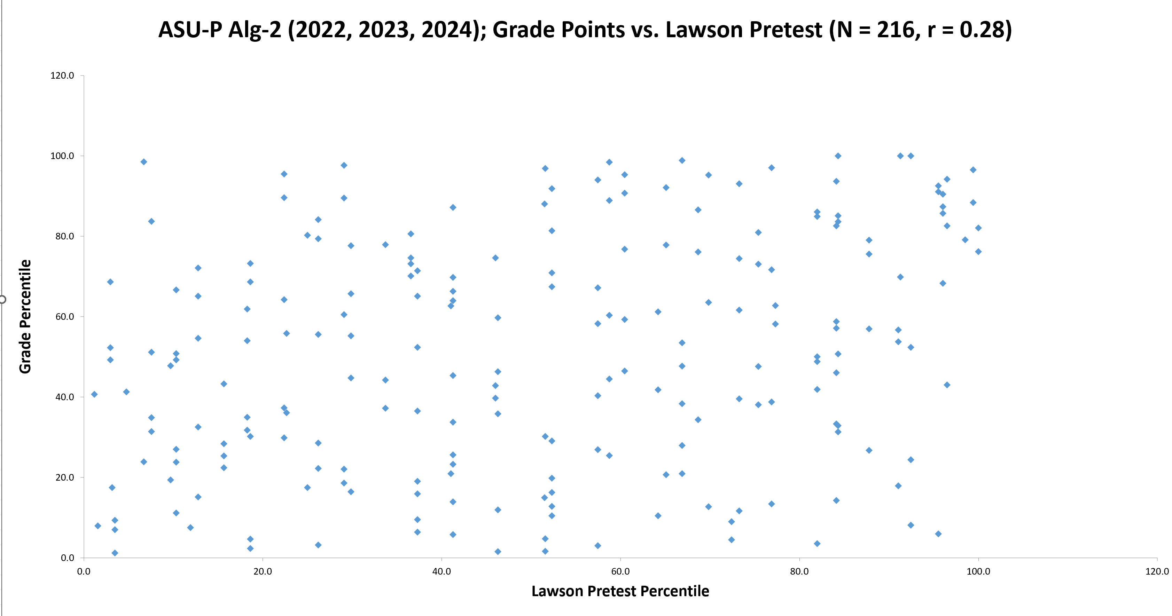

Slide 33
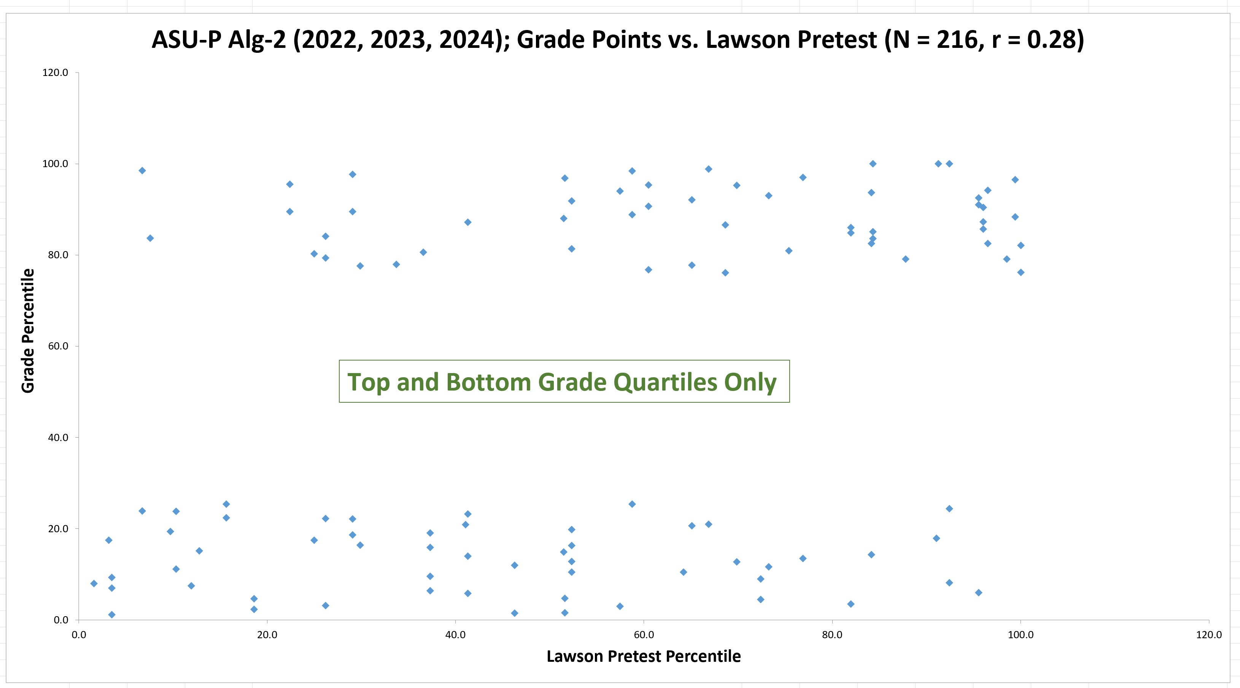

Slide 34
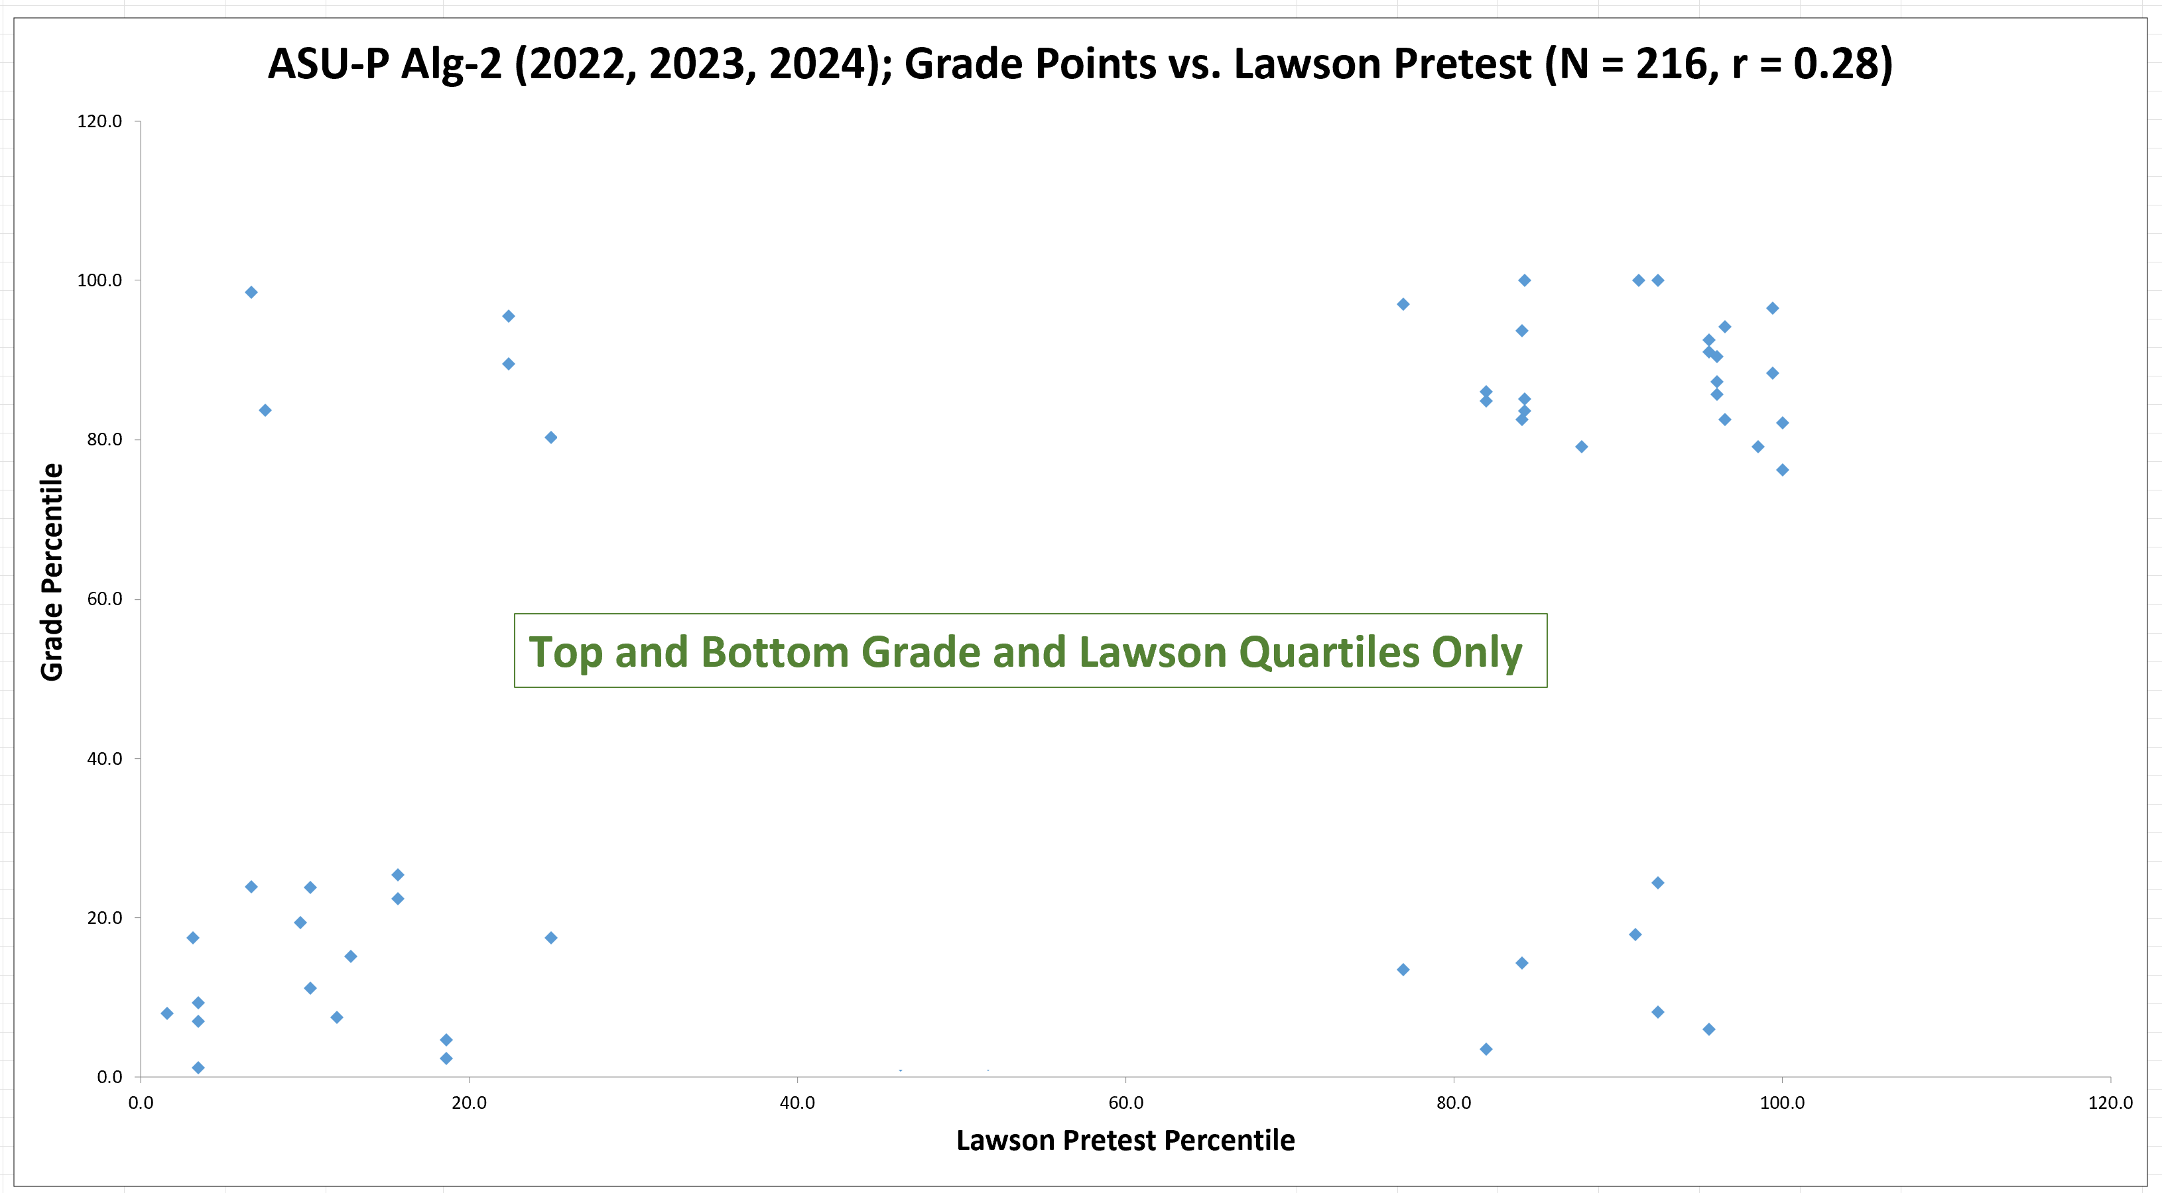

Slide 35
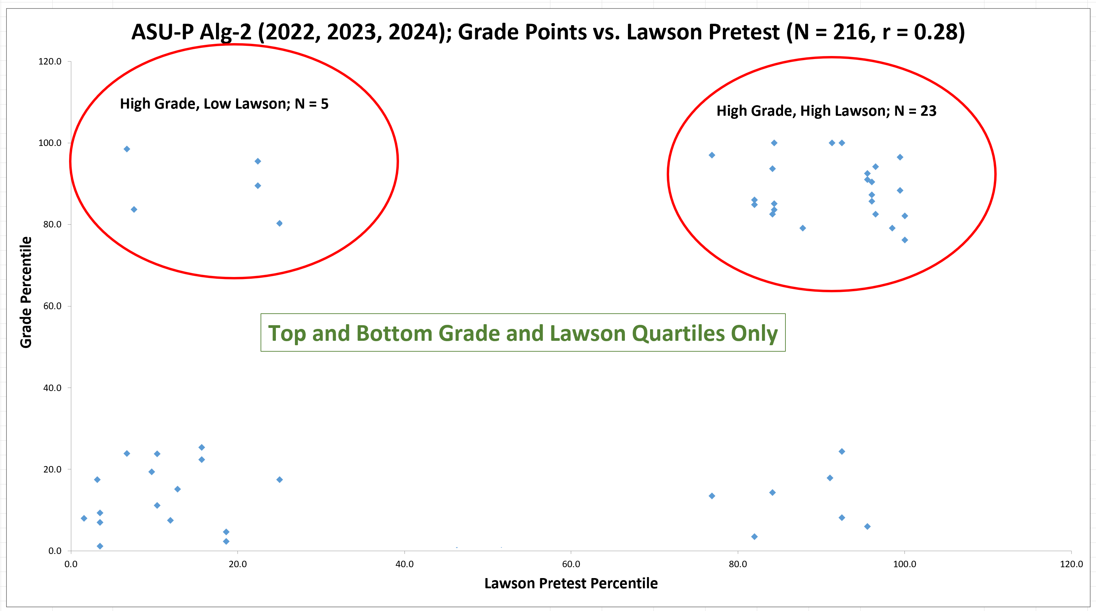

Slide 36
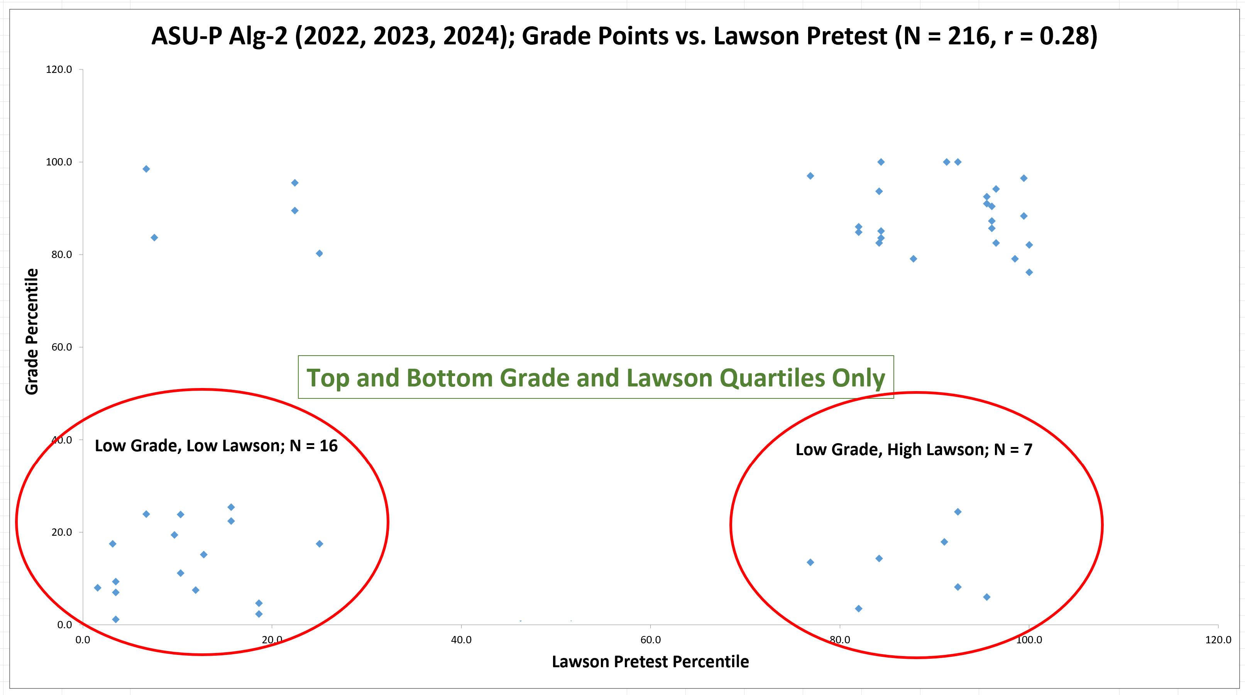

Slide 38
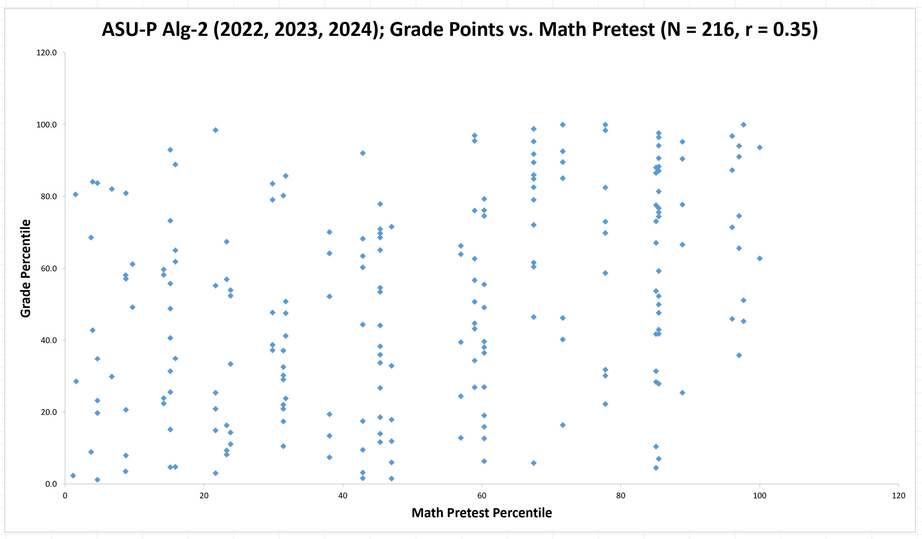

Slide 39
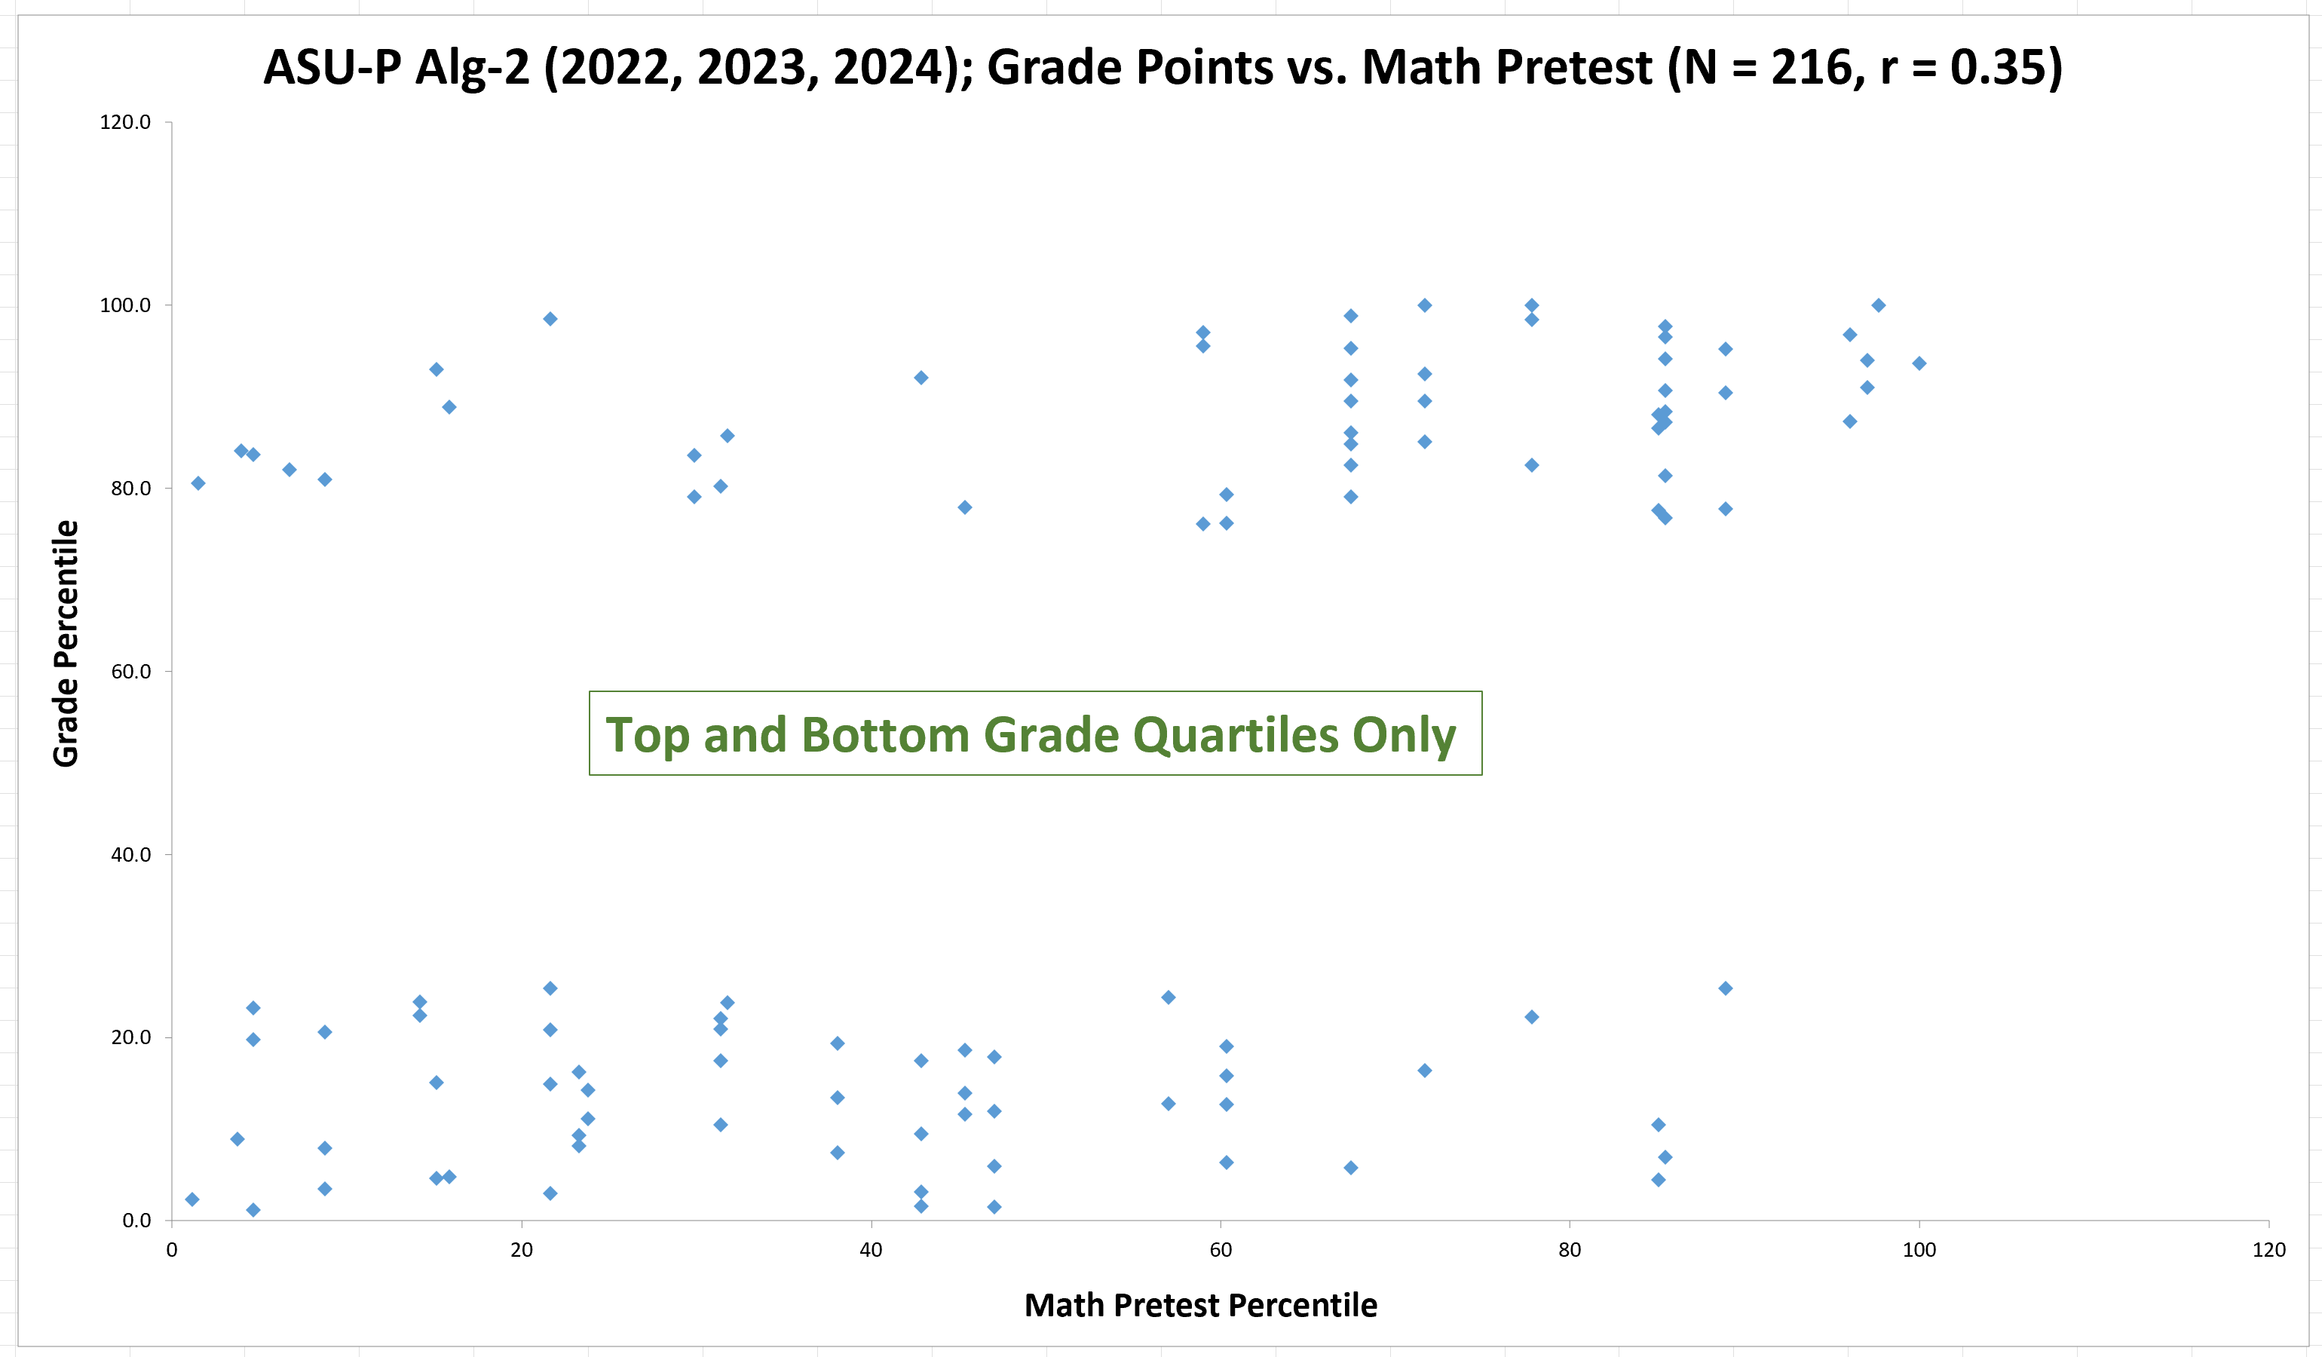

Slide 40
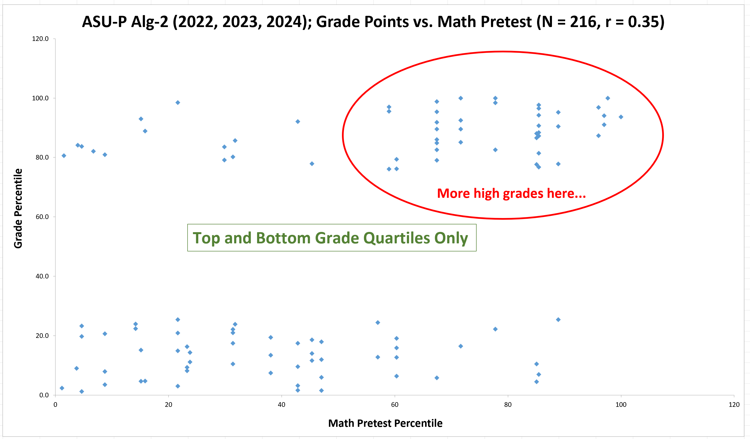

Slide 41
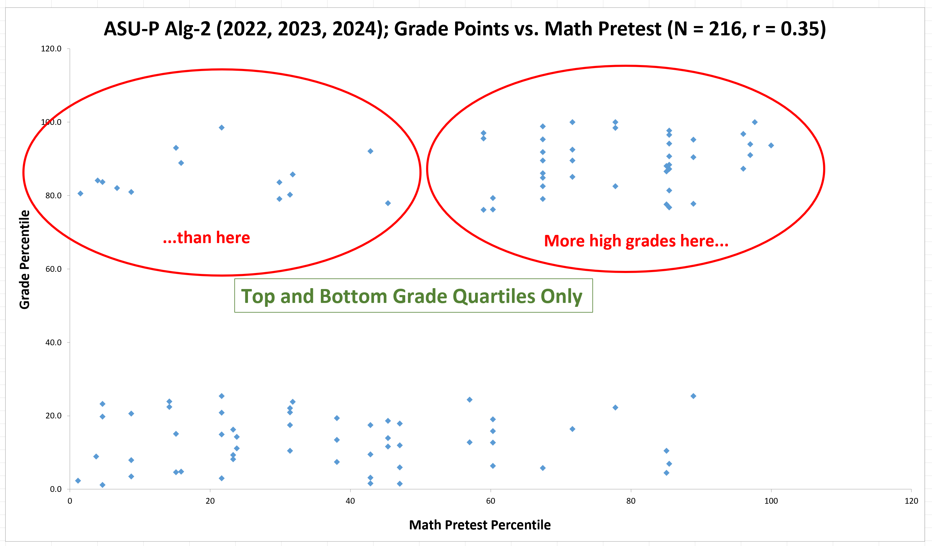

Slide 42
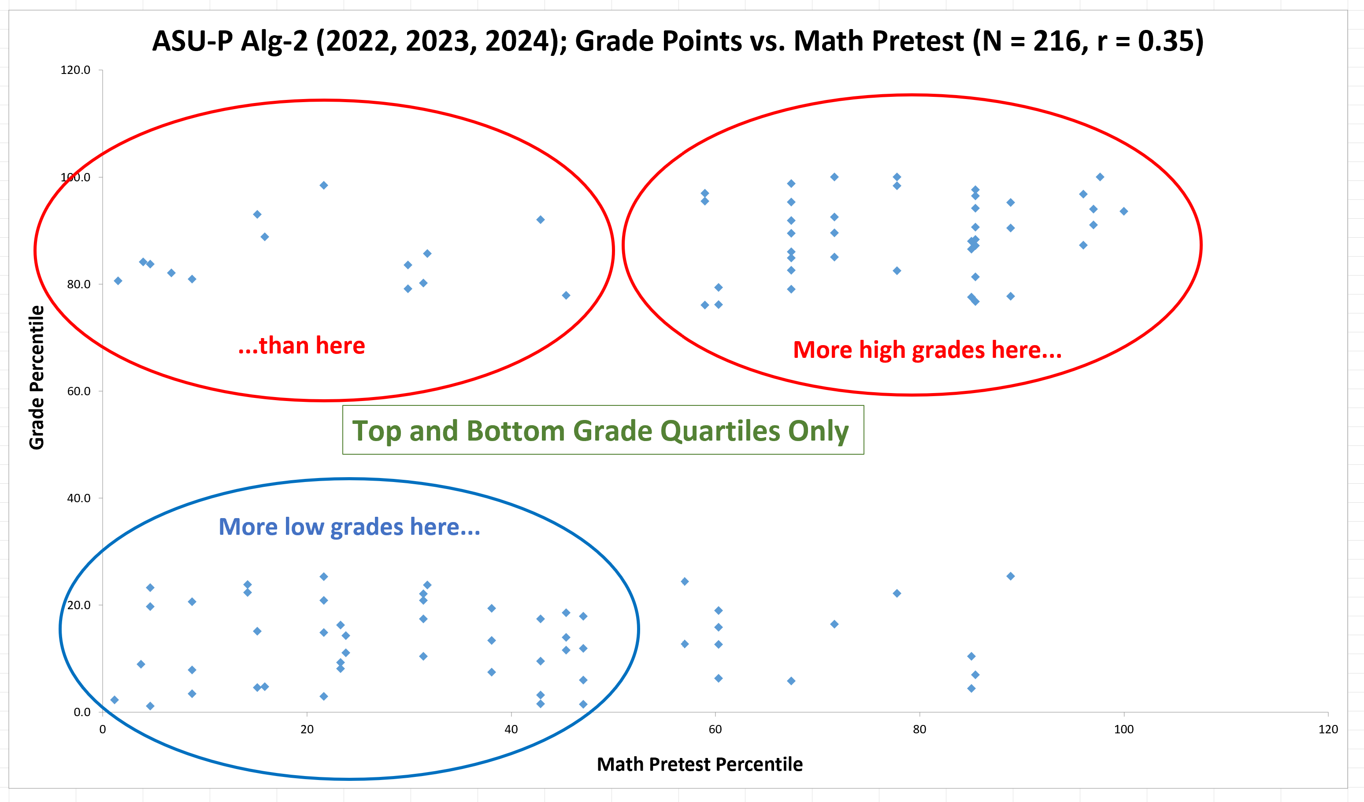

Slide 43
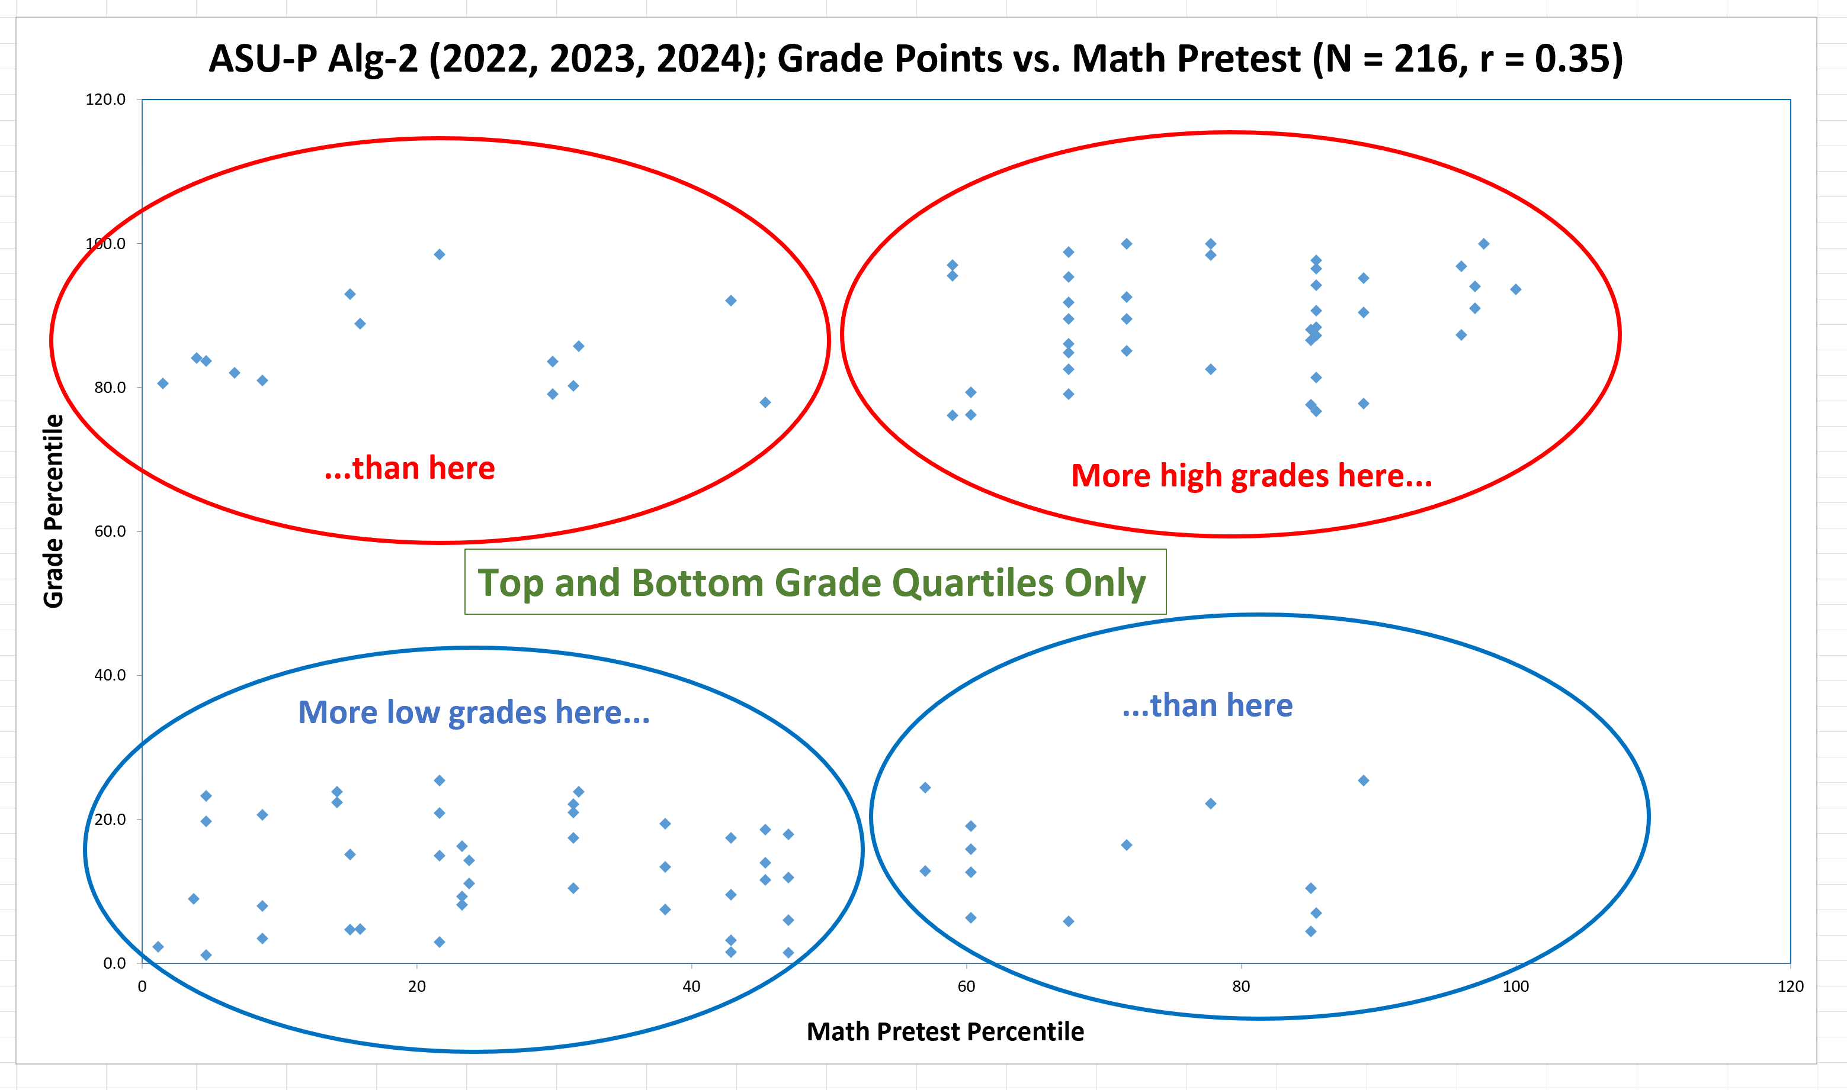

Slide 44
Relevant Questions
Can an “accurate” predictive model be created that incorporares multiple predictor variables?
No, but better than random

Slide 45
Alg-2 ASU-P, 2022-23-24, N = 216
Q: How accurately can this model predict students’ grades?
A: If we randomly guess in which grade quartile each student will end up, we’d be right 25% of the time.
If instead we had applied this model to each actual* student’s Lawson and Math pretest scores, we would have correctly predicted whether they ended up with top- or bottom-quartile grades 45% of the time.
*that is, the students in Alg-2 ASU-P 2022-23-24

Slide 46
Relevant Questions
Does using multiple predictor variables offer greater predictive power than using just one of them?
Yes

Slide 47
Further Analysis of Alg-2 ASU-P sample (N = 216)
Probability of top-quartile grade
Probability of bottom-quartile grade
0%
28%
“∞”
Top-half on Math pretest
54%
24%
2.3
Top-Quartile on Lawson Pretest
Bottom-half on Math pretest
Ratio

Slide 48
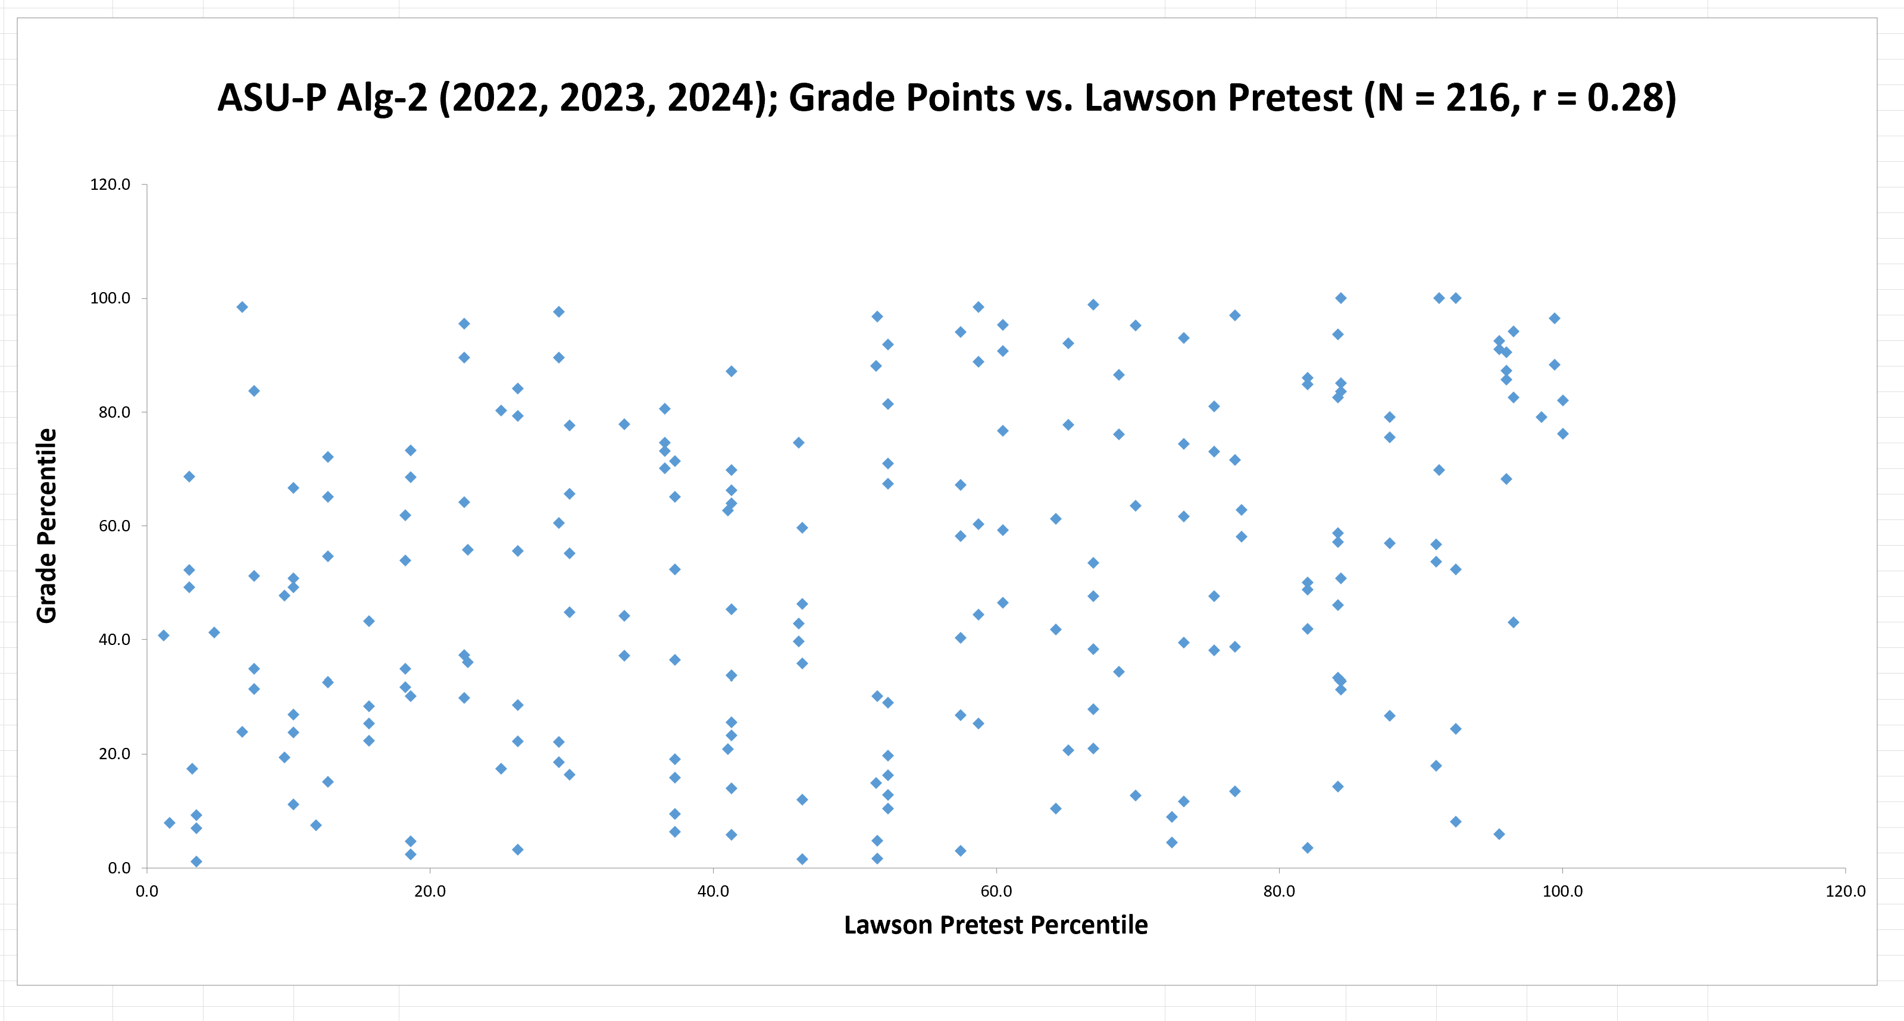

Slide 51
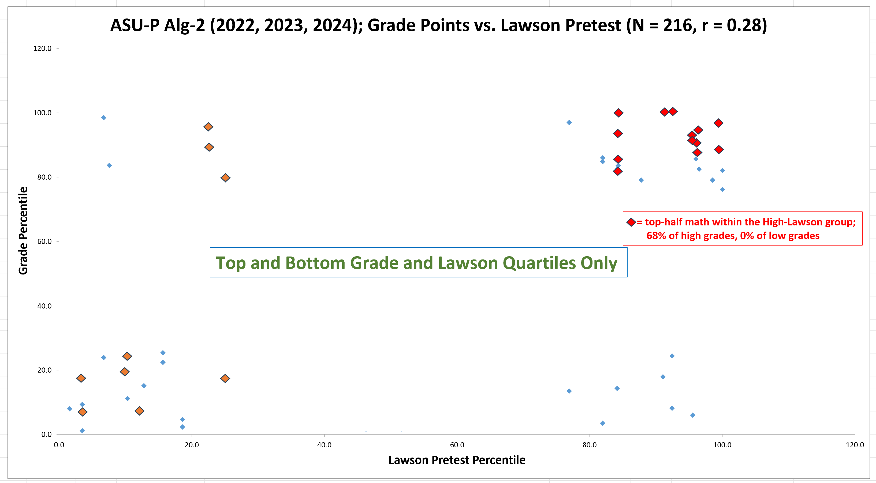

Slide 52
Relevant Questions
Does better performance on one pretest indicate that another pretest is more (or less) predictive? (This would be an “interaction” effect.)
Maybe

Slide 53
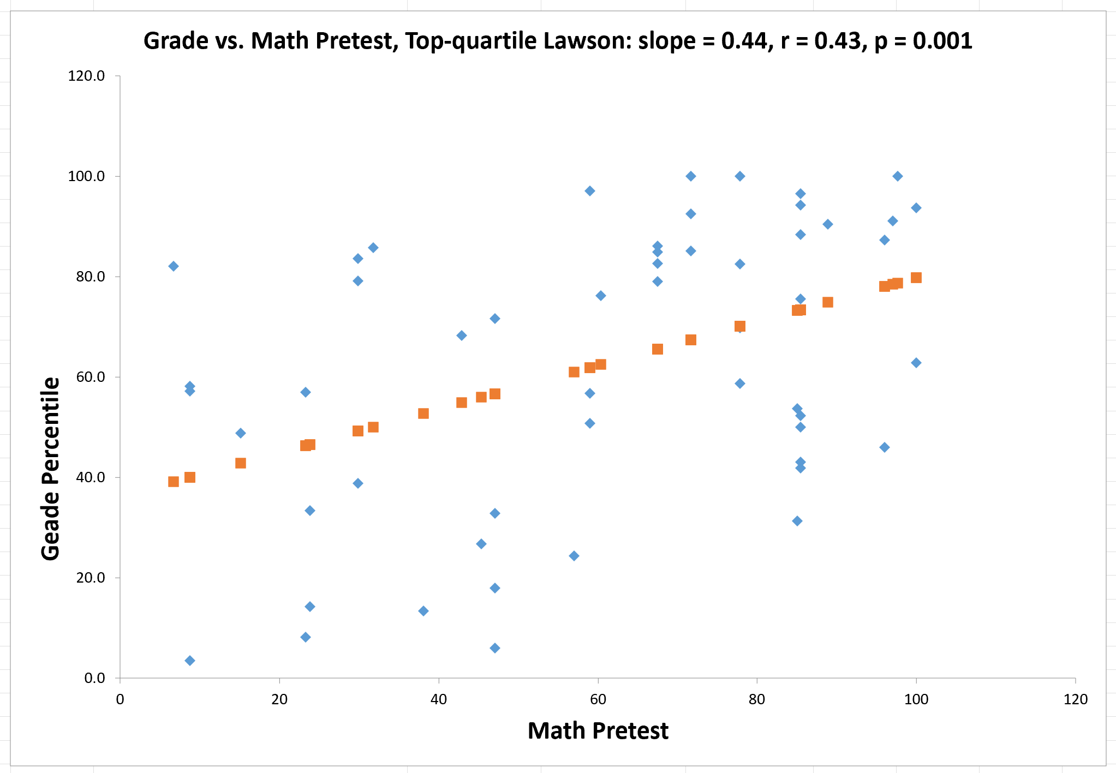

Slide 54
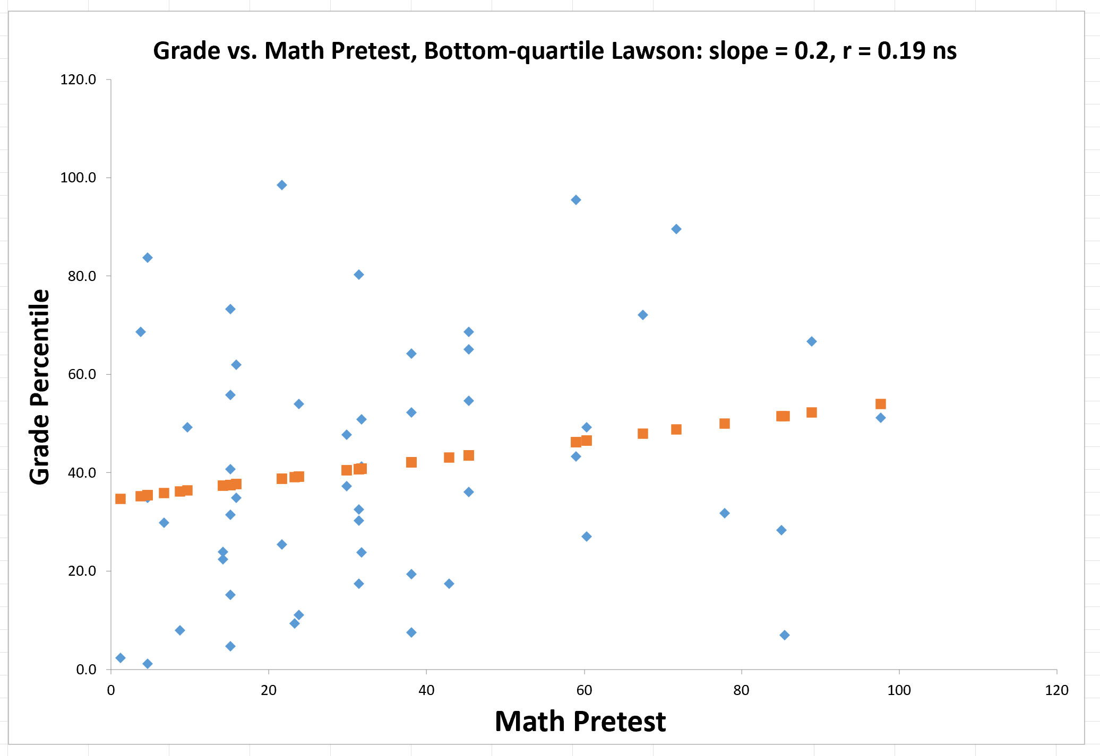

Slide 55
Important Note
Anecdotal evidence shows:
Students with low pretest scores but high grades are often highly engaged and regular participants in class activity
High scores but low grades are often associated with missing many classes and assignments

Slide 56
Summary
High and low pretest scores on diagnostic tests are consistently predictive of students’ probability of attaining high or low grades
High pre-instruction scores on a math diagnostic, a test of scientific reasoning, and the FCI are all independently associated with higher probability of getting high grades (and avoiding low grades)
Our results are consistent with findings reported by:
L. Ding, PRPER 10, 023101 (2014)]
Salehi et al., PRPER 15, 020114 (2019)
Stewart et al., PRPER 17, 010107 (2021)

