Slide 1
Physics students’ mathematical environment: Operational skills, contextual understanding, symbolic representation
David E. Meltzer,¹ Dakota H. King,² and John D. Byrd^{1,3}
¹Arizona State University
²Arizona State University (present address) and
National Heart, Lung, and Blood Institute, National Institutes of Health
³Michigan State University (present address)
Supported in part by NSF DUE #1504986 and #1914712

Slide 2
Data Sources
We have given diagnostic pretests covering pre-college mathematics to over 7000 introductory physics students (non-credit; calculators allowed):
In addition, we have carried out more than 70 one-on-one problem-solving interviews with physics students to further explore the nature of students’ thinking.

Slide 3
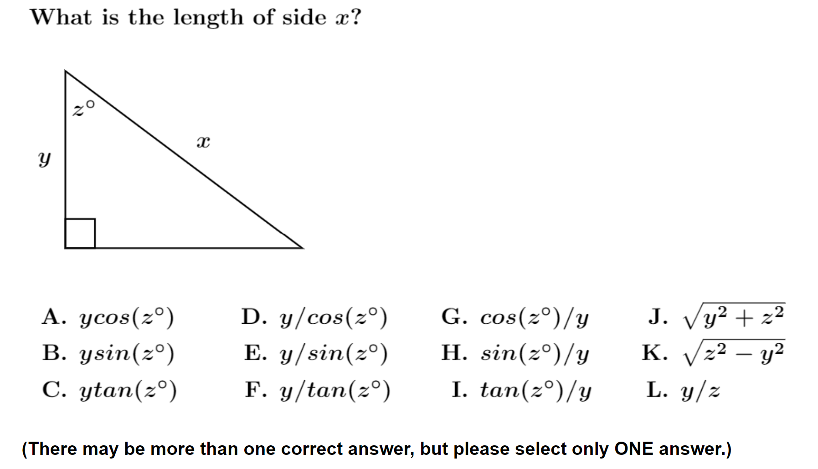
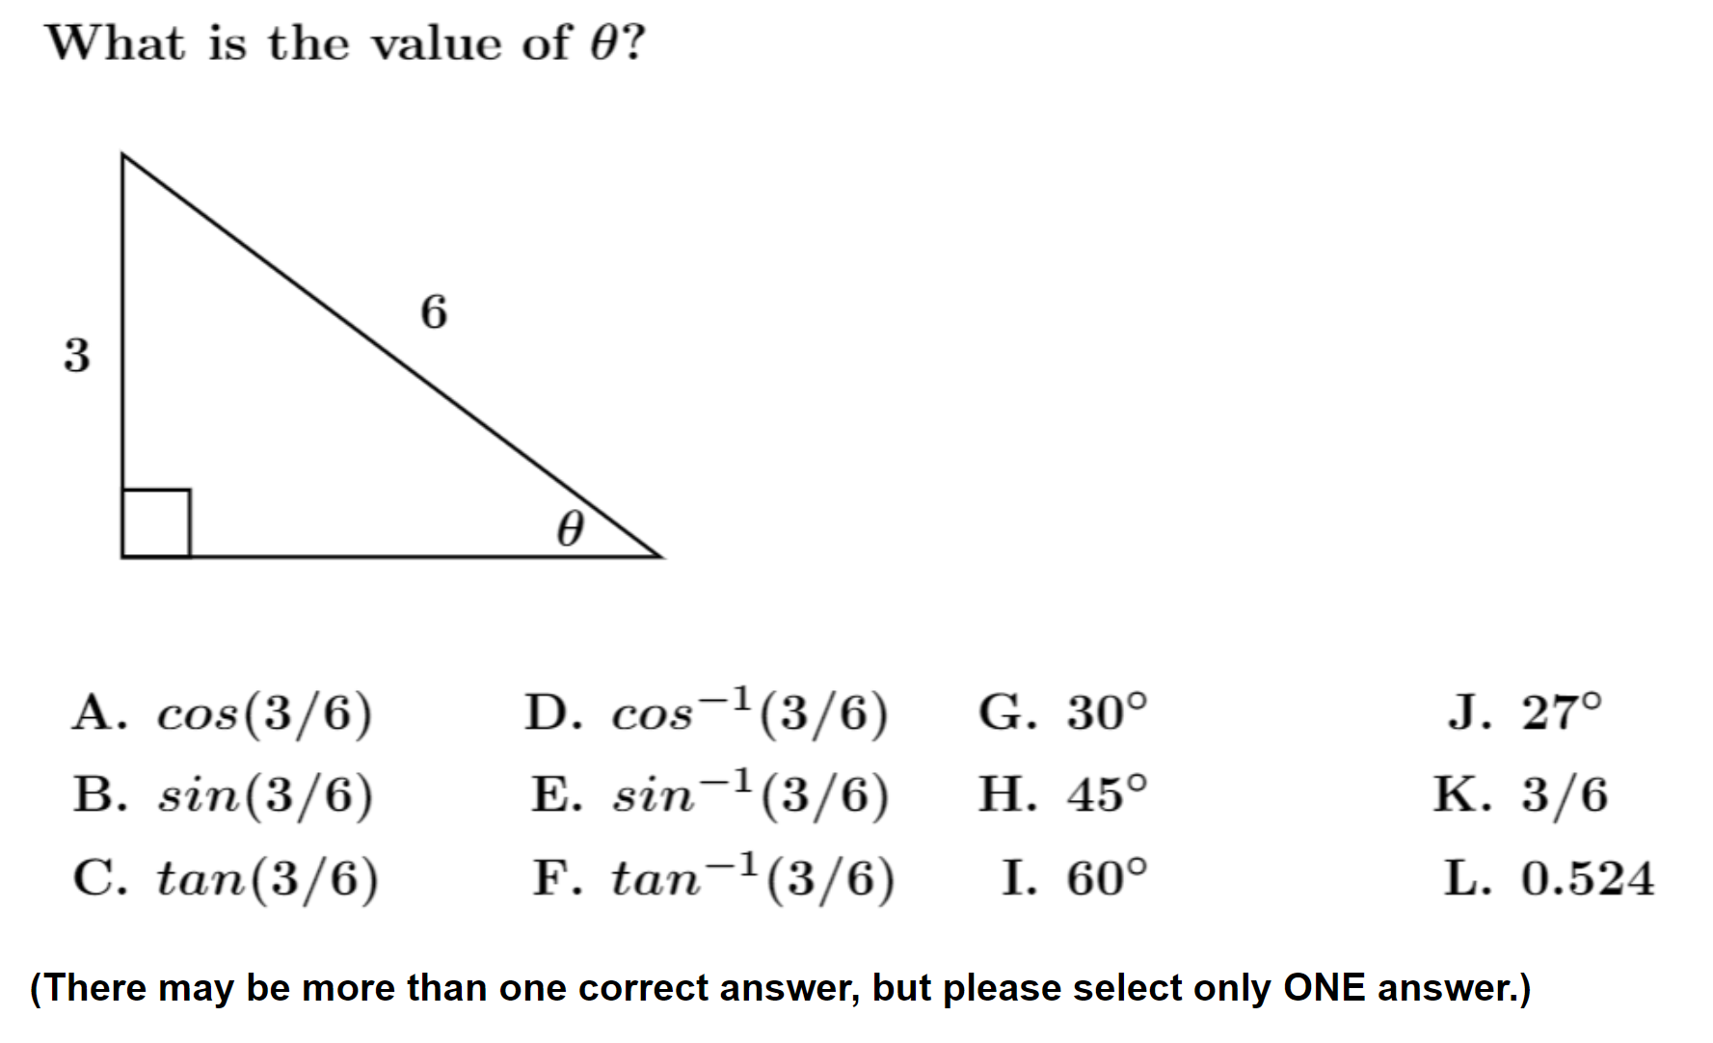

Slide 4
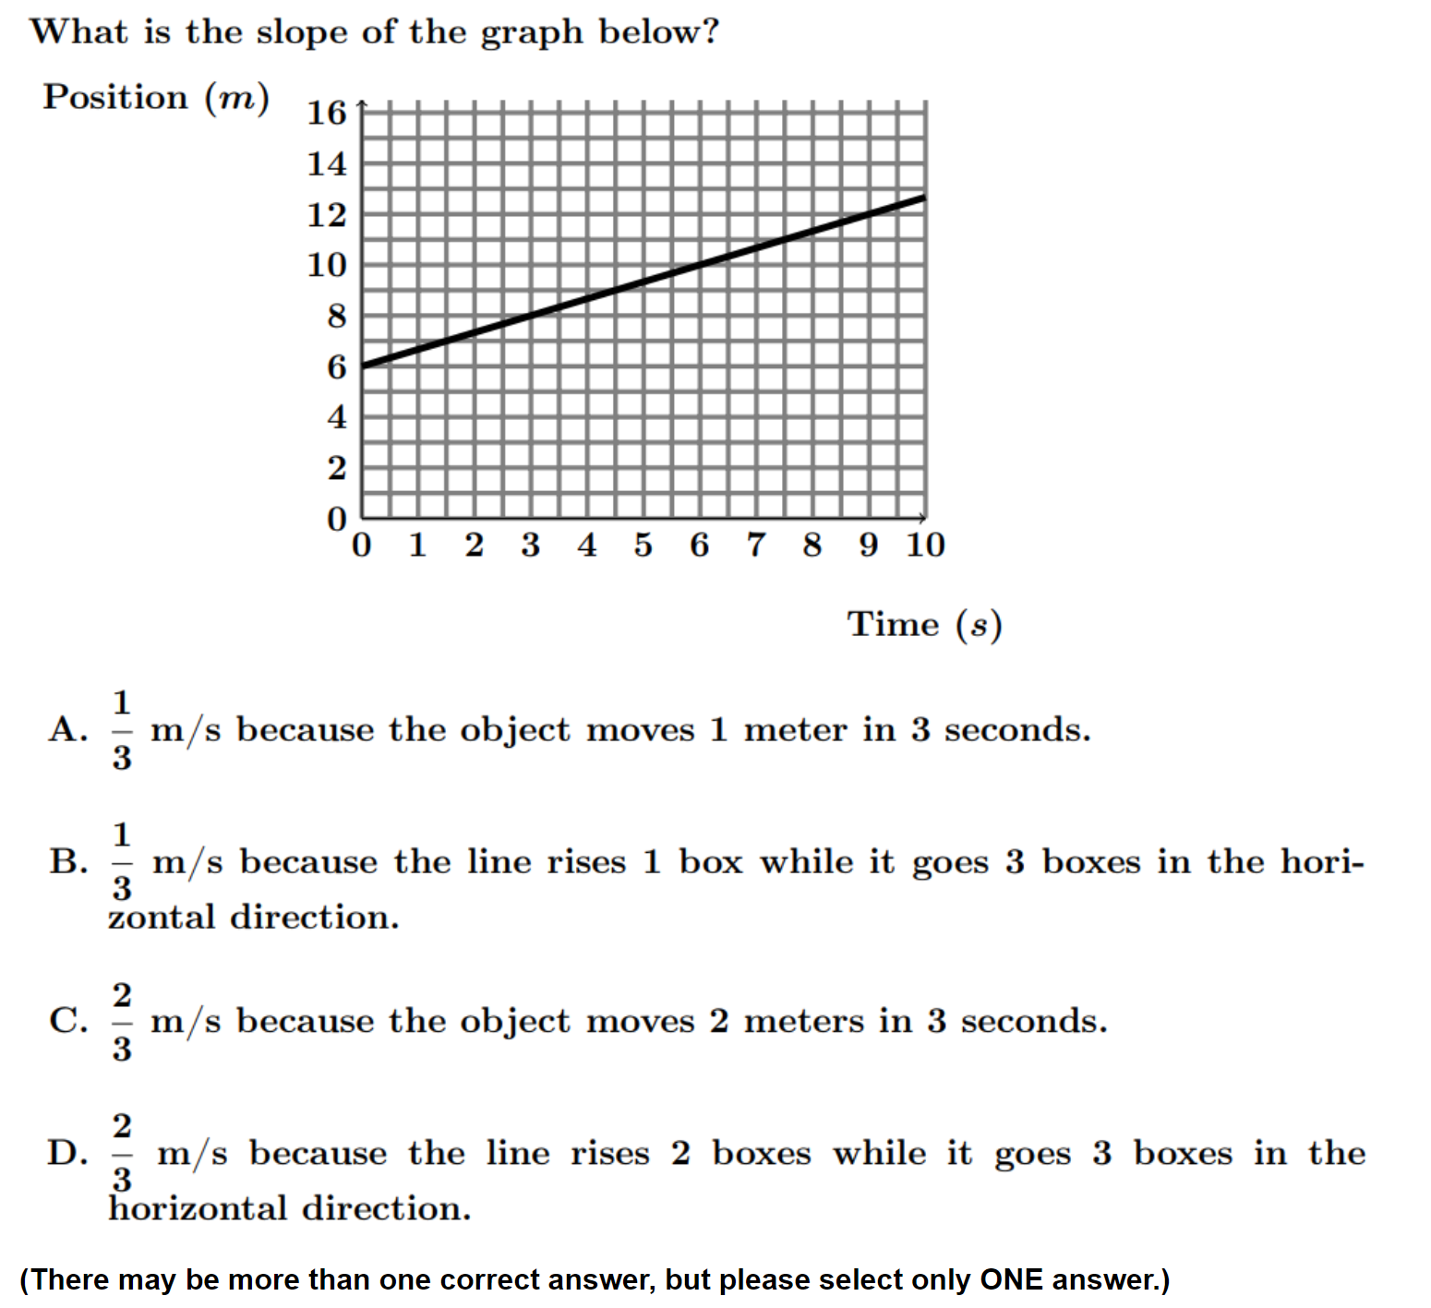

Slide 5
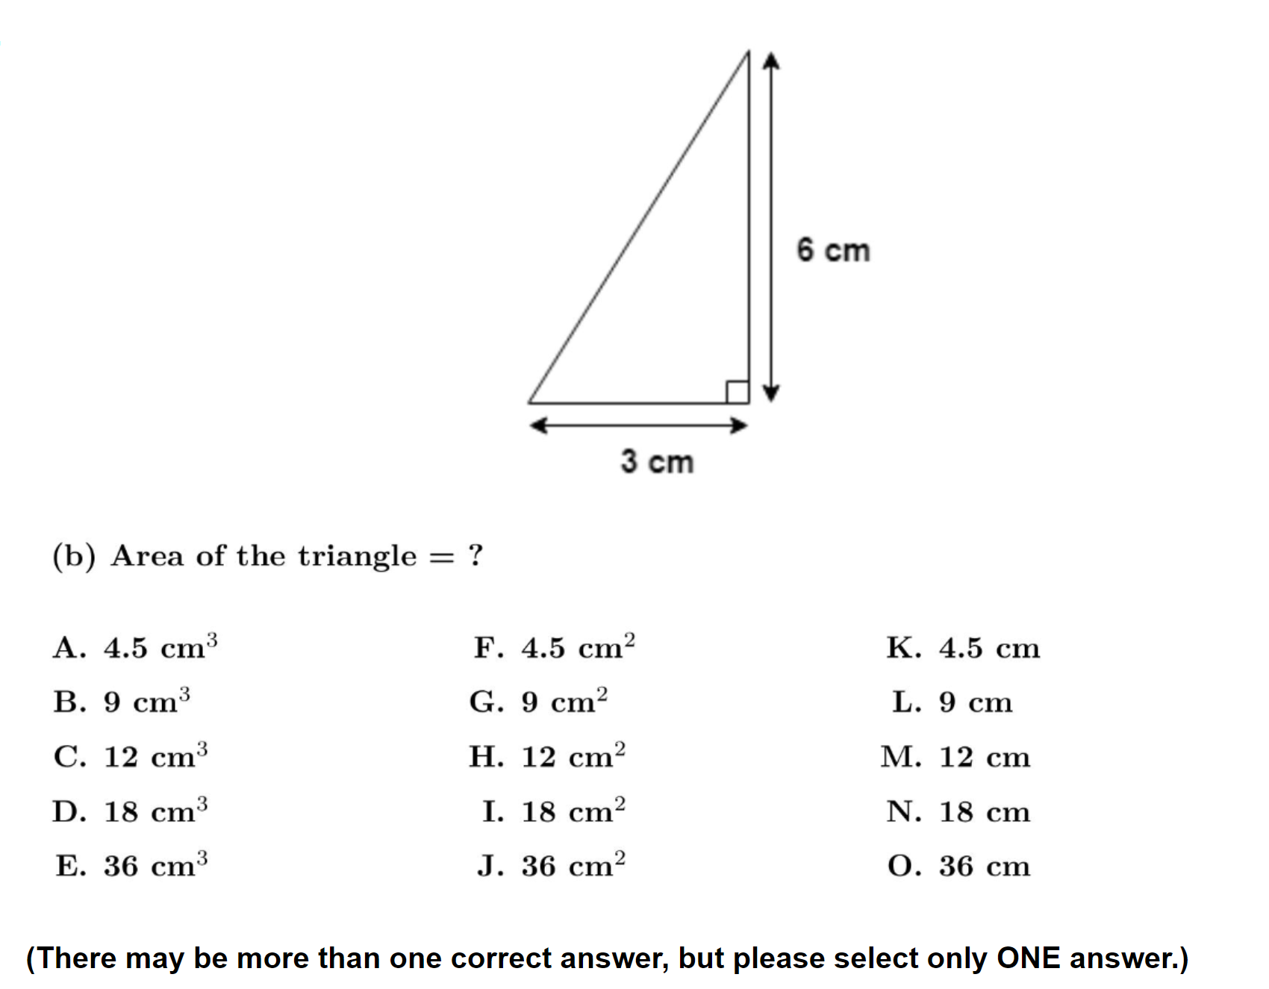
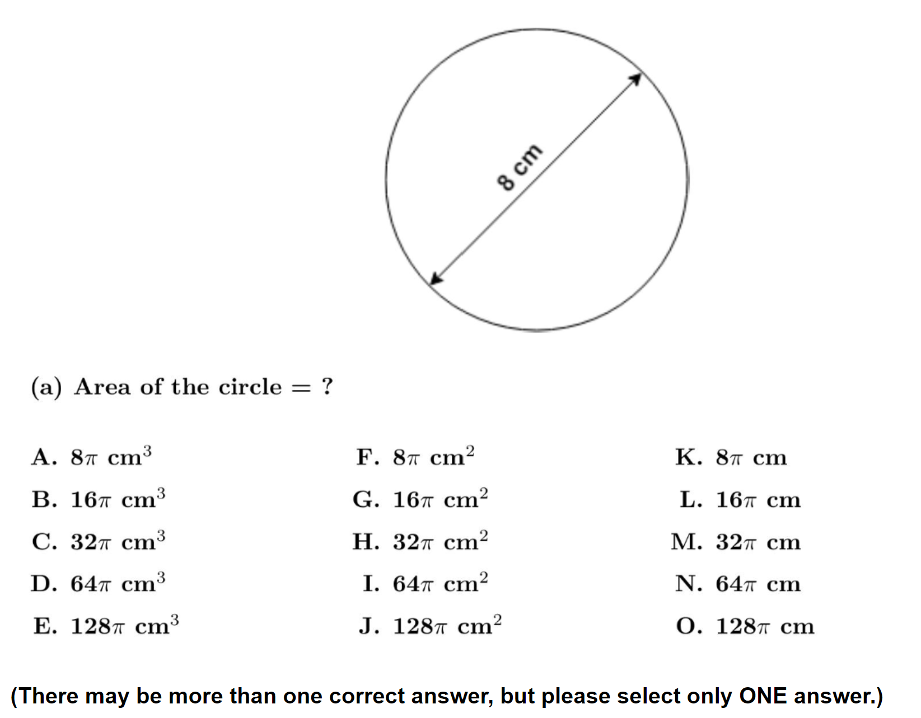
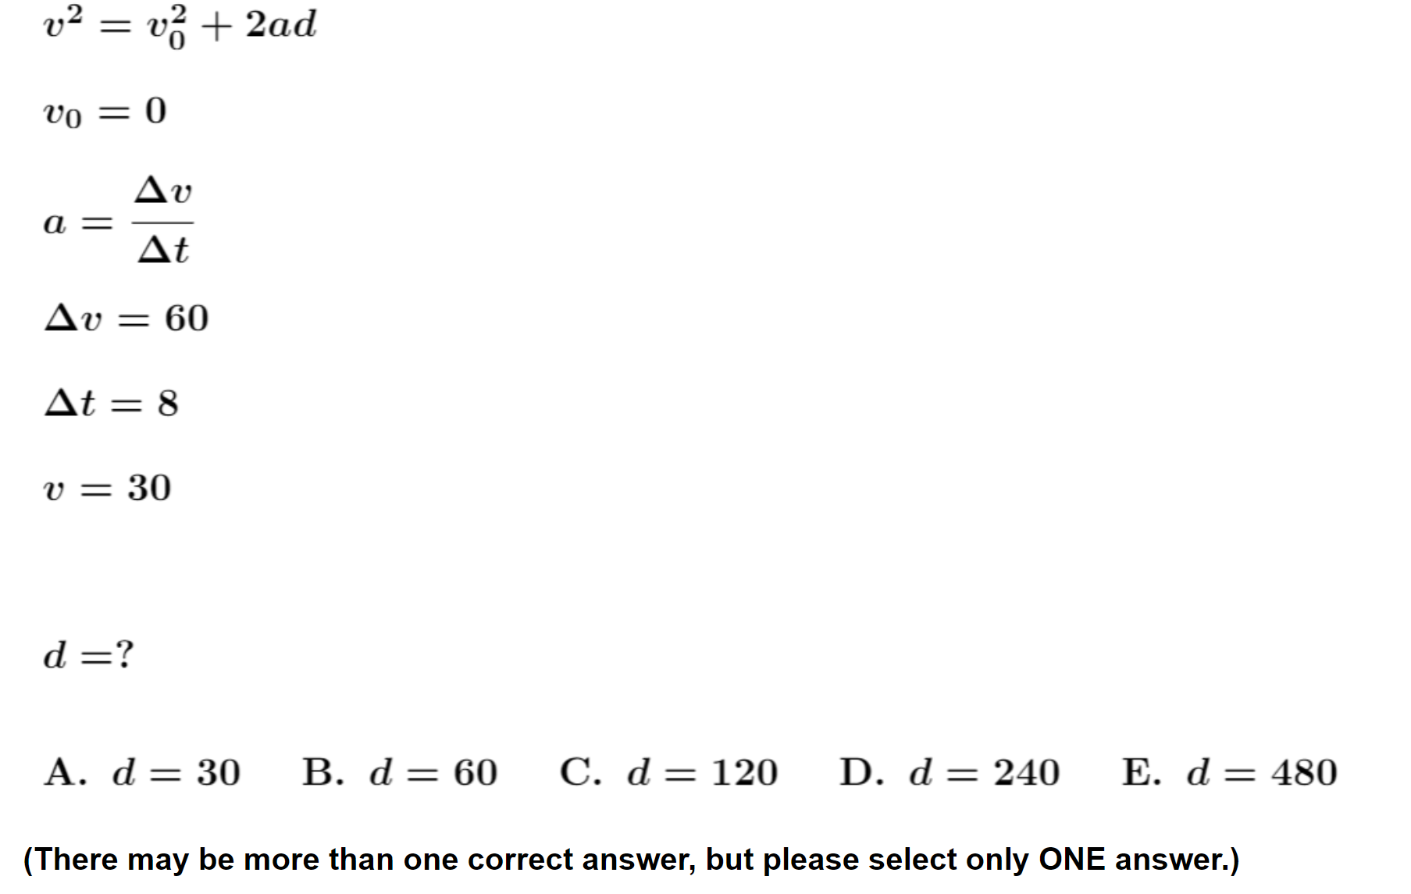
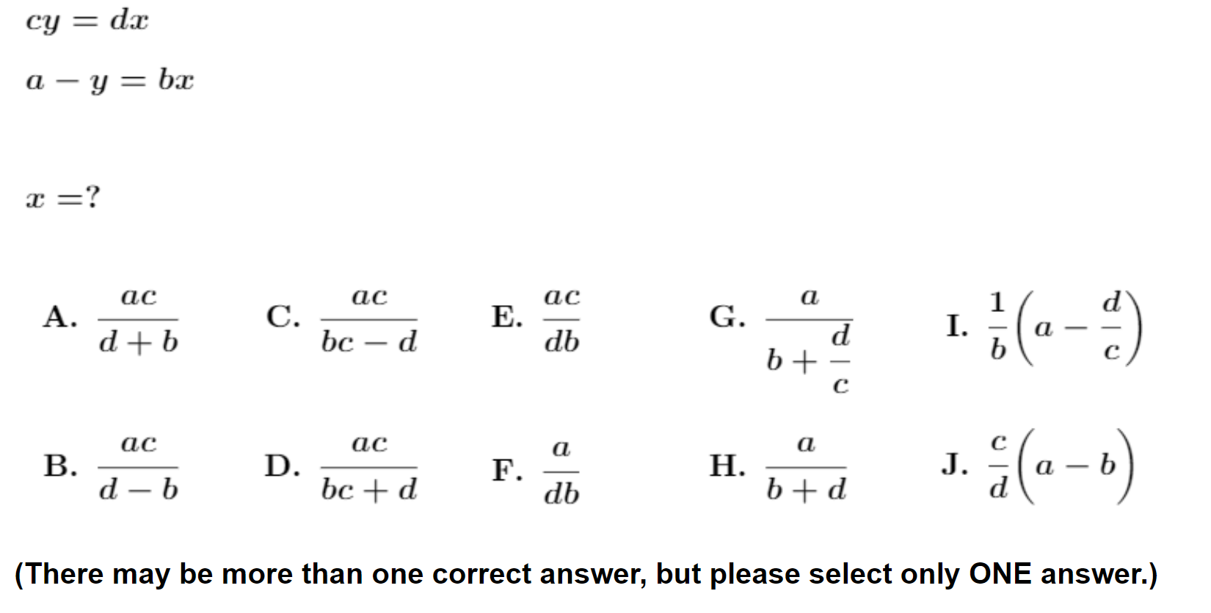

Slide 6
Trigonometry Questions with samples of correct student responses

Slide 8
3.

Slide 9
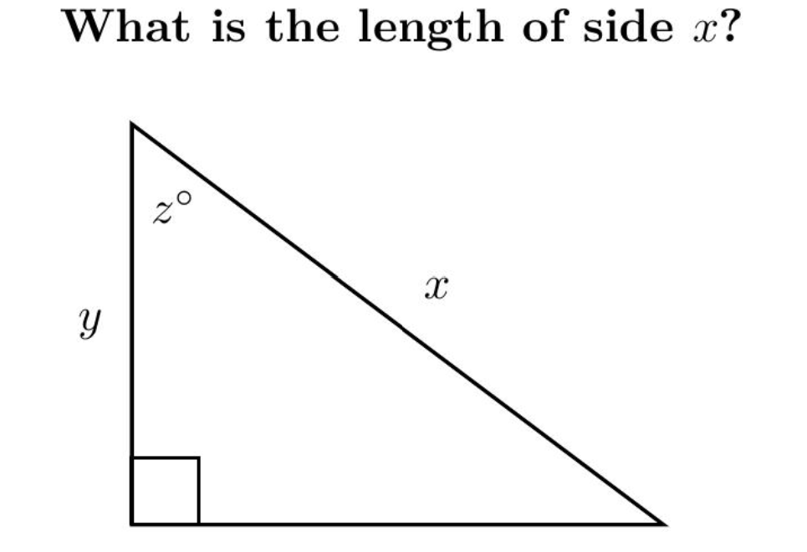
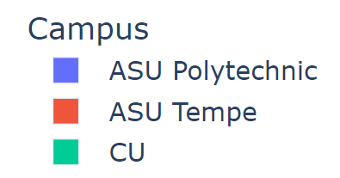
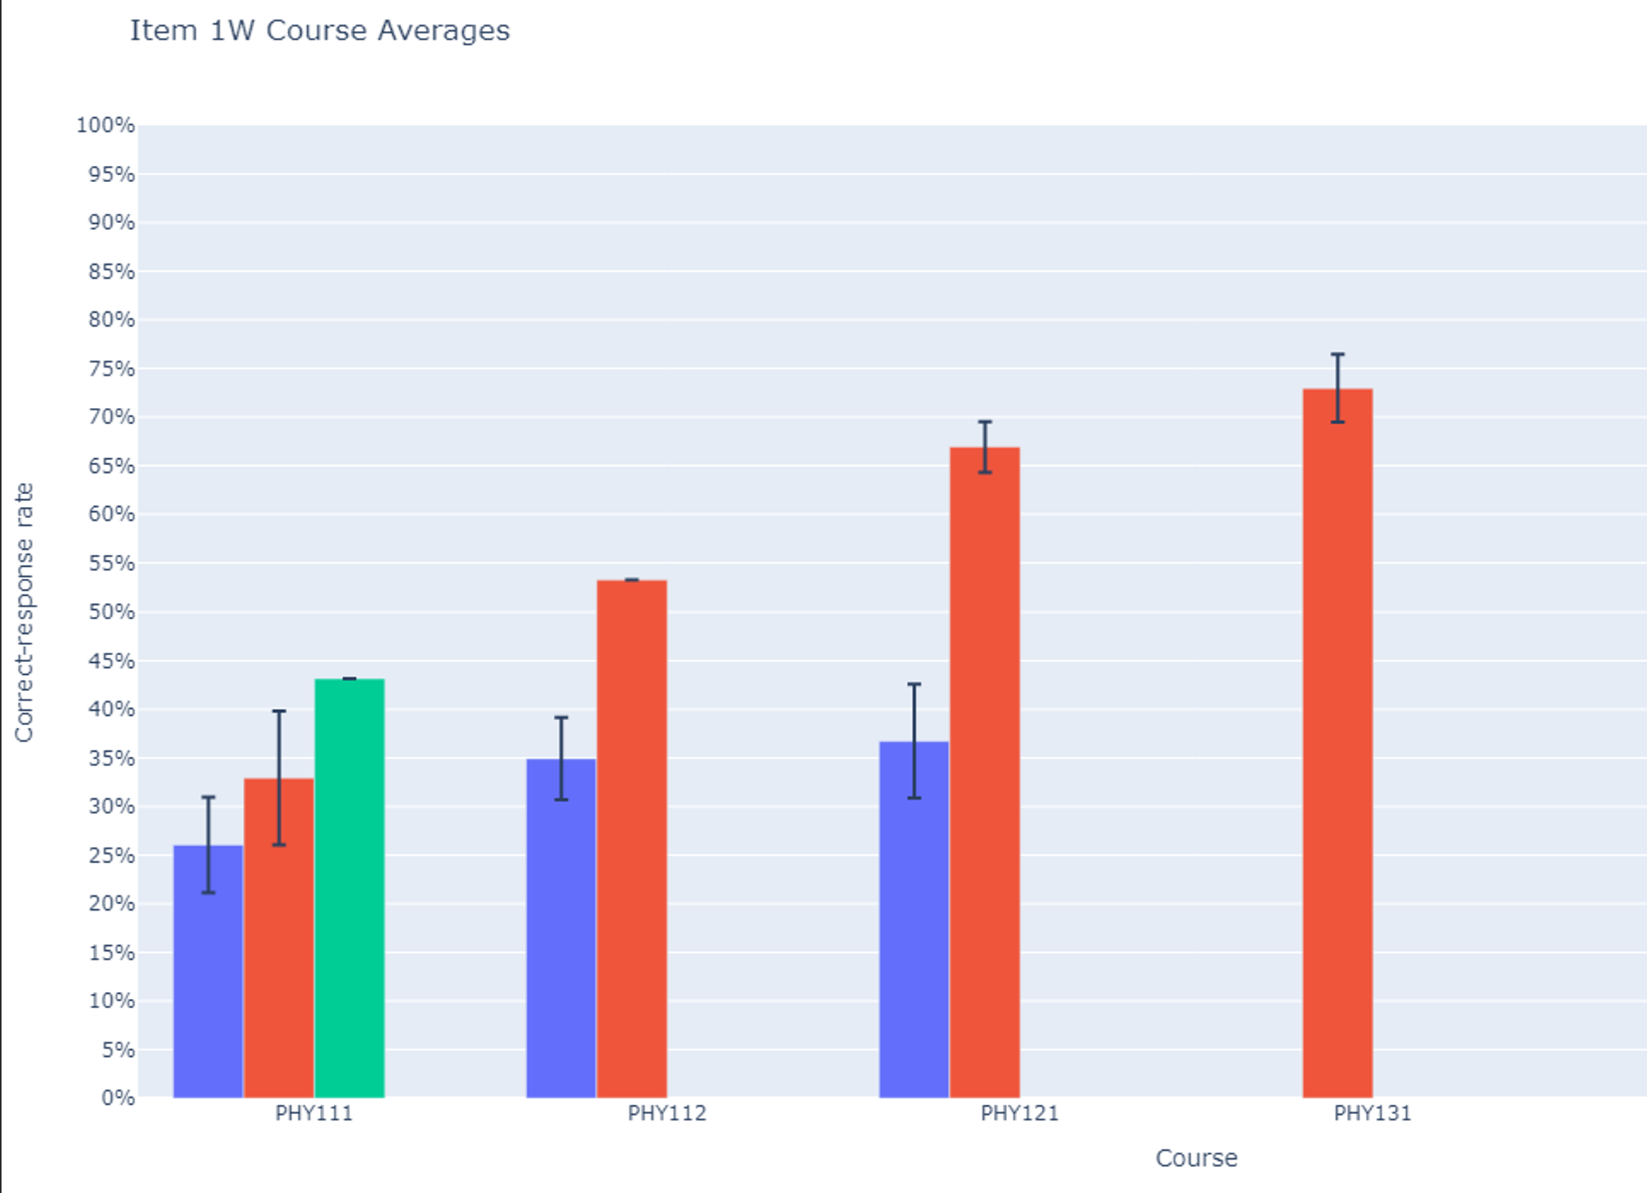
Correct-response rates (written, free-response)
(36 classes; N > 3000)
Many results in the 30-60% range
Alg-1
Alg-2
Calc-1
Calc-2

Slide 10
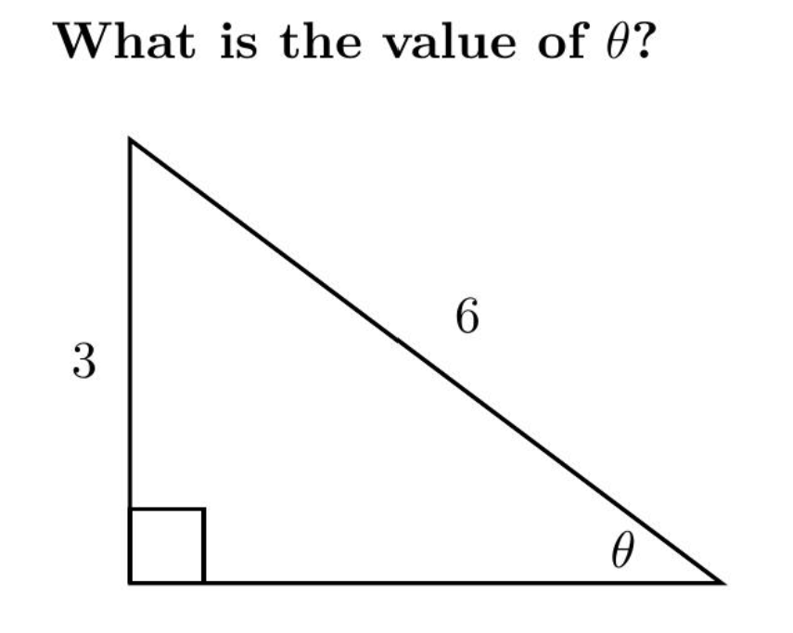
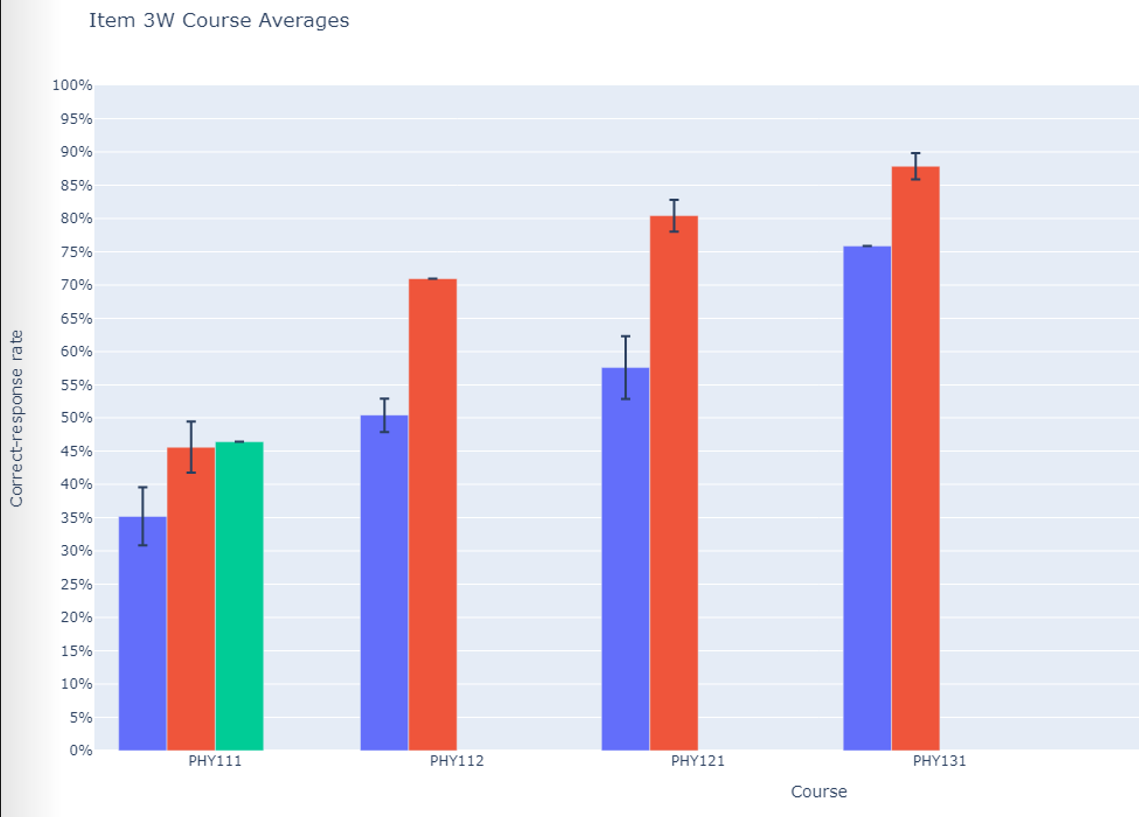
Correct-response rates (written, free-response)
(36 classes; N > 3000)
Many results in the 30-60% range
Alg-1
Alg-2
Calc-1
Calc-2
Alg-1
Alg-2
Calc-1
Calc-2

Slide 11
But the Problem is More Complicated…
Weak calculational skills are only part of the problem.
Student difficulties that appear to be mathematical in origin may actually be due in part to application in a physical context [Thompson, Manogue, Roundy, and Mountcastle, 2012; Zavala and Barniol, 2013]

Slide 12
“Language mismatches”
Students are often confused by the very different symbols and techniques used in physics classes, for identical operations first seen in mathematics classes (Dray and Manogue, 1999-2004)
Example: The “area element” used in vector calculus to do area integrals looks very different in physics textbooks, compared to mathematics textbooks
dS = $\sqrt{[1+\left(\frac{∂z}{∂x}\right)2+(\frac{∂z}{∂y}}$) $2$] dx dy [math, general expression]
dS = r² sin θ dθ dϕ [physics, for a sphere]

Slide 13
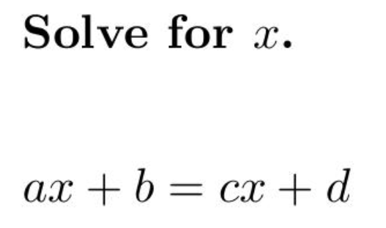
Confusion can result from the nature of the symbols themselves

Slide 14
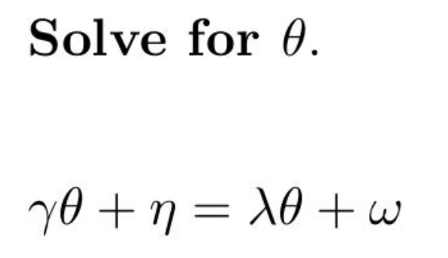
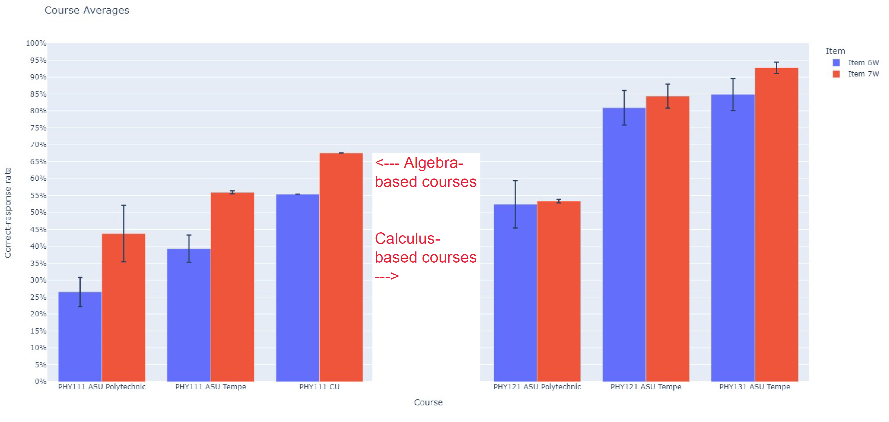
Significantly lower correct-response rates on Greek-letter version in algebra-based courses
(Total N > 1000)

Slide 15
Significantly lower correct-response rates on Greek-letter version in algebra-based courses
(Total N > 1000)

Slide 16
Physics concepts and context make a difference
Distinguishing between a quantity (v), change in that quantity (Δv), and ratios of changes (Δv/Δt) is always challenging, but in the context of motion, additional obstacles are introduced by confusion about the meaning and the distinction between velocity and acceleration. (Trowbridge and McDermott, 1981)
Students’ difficulties in graphical interpretation in the context of motion are exacerbated by misleading intuitions drawn from objects’ physical trajectories. (McDermott, Rosenquist, and Van Zee, 1987)
Finding and comparing the “area under the curve” may be more challenging in a thermodynamics context than in a “pure math” context, e.g., in analyzing thermodynamic process represented on a pressure-volume diagram. (Christensen and Thompson, 2010-2012)

Slide 17
Influence of context
Shaffer and McDermott (2005) found a lower correct-response rate on a vector question in a physical context (45% correct, left diagram) than in an abstract mathematical context (65% correct, right diagram)

Slide 18
What factors influence ability to interpret context?
Higher proficiency with basic calculational skills frees energy and time to apply conceptual knowledge in appropriate contexts.
Self-checking skills can help avoid preventable errors.
The level of reasoning skill may impact ability to interpret contexts appropriately.
Deeper understanding of physics concepts can help guide their appropriate application in context.

Slide 19
Findings from >70 Interviews: Students make many “careless” errors
During interviews, students tended to self-correct approximately 60% of their initial errors with little or no prompting, suggesting that many errors are “careless.”
These findings suggest that increased focus on improving students’ self-checking behavior might provide significant performance dividends.
However, studies have shown that making these improvements is quite challenging

Slide 20
Relation Between Scores and Grades
Performance on full online diagnostic can approximately predict final course grade

Slide 21
Low Course Grade vs. Full Diagnostic Score
Course | Campus | N | Overall % grade ≤ C+ | Score ≥ 81% % grade ≤ C+ | Score ≤ 57% % grade ≤ C+ | Low-grade Ratio score ≤ 57% vs. score ≥ 81%

Slide 22
Low Course Grade vs. Full Diagnostic Score
Course | Campus | N | Overall % grade ≤ C+
Alg-1 2021 | ASU-P | 78
Alg-1: Algebra-based course, first semester

Slide 23
Low Course Grade vs. Full Diagnostic Score
Course | Campus | N | Overall % grade ≤ C+
Alg-1 2021 | ASU-P | 78 | 26%
Alg-1: Algebra-based course, first semester

Slide 24
Low Course Grade vs. Full Diagnostic Score
Course | Campus | N | Overall % grade ≤ C+ | Score ≥ 81% % grade ≤ C+ | Score ≤ 57% % grade ≤ C+ | Low-grade Ratio score ≤ 57% vs. score ≥ 81%
Alg-1 2021 | ASU-P | 78 | 26% | 19% | 38% | 2.1
Alg-1: Algebra-based course, first semester
Students who scored low on math diagnostic pretest had more “C” course grades than those who scored high

Slide 25
Low Course Grade vs. Full Diagnostic Score
Course | Campus | N
Alg-1 2021 | ASU-P | 78
Alg-1 2022 | ASU-P | 93
Alg-2 | ASU-P | 72
Calc-1 | UWF | 103
Alg-1: Algebra-based course, first semester
Alg-2: Algebra-based course, second semester
Calc-1: Calculus-based course, first semester
ASU-P: Arizona State University, Polytechnic campus
UWF: University of West Florida

Slide 26
Low Course Grade vs. Full Diagnostic Score
Course | Campus | N | Overall % grade ≤ C+
Alg-1 2021 | ASU-P | 78 | 26%
Alg-1 2022 | ASU-P | 93 | 19%
Alg-2 | ASU-P | 72 | 29%
Calc-1 | UWF | 103 | 39%
Alg-1: Algebra-based course, first semester
Alg-2: Algebra-based course, second semester
Calc-1: Calculus-based course, first semester
ASU-P: Arizona State University, Polytechnic campus
UWF: University of West Florida

Slide 27
Low Course Grade vs. Full Diagnostic Score
Course | Campus | N | Overall % grade ≤ C+ | Score ≥ 81% % grade ≤ C+ | Score ≤ 57% % grade ≤ C+ | Low-grade Ratio score ≤ 57% vs. score ≥ 81%
Alg-1 2021 | ASU-P | 78 | 26%
Alg-1 2022 | ASU-P | 93 | 19%
Alg-2 | ASU-P | 72 | 29%
Calc-1 | UWF | 103 | 39%
Alg-1: Algebra-based course, first semester
Alg-2: Algebra-based course, second semester
Calc-1: Calculus-based course, first semester
ASU-P: Arizona State University, Polytechnic campus
UWF: University of West Florida

Slide 28
Low Course Grade vs. Full Diagnostic Score
Course | Campus | N | Overall % grade ≤ C+ | Score ≥ 81% % grade ≤ C+ | Score ≤ 57% % grade ≤ C+ | Low-grade Ratio score ≤ 57% vs. score ≥ 81%
Alg-1 2021 | ASU-P | 78 | 26% | 19% | 38% | 2.1
Alg-1 2022 | ASU-P | 93 | 19% | 8% | 28% | 3.4
Alg-2 | ASU-P | 72 | 29% | 14% | 35% | 2.6
Calc-1 | UWF | 103 | 39% | 26% | 54% | 2.1
Alg-1: Algebra-based course, first semester
Alg-2: Algebra-based course, second semester
Calc-1: Calculus-based course, first semester
ASU-P: Arizona State University, Polytechnic campus
UWF: University of West Florida
Students who scored low on math diagnostic pretest had consistently more “C” course grades than those who scored high

Slide 29
High Course Grade vs. Full Diagnostic Score
Course | Campus | N | Overall % grade ≥ A- | Score ≥ 81% % grade ≥ A- | Score ≤ 57% % grade ≥ A- | High-grade Ratio score ≥ 81% vs. score ≤ 57%
Alg-1 2021 | ASU-P | 78
Alg-1 2022 | ASU-P | 93
Alg-2 | ASU-P | 72
Alg-2 | ASU-T | 129
Calc-1 | UWF | 103
Calc-2 | UWF | 59
Alg-1: Algebra-based course, first semester
Alg-2: Algebra-based course, second semester
Calc-1: Calculus-based course, first semester
Calc-2: Calculus-based course, second semester
ASU-P: Arizona State University, Polytechnic campus
ASU-T: Arizona State University, Tempe campus
UWF: University of West Florida

Slide 30
High Course Grade vs. Full Diagnostic Score
Course | Campus | N | Overall % grade ≥ A- | Score ≥ 81% % grade ≥ A- | Score ≤ 57% % grade ≥ A- | High-grade Ratio score ≥ 81% vs. score ≤ 57%
Alg-1 2021 | ASU-P | 78 | 35%
Alg-1 2022 | ASU-P | 93 | 45%
Alg-2 | ASU-P | 72 | 39%
Alg-2 | ASU-T | 129 | 60%
Calc-1 | UWF | 103 | 22%
Calc-2 | UWF | 59 | 49%
Alg-1: Algebra-based course, first semester
Alg-2: Algebra-based course, second semester
Calc-1: Calculus-based course, first semester
Calc-2: Calculus-based course, second semester
ASU-P: Arizona State University, Polytechnic campus
ASU-T: Arizona State University, Tempe campus
UWF: University of West Florida

Slide 31
High Course Grade vs. Full Diagnostic Score
Course | Campus | N | Overall % grade ≥ A- | Score ≥ 81% % grade ≥ A- | Score ≤ 57% % grade ≥ A- | High-grade Ratio score ≥ 81% vs. score ≤ 57%
Alg-1 2021 | ASU-P | 78 | 35% | 63% | 15% | 4.2
Alg-1 2022 | ASU-P | 93 | 45% | 67% | 28% | 2.4
Alg-2 | ASU-P | 72 | 39% | 64% | 25% | 2.6
Alg-2 | ASU-T | 129 | 60% | 67% | 55% | 1.2
Calc-1 | UWF | 103 | 22% | 40% | 0% | “∞”
Calc-2 | UWF | 59 | 49% | 61% | 38% | 1.6
Alg-1: Algebra-based course, first semester
Alg-2: Algebra-based course, second semester
Calc-1: Calculus-based course, first semester
Calc-2: Calculus-based course, second semester
ASU-P: Arizona State University, Polytechnic campus
ASU-T: Arizona State University, Tempe campus
UWF: University of West Florida
Students who scored high on math diagnostic pretest had consistently more “A” course grades than those who scored low

Slide 32
Factors other than math preparation may influence course performance
For example:
Scientific reasoning skills, as measured by the Lawson Test of Scientific Reasoning
Physics concept knowledge, as measured by the Force Concept Inventory

Slide 33
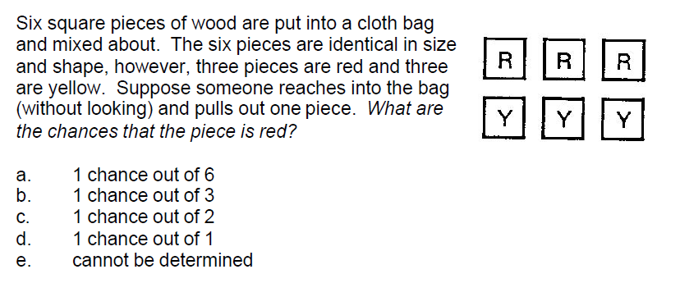
Scientific reasoning skills: The 24-item Lawson test

Slide 34
High Course Grade vs. Lawson Test of Scientific Reasoning Pretest Score
Course | Campus | N | Overall % grade ≥ A- | Top-quartile Lawson % grade ≥ A- | Bottom-quartile Lawson % grade ≥ A- | High-grade Ratio Top quartile vs. Bottom quartile
Alg-1 2021 | ASU-P | 73 | 35% | 65% | 17% | 3.9
Alg-1 2022 | ASU-P | 99 | 45% | 62% | 28% | 2.2
Alg-2 | ASU-P | 73 | 39% | 60% | 15% | 4.0
Alg-1: Algebra-based course, first semester
Alg-2: Algebra-based course, second semester
ASU-P: Arizona State University, Polytechnic campus
Students who scored high on Lawson reasoning pretest had consistently more “A” course grades than those who scored low

Slide 35
Low Course Grade vs. Lawson Test of Scientific Reasoning Pretest Score
Course | Campus | N | Overall % grade ≤ C+ | Top-quartile Lawson % grade ≤ C+ | Bottom-quartile Lawson % grade ≤ C+ | Low-grade Ratio Bottom quartile vs. Top quartile
Alg-1 2021 | ASU-P | 73 | 26% | 5% | 56% | 11.1
Alg-1 2022 | ASU-P | 99 | 19% | 10% | 28% | 2.9
Alg-2 | ASU-P | 73 | 29% | 10% | 35% | 3.5
Alg-1: Algebra-based course, first semester
Alg-2: Algebra-based course, second semester
ASU-P: Arizona State University, Polytechnic campus
Students who scored low on Lawson reasoning pretest had consistently more “C” course grades than those who scored high

Slide 36
Physics concept knowledge: The 30-item FCI

Slide 37
What Grade is Predicted by FCI Pretest Score?
Henderson (2002), University of Minnesota (N > 1000)
FCI Pretest score: 0-30% 63-100%
A: 10% A: 47%
B: 30% B: 40%
C: 46% C: 9%
Students who scored high on FCI pretest had higher course grades than those who scored low

Slide 38
What Grade is Predicted by FCI Pretest Score?
Meltzer (2012/13), Arizona State University (N > 100)
FCI Pretest score: 0-30% 63-100%
A: 12% A: 65%
B: 44% B: 22%
C: 26% C: 13%
Students who scored high on FCI pretest had higher course grades than those who scored low

Slide 39
Factors are correlated, but not 100%
Outliers using one prediction method—e.g., low-scorers on the math diagnostic with high grades—can often be explained by high pretest scores on another predictor, such as the Lawson reasoning test or the FCI
Students with low pretest scores on all diagnostics can sometimes perform well with exceptional efforts (e.g., regular class attendance, excellent class participation, consistent execution of assignments)

Slide 40
Summary
Numerous factors influence students’ physics course performance
Previous preparation in calculational and reasoning skills is important, as well as physics concept knowledge
Motivation and effort can potentially compensate for relative weaknesses in skills or knowledge preparation

