Slide 1
Investigation of context dependence of students' responses to thermodynamics problems and its potential application to dual-process theory research
David E. Meltzer
Arizona State University
Mary Jane Brundage
Misericordia University
Chandralekha Singh
University of Pittsburgh

Slide 2
(appearing soon…)

Slide 3
Exploring students’ thinking when solving thermodynamics problems
We explored students' responses to a wide variety of problem types, such that 2-5 different problems all target the same physics concept; 13 different thermodynamics concepts serve as the targets. The problems differ from each other by using diverse physical settings and scenarios, as well as various types of potentially distracting features.
Multiple-choice instrument: “Survey of Thermodynamic Processes and First and Second Laws (STPFaSL-Long)”; 78 problems in all; administered after instruction in standard lecture courses.
Sample size ranges (varied by item)
Calculus-based introductory physics courses: 320-491
Algebra-based introductory physics courses: 331-550
With these sample sizes, differences in correct-response rates ≈15% or greater are statistically significant, generally with p<0.001 and effect size > 0.3
Interview data: Interviews carried out with 17 students (11 introductory; 6 upper-level)

Slide 5
Targeted Concepts (among others) (E= internal energy; W = work done by system; Q = heat transfer to system)
E is proportional to T for an ideal gas
The sign of ΔE for an ideal gas undergoing an isochoric or isobaric process is determined by whether pressure or volume are increasing
W is positive for an expansion whether adiabatic or isothermal
In a reversible isothermal process, Q ≠ 0 and the sign of Q is determined by whether volume is increasing or decreasing

Slide 6
Targeted Concepts (among others) (E= internal energy; W = work done by system; Q = heat transfer to system)
E is proportional to T for an ideal gas
The sign of ΔE for an ideal gas undergoing an isochoric or isobaric process is determined by whether pressure and/or volume are increasing
W is positive for an expansion whether adiabatic or isothermal
In a reversible isothermal process, Q ≠ 0 and the sign of Q is determined by whether volume is increasing or decreasing

Slide 7
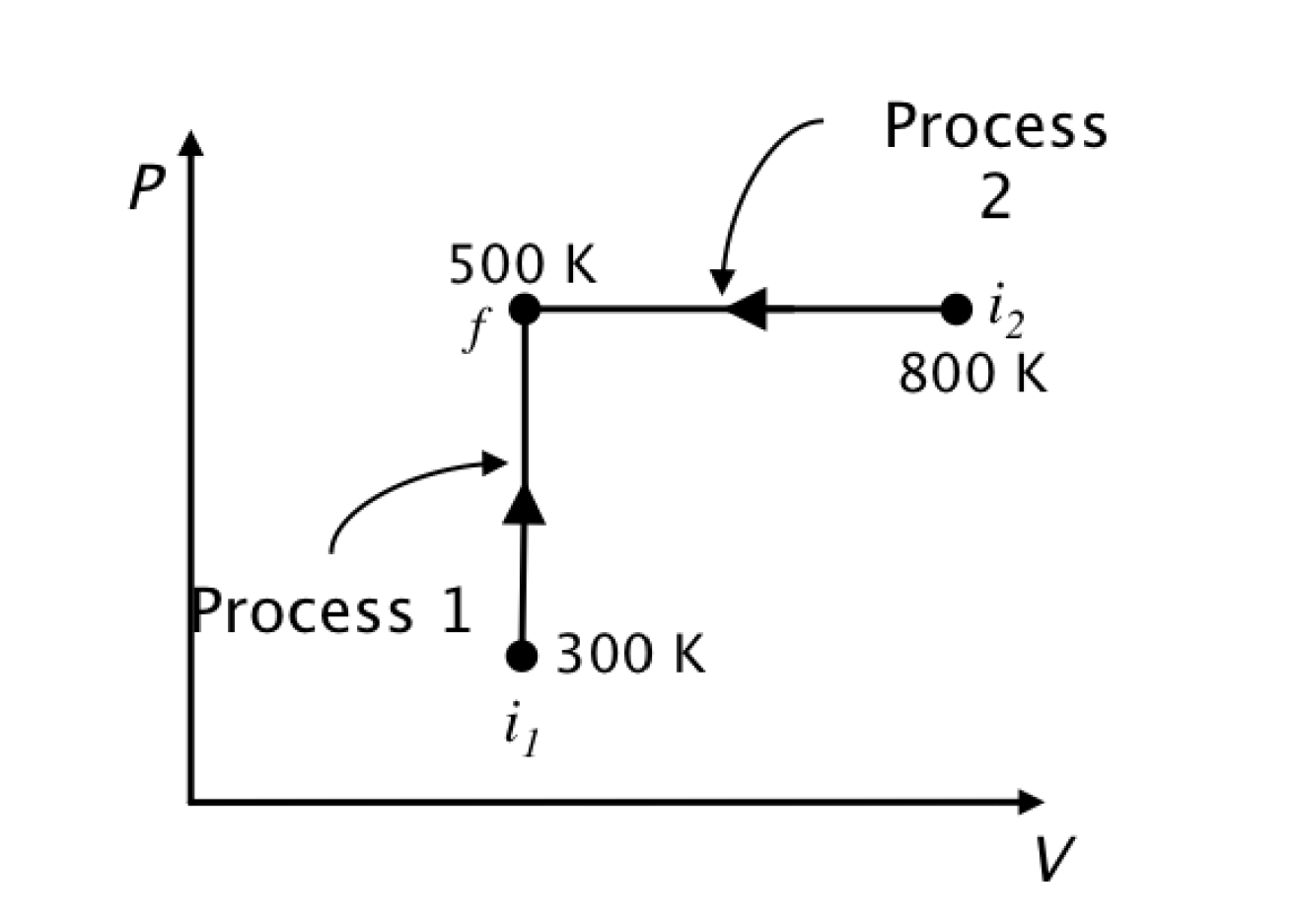
Answer: (b); temperature increases so internal energy increases.
Correct-response rate; Calculus-based: 76%; Algebra-based: 81%
More errors on #34 →
Answer: (c); temperature decreases so internal energy decreases.
Correct-response rate; Calculus-based: 58%; Algebra-based: 55%

Slide 8
Why did students make significantly more errors on #34?
Interviews: 3 of 6 students who gave incorrect answer on #34 (Process 2) argued “Work done is negative so internal energy will increase”
This would be true for an adiabatic process; however, students have completely ignored the role of heat transfer (Q < 0 in this case).
Students were distracted by work considerations; this was also true for Process 1 (zero work) but not, apparently, to the same degree as in Process 2.
The salience of the negative-work feature in Process 2 seems to have played a key role in students’ thinking.
Answer: (c); temperature decreases so internal energy decreases.
Correct-response rate; Calculus-based: 58%; Algebra-based: 55%

Slide 9
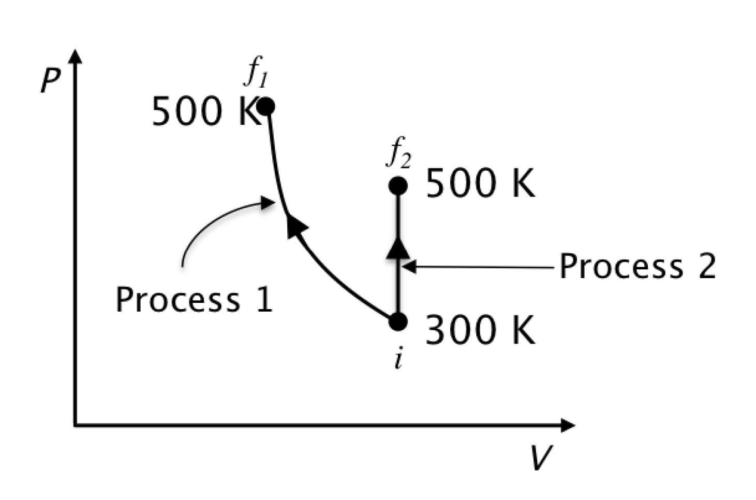
Answer: (a); temperature changes are equal so internal energy changes are equal.
Respondents choosing “b” (Process 1 change is greater), Calculus-based: 41%; Algebra-based: 51%
Respondents choosing “c” (Process 2 change is greater), Calculus-based: 25%; Algebra-based: 20%
preferred
Interviews: 3 of 5 students who answered “b”or “c” provided incorrect arguments regarding work.
Students were distracted by work considerations based on the shape and direction of the process arrows; the Process 1 arrow may have been more salient, thus attracting more incorrect responses.

Slide 10
Targeted Concepts (among others) (E= internal energy; W = work done by system; Q = heat transfer to system)
E is proportional to T for an ideal gas
The sign of ΔE for an ideal gas undergoing an isochoric or isobaric process is determined by whether pressure or volume are increasing
W is positive for an expansion whether adiabatic or isothermal
In a reversible isothermal process, Q ≠ 0 and the sign of Q is determined by whether volume is increasing or decreasing

Slide 11
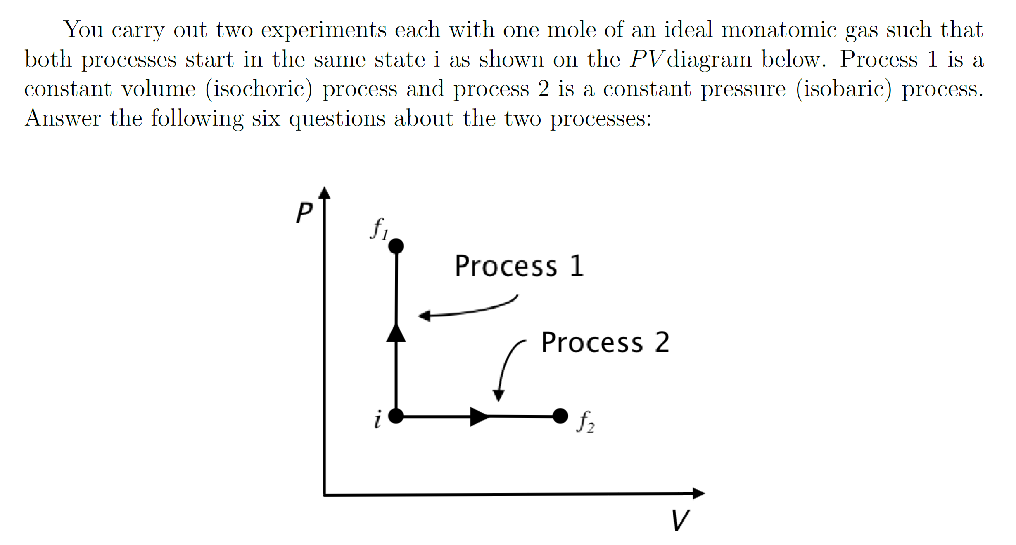
Answer to both #44 and #45: (b); PV increases so internal energy increases [Eint = (3/2) NkT = (3/2) PV)].
Correct-response rate on Process 1, Calculus-based: 69%; Algebra-based: 70%
Correct-response rate on Process 2, Calculus-based: 43%; Algebra-based: 37%
Interviews: 7 of 9 incorrect responses on Process 2 were justified by saying work done is positive so energy would decrease, thus ignoring the role of heat transfer.
For Process 2, the salience of the right-pointing arrow indicating that positive work is done lured students into flawed arguments regarding work and ignoring heat transfer.
More incorrect answers on Process 2

Slide 12
Targeted Concepts (among others) (E= internal energy; W = work done by system; Q = heat transfer to system)
E is proportional to T for an ideal gas
The sign of ΔE for an ideal gas undergoing an isochoric or isobaric process is determined by whether pressure or volume are increasing
W is positive for an expansion whether adiabatic or isothermal
In a reversible isothermal process, Q ≠ 0 and the sign of Q is determined by whether volume is increasing or decreasing

Slide 13
Correct-response rate
Calculus-based: 65%; Algebra-based: 55%
Work = 0 responses
Calculus-based: 11%; Algebra-based: 16%
Correct-response rate
Calculus-based: 54%; Algebra-based: 41%
Work = 0 responses
Calculus-based: 19%; Algebra-based: 27%
More Work = 0 responses on “reversible adiabatic” expansion question
Interviews: Most incorrect answers on #3 were justified by Q = 0 arguments

Slide 14
Targeted Concepts (among others) (E= internal energy; W = work done by system; Q = heat transfer to system)
E is proportional to T for an ideal gas
The sign of ΔE for an ideal gas undergoing an isochoric or isobaric process is determined by whether pressure or volume are increasing
W is positive for an expansion whether adiabatic or isothermal
In a reversible isothermal process, Q ≠ 0 and the sign of Q is determined by whether volume is increasing or decreasing

Slide 15
Q─W = ΔE = 0 since ΔT=0, so Q = W > 0
Correct-response rate
Calculus-based: 43%; Algebra-based: 44%
Q = 0 responses
Calculus-based: 30%; Algebra-based: 37%
Q─W = ΔE = 0 since ΔT=0, so Q = W < 0
Correct-response rate
Calculus-based: 30%; Algebra-based: 21%
Q = 0 responses
Calculus-based: 50%; Algebra-based: 59%
Many more Q = 0 responses on “reversible compression” question, justified by “process is isothermal” arguments

Slide 16
General Findings
In problems involving PV diagrams, shapes and directions of process arrows often triggered unproductive lines of reasoning regarding work, distracting students from the problem features most relevant to finding a solution.
Certain terms may by their very presence trigger potentially unproductive lines of reasoning, including, for example, “adiabatic” and “reversible.”
In thermodynamics, students are prone to focus attention on the “most salient” variable (such as heat in an adiabatic process or work in an isobaric process) while ignoring other crucial variables.

Slide 17
Implications of Findings
Changes to problem properties considered minor by experts can lead to vastly different correct- (and incorrect-) response rates by students.
In thermodynamics, certain features of PV diagrams or problem wording and terminology can divert students into long chains of confused reasoning regarding work or heat, ignoring the most-relevant problem features.
In thermodynamics, immediate “intuitive” responses are often linked to a perceived need to carry out lengthy calculations, instead of focusing on problem features that could lead to quick solutions.
Dual-process theory “process 1” and “process 2” seem to have a propensity to intermingle in the thermodynamics context.

