Slide 1
How can we assess students’ knowledge when small differences in problem properties can significantly alter students’ responses?
David E. Meltzer
Arizona State University
Supported in part by NSF DUE #1504986 and #1914712

Slide 2
Overview: Experts’ vs. Learners’ Knowledge
An “expert” can see through superficial differences between problem properties (e.g., diagrams, wording, physical context) and focus sharply on the underlying concept, usually proceeding smoothly towards a productive solution pathway.
A “learner” has incomplete and imperfect knowledge, and can often be distracted or misled by irrelevant or insignificant problem properties, leading to incorrect responses.

Slide 3
Overview: Experts’ vs. Learners’ Knowledge
We often implicitly assume that “small” changes in problem properties lead to small changes in students’ responses, therefore assuming that large differences in students’ responses to (apparently) identical problems signify large differences in student understanding.
Suppose, by contrast, that small changes in problem properties can lead to large differences in students’ responses—“nonlinear response,” so to speak. Then, consistency of students’ responses between different assessment problems and instruments could be reduced. How, then, are we to assess students’ true understanding of the underlying concepts?

Slide 4
What “non-conceptual” properties can increase problem difficulty?
Use of potentially misleading/distracting diagrammatic elements
Inclusion of (potentially misleading) irrelevant or redundant information
Use of symbols in place of numbers (e.g., m or μ for mass)
Multiple relevant factors or variables in same problem (e.g., E, Q, W)
Dependence on or use of unfamiliar or subtle assumptions or terms
e.g., adiabatic, thermal reservoir, quasi-static, reversible, spontaneous

Slide 5
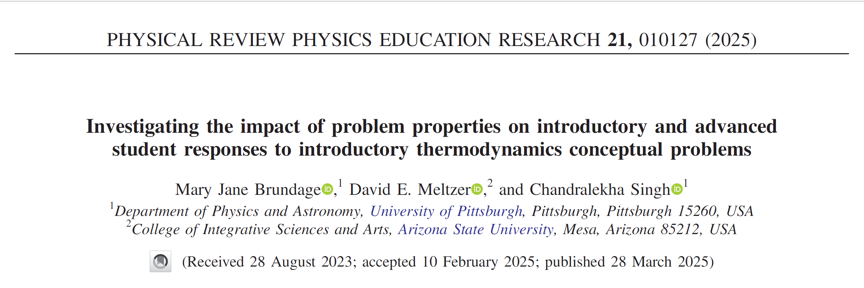

Slide 6
Exploring students’ thinking when solving thermodynamics problems
78-item Multiple-choice instrument: “Survey of Thermodynamic Processes and First and Second Laws (STPFaSL-Long)”
administered after instruction in standard algebra- and calculus-based lecture courses
Each individual thermodynamics concept was targeted by 2-5 different problems
Problems differ from each other by:
using diverse physical settings and scenarios
very minor changes in wording or in diagrammatic features
including diverse potentially distracting features
Sample size ranged from 320-550 (varied by problem)
With these sample sizes, differences in correct-response rates ≈15% or greater are statistically significant, generally with p<0.001 and effect size > 0.3
Interview data: Interviews carried out with 17 students (11 introductory; 6 upper-level)

Slide 7
Targeted Concepts (among others) (E= internal energy; W = work done by system; Q = heat transfer to system)
E is proportional to T for an ideal gas
The sign of ΔE for an ideal gas is determined by whether the product PV is increasing or decreasing
W is positive for an expansion
In a reversible isothermal process, Q ≠ 0 and the sign of Q is determined by whether volume is increasing or decreasing

Slide 8
Targeted Concepts (among others) (E= internal energy; W = work done by system; Q = heat transfer to system)
E is proportional to T for an ideal gas
The sign of ΔE for an ideal gas is determined by whether the product PV is increasing or decreasing
W is positive for an expansion
In a reversible isothermal process, Q ≠ 0 and the sign of Q is determined by whether volume is increasing or decreasing

Slide 9
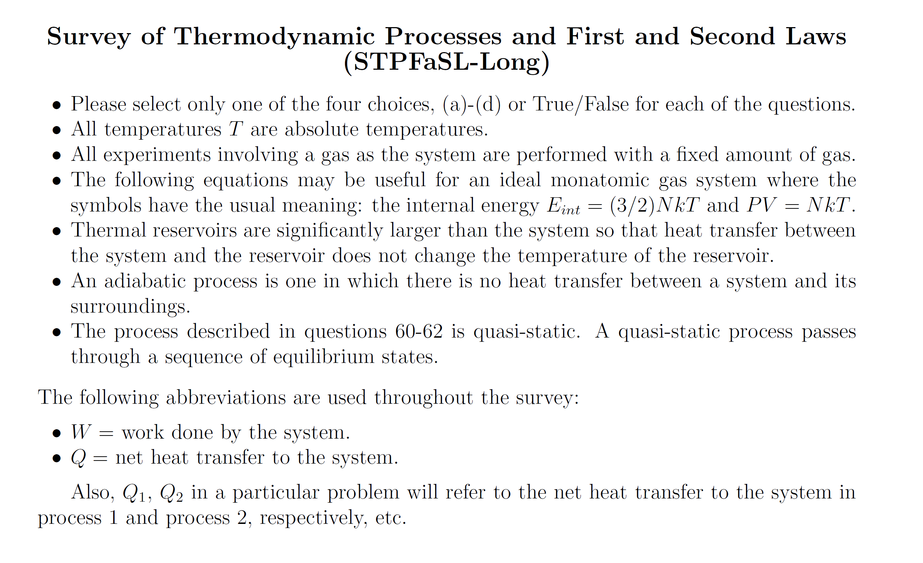
Information provided to students on first page:

Slide 10
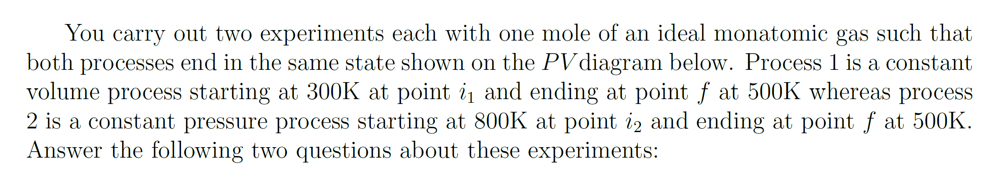
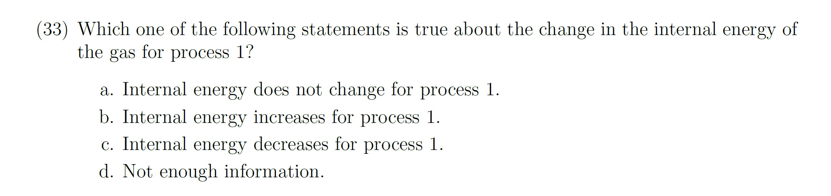
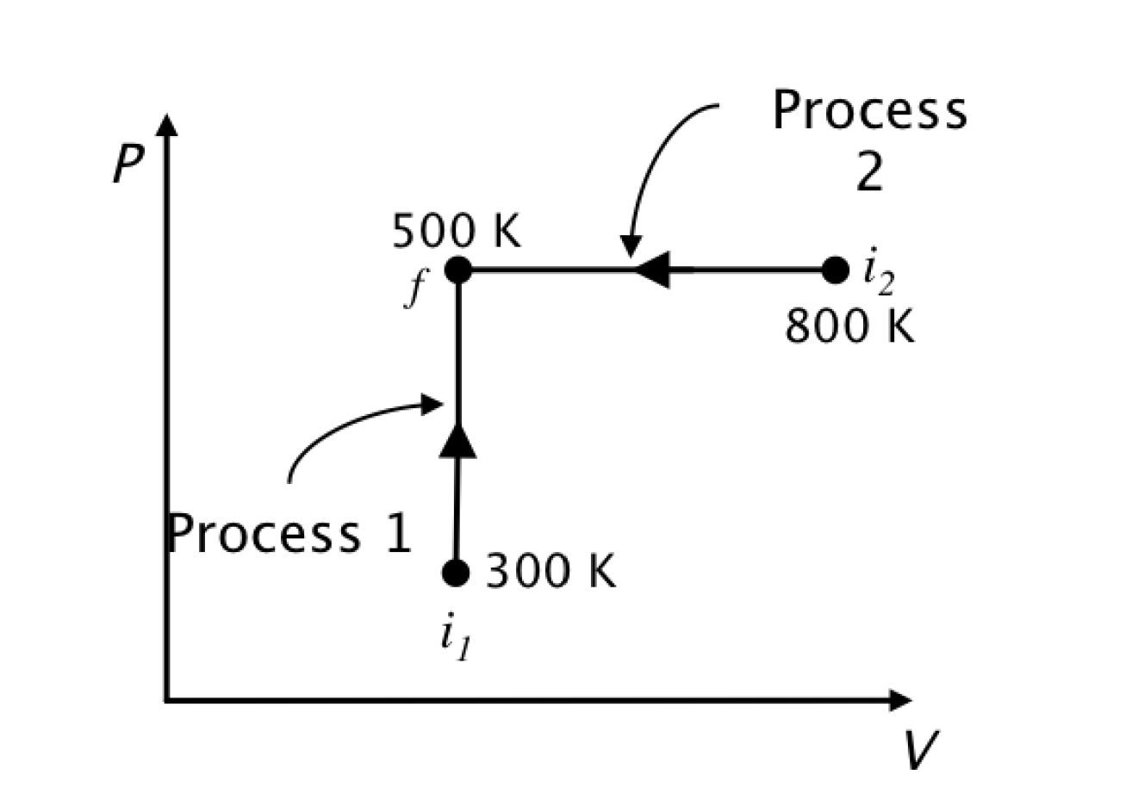
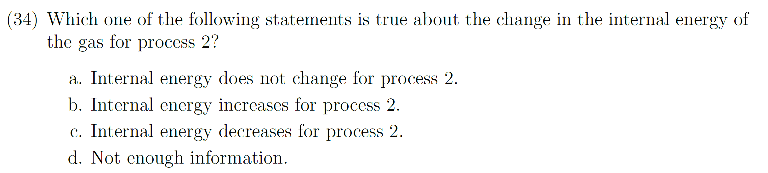
Answer: (b); temperature increases so internal energy increases.
Correct-response rate; Calculus-based: 76%; Algebra-based: 81%
Answer: (c); temperature decreases so internal energy decreases.
Correct-response rate; Calculus-based: 58%; Algebra-based: 55%
Many more errors on #34 (Process 2) →

Slide 11
Why did students make significantly more errors on #34?
Interviews: 3 of 6 students who gave incorrect answer on #34 (Process 2) argued “Work done is negative so internal energy will increase”
This would be true for an adiabatic process; however, students have completely ignored the role of heat transfer (Q < 0 in this case).
Students were distracted by work considerations; this was also true for Process 1 (zero work) but not, apparently, to the same degree as in Process 2.
The salience of the negative-work feature in Process 2 seems to have played a key role in students’ thinking.
Answer: (c); temperature decreases so internal energy decreases.
Correct-response rate; Calculus-based: 58%; Algebra-based: 55%

Slide 12
The use of a horizontal arrow on a PV diagram (instead of an arrow pointed straight up) lured some students into unproductive considerations regarding work, lowering the correct-response rate by 18-26%.

Slide 13
Targeted Concepts (among others) (E= internal energy; W = work done by system; Q = heat transfer to system)
E is proportional to T for an ideal gas
The sign of ΔE for an ideal gas is determined by whether the product PV is increasing or decreasing
W is positive for an expansion
In a reversible isothermal process, Q ≠ 0 and the sign of Q is determined by whether volume is increasing or decreasing

Slide 14
Information provided to students on first page:

Slide 15
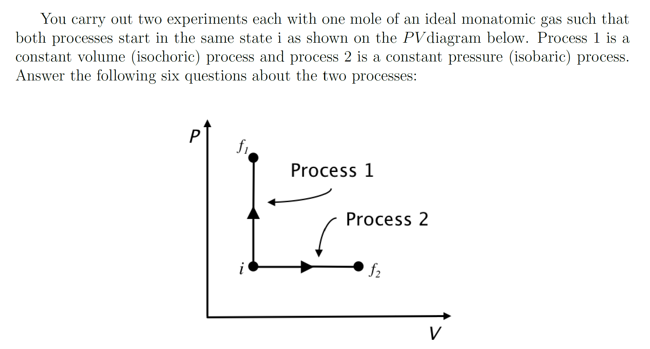
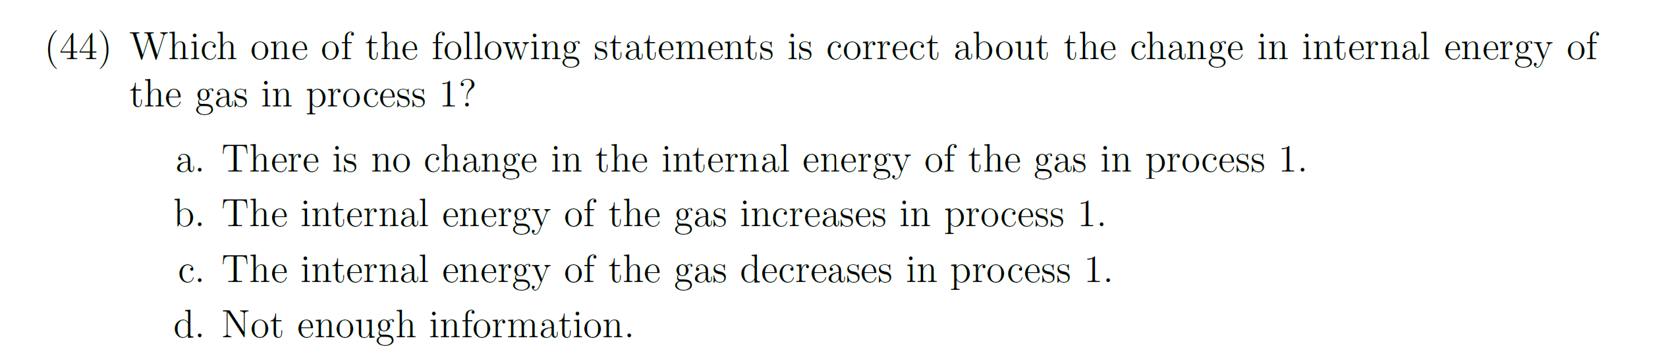
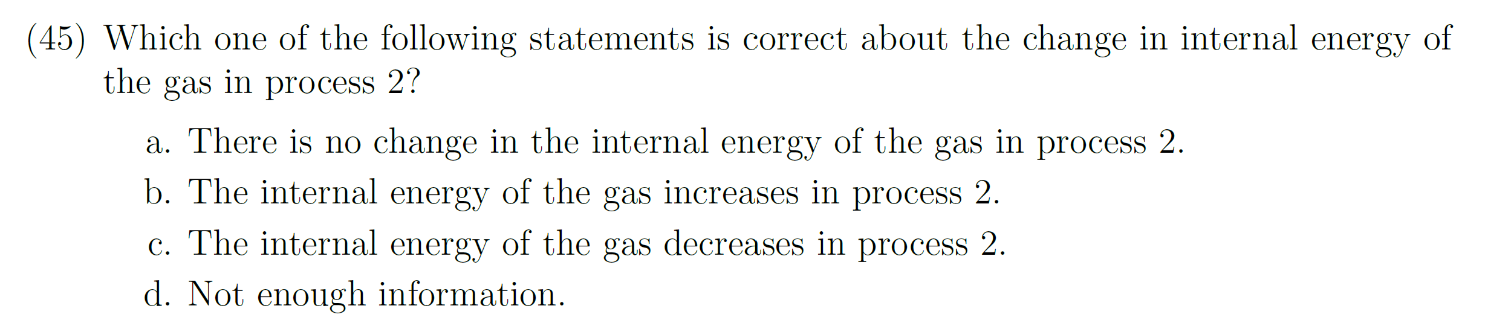
[N ≈500]
Answer to both #44 and #45: (b); PV increases so internal energy increases [Eint = (3/2) NkT = (3/2) PV)].
Correct-response rate on Process 1, Calculus-based: 69%; Algebra-based: 70%
Correct-response rate on Process 2, Calculus-based: 43%; Algebra-based: 37%
Interviews: 7 of 9 incorrect responses on Process 2 were justified by saying work done is positive so energy would decrease, thus ignoring the role of heat transfer.
For Process 2, the salience of the right-pointing horizontal arrow indicating that positive work is done lured students into flawed arguments regarding work and ignoring heat transfer.
More incorrect answers on Process 2

Slide 16
The use of a horizontal arrow on a PV diagram (instead of an arrow pointed straight up) lured students into unproductive considerations regarding work, lowering the correct-response rate by 26-33%.
✓
X

Slide 17
Targeted Concepts (among others) (E= internal energy; W = work done by system; Q = heat transfer to system)
E is proportional to T for an ideal gas
The sign of ΔE for an ideal gas is determined by whether the product PV is increasing or decreasing
W is positive for an expansion
In a reversible isothermal process, Q ≠ 0 and the sign of Q is determined by whether volume is increasing or decreasing

Slide 18
Information provided to students on first page:

Slide 19
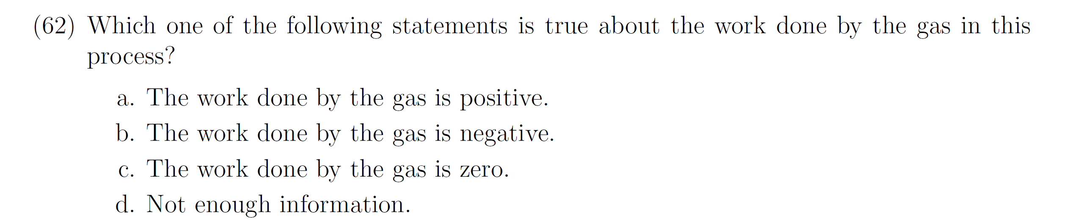
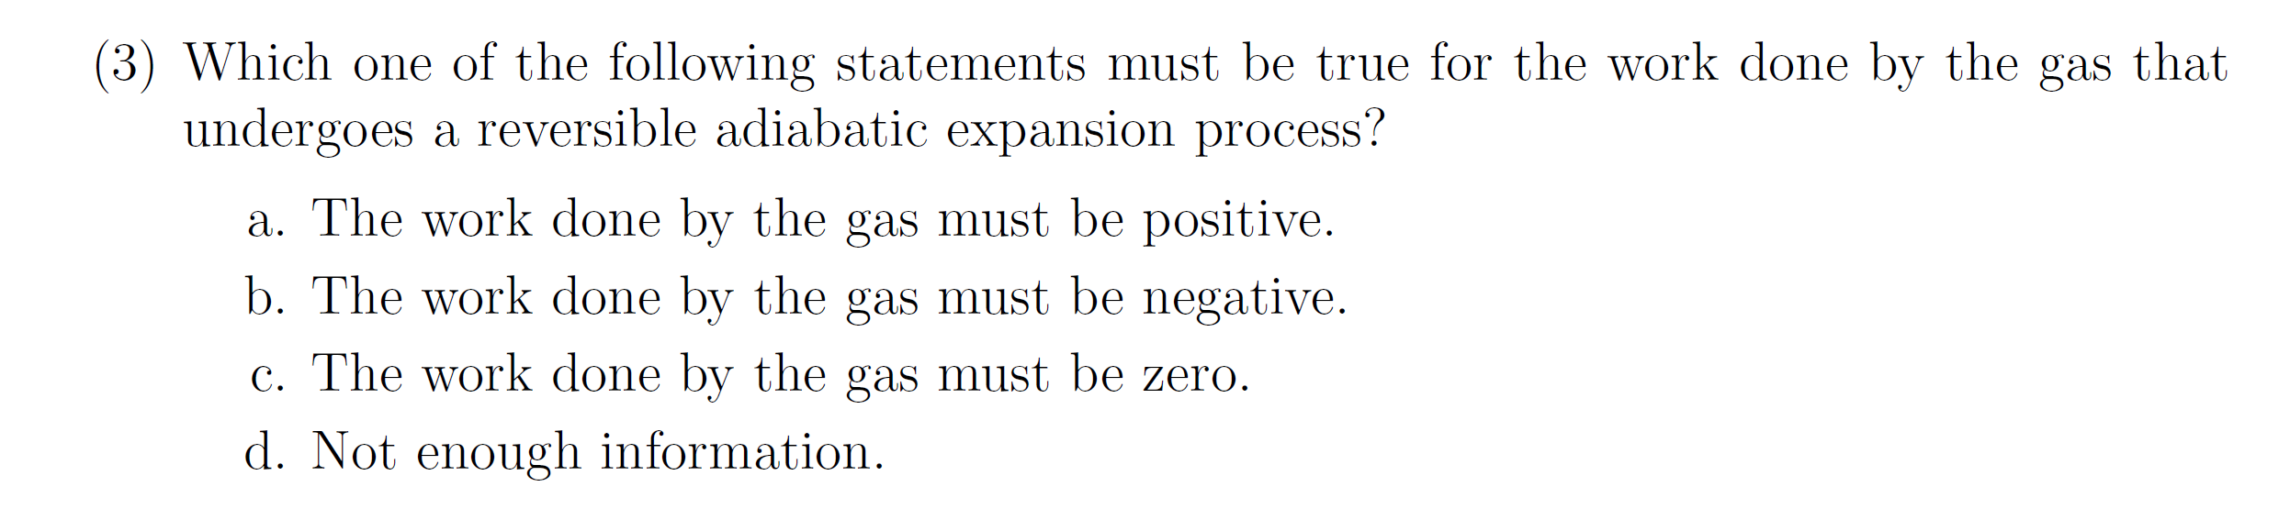
Correct-response rate
Calculus-based: 65%; Algebra-based: 55%
Work = 0 responses
Calculus-based: 11%; Algebra-based: 16%
Lower correct-response rate
Correct-response rate
Calculus-based: 54%; Algebra-based: 41%
Work = 0 responses
Calculus-based: 19%; Algebra-based: 27%
More W = 0 responses
[N ≈300 for each class]

Slide 20
Correct-response rate
Calculus-based: 65%; Algebra-based: 55%
Work = 0 responses
Calculus-based: 11%; Algebra-based: 16%
Lower correct-response rate
Correct-response rate
Calculus-based: 54%; Algebra-based: 41%
Work = 0 responses
Calculus-based: 19%; Algebra-based: 27%
More W = 0 responses
More Work = 0 responses on “reversible adiabatic” expansion question
Interviews: Most incorrect answers on #3 were justified by Q = 0 arguments

Slide 21
The replacement of the word isothermal by the term reversible adiabatic lowered the correct-response rate by 11-14%, even though both processes were described as an “expansion.”

Slide 22
Targeted Concepts (among others) (E= internal energy; W = work done by system; Q = heat transfer to system)
E is proportional to T for an ideal gas
The sign of ΔE for an ideal gas undergoing an isochoric or isobaric process is determined by whether pressure or volume are increasing
W is positive for an expansion whether adiabatic or isothermal
In a reversible isothermal process, Q ≠ 0 and the sign of Q is determined by whether volume is increasing or decreasing

Slide 23
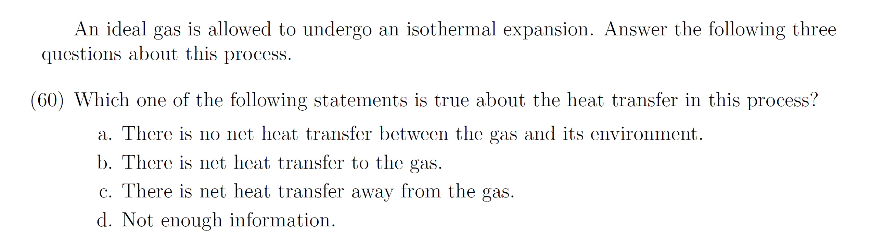
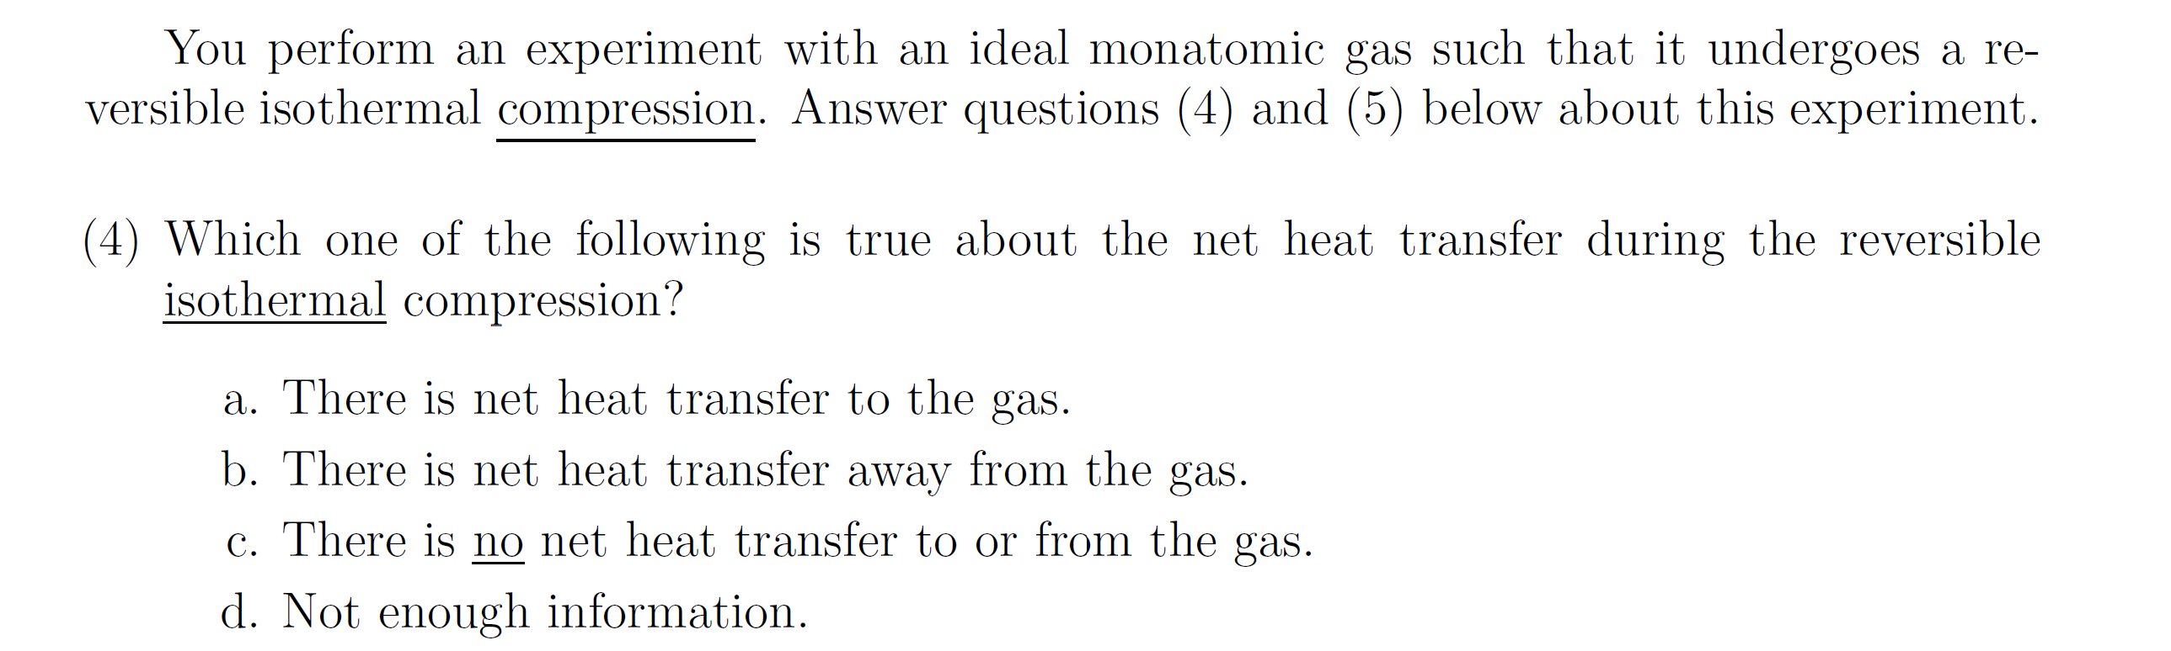
Q─W = ΔE = 0 since ΔT=0, so Q = W > 0
Correct-response rate
Calculus-based: 43%; Algebra-based: 44%
Q = 0 responses
Calculus-based: 30%; Algebra-based: 37%
Q─W = ΔE = 0 since ΔT=0, so Q = W < 0
Correct-response rate
Calculus-based: 30%; Algebra-based: 21%
Q = 0 responses
Calculus-based: 50%; Algebra-based: 59%
Many more Q = 0 responses on “reversible compression” question, justified by “process is isothermal” arguments

Slide 24
General Findings
Horizontal process arrows on PV diagrams often triggered unproductive lines of reasoning regarding work
Certain terms may trigger unproductive lines of reasoning (e.g., adiabatic)
Students tend to focus attention on the “most salient” variable (such as heat in an adiabatic process) while ignoring other variables

Slide 25
Symbolic Procedures
Confusion of symbolic meaning: Students perform worse on solving problems when symbols are used to represent common physical quantities in equations [Torigoe and Gladding, 2007; 2011)
Example [Multiple-choice questions; University of Illinois]:
Version #1: A car can go from 0 to 60 m/s in 8 s. At what distance d from the start at rest is the car traveling 30 m/s?
Version #2: A car can go from 0 to v₁ in t₁ seconds. At what distance d from the start at rest is the car traveling (v₁/2)?
Our results on “stripped-down” versions are analogous, although differences are smaller
[93% correct]
[57% correct]
Much worse!

Slide 26
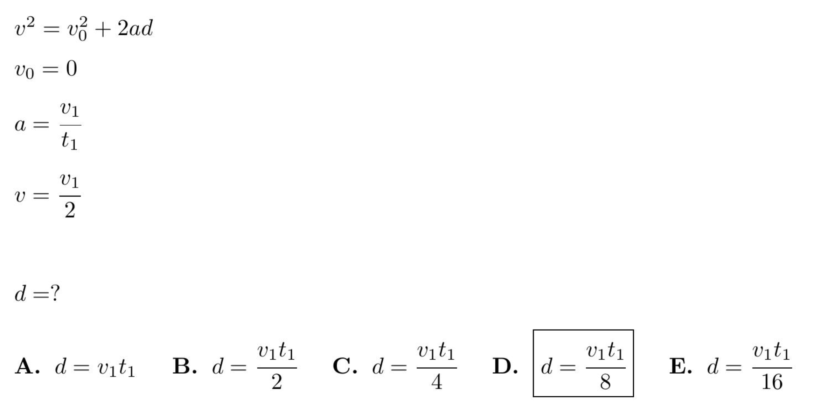
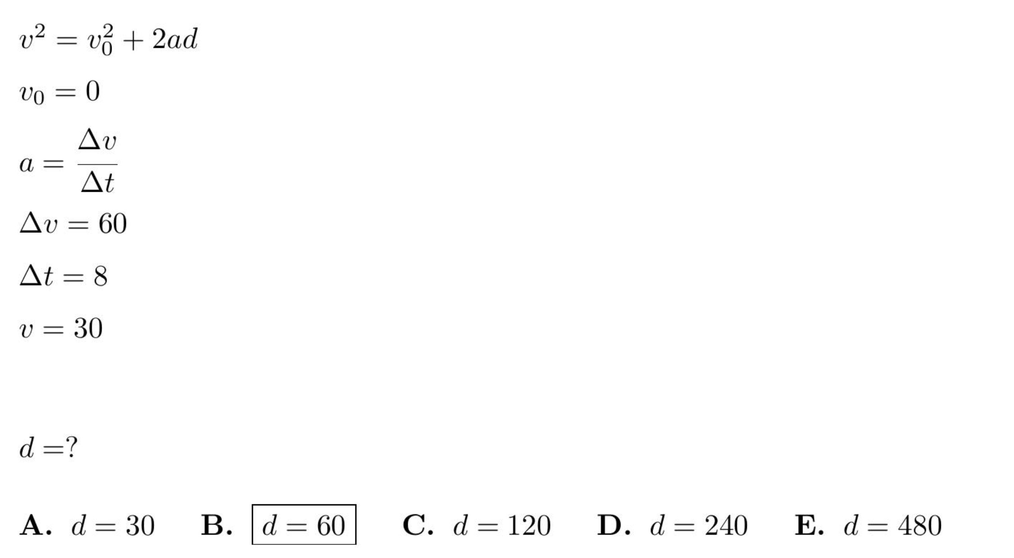
Symbolic version
Numeric version

Slide 27
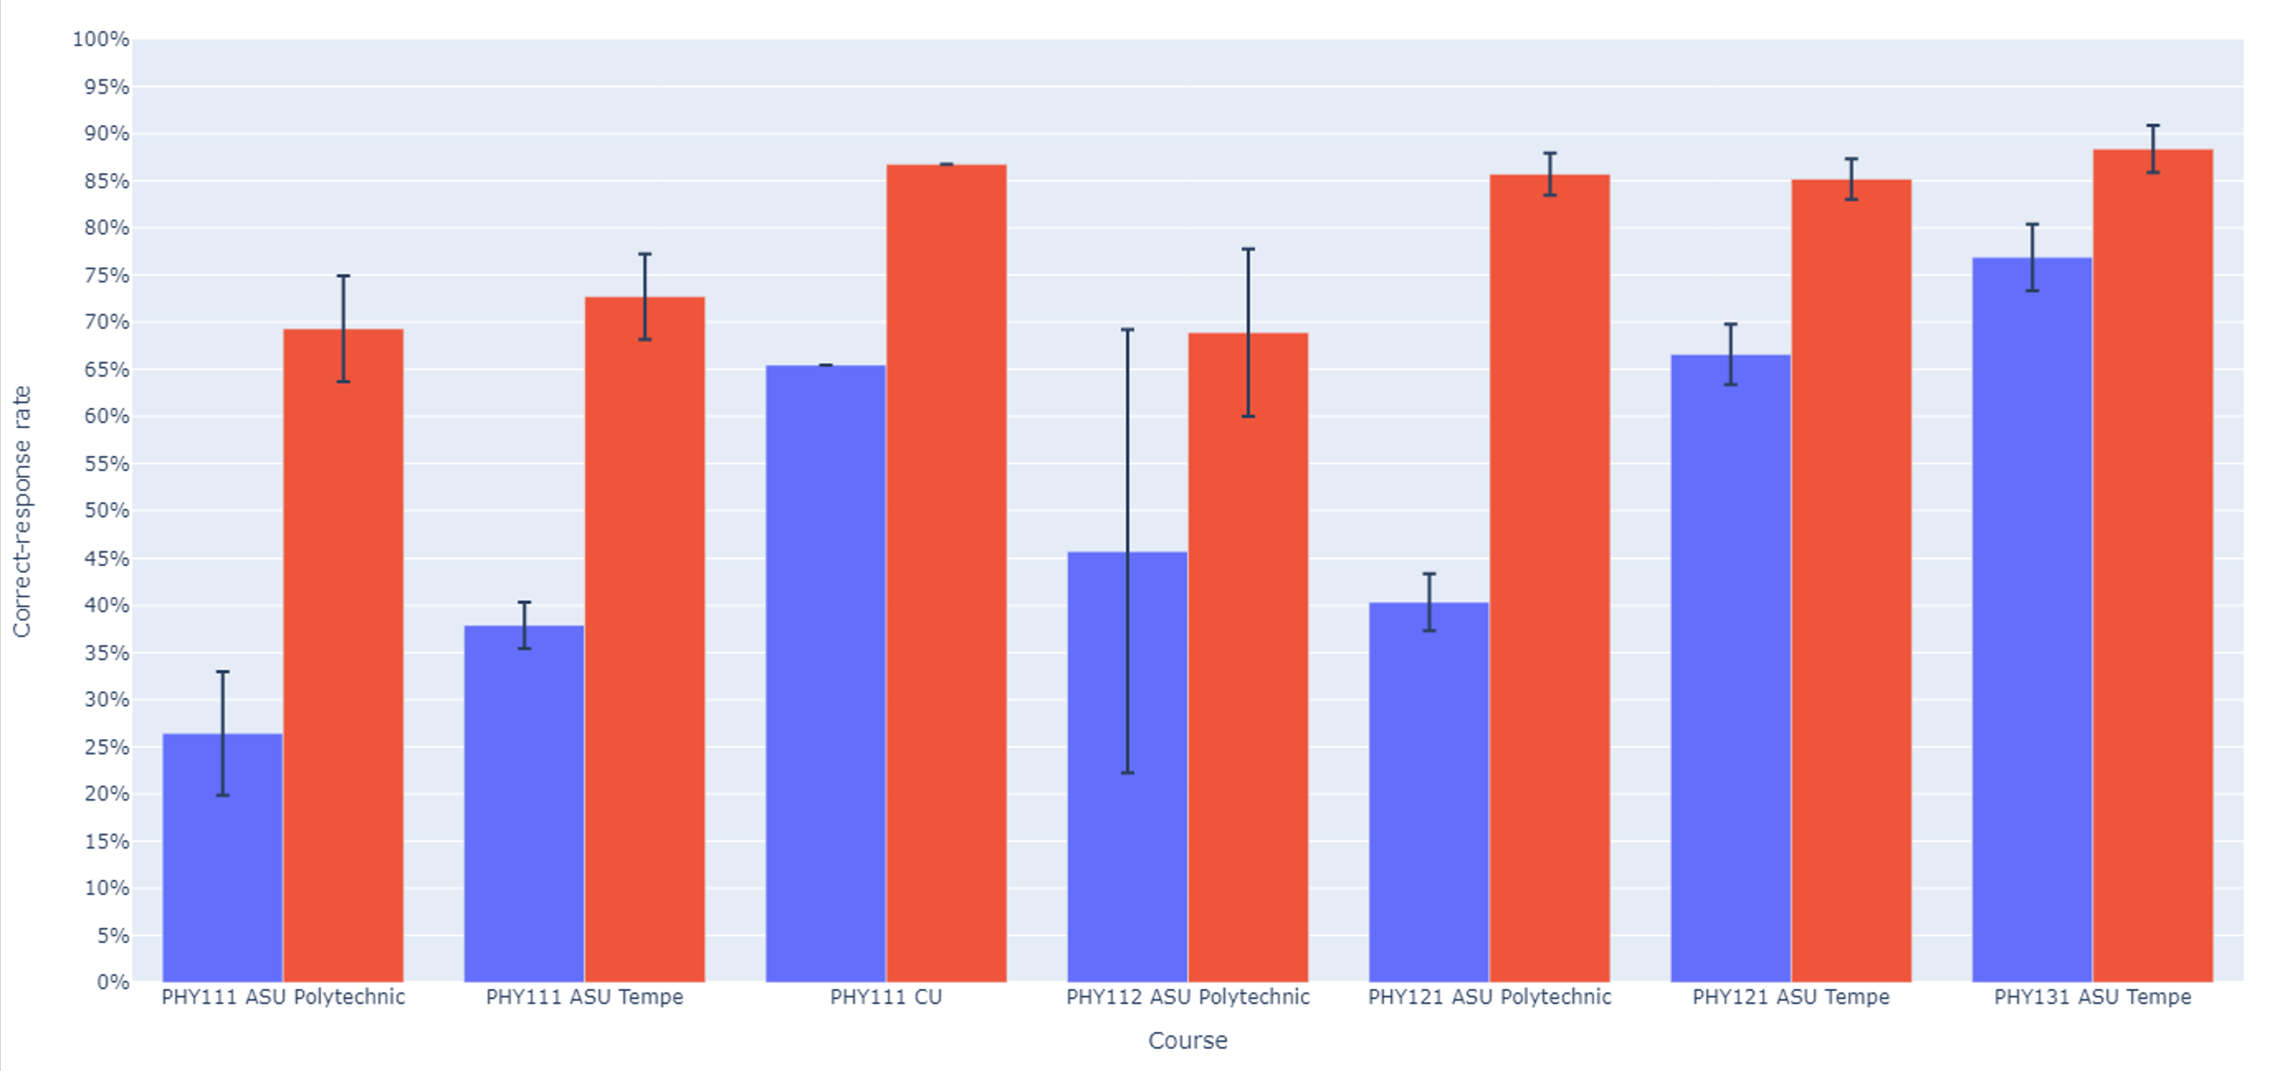
Symbolic version: Numeric version:

Slide 28
Algebra: Simultaneous Equations (algebra-based course, ASU-T)
0.5y = 2x
78.4 − y = 8x
[Solve for x]
Numeric Version 61% correct (N = 470)
cy = dx
a − y = bx
[Solve for x]
Symbolic Version 55% correct (N = 862)

Slide 29
Algebra: Simultaneous Equations (algebra-based course, ASU-T)
0.5y = 2x
78.4 − y = 8x
[Solve for x]
Numeric Version 61% correct (N = 470)
cy = dx
a − y = bx
[Solve for x]
Symbolic Version 31% correct (N = 372)

Slide 30
Algebra: Simultaneous Equations (calculus-based course, ASU-T)
0.5y = 2x
78.4 − y = 8x
[Solve for x]
Numeric Version 79% correct (N = 1205)
cy = dx
a − y = bx
[Solve for x]
Symbolic Version 55% correct (N = 862)

Slide 31
Algebra: Simultaneous Equations (calculus-based course, ASU-T)
0.5y = 2x
78.4 − y = 8x
[Solve for x]
Numeric Version 79% correct (N = 1205)
cy = dx
a − y = bx
[Solve for x]
Symbolic Version 55% correct (N = 1202)

Slide 32
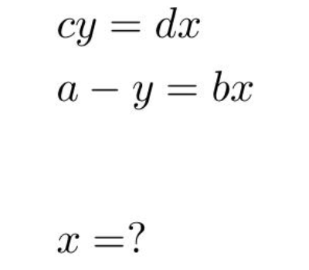
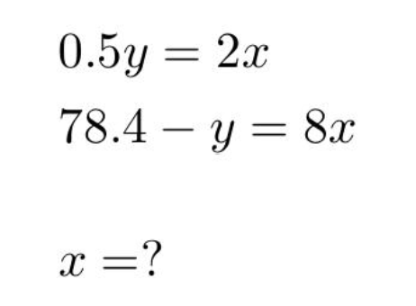
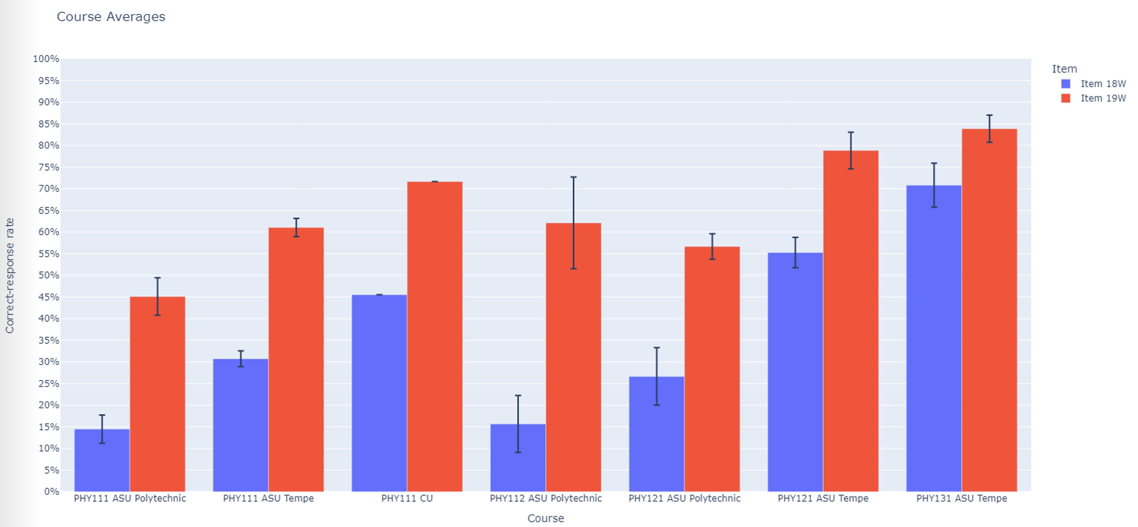

Slide 33
Conclusion: Symbolic notation degrades student performance
Use of symbols to replace numbers in otherwise identical algebraic equations lowered correct-response rates by ≈25%.

Slide 34
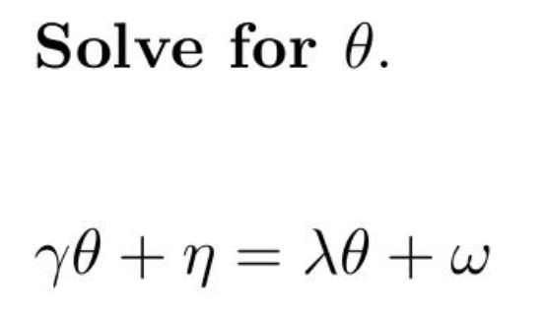
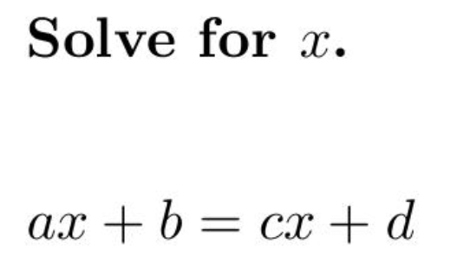
Confusion can result from the nature of the symbols themselves

Slide 35
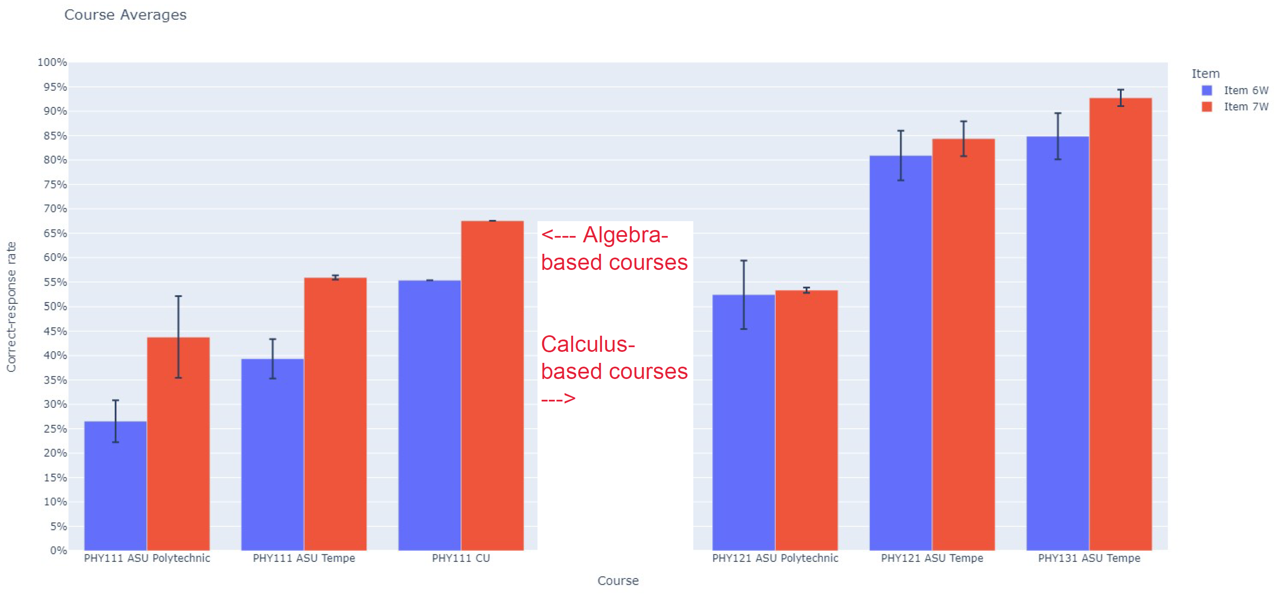
Significantly lower correct-response rates on Greek-letter version in algebra-based courses
(Total N > 1000)

Slide 36
Significantly lower correct-response rates on Greek-letter version in algebra-based courses
(Total N > 1000)

Slide 37
Implications of Findings
Minor changes to problem properties can lead to vastly different correct-response rates.
Certain specific elements of diagrams or terminology can divert students into long chains of unproductive reasoning.
Use of symbols instead of numbers, or use of unfamiliar symbols, can significantly degrade student performance
Focused instructional guidance may be needed to aid students in addressing these challenges.
To ensure consistency and reliability of assessment problems and instruments, research on students’ responses to variations in problem properties is essential.

