Slide 1
Problem-property dependence of students' responses to thermodynamics problems
David E. Meltzer
Arizona State University
Mary Jane Brundage
Misericordia University
Chandralekha Singh
University of Pittsburgh

Slide 2
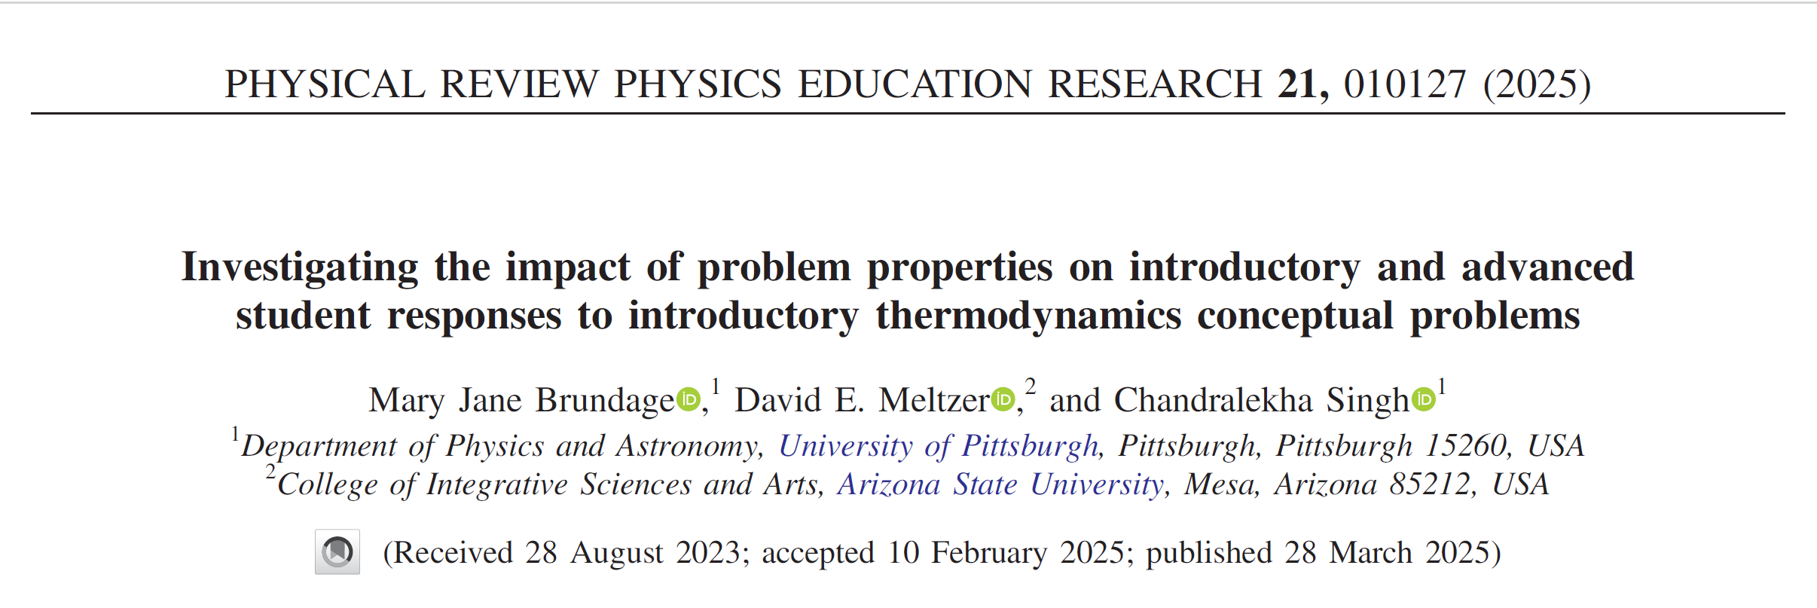

Slide 3
Exploring students’ thinking when solving thermodynamics problems
78-item Multiple-choice instrument: “Survey of Thermodynamic Processes and First and Second Laws (STPFaSL-Long)”
  administered after instruction in standard algebra- and calculus-based lecture courses
Each individual thermodynamics concept was targeted by 2-5 different problems
Problems differ from each other by:
  using diverse physical settings and scenarios
  very minor changes in wording or in diagrammatic features
  including diverse potentially distracting features
Sample size ranged from 320-550 (varied by problem)
With these sample sizes, differences in correct-response rates ≈15% or greater are statistically significant, generally with p<0.001 and effect size > 0.3
Interview data: Interviews carried out with 17 students (11 introductory; 6 upper-level)

Slide 4
Targeted Concepts (among others)
(E= internal energy; W = work done by system; Q = heat transfer to system)
E is proportional to T for an ideal gas
The sign of ΔE for an ideal gas is determined by whether the product PV is increasing or decreasing
W is positive for an expansion

Slide 5
Targeted Concepts (among others)
(E= internal energy; W = work done by system; Q = heat transfer to system)
E is proportional to T for an ideal gas
The sign of ΔE for an ideal gas is determined by whether the product PV is increasing or decreasing
W is positive for an expansion

Slide 6
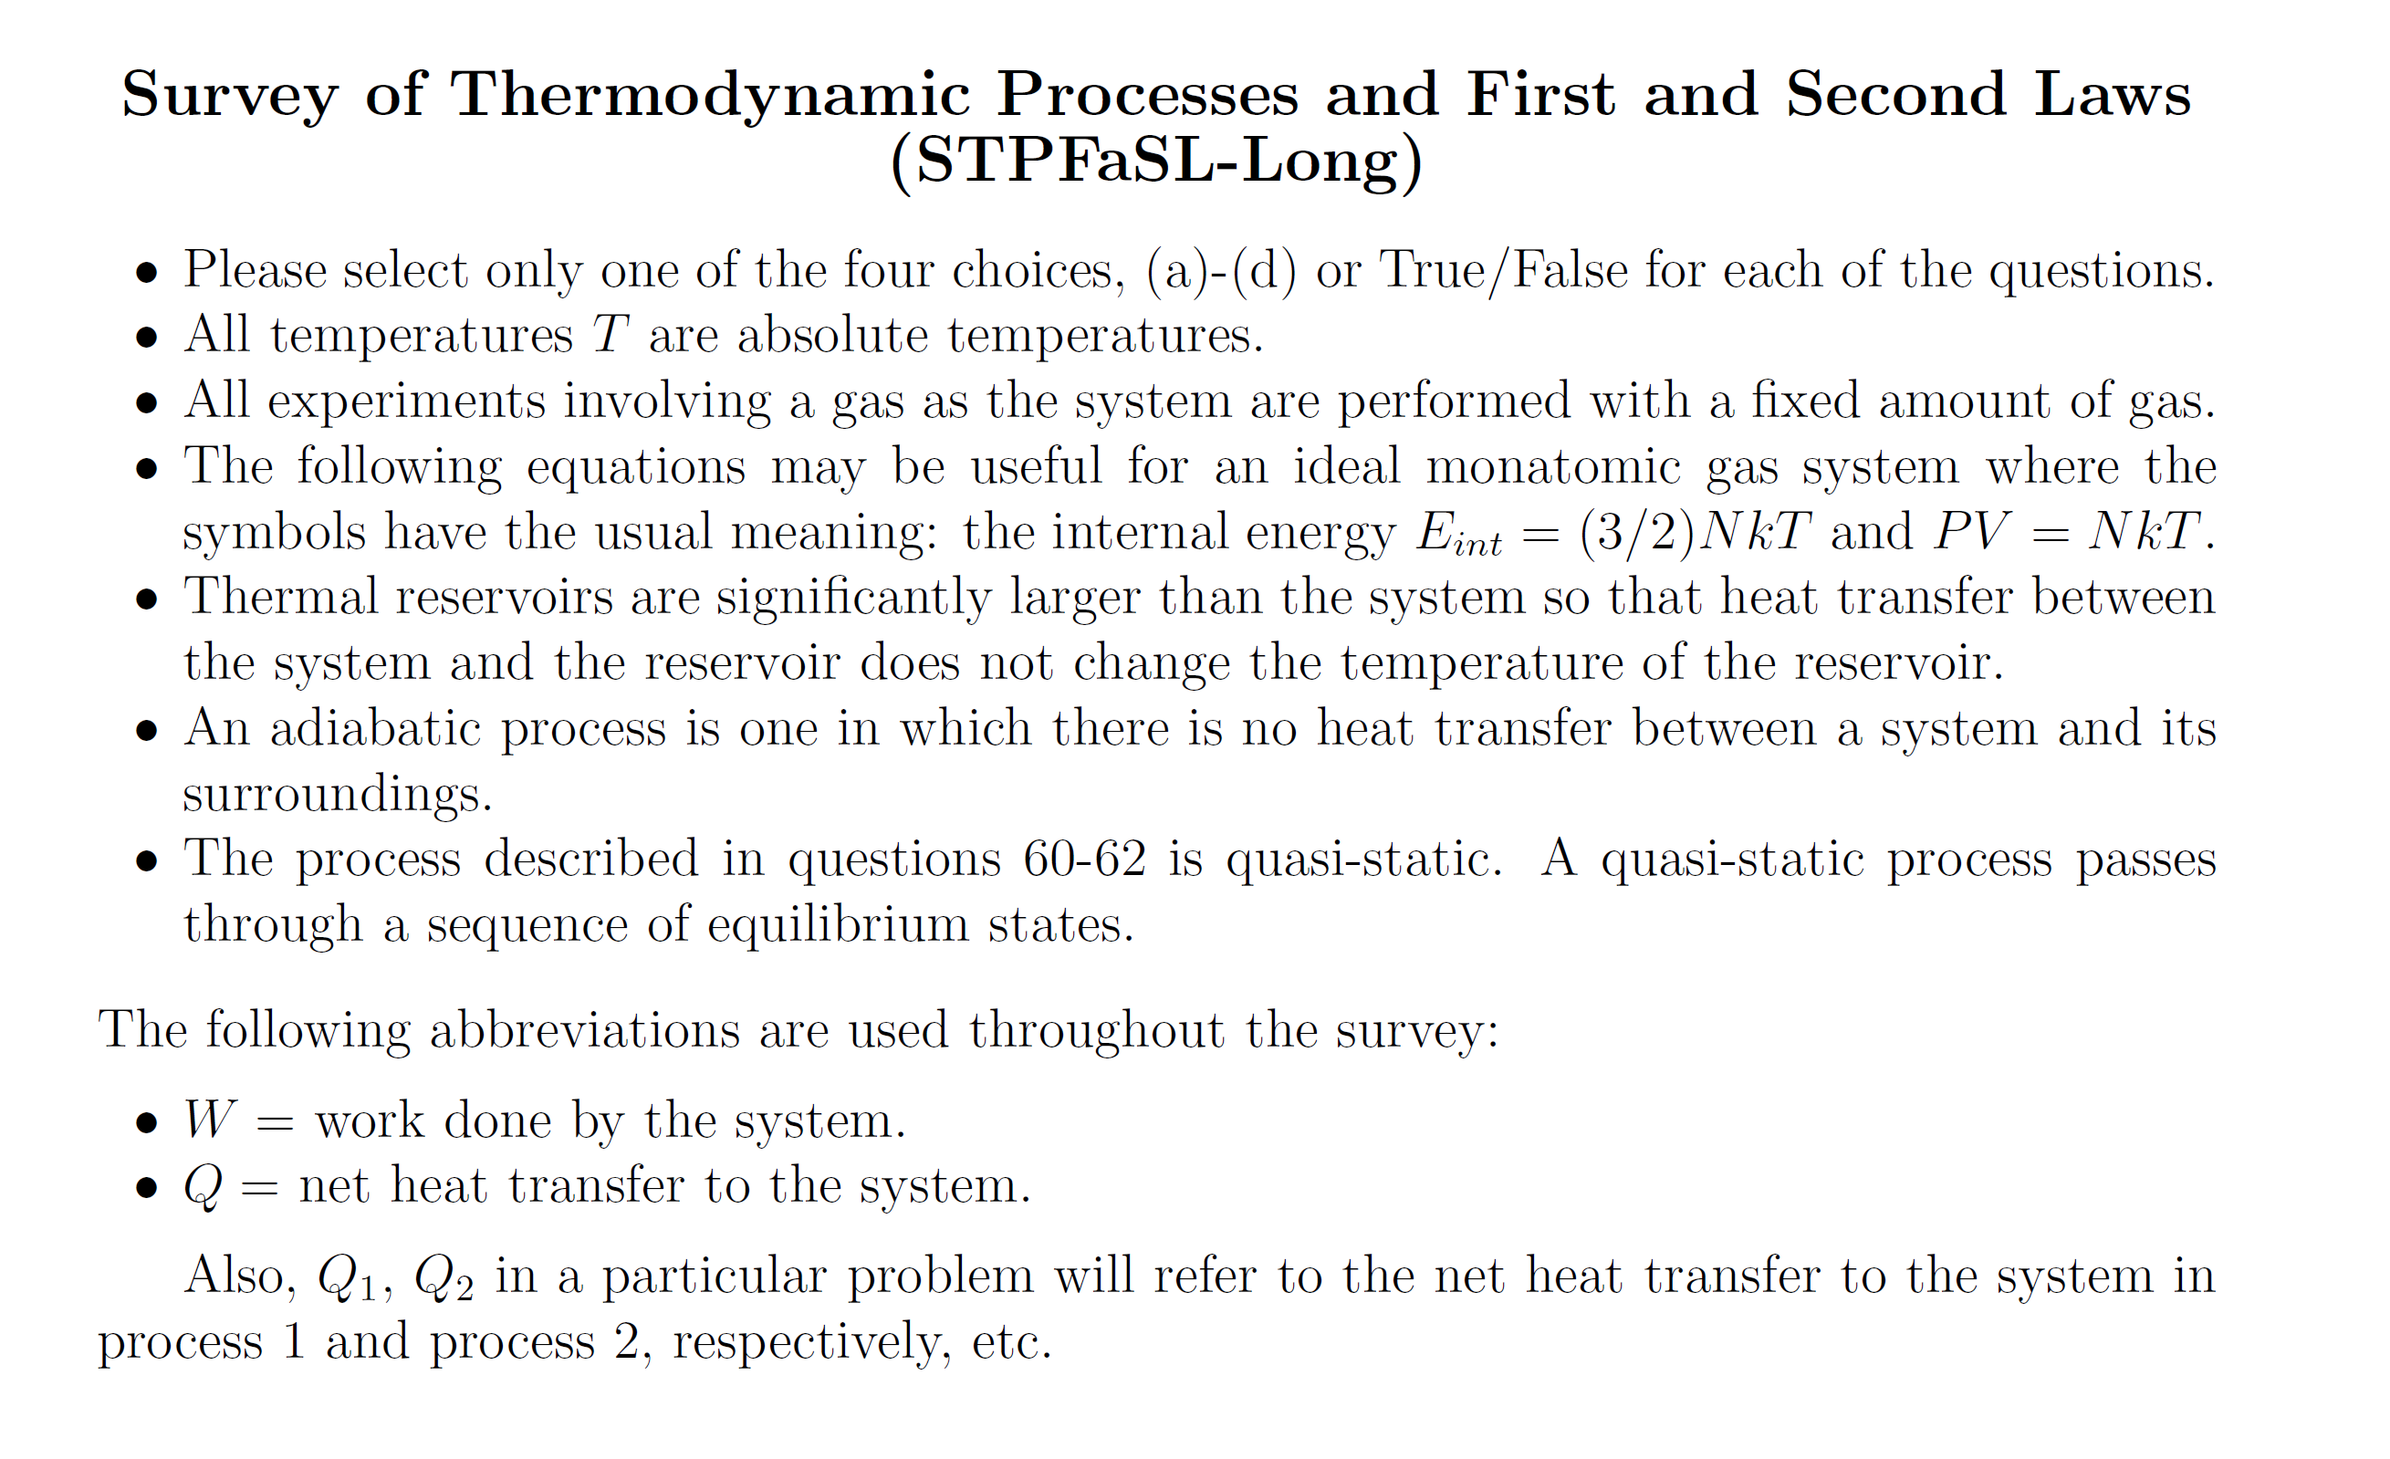
Information provided to students on first page:

Slide 7
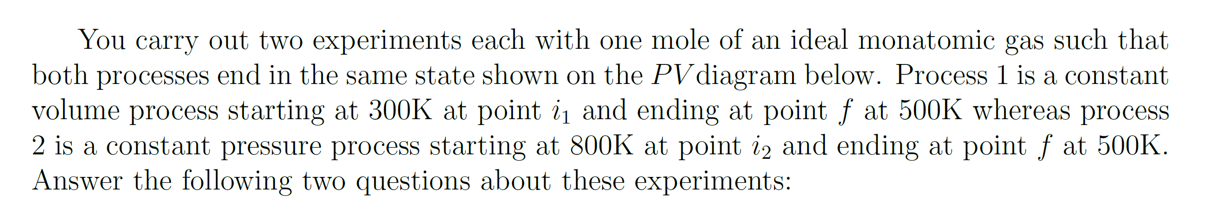
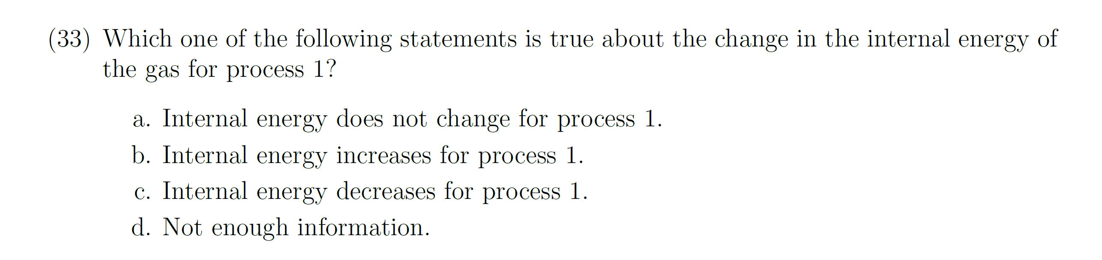
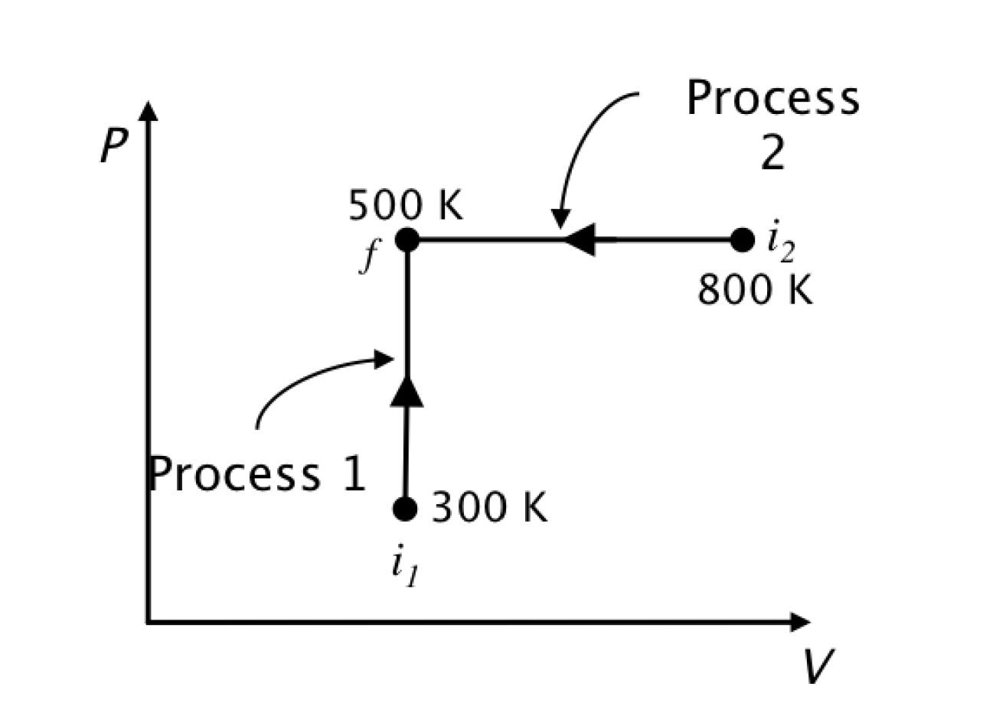
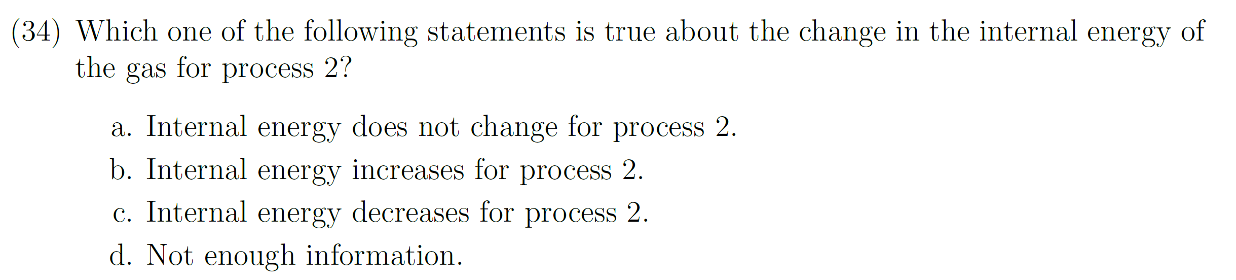
Answer: (b); temperature increases so internal energy increases.
Correct-response rate; Calculus-based: 76%; Algebra-based: 81%
Answer: (c); temperature decreases so internal energy decreases.
Correct-response rate; Calculus-based: 58%; Algebra-based: 55%
Many more errors on #34 (Process 2) →

Slide 8
Why did students make significantly more errors on #34?
Interviews: 3 of 6 students who gave incorrect answer on #34 (Process 2) argued “Work done is negative so internal energy will increase”
This would be true for an adiabatic process; however, students have completely ignored the role of heat transfer (Q < 0 in this case).
Students were distracted by work considerations; this was also true for Process 1 (zero work) but not, apparently, to the same degree as in Process 2.
The salience of the negative-work feature in Process 2 seems to have played a key role in students’ thinking.
Answer: (c); temperature decreases so internal energy decreases.
Correct-response rate; Calculus-based: 58%; Algebra-based: 55%

Slide 9
The use of a horizontal arrow on a PV diagram (instead of an arrow pointed straight up) lured some students into unproductive considerations regarding work, lowering the correct-response rate by 18-26%.

Slide 10
Targeted Concepts (among others)
(E= internal energy; W = work done by system; Q = heat transfer to system)
E is proportional to T for an ideal gas
The sign of ΔE for an ideal gas is determined by whether the product PV is increasing or decreasing
W is positive for an expansion

Slide 11
Information provided to students on first page:

Slide 12
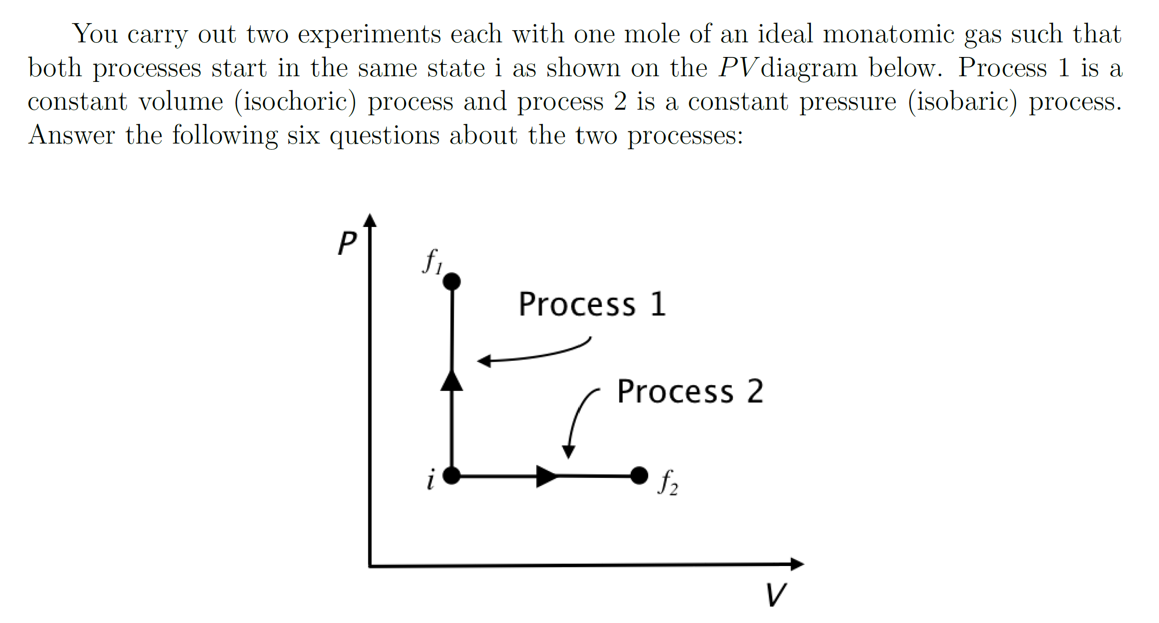
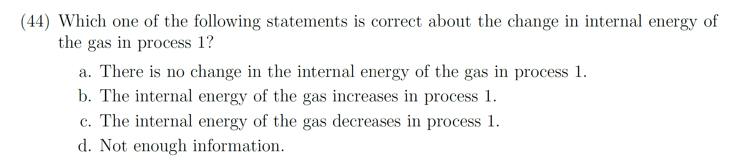
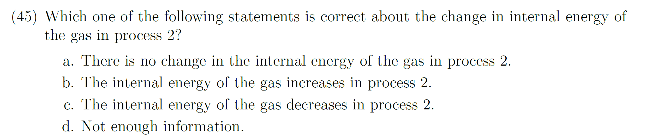
Answer to both #44 and #45: (b); PV increases so internal energy increases [Eint = (3/2) NkT = (3/2) PV)].
Correct-response rate on Process 1, Calculus-based: 69%; Algebra-based: 70%
Correct-response rate on Process 2, Calculus-based: 43%; Algebra-based: 37%
Interviews: 7 of 9 incorrect responses on Process 2 were justified by saying work done is positive so energy would decrease, thus ignoring the role of heat transfer.
For Process 2, the salience of the right-pointing horizontal arrow indicating that positive work is done lured students into flawed arguments regarding work and ignoring heat transfer.
More incorrect answers on Process 2

Slide 13
The use of a horizontal arrow on a PV diagram (instead of an arrow pointed straight up) lured students into unproductive considerations regarding work, lowering the correct-response rate by 26-33%.
✓
X

Slide 14
Targeted Concepts (among others)
(E= internal energy; W = work done by system; Q = heat transfer to system)
E is proportional to T for an ideal gas
The sign of ΔE for an ideal gas is determined by whether the product PV is increasing or decreasing
W is positive for an expansion

Slide 15
Information provided to students on first page:

Slide 16
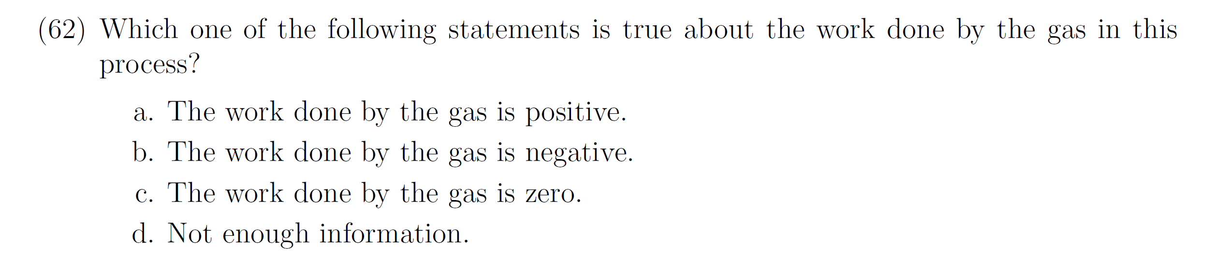
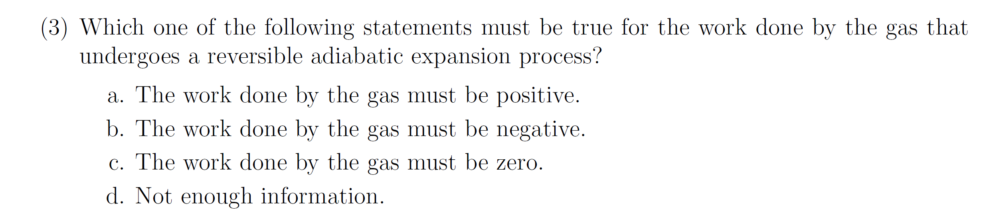
Correct-response rate
Calculus-based: 65%; Algebra-based: 55%
Work = 0 responses
Calculus-based: 11%; Algebra-based: 16%
Lower correct-response rate
Correct-response rate
Calculus-based: 54%; Algebra-based: 41%
Work = 0 responses
Calculus-based: 19%; Algebra-based: 27%
More W = 0 responses

Slide 17
Correct-response rate
Calculus-based: 65%; Algebra-based: 55%
Work = 0 responses
Calculus-based: 11%; Algebra-based: 16%
Lower correct-response rate
Correct-response rate
Calculus-based: 54%; Algebra-based: 41%
Work = 0 responses
Calculus-based: 19%; Algebra-based: 27%
More W = 0 responses
More Work = 0 responses on “reversible adiabatic” expansion question
Interviews: Most incorrect answers on #3 were justified by Q = 0 arguments

Slide 18
The replacement of the word isothermal by the term reversible adiabatic lowered the correct-response rate by 11-14%, even though both processes were described as an “expansion.”

Slide 19
General Findings
Horizontal process arrows on PV diagrams often triggered unproductive lines of reasoning regarding work
Certain terms may trigger unproductive lines of reasoning (e.g., adiabatic)
Students tend to focus attention on the “most salient” variable (such as heat in an adiabatic process) while ignoring other variables

Slide 20
What makes a problem hard(er)?
Use of potentially misleading/distracting diagrammatic elements
Inclusion of (potentially misleading) irrelevant or redundant information
Use of symbols in place of numbers (e.g., m or μ for mass)
Need for unfamiliar or unpracticed mathematical skills
Multiple relevant factors or variables in same problem (e.g., E, Q, W)
Need for spatial reasoning (e.g., right-hand rules in magnetism)
Dependence on or use of unfamiliar or subtle assumptions or terms
  e.g., adiabatic, thermal reservoir, quasi-static, reversible, spontaneous
Use of quantities with different defining equations in different contexts
  e.g., Q = mcΔT in calorimetry, but also Q = ΔU+W≠0 even when ΔT=0)

Slide 21
Implications of Findings
Minor changes to problem properties can lead to vastly different correct- response rates.
Certain specific elements of diagrams or terminology can divert students into long chains of unproductive reasoning.
Immediate “intuitive” responses often trigger lengthy chains of “off-track” unproductive reasoning.
Focused instructional guidance may be needed to aid students in addressing these challenges.

