Slide 1
What makes a physics problem hard? Research on problem difficulty
David E. Meltzer
Arizona State University

Slide 2
What makes a problem hard(er)?
Use of potentially misleading/distracting diagrammatic elements
Inclusion of (potentially misleading) irrelevant or redundant information
Use of symbols in place of numbers (e.g., m or μ for mass)
Multiple relevant factors or variables in same problem (e.g., E, Q, W)
Dependence on or use of unfamiliar or subtle assumptions or terms
e.g., adiabatic, thermal reservoir, quasi-static, reversible, spontaneous

Slide 3
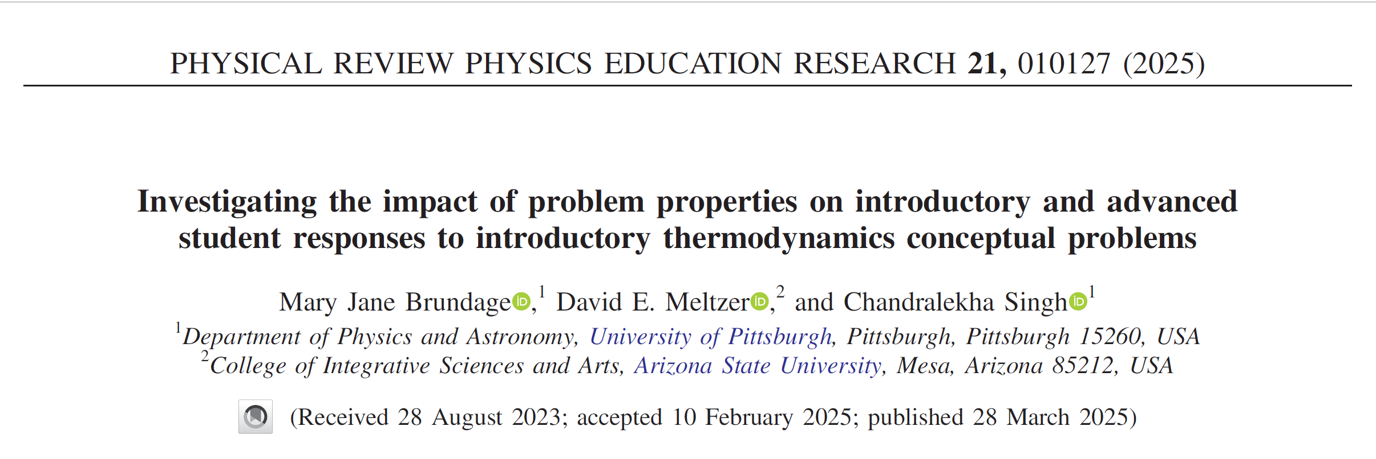

Slide 4
Targeted Concepts (among others) (E= internal energy; W = work done by system; Q = heat transfer to system)
E is proportional to T for an ideal gas
The sign of ΔE for an ideal gas is determined by whether the product PV is increasing or decreasing
W is positive for an expansion

Slide 5
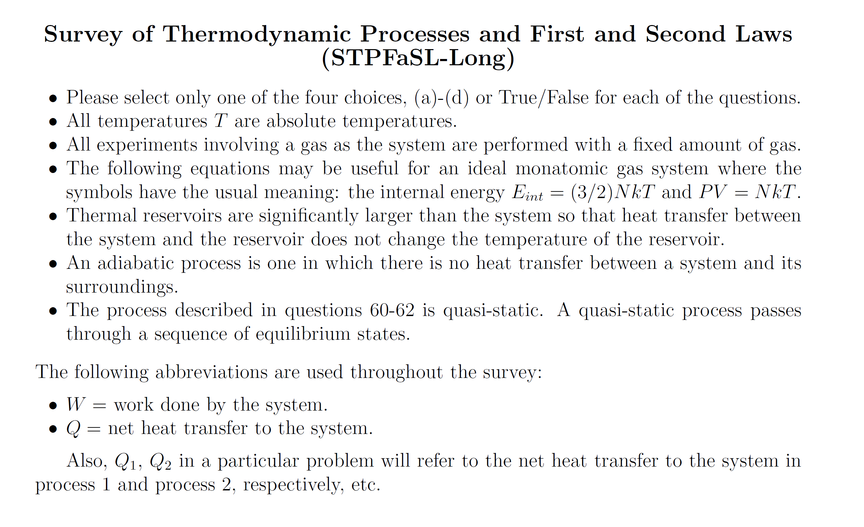
Information provided to students on first page:

Slide 6
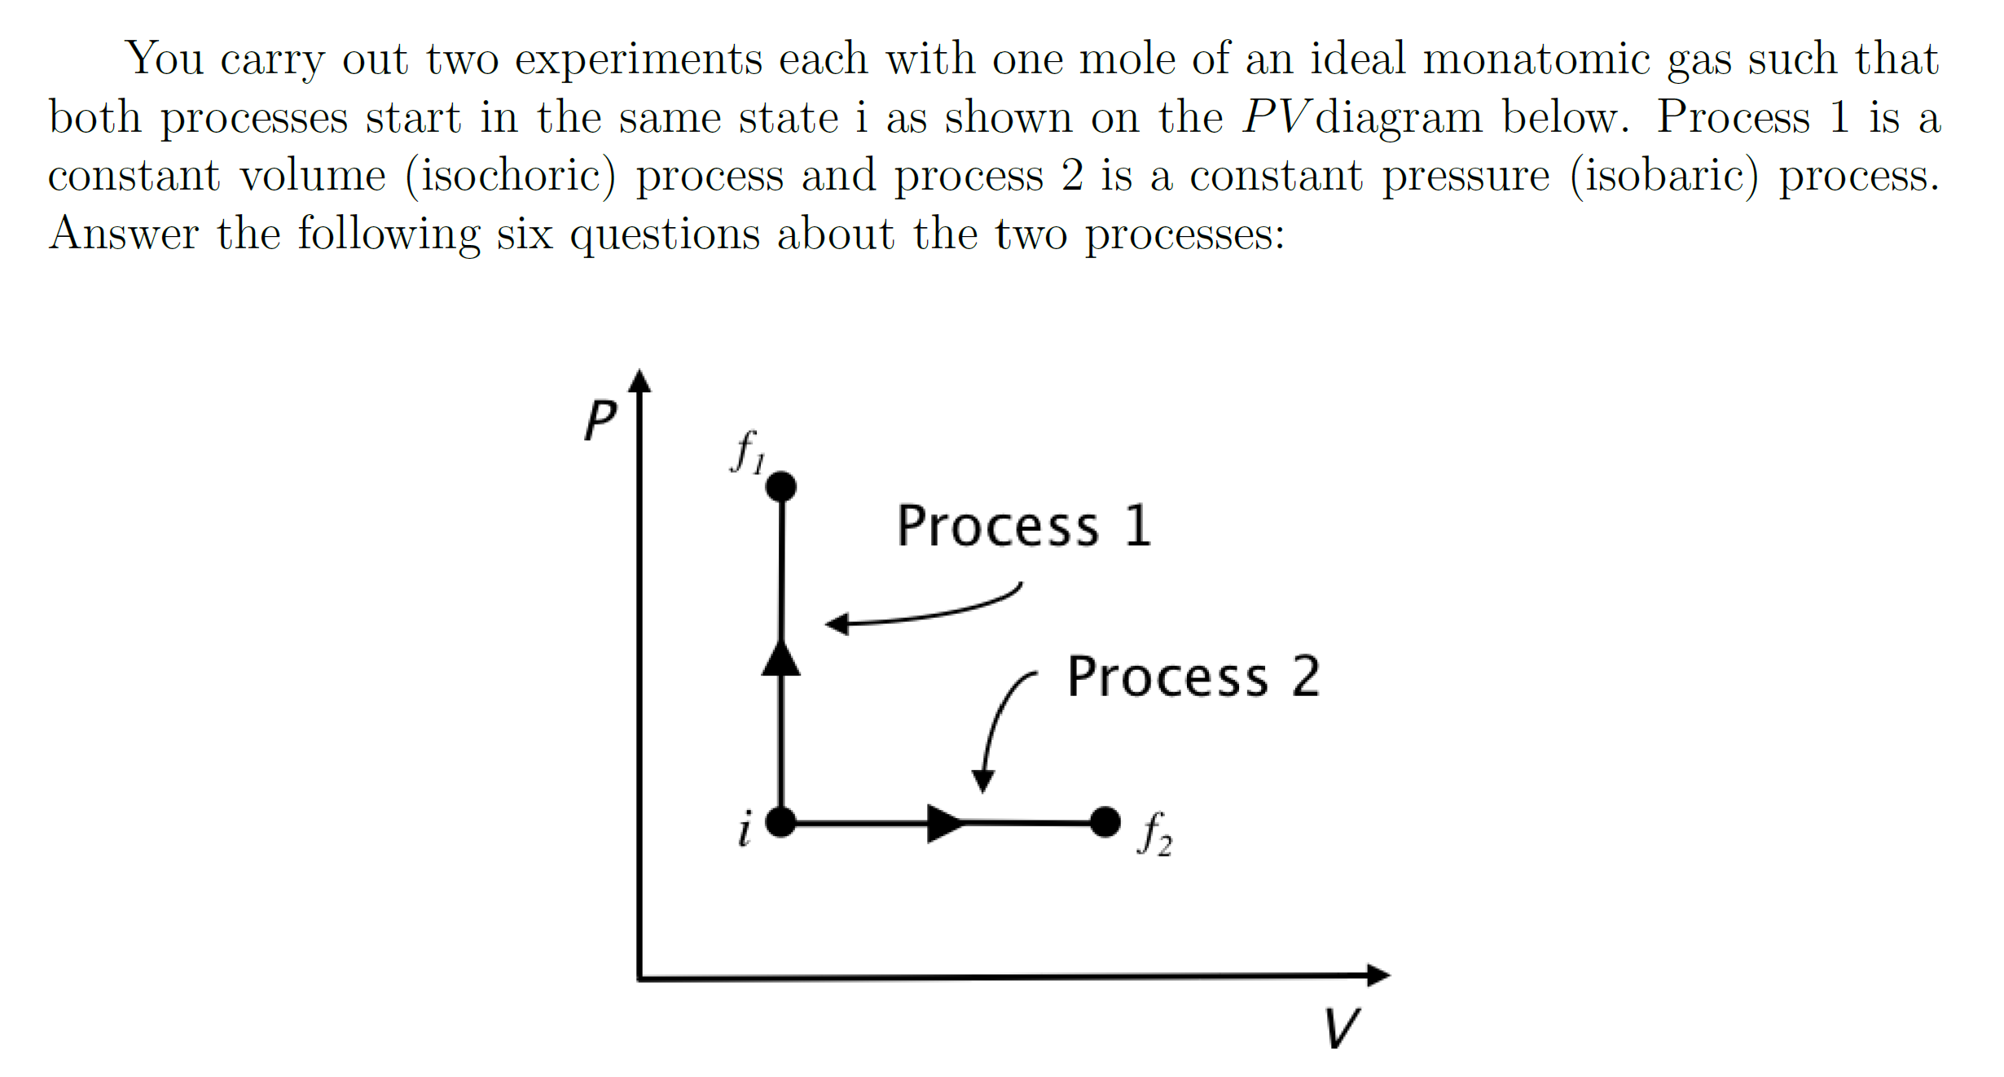
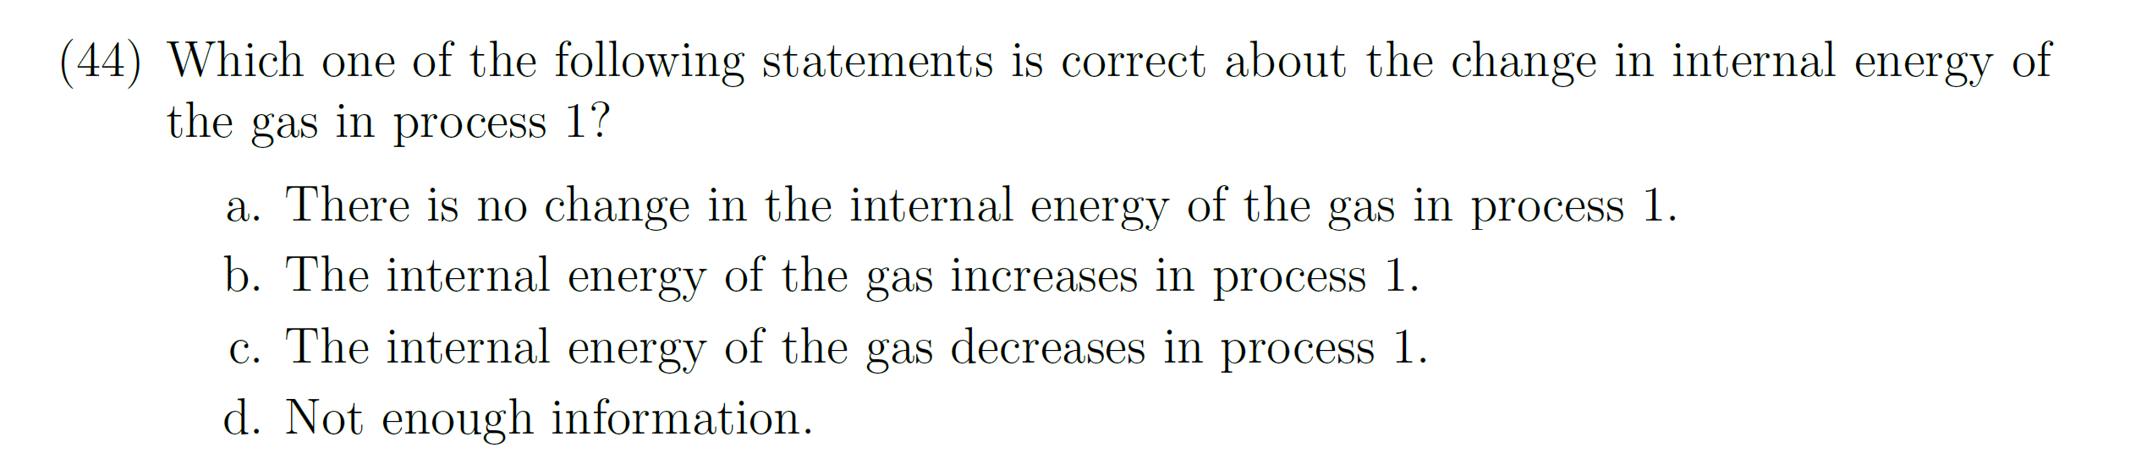
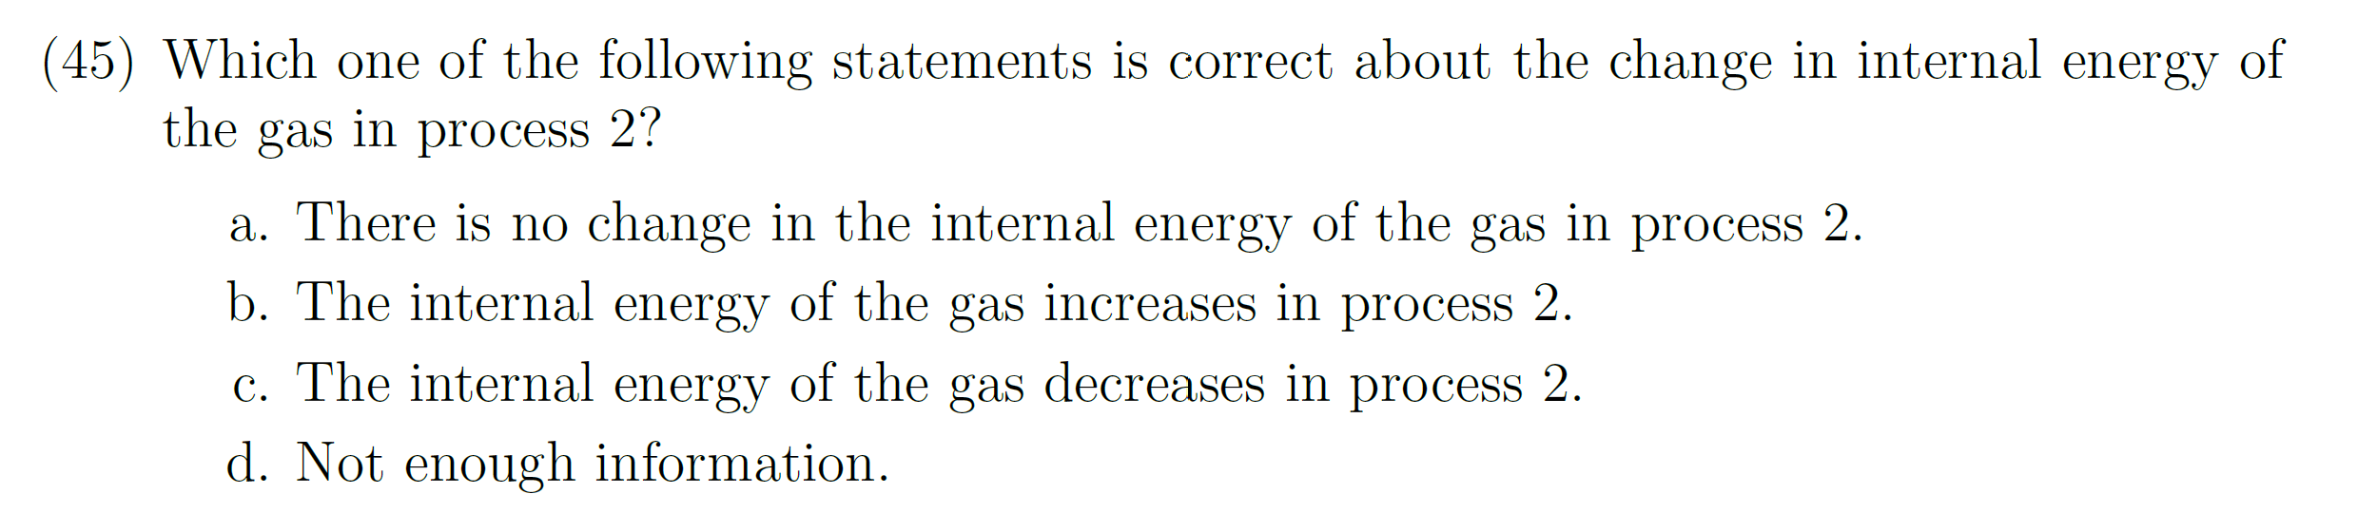
[N ≈500]
Answer to both #44 and #45: (b); PV increases so internal energy increases [Eint = (3/2) NkT = (3/2) PV)].
Correct-response rate on Process 1, Calculus-based: 69%; Algebra-based: 70%
Correct-response rate on Process 2, Calculus-based: 43%; Algebra-based: 37%
Interviews: 7 of 9 incorrect responses on Process 2 were justified by saying work done is positive so energy would decrease, thus ignoring the role of heat transfer.
For Process 2, the salience of the right-pointing horizontal arrow indicating that positive work is done lured students into flawed arguments regarding work and ignoring heat transfer.
More incorrect answers on Process 2

Slide 7
The use of a horizontal arrow on a PV diagram (instead of an arrow pointed straight up) lured students into unproductive considerations regarding work, lowering the correct-response rate by 26-33%.
✓
X

Slide 8
Targeted Concepts (among others) (E= internal energy; W = work done by system; Q = heat transfer to system)
E is proportional to T for an ideal gas
The sign of ΔE for an ideal gas is determined by whether the product PV is increasing or decreasing
W is positive for an expansion

Slide 9
Information provided to students on first page:

Slide 10
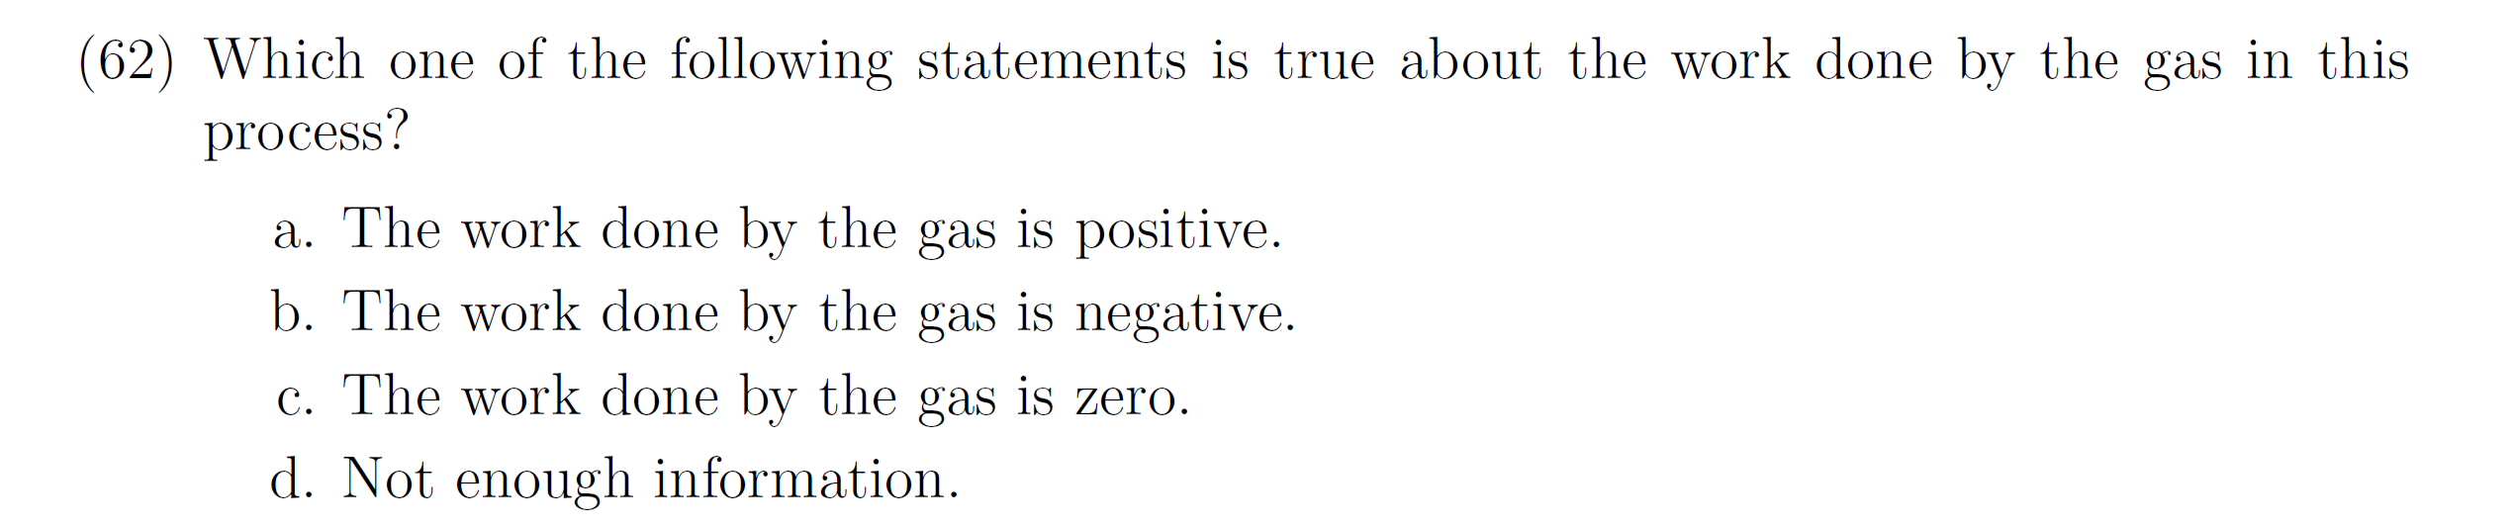
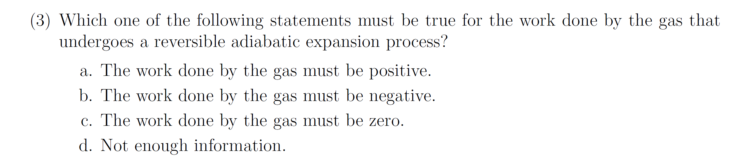
Correct-response rate
Calculus-based: 65%; Algebra-based: 55%
Work = 0 responses
Calculus-based: 11%; Algebra-based: 16%
Lower correct-response rate
Correct-response rate
Calculus-based: 54%; Algebra-based: 41%
Work = 0 responses
Calculus-based: 19%; Algebra-based: 27%
More W = 0 responses
[N ≈300 for each class]

Slide 11
Correct-response rate
Calculus-based: 65%; Algebra-based: 55%
Work = 0 responses
Calculus-based: 11%; Algebra-based: 16%
Lower correct-response rate
Correct-response rate
Calculus-based: 54%; Algebra-based: 41%
Work = 0 responses
Calculus-based: 19%; Algebra-based: 27%
More W = 0 responses
More Work = 0 responses on “reversible adiabatic” expansion question
Interviews: Most incorrect answers on #3 were justified by Q = 0 arguments

Slide 12
The replacement of the word isothermal by the term reversible adiabatic lowered the correct-response rate by 11-14%, even though both processes were described as an “expansion.”

Slide 13
Symbolic Procedures
Confusion of symbolic meaning: Students perform worse on solving problems when symbols are used to represent common physical quantities in equations [Torigoe and Gladding, 2007; 2011)
Example [Multiple-choice questions; University of Illinois]:
Version #1: A car can go from 0 to 60 m/s in 8 s. At what distance d from the start at rest is the car traveling 30 m/s?
Version #2: A car can go from 0 to v₁ in t₁ seconds. At what distance d from the start at rest is the car traveling (v₁/2)?
Our results on “stripped-down” versions are analogous, although differences are smaller
[93% correct]
[57% correct]
Much worse!

Slide 14
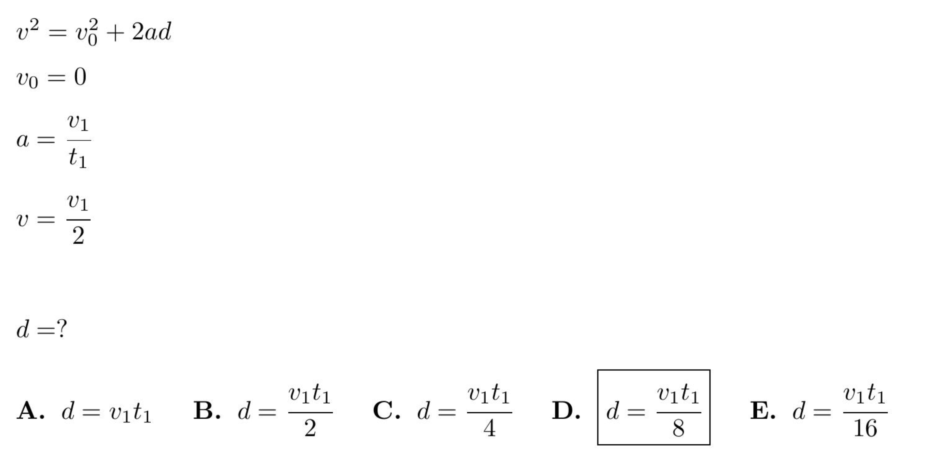
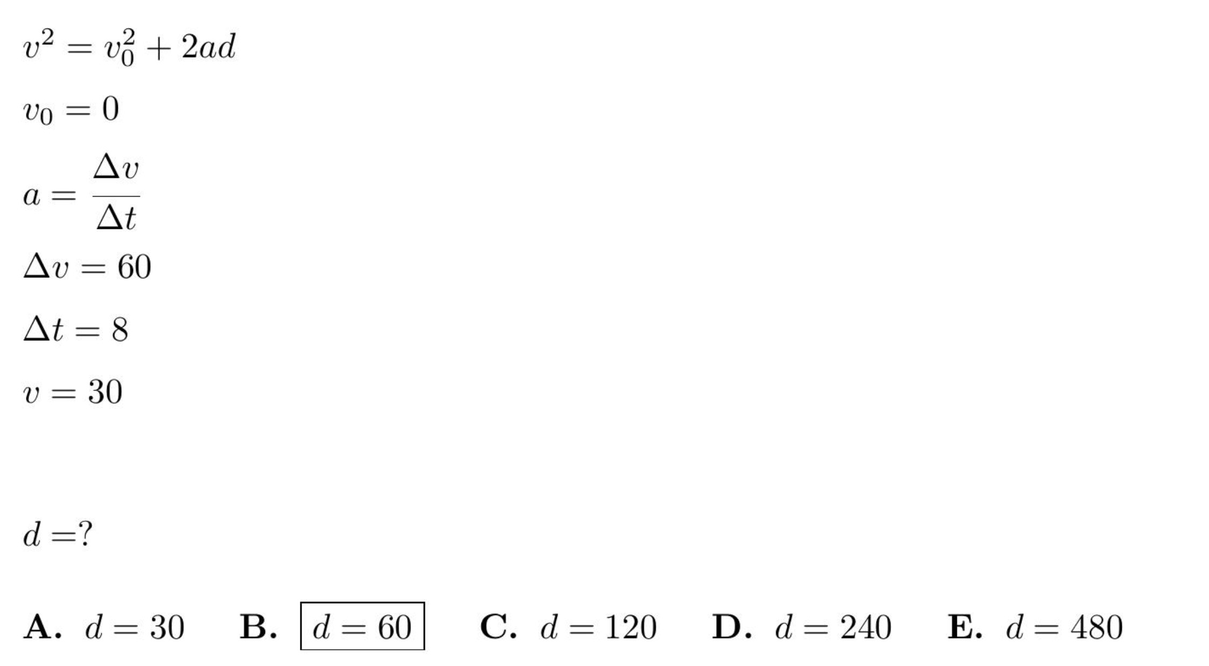
Symbolic version
Numeric version

Slide 15
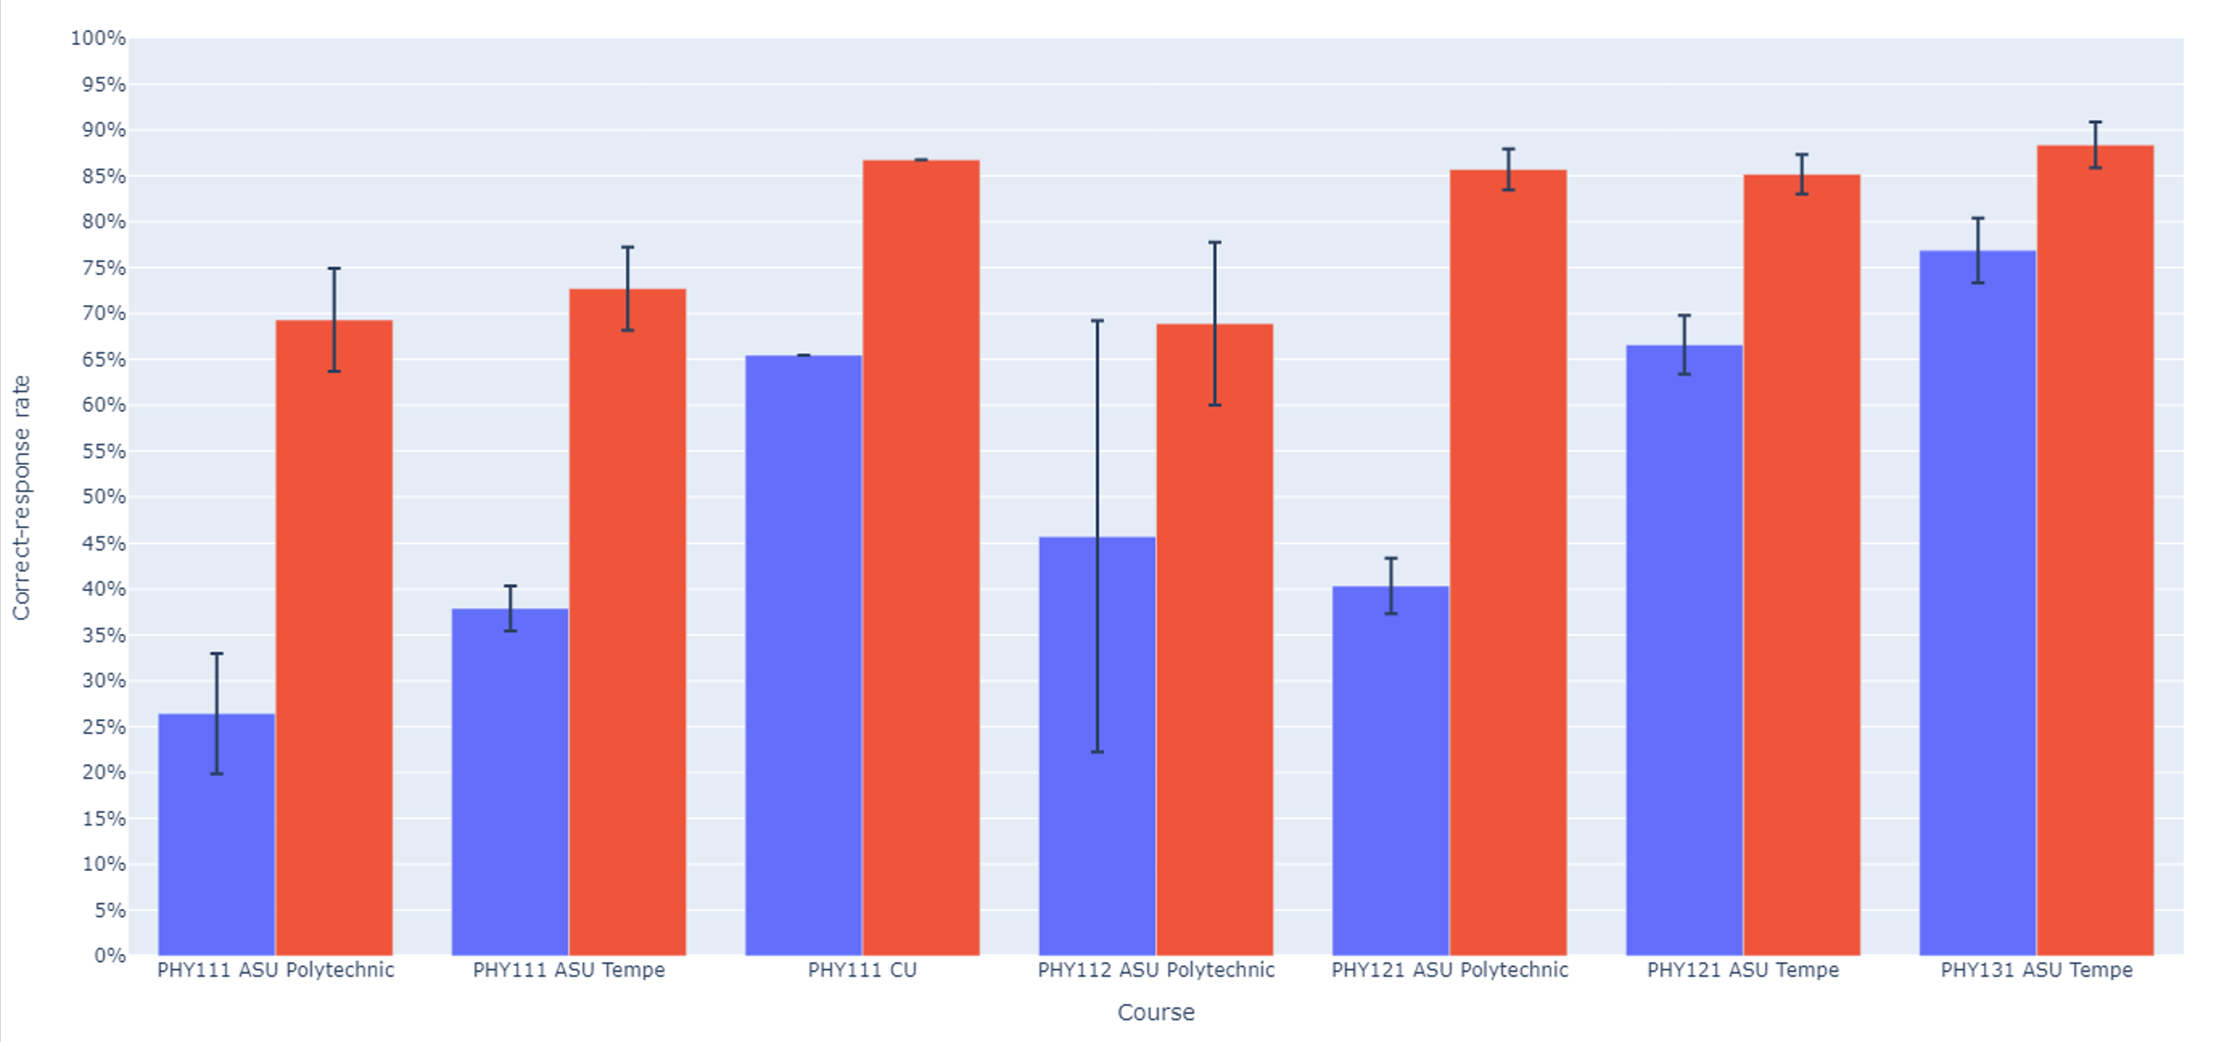
Symbolic version: Numeric version:

Slide 16
Algebra: Simultaneous Equations (algebra-based course, ASU-T)
0.5y = 2x
78.4 − y = 8x
[Solve for x]
Numeric Version 61% correct (N = 470)
cy = dx
a − y = bx
[Solve for x]
Symbolic Version 55% correct (N = 862)

Slide 17
Algebra: Simultaneous Equations (algebra-based course, ASU-T)
0.5y = 2x
78.4 − y = 8x
[Solve for x]
Numeric Version 61% correct (N = 470)
cy = dx
a − y = bx
[Solve for x]
Symbolic Version 31% correct (N = 372)

Slide 18
Algebra: Simultaneous Equations (calculus-based course, ASU-T)
0.5y = 2x
78.4 − y = 8x
[Solve for x]
Numeric Version 79% correct (N = 1205)
cy = dx
a − y = bx
[Solve for x]
Symbolic Version 55% correct (N = 862)

Slide 19
Algebra: Simultaneous Equations (calculus-based course, ASU-T)
0.5y = 2x
78.4 − y = 8x
[Solve for x]
Numeric Version 79% correct (N = 1205)
cy = dx
a − y = bx
[Solve for x]
Symbolic Version 55% correct (N = 1202)

Slide 20
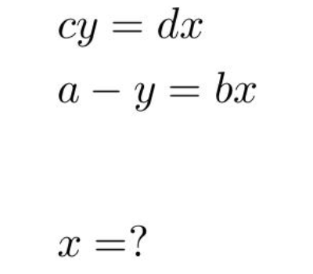
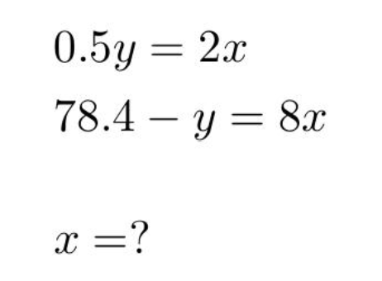
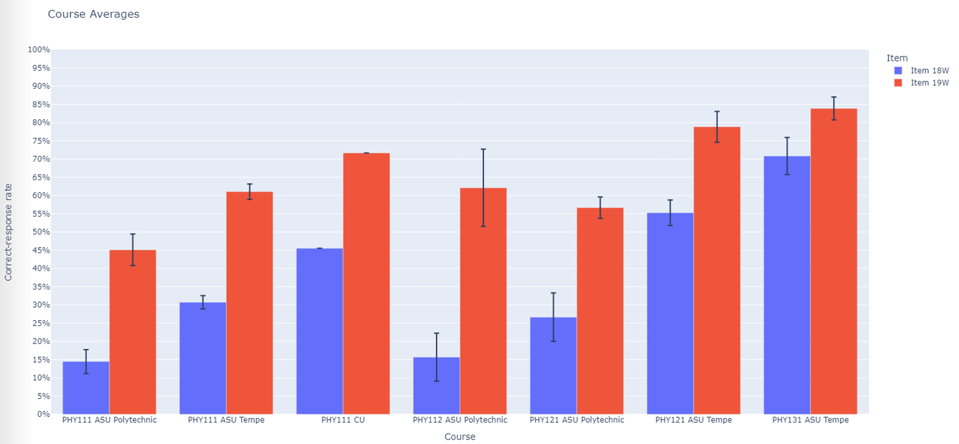

Slide 21
Conclusion: Symbolic notation degrades student performance
Use of symbols to replace numbers in otherwise identical algebraic equations lowered correct-response rates by ≈25%.

Slide 22
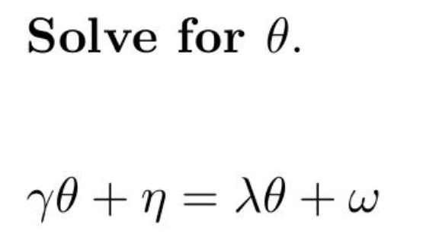
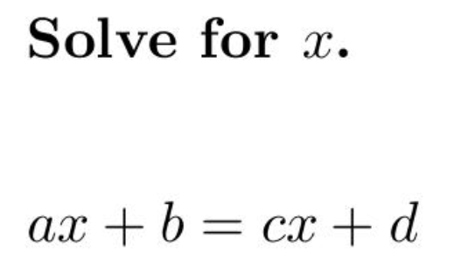
Confusion can result from the nature of the symbols themselves

Slide 23
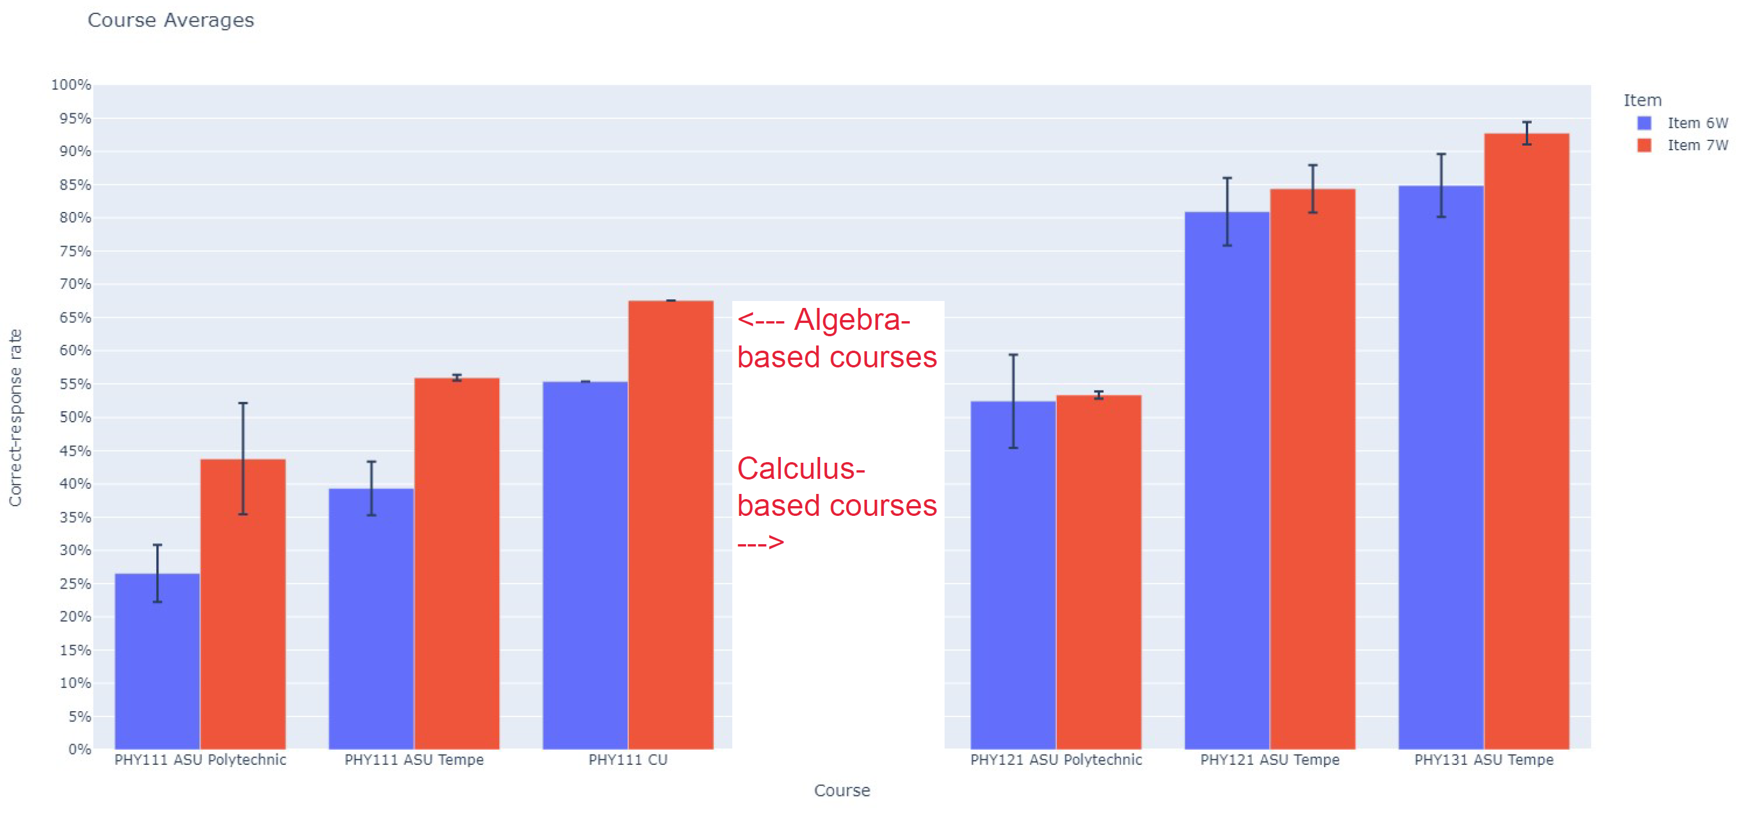
Significantly lower correct-response rates on Greek-letter version in algebra-based courses
(Total N > 1000)

Slide 24
Significantly lower correct-response rates on Greek-letter version in algebra-based courses
(Total N > 1000)

Slide 25
Implications of Findings
Minor changes to problem properties can lead to vastly different correct- response rates.
Certain specific elements of diagrams or terminology can divert students into long chains of unproductive reasoning.
Use of symbols instead of numbers, or use of unfamiliar symbols, can significantly degrade student performance
Focused instructional guidance may be needed to aid students in addressing these challenges.

