Slide 1
Impact of physics problem characteristics on problem difficulty
David E. Meltzer
Arizona State University
Supported in part by NSF DUE #1504986 and #1914712

Slide 2
What “non-conceptual” properties can increase problem difficulty?
Use of potentially misleading/distracting diagrammatic elements
Inclusion of (potentially misleading) irrelevant or redundant information
Use of symbols in place of numbers (e.g., m or μ for mass)
Dependence on or use of unfamiliar or subtle assumptions or terms
  e.g., adiabatic, thermal reservoir, quasi-static, reversible, spontaneous

Slide 3
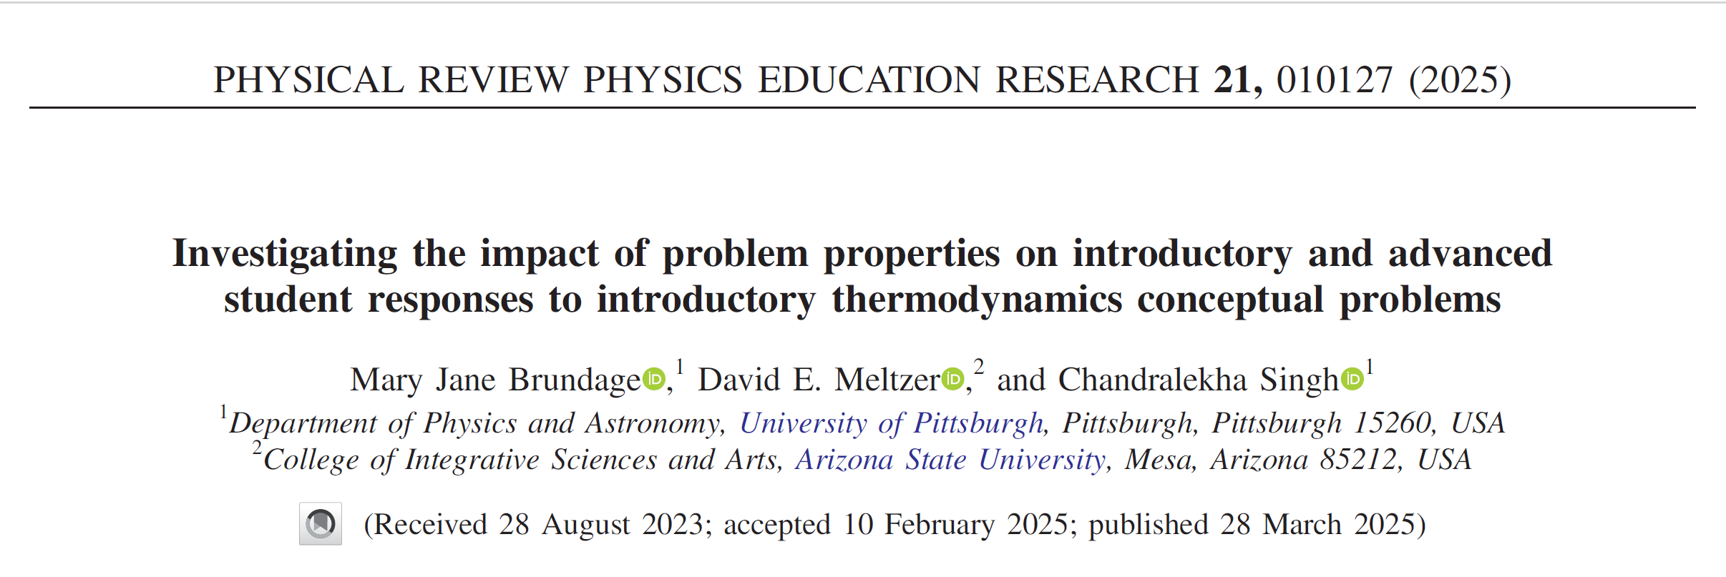

Slide 4
Targeted Concepts (among others)
(E= internal energy; Q = heat transfer to system)
E is proportional to T for an ideal gas
The sign of ΔE for an ideal gas is determined by whether the product PV is increasing or decreasing
In a reversible isothermal process, Q ≠ 0

Slide 5
Targeted Concepts (among others)
(E= internal energy; Q = heat transfer to system)
E is proportional to T for an ideal gas
The sign of ΔE for an ideal gas is determined by whether the product PV is increasing or decreasing
In a reversible isothermal process, Q ≠ 0

Slide 6
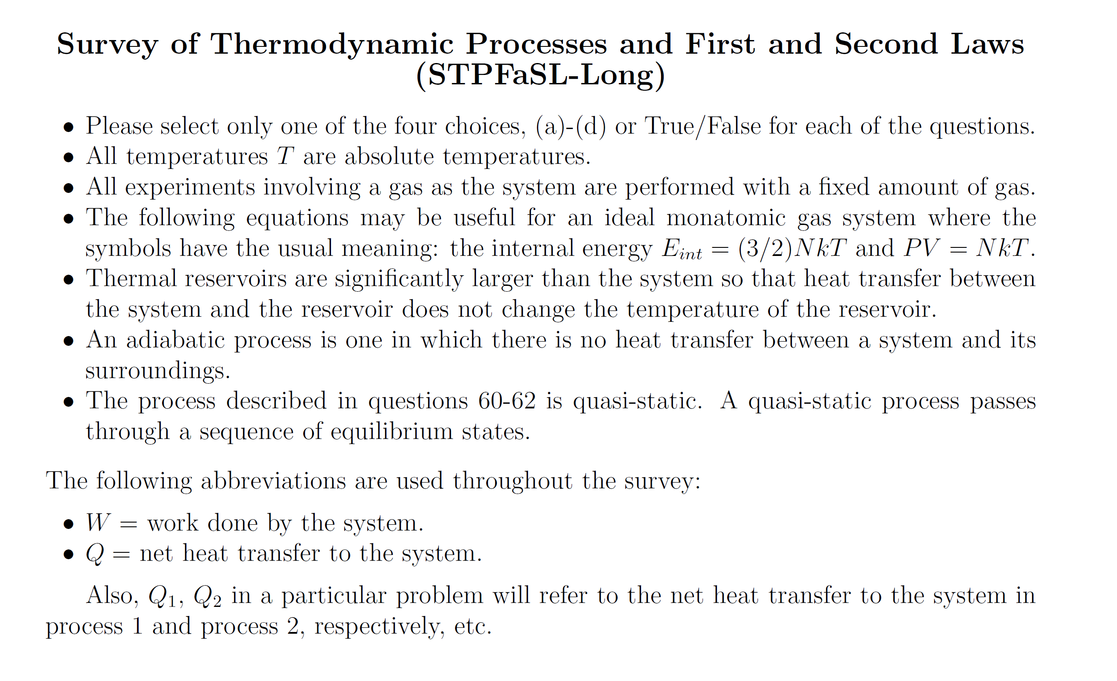
Information provided to students on first page:

Slide 7
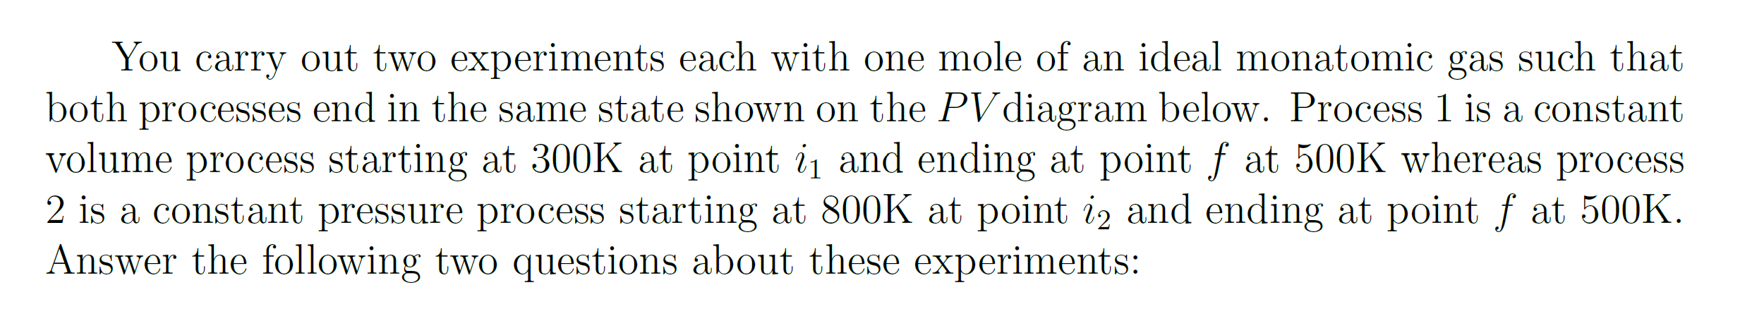
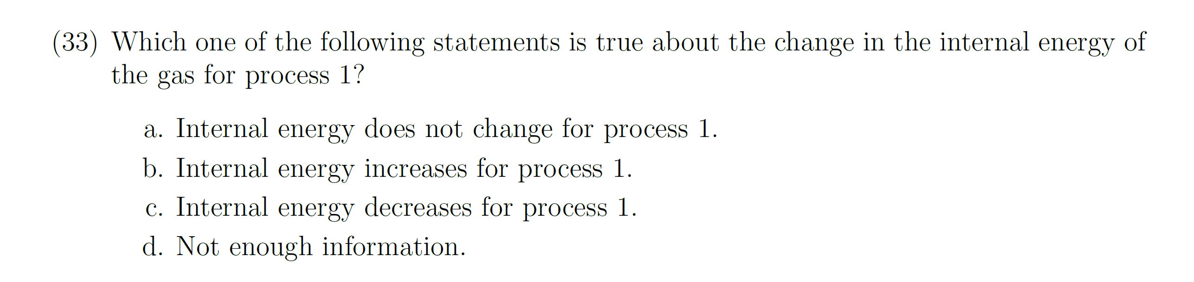
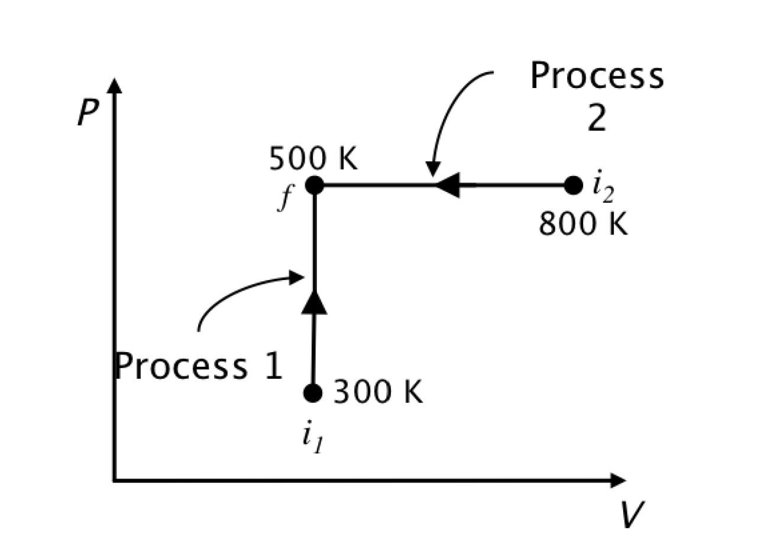
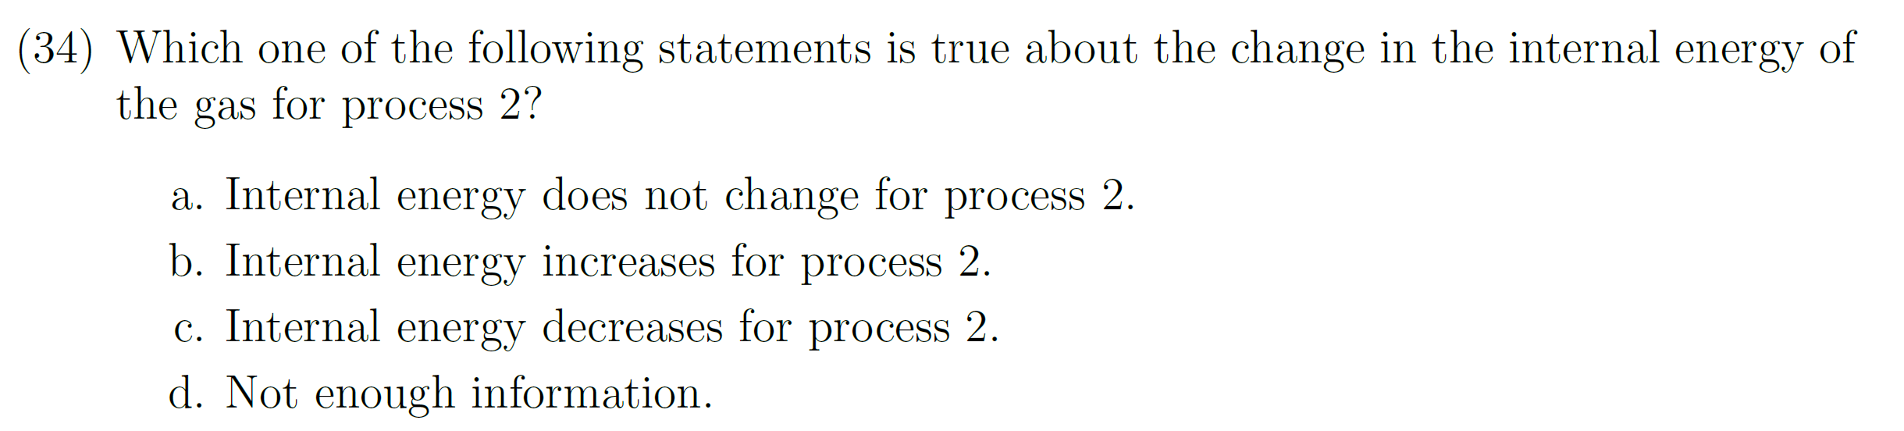
Answer: (b); temperature increases so internal energy increases.
Correct-response rate; Calculus-based: 76%; Algebra-based: 81%
Answer: (c); temperature decreases so internal energy decreases.
Correct-response rate; Calculus-based: 58%; Algebra-based: 55%
Many more errors on #34 (Process 2) →

Slide 8
Why did students make significantly more errors on #34?
Interviews: 3 of 6 students who gave incorrect answer on #34 (Process 2) argued “Work done is negative so internal energy will increase”
Students were excessively distracted by work considerations on Process 2.
Answer: (c); temperature decreases so internal energy decreases.
Correct-response rate; Calculus-based: 58%; Algebra-based: 55%

Slide 9
The use of a horizontal arrow on a PV diagram (instead of an arrow pointed straight up) lured some students into unproductive considerations regarding work.

Slide 10
Targeted Concepts (among others)
(E= internal energy; W = work done by system; Q = heat transfer to system)
E is proportional to T for an ideal gas
The sign of ΔE for an ideal gas is determined by whether the product PV is increasing or decreasing
In a reversible isothermal process, Q ≠ 0

Slide 11
Information provided to students on first page:

Slide 12
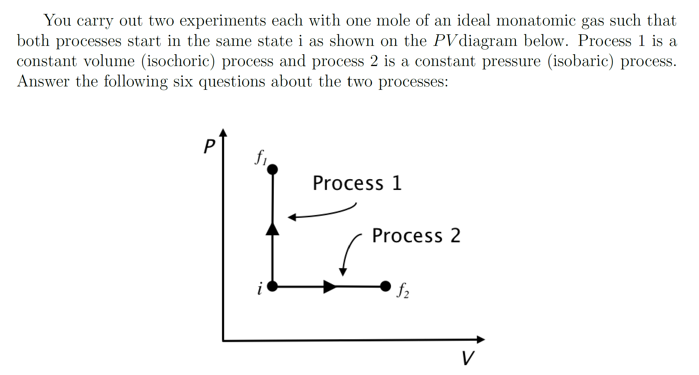
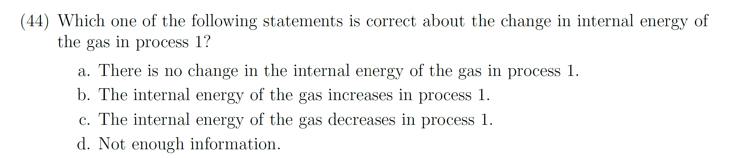
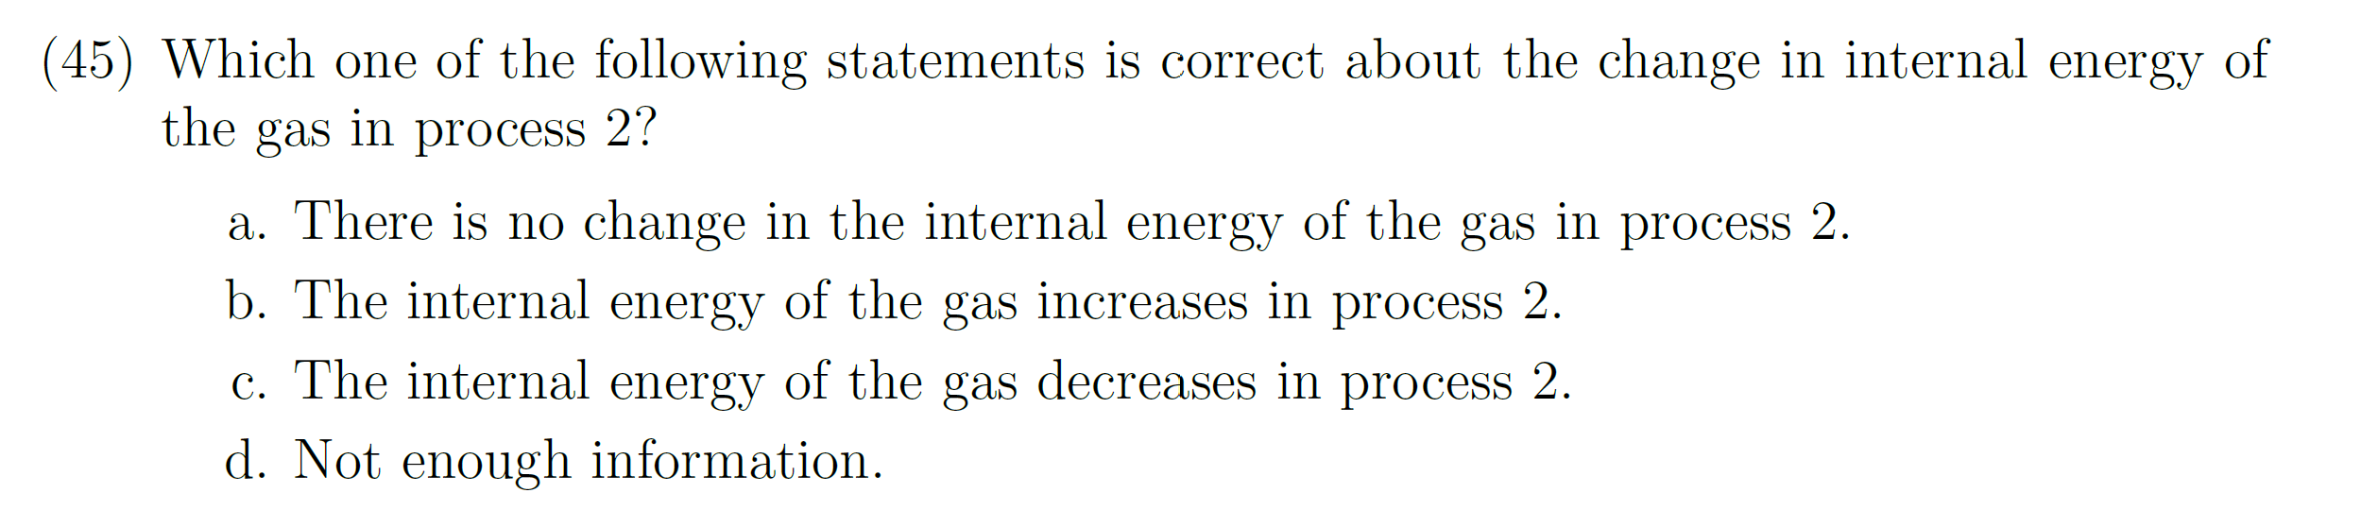
[N ≈500]
Answer to both #44 and #45: (b); PV increases so internal energy increases [Eint = (3/2) NkT = (3/2) PV)].
Correct-response rate on Process 1, Calculus-based: 69%; Algebra-based: 70%
Correct-response rate on Process 2, Calculus-based: 43%; Algebra-based: 37%
Interviews: 7 of 9 incorrect responses on Process 2 were justified by saying work done is positive so energy would decrease, thus ignoring the role of heat transfer.
More incorrect answers on Process 2

Slide 13
The use of a horizontal arrow on a PV diagram (instead of an arrow pointed straight up) lured students into unproductive considerations regarding work, lowering the correct-response rate by 26-33%.
✓
X

Slide 14
Targeted Concepts (among others)
(E= internal energy; W = work done by system; Q = heat transfer to system)
E is proportional to T for an ideal gas
The sign of ΔE for an ideal gas is determined by whether the product PV is increasing or decreasing
In a reversible isothermal process, Q ≠ 0

Slide 15
Targeted Concepts (among others)
(E= internal energy; W = work done by system; Q = heat transfer to system)
E is proportional to T for an ideal gas
The sign of ΔE for an ideal gas undergoing an isochoric or isobaric process is determined by whether pressure or volume are increasing
In a reversible isothermal process, Q ≠ 0

Slide 16
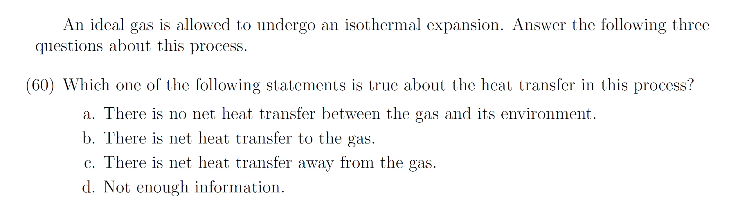
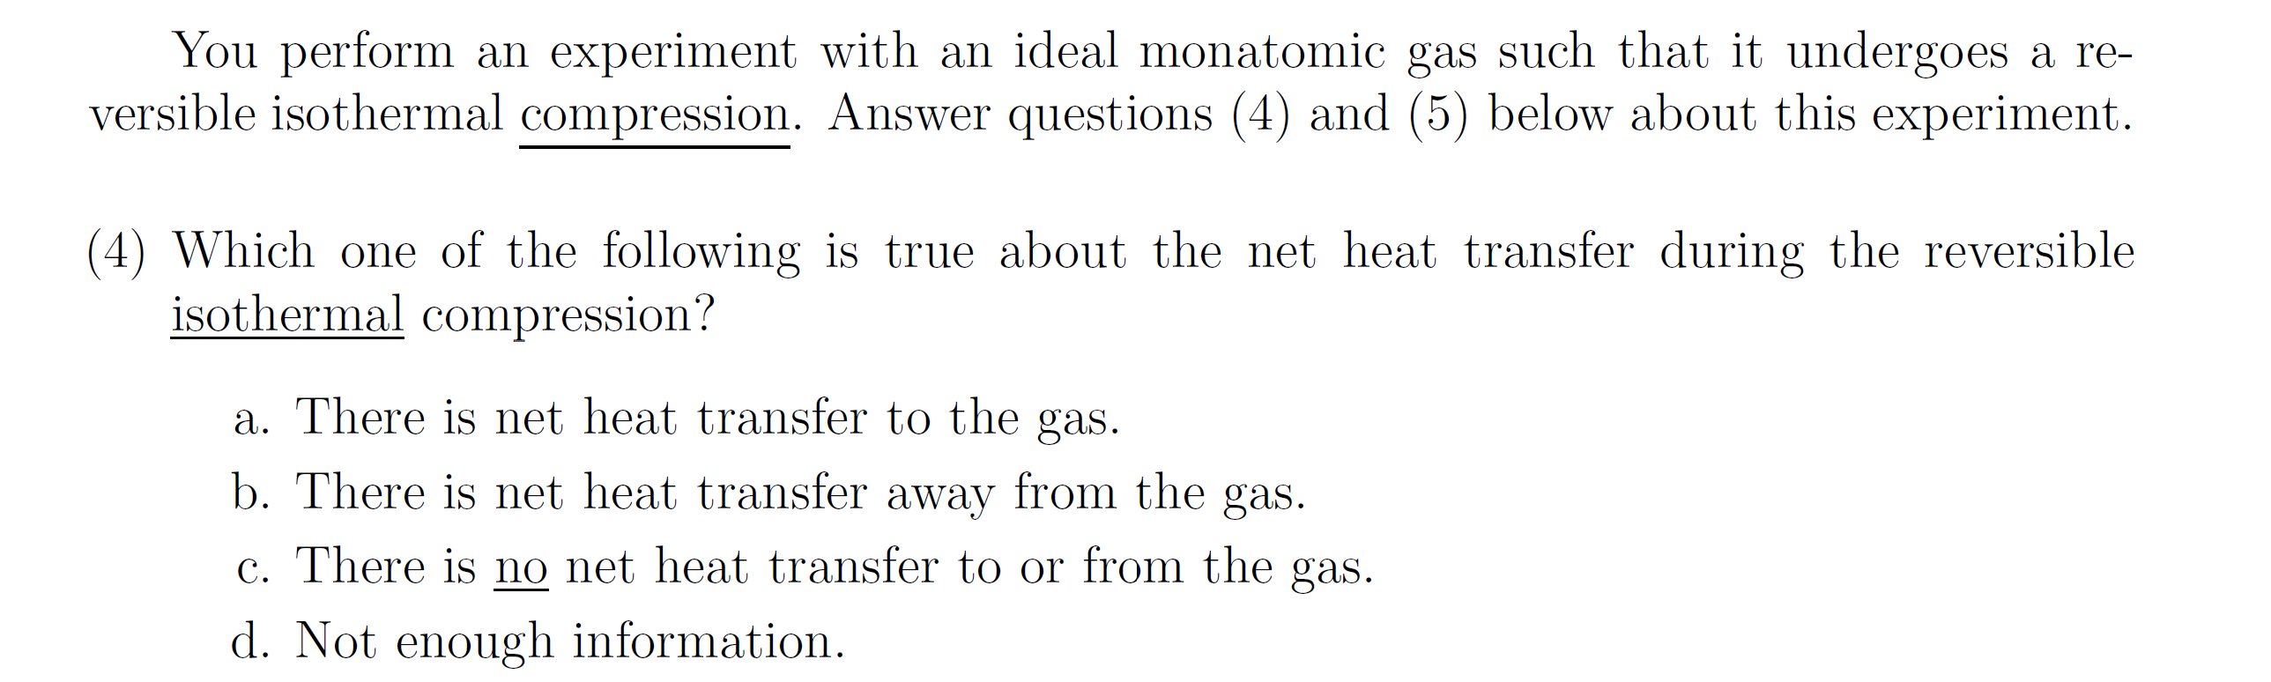
Q─W = ΔE = 0 since ΔT=0, so Q = W > 0
Correct-response rate
Calculus-based: 43%; Algebra-based: 44%
Q = 0 responses
Calculus-based: 30%; Algebra-based: 37%
Q─W = ΔE = 0 since ΔT=0, so Q = W < 0
Correct-response rate
Calculus-based: 30%; Algebra-based: 21%
Q = 0 responses
Calculus-based: 50%; Algebra-based: 59%
Many more Q = 0 responses on “reversible compression” question, justified by “process is isothermal” arguments

Slide 17
General Findings
Horizontal process arrows on PV diagrams often triggered unproductive lines of reasoning regarding work
Certain terms may trigger unproductive lines of reasoning (e.g., reversible)

Slide 18
Symbolic Procedures
    Confusion of symbolic meaning: Students perform worse on solving problems when symbols are used to represent common physical quantities in equations [Torigoe and Gladding, 2007; 2011)
    Example [Multiple-choice questions; University of Illinois]:
Version #1: A car can go from 0 to 60 m/s in 8 s. At what distance d from the start at rest is the car traveling 30 m/s?
Version #2: A car can go from 0 to v₁ in t₁ seconds. At what distance d from the start at rest is the car traveling (v₁/2)?
Our results on “stripped-down” versions are analogous, although differences are smaller
[93% correct]
[57% correct]
Much worse!

Slide 19
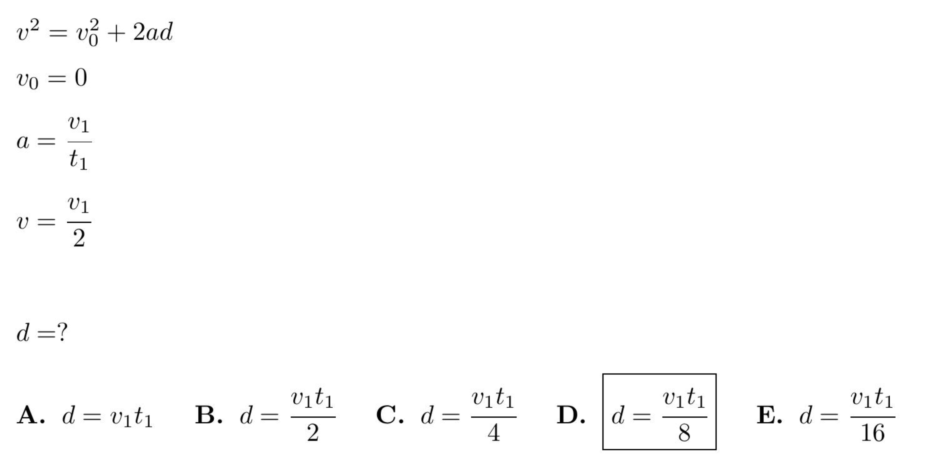
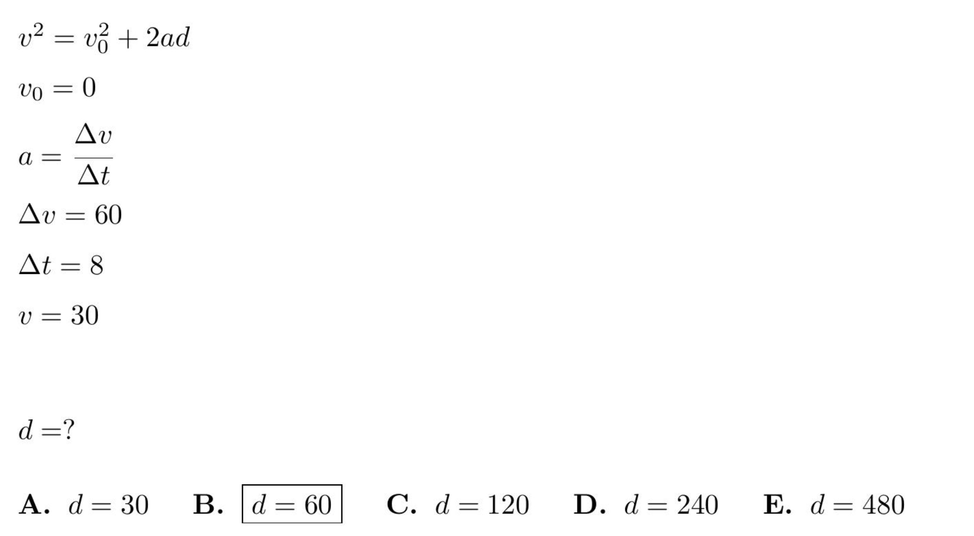
Symbolic version
Numeric version

Slide 20
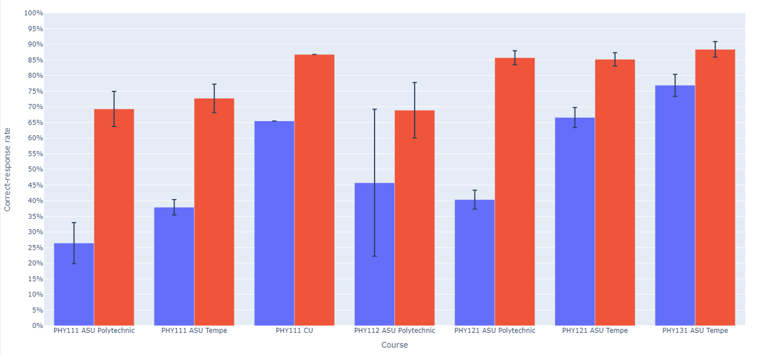
Symbolic version: Numeric version:

Slide 21
Algebra: Simultaneous Equations (algebra-based course, ASU-T)
0.5y = 2x
78.4 − y = 8x
[Solve for x]
  Numeric Version 61% correct (N = 470)
cy = dx
a − y = bx
[Solve for x]
  Symbolic Version 55% correct (N = 862)

Slide 22
Algebra: Simultaneous Equations (algebra-based course, ASU-T)
0.5y = 2x
78.4 − y = 8x
[Solve for x]
  Numeric Version 61% correct (N = 470)
cy = dx
a − y = bx
[Solve for x]
  Symbolic Version 31% correct (N = 372)

Slide 23
Algebra: Simultaneous Equations (calculus-based course, ASU-T)
0.5y = 2x
78.4 − y = 8x
[Solve for x]
  Numeric Version 79% correct (N = 1205)
cy = dx
a − y = bx
[Solve for x]
  Symbolic Version 55% correct (N = 862)

Slide 24
Algebra: Simultaneous Equations (calculus-based course, ASU-T)
0.5y = 2x
78.4 − y = 8x
[Solve for x]
  Numeric Version 79% correct (N = 1205)
cy = dx
a − y = bx
[Solve for x]
  Symbolic Version 55% correct (N = 1202)

Slide 25
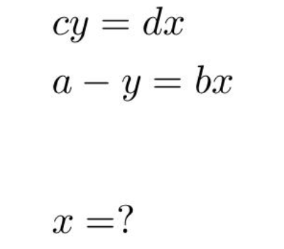
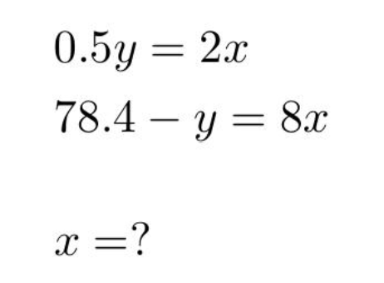
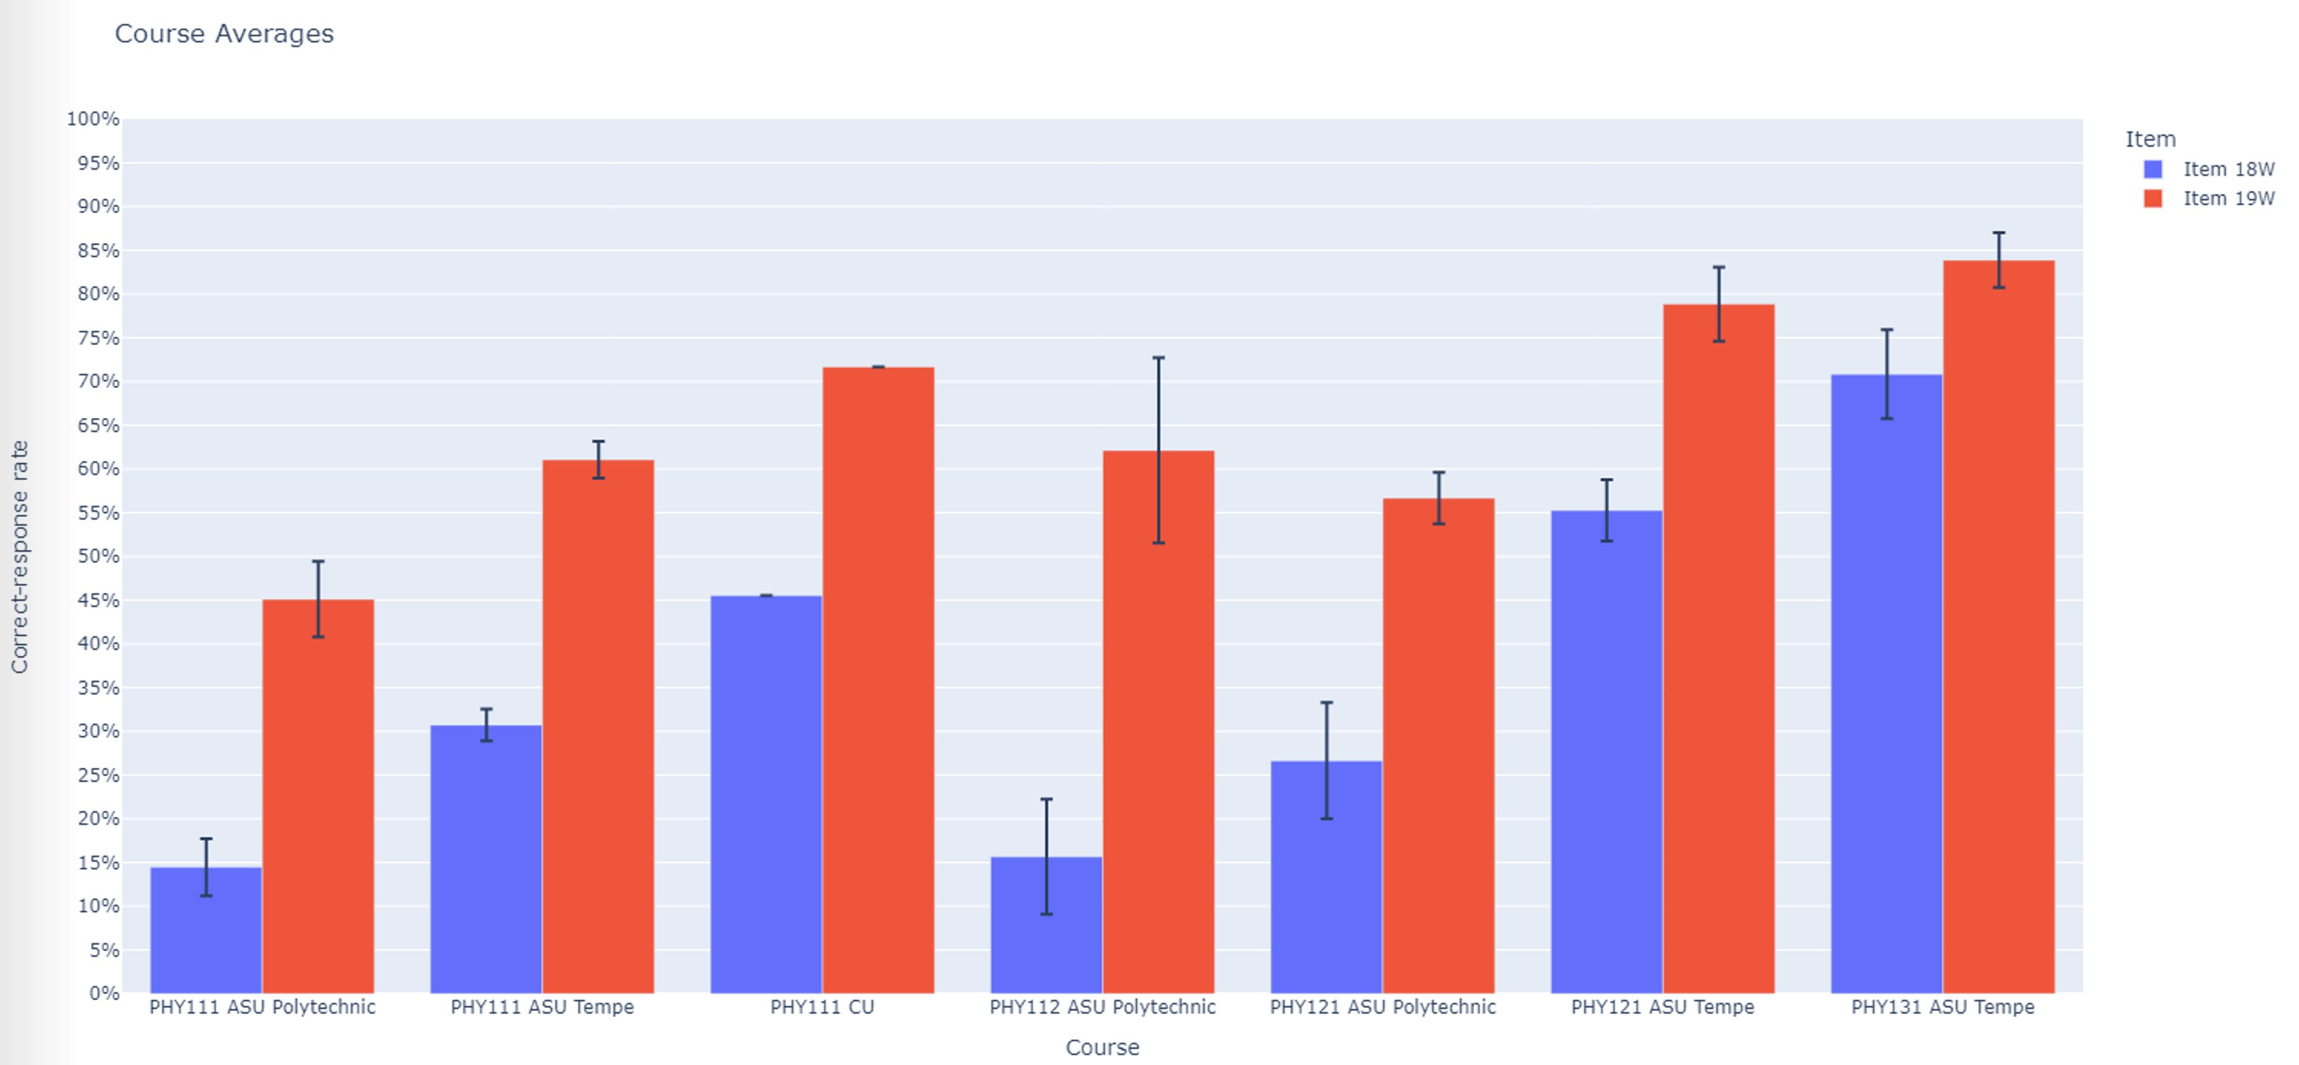

Slide 26
Conclusion:
Symbolic notation degrades student performance
Use of symbols to replace numbers in otherwise identical algebraic equations lowered correct-response rates by ≈25%.

Slide 27
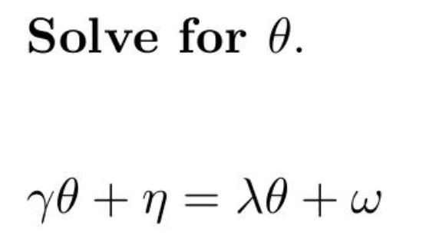
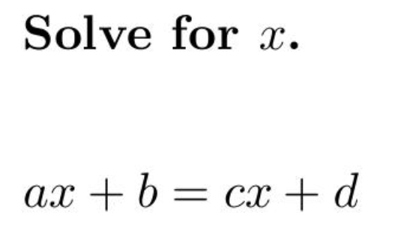
Confusion can result from the nature of the symbols themselves

Slide 28
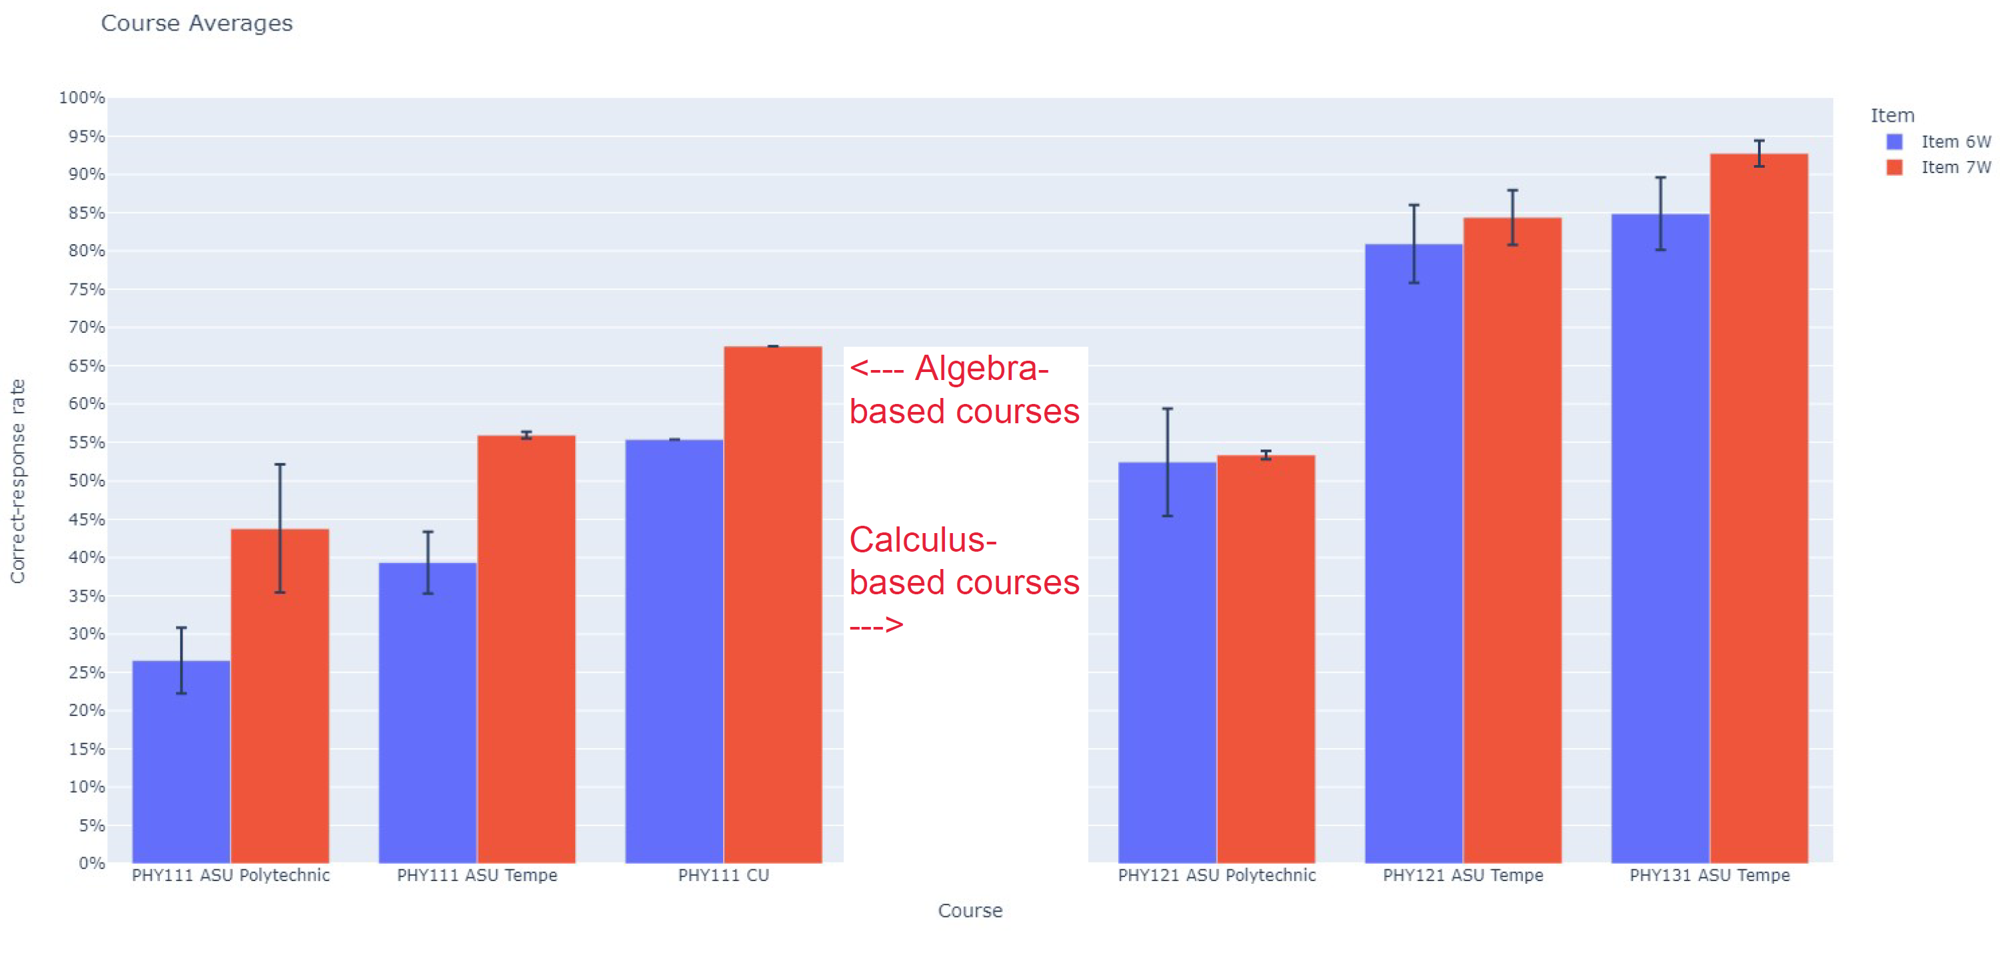
Significantly lower correct-response rates on Greek-letter version in algebra-based courses
(Total N > 1000)

Slide 29
Significantly lower correct-response rates on Greek-letter version in algebra-based courses
(Total N > 1000)

Slide 30
Implications of Findings
Minor changes to problem properties can lead to vastly different correct-response rates.
Certain specific elements of diagrams or terminology can divert students into long chains of unproductive reasoning.
Use of symbols instead of numbers, or use of unfamiliar symbols, can significantly degrade student performance
To ensure consistency and reliability of assessment problems and instruments, research on students’ responses to variations in problem properties is essential.

